Slide 1



British Airways
Predictive Model Performance

Slide 2
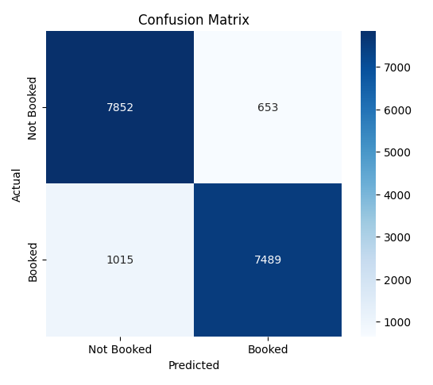
Summary
Model: Random Forest Classifier
Accuracy: 90.19%
Precision: 91.98%
Recall: 88.06%
F1 Score: 89.98%
Balanced dataset using SMOTE to handle class imbalance
Cross-validation used for model evaluation

Slide 3
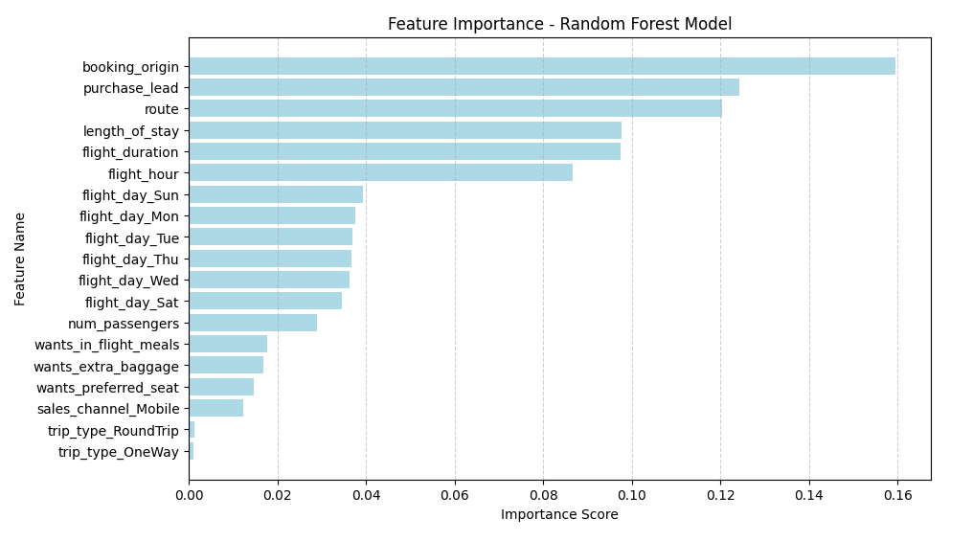
Feature Importance:

Slide 4
Thank
You

