Slide 1

BRITISH AIRWAYS REVIEWS ANALYSIS
Topic Modeling and Key Insights from Customer Reviews

Slide 2

KEY TOPICS FROM REVIEWS
Economy class experience, staff service, seating comfort
Customer service, delays, time management
Food quality, cabin experience, crew behavior
Business class experience, seat comfort, meals
Luggage handling, check-in process, staff assistance

Slide 3
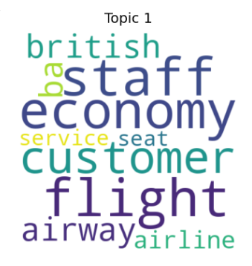
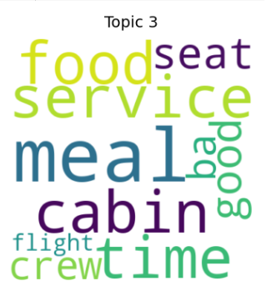
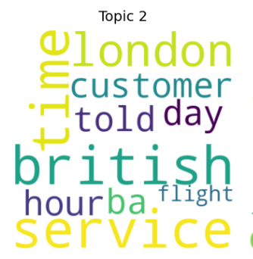
WORD CLOUD VISUALIZATIONS OF TOPICS

Slide 4
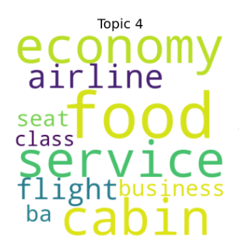
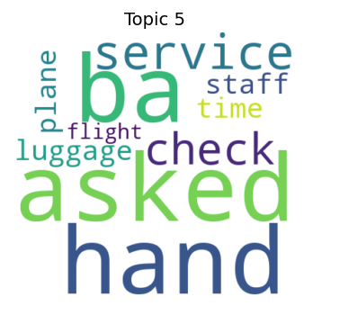

Slide 5
KEY INSIGHTS AND RECOMMENDATIONS
Economy class passengers often complain about seat comfort and staff behavior.
Delays and customer service issues are frequently mentioned.
Business class passengers highlight food quality and seat comfort.
Luggage handling and check-in experiences vary widely among passengers.
Addressing these key concerns could improve customer satisfaction.

Slide 6
THANK YOU

