Slide 1

Resilient India AI
Autonomous Geopolitical Risk Intelligence & Procurement Orchestration Engine (Problem Statement 2)
Turning Reactive Energy Crisis Response into Anticipatory National Defense
TEAM RESILIENT INDIA
ENERGY SUPPLY CHAIN RESILIENCE
HACKATHON 2026

Slide 2
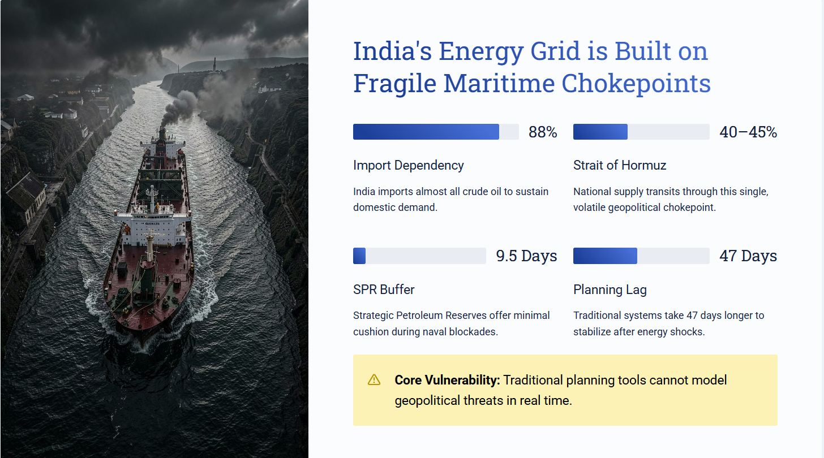

Slide 3
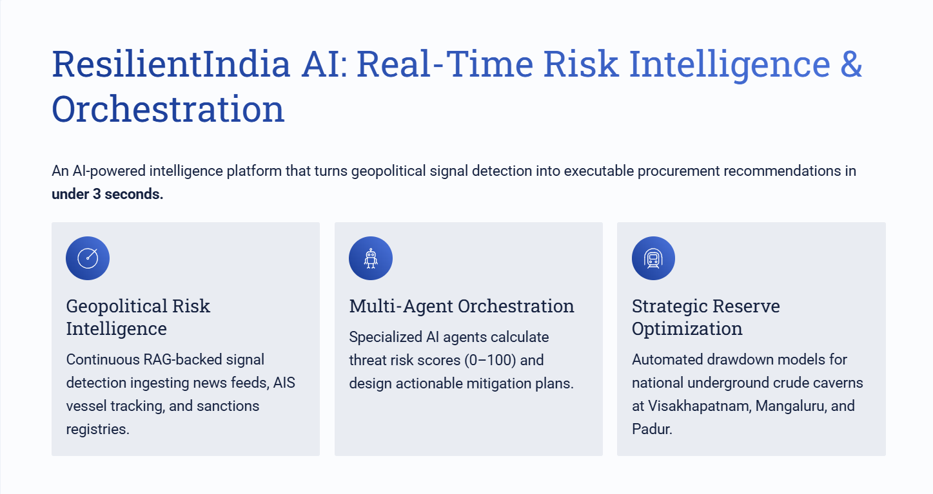

Slide 4
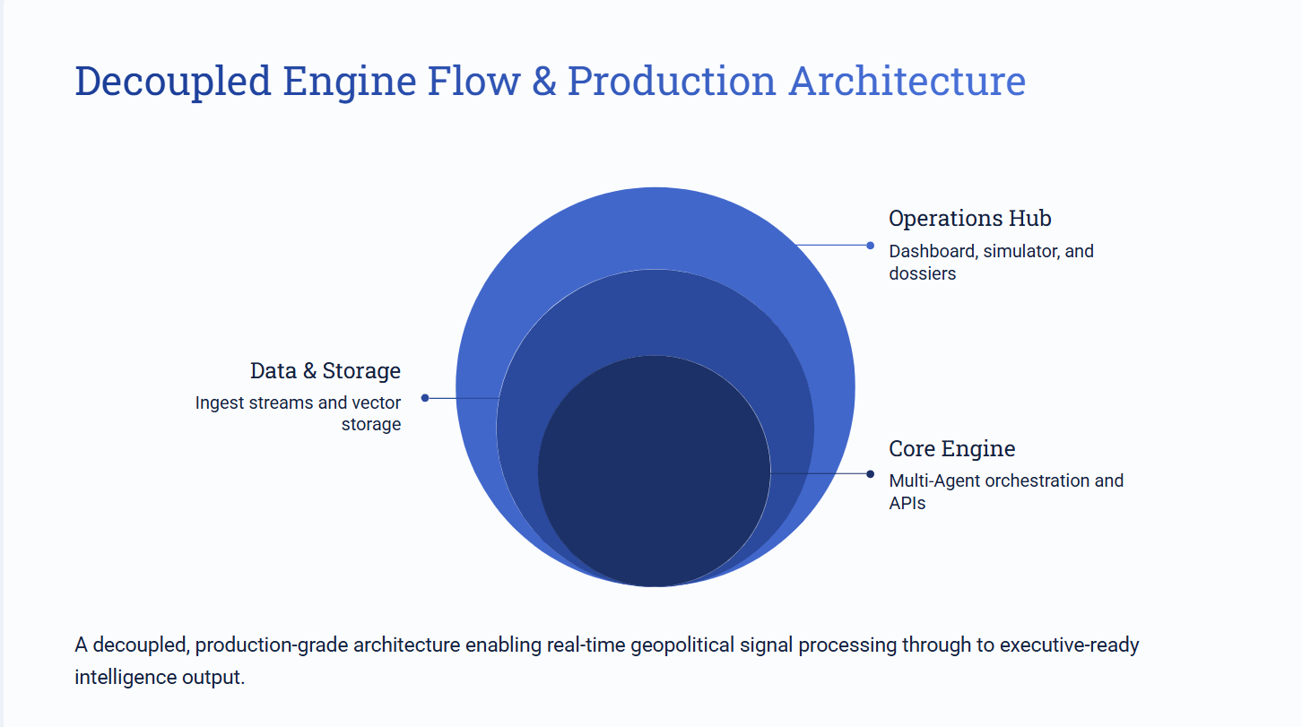
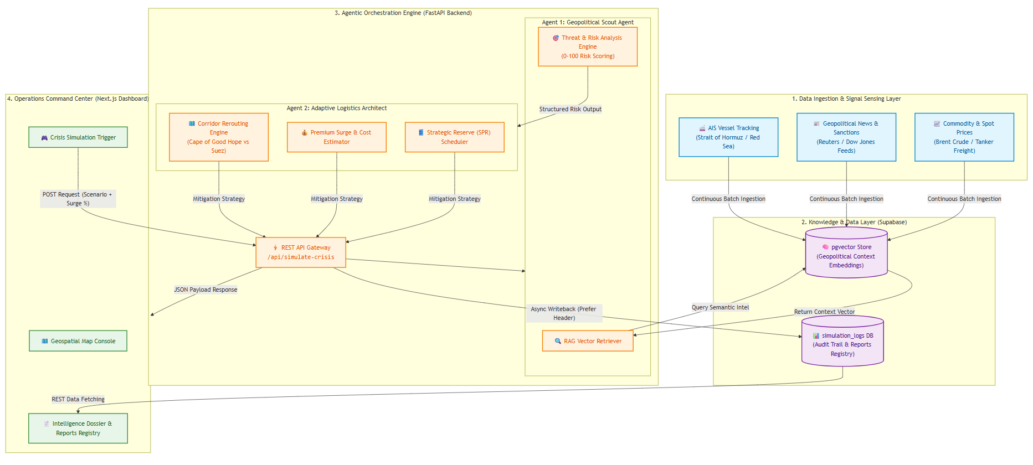

Slide 5
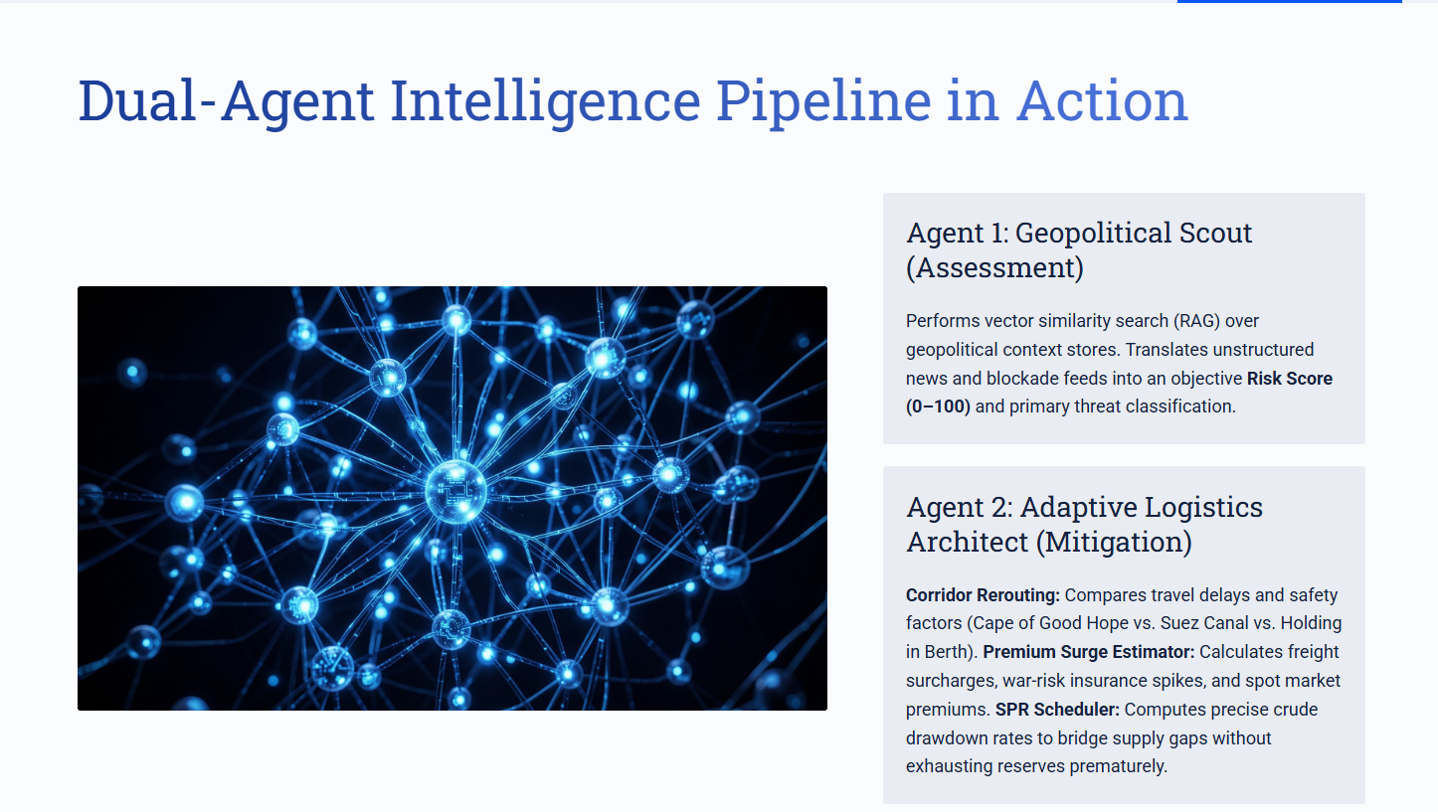

Slide 6
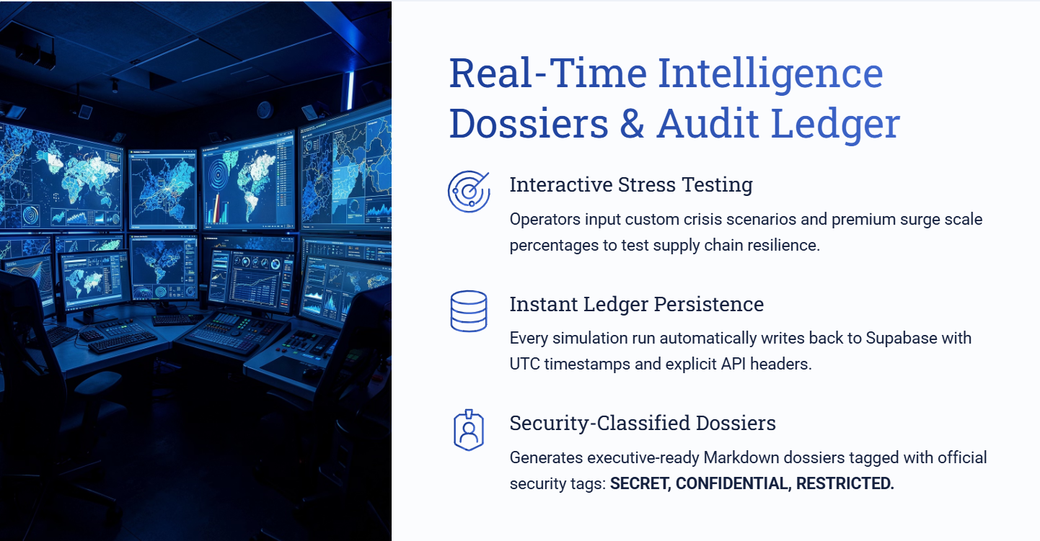

Slide 7
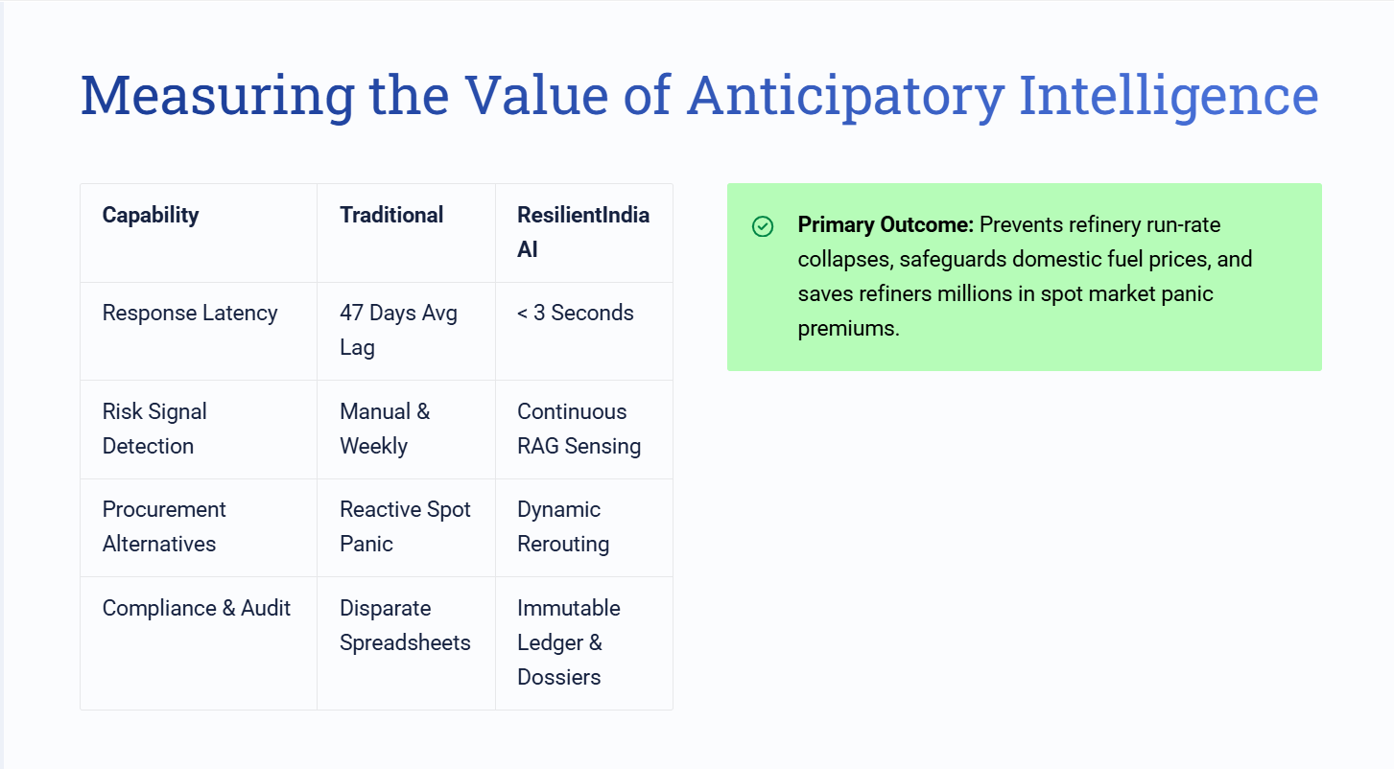

Slide 8
