Slide 1



Slide 2
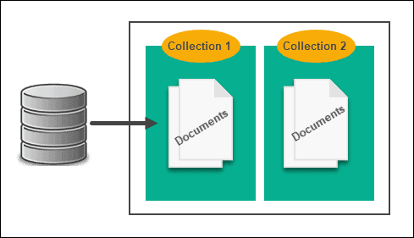
What is MongoDB?
Open-Source Document based Dataset.
Stores the data in JSON-like format.
It's a NoSQL Database.
Schema Free

Slide 3


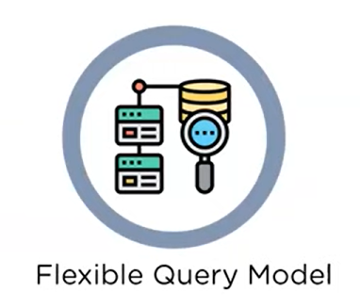
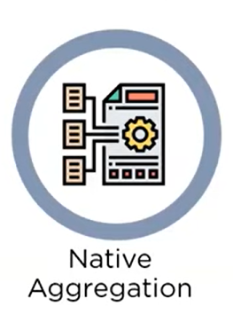
Why MongoDB?

Slide 4
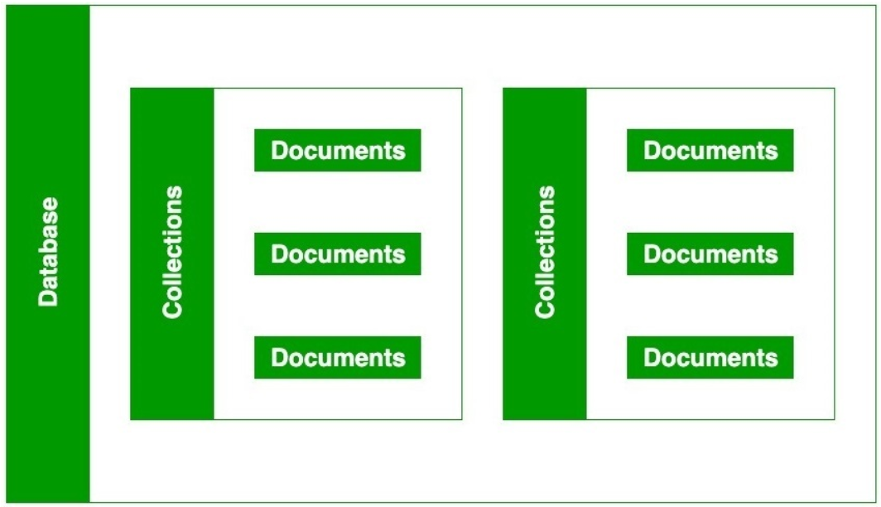
Working of MongoDB?
Architecture of MongoDB is shown.
Database, collection, and documents are related to each other.
Inside Collection we can have other collections and documents.
Document holds the data in key-value pair.
The data stored in the MongoDB is in the format of BSON documents.
Here, BSON stands for Binary representation of JSON documents.

Slide 5
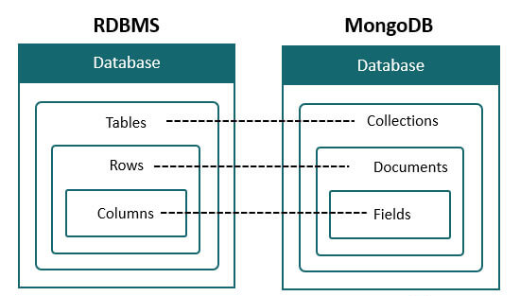
Difference Between MongoDB and RDBMS?

