Slide 1
Click to Start

Slide 2
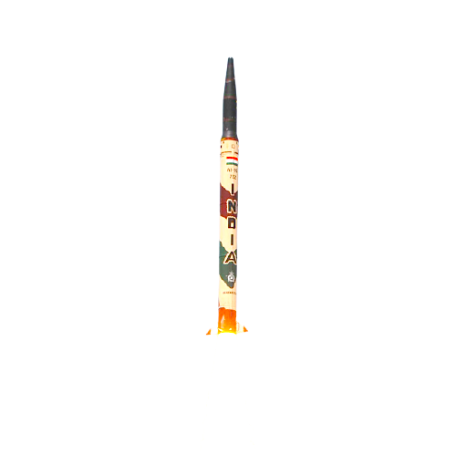
MISSILE
Mini replica AGNI-I
1

Slide 3
A missile is a guided airborne ranged weapon capable of self-propelled flight usually by a jet engine or rocket motor.
2

Slide 4

Making Process:
MDF
3d Printed Cone
PVC PIPE
MDF
3

Slide 5
Making Process:
4

Slide 6
Making Process:
FUEL
Sugar (fuel)
Potassium Nitrate(Oxidiser)
5
Mini Ignitor

Slide 7
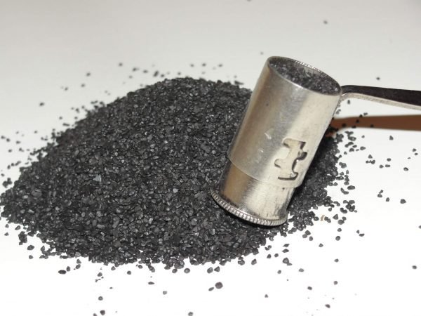
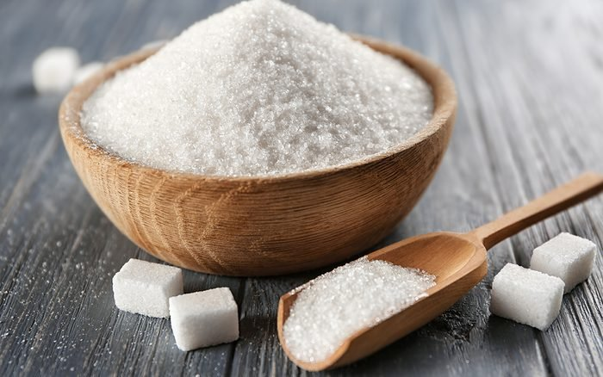
Safety!
GUN POWDER
SUGAR FUEL
60mm/s
1.3mm/s
More Thrust
Less Burn time
Less Thrust
More Burn time
46X slow in burning
6

Slide 8
Safety!
All the Test will be done in open and safe space(no flammable object nearby)
All the Test will be done in supervision of workshop assistant
All the Test will be done for only and only data capturing, no unnecessary test will done for fun or filming purpose
Use of Fire extinguisher
Test will be immediately shut-off if any tool get breaks in between
Test will be immediately shut-off if any unnecessary fluctuations (like sudden rise of thrust) recorded
7

Slide 9
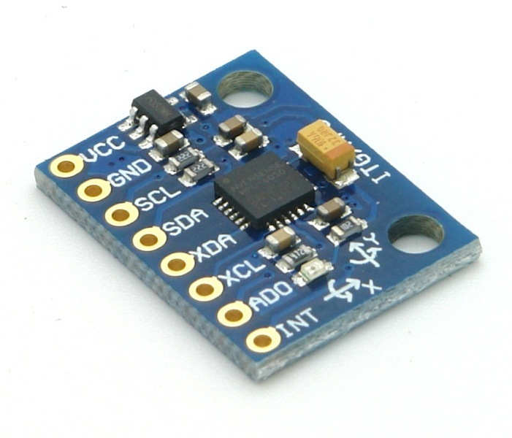
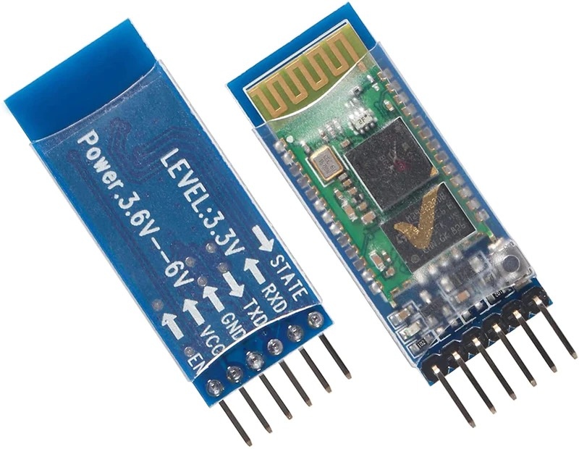
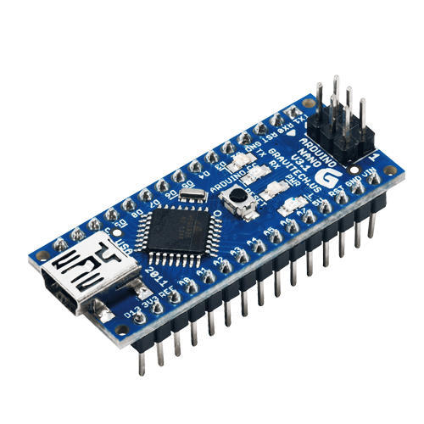
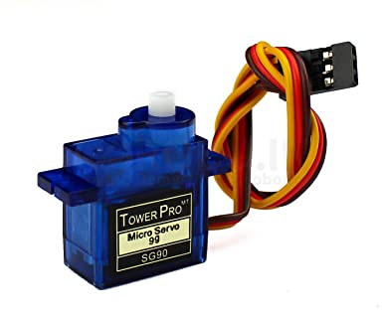
MPU6050
HC-05
SENSORS AND ACTUATORS
8
Arduino Nano
Servo SG90

Slide 10
SENSORS AND ACTUATORS
MPU6050
HC-05
Arduino Nano
Servo SG90
9

Slide 11
SENSORS AND ACTUATORS
10
FUEL

Slide 12
SENSORS AND ACTUATORS
WHERE IS AI?
11

Slide 13
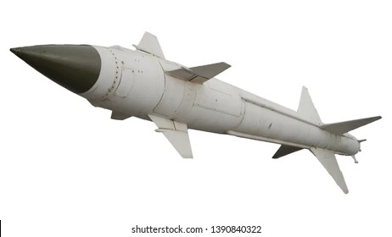
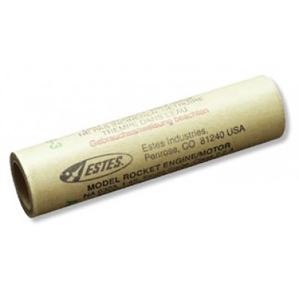
AI APPLICATION
ROCKET MOTOR
MISSILE
12

Slide 14
HOW MUCH AMOUNT OF FUEL CAN LIFT HOW MUCH LOAD
AI APPLICATION
ROCKET MOTOR
MISSILE
13

Slide 15
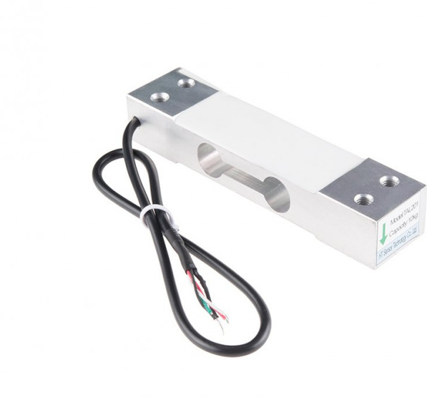
LOAD CELL 5KG
14

Slide 16
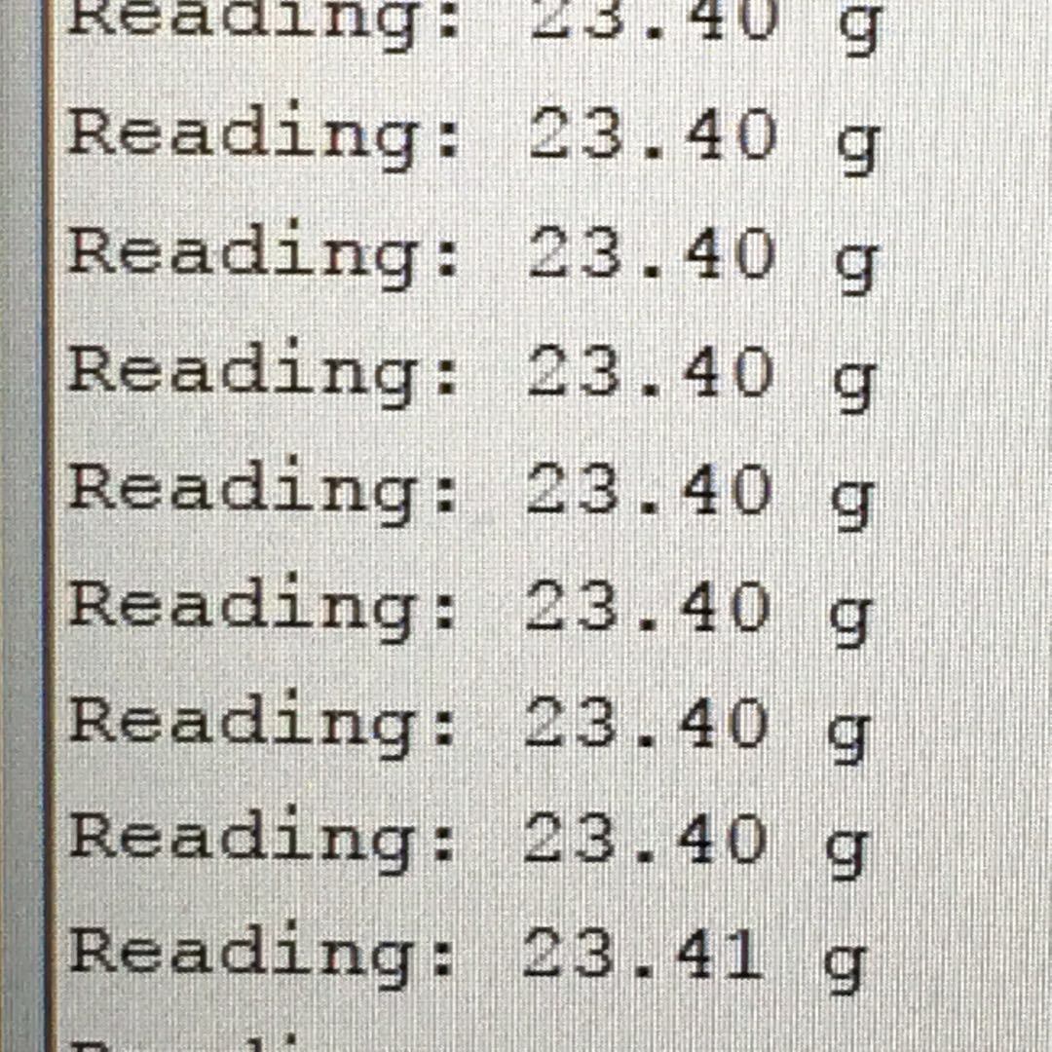
15

Slide 17
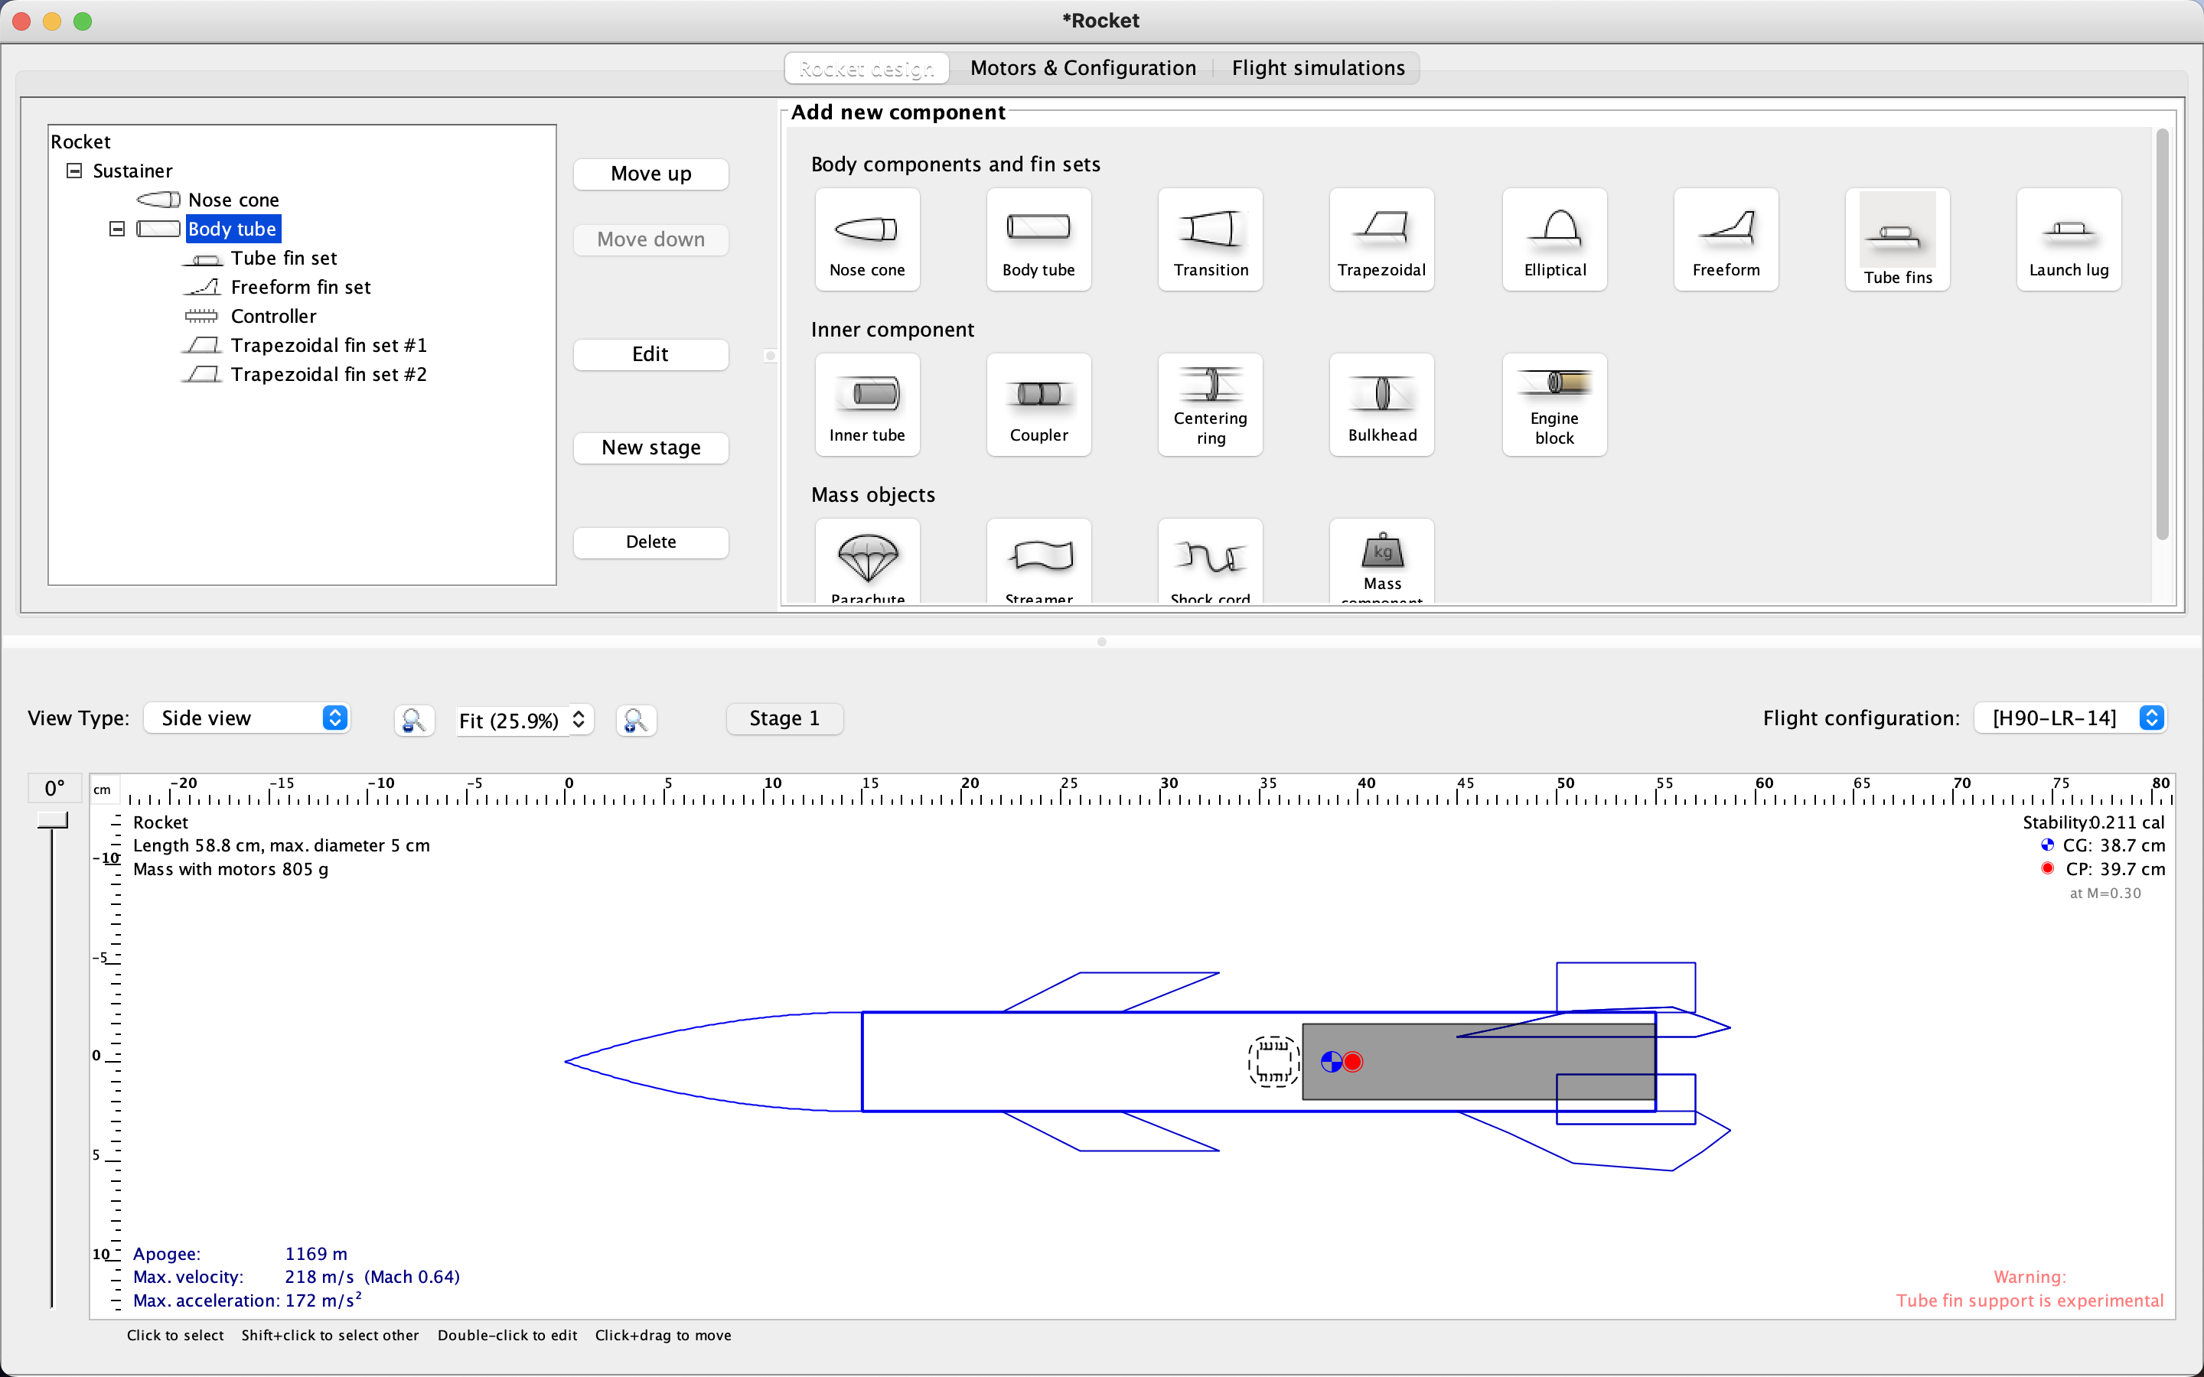
16

Slide 18
17

Slide 19
LOGISTIC ALGORITHM
18
Feature
?
805g
Target

Slide 20
TEAM MEMBERS
Kashyap Mistry
Amaneet Benipal
Rugved Tamhan
19

Slide 21
END
20

