Slide 1
LOAN DEFAULT
Understanding of risk analytics in banking and financial services
Business Case Study – FINTECH CAPESTONE
By,
KASI

Slide 2
AGENDA
About the Project
Introduction to the Project
Insights and Recommendations based on the Analysis
Insights and recommendations based on Hypothesis testing

Slide 3
ABOUT THE PROJECT
This project focuses on risk analytics within the banking sector, aiming to identify key factors that contribute to loan defaults. By analyzing variables such as loan amounts, LTV (Loan-to-Value) ratios, property values, and borrower demographics, we uncover insights that can help predict and mitigate default risks. Our analysis utilizes statistical techniques, including Chi-Square and Mann-Whitney U tests, to highlight relationships between these factors and loan status. The goal is to provide actionable insights for improving risk assessment strategies and making more informed lending decisions to minimize defaults.

Slide 4
INTRODUCTION TO THE PROJECT
Objective: Identify key factors influencing loan defaults and provide actionable insights to reduce the risk.
Dataset Overview: Analyzed 148,670 records with key variables such as loan amount, property value, LTV, and credit score.
Methods Used: Exploratory Data Analysis, Hypothesis Testing and descriptive statistics.

Slide 5
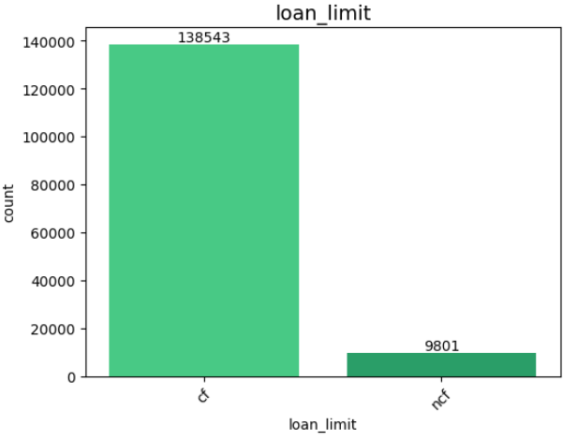
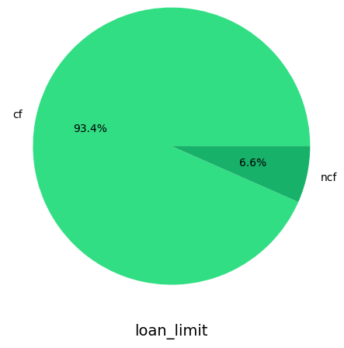
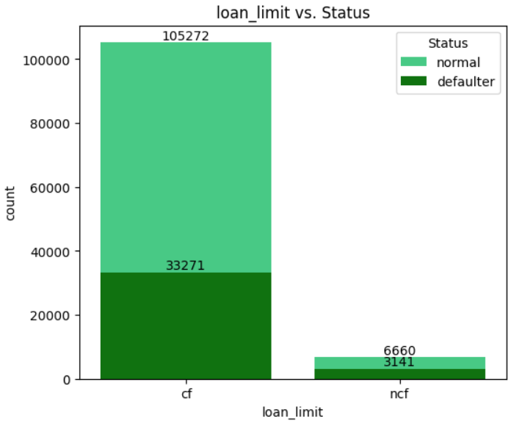
LOAN LIMIT ANALYSIS
The majority of loans fall under the conforming category, indicating a preference or higher eligibility for loans that meet standard criteria.
Higher Stability in Confirmed Loan Limits.
Increased Risk in Non-Confirmed Loan Limits
Recommendation:
The significant number of defaults among non-confirmed borrowers highlights an opportunity for lenders to improve their assessment procedures and support mechanisms for these clients

Slide 6
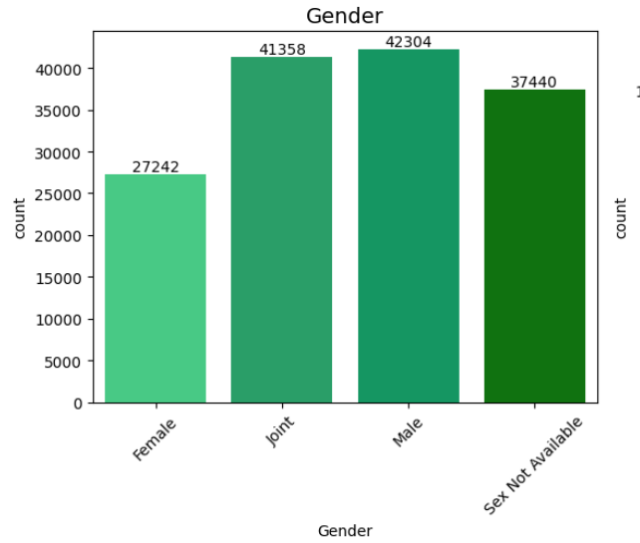
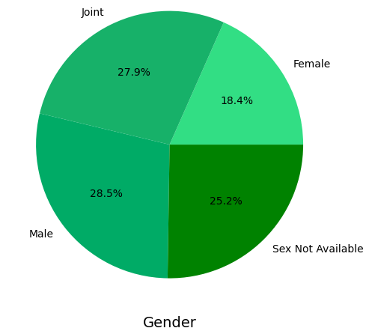
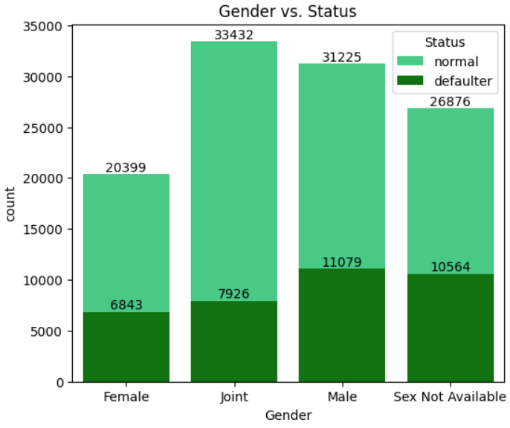
GENDER ANALYSIS
There is a near-even split between male and joint applications, with a relatively high number of cases where gender information is unavailable. Female applicants represent the smallest group.
Joint borrowers show a relatively lower default rate.
Borrowers with unspecified gender also exhibit a high default rate.
Recommendation:
The significant number of defaults among non-confirmed borrowers highlights an opportunity for lenders to improve their assessment procedures and support mechanisms for these clients

Slide 7
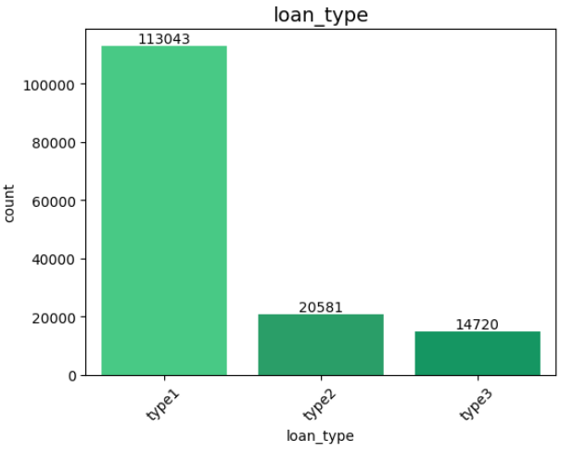
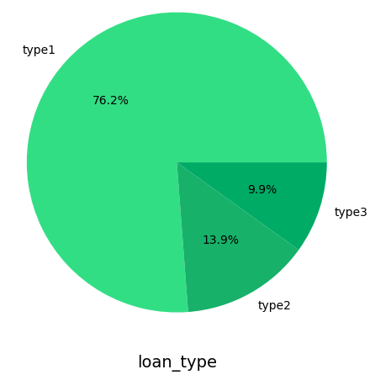
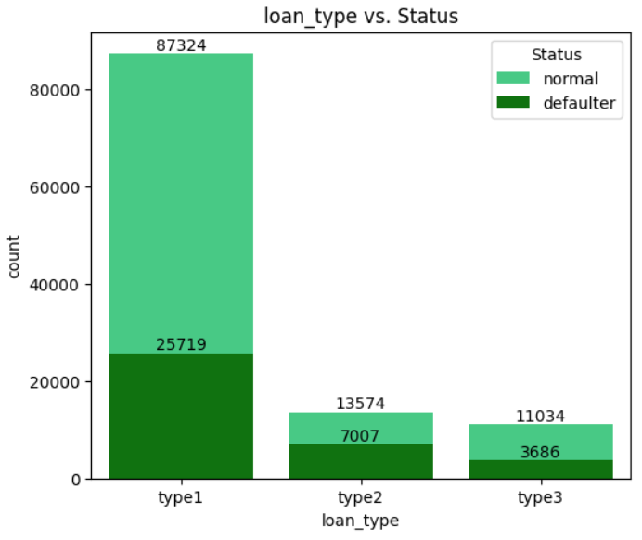
LOAN TYPE ANALYSIS
The vast majority of loans belong to loan type 1, showing a strong concentration in this category.
Loan Type 1 stands out as the most favorable in terms of low defaults
Loan Type 2 presents significant risks with a high default rate.
Recommendation:
Revise the lending criteria and conduct a thorough review of the terms and borrower profiles for Loan Type 2, as it shows a significantly higher default rate compared to other loan types, to mitigate risk and improve overall loan performance.

Slide 8
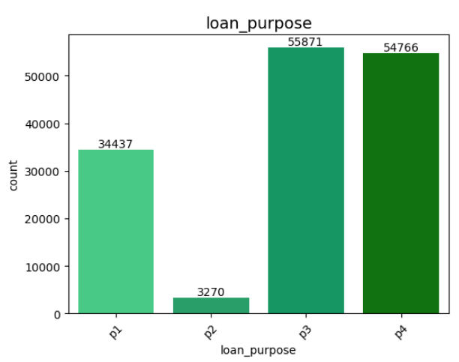
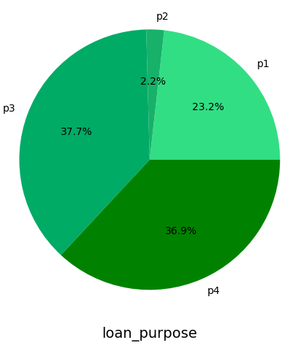
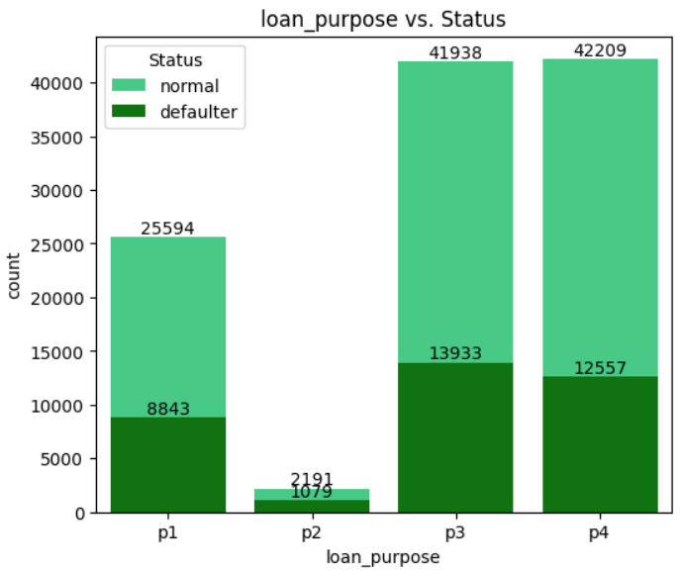
LOAN PURPOSE ANALYSIS
The majority of loans are associated with purposes p3 and p4, indicating a focus on certain use cases for loans.
Loan Purposes P1 and P2 show high default rates.
Loan Purpose P4 has the best performance with the lowest default rate.
Recommendation:
Conduct a detailed analysis of Loan Purpose P1 and Loan Purpose P2, as they exhibit high default rates, to identify underlying risk factors and develop targeted strategies to mitigate risks associated with these loan purposes.

Slide 9
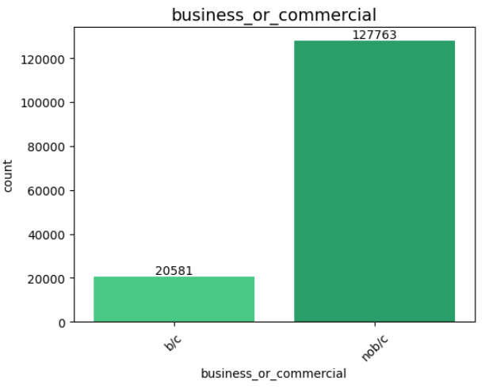
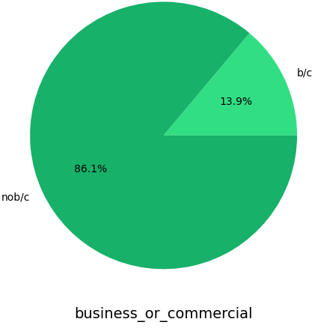
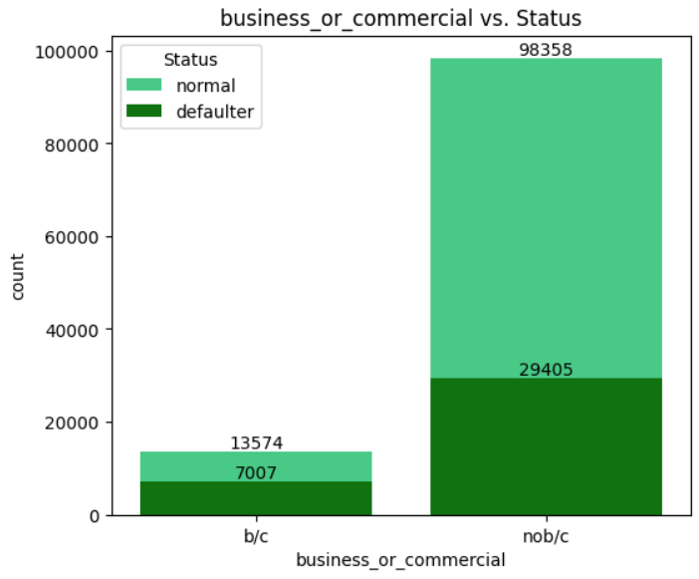
BUSINESS (OR) COMMERCIAL LOAN ANALYSIS
The most loans are for personal or non-business purposes, with a small proportion allocated for commercial needs.
Loans given to business/commercial establishments (b/c) exhibit a higher default rate.
Non-commercial or personal loans (nob/c) demonstrate stronger performance, with a higher proportion of normal loans and a lower default rate.
Recommendation:
Enhance risk assessment protocols for business/commercial loans due to their higher default rate, and consider implementing more stringent lending criteria or providing additional support to borrowers in this category to reduce default risks.

Slide 10
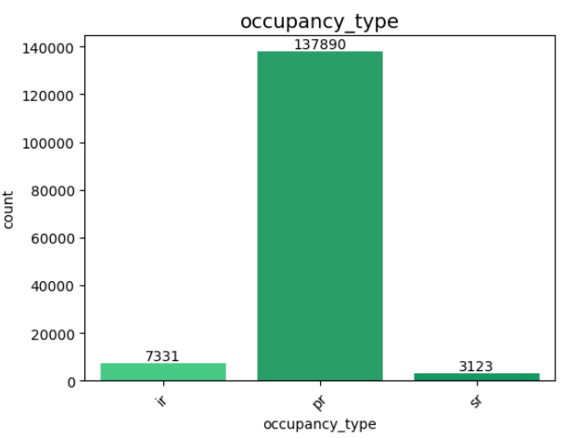
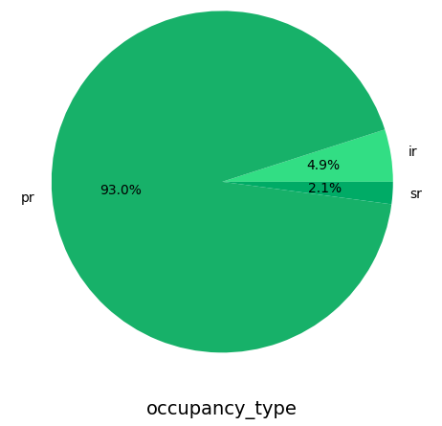
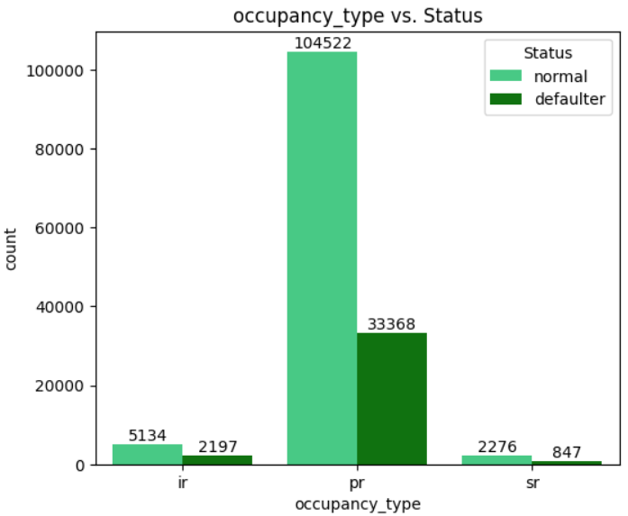
OCCUPANCY TYPE ANALYSIS
The vast majority of loans are tied to primary residences, with investment and secondary residences making up only a small fraction.
Higher Default Rates for Investment Residences.
Stability in Secondary Residences
Recommendation:
Implement stricter credit assessments and risk management strategies for investment residences (occupancy type 'ir') to mitigate the high default rates, while maintaining supportive measures for primary and secondary residence borrowers to ensure overall portfolio stability.

Slide 11
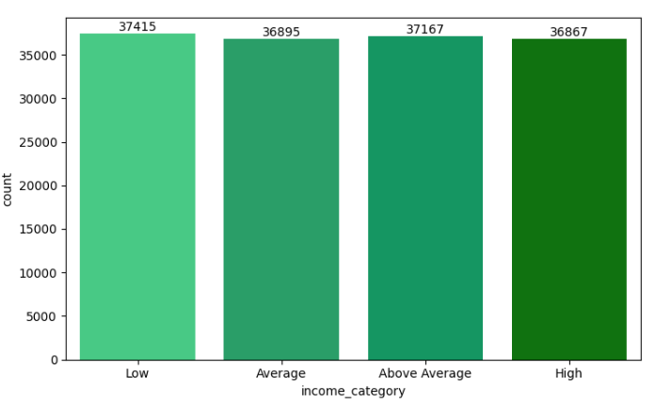
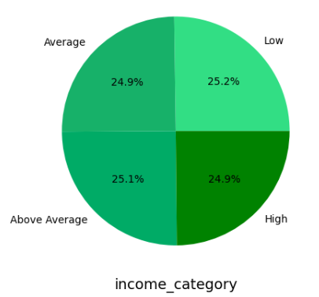
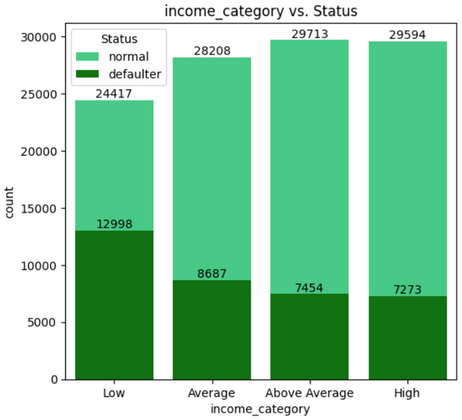
INCOME CATEGORY ANALYSIS
The counts of borrowers are relatively balanced across the four income categories
The Low income category having the highest number of borrowers (37,415), followed closely by Above Average (37,167), Average (36,895), and High (36,867)
As income increases from Low to High, the number of defaulters decreases. The ratio of normal to defaulter improves, showing that higher income groups tend to default less frequently.
Recommendation:
Implement targeted financial assistance and risk management strategies for low-income borrowers, as they exhibit a slightly higher default rate compared to higher-income groups

Slide 12
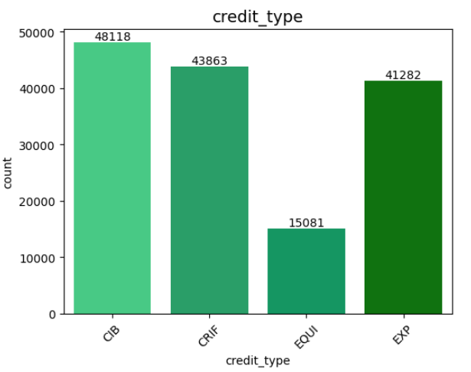
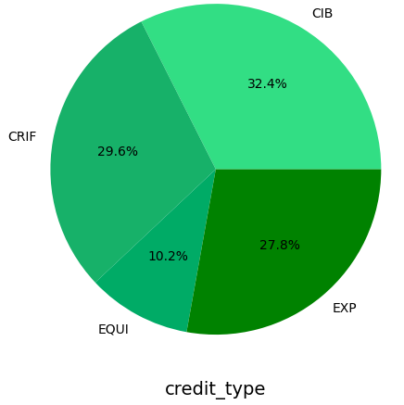
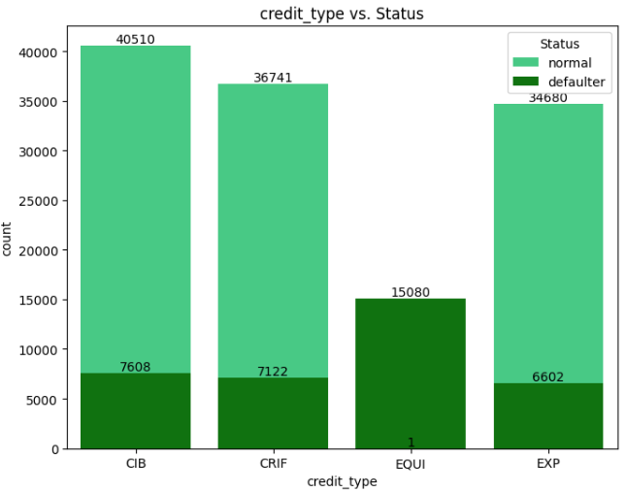
CREDIT TYPE ANALYSIS
The distribution of credit types is somewhat balanced, with CIB leading, but a significant portion of applicants also use CRIF and EXP.
CIB credit type has a relatively strong track record with the lowest default rate among credit types.
The EQUI credit type has only 1 normal borrower and 15,080 defaulters. This suggests that EQUI credit is predominantly linked to defaults and poses a significant risk to lenders.
Recommendation:
Tighten lending criteria for EQUI credit types to mitigate the overwhelming risk of defaults

Slide 13
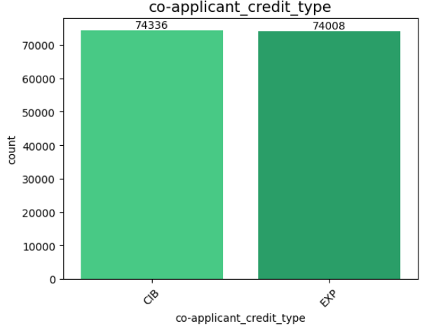
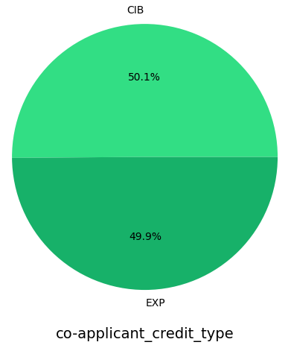
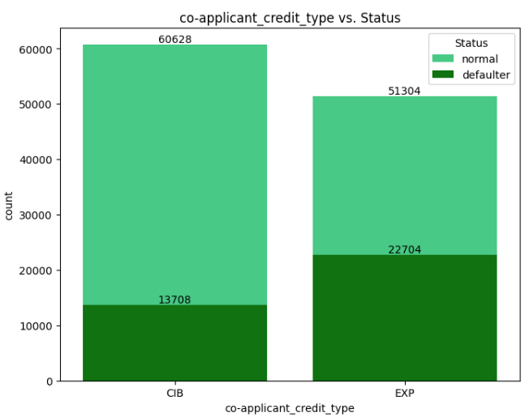
COAPPLICANT CREDIT TYPE ANALYSIS
There is no significant preference for one credit type over the other when it comes to co-applicants.
Loans with CIB as the co-applicant credit type show a good proportion of normal status, although slightly higher default risk compared to primary credit types.
Loans with EXP as the co-applicant credit type have a significantly higher default rate, suggesting co-applicants with EXP credit may represent a higher risk.
Recommendation:
Strengthen co-applicant assessments, especially when EXP is the co-applicant credit type, as this significantly increases the likelihood of default.

Slide 14
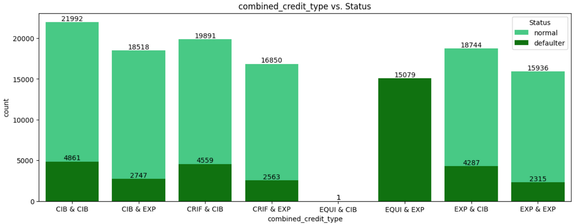
COMBINED CREDIT TYPE ANALYSIS
CIB as a co-applicant credit type consistently reduces the default rate, making it a more reliable choice across different primary credit types (CIB, CRIF, EXP).
In most cases, EXP as a co-applicant results in a higher success rate, showing lower default rates.
EQUI is highly risky, especially when paired with EXP as the co-applicant credit type, which leads to 100% default rates. This combination should be avoided.
The combination of EXP as both credit type and co-applicant performs surprisingly well, with a low default rate (12.86%). This shows that EXP credit type can be reliable when both borrower and co-applicant have the same credit type.
Recommendations:
Avoid lending to borrowers with EQUI credit type, especially when paired with EXP as the co-applicant credit type, as this combination has an extremely high default risk.

Slide 15
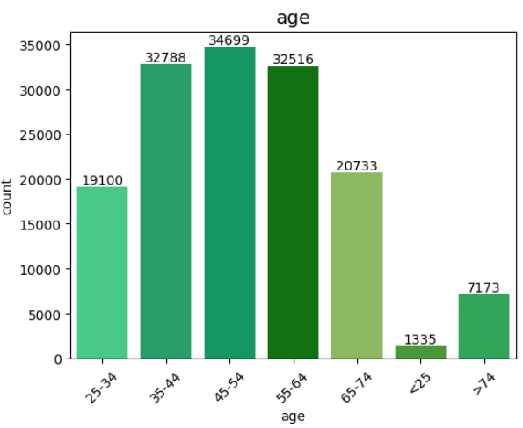
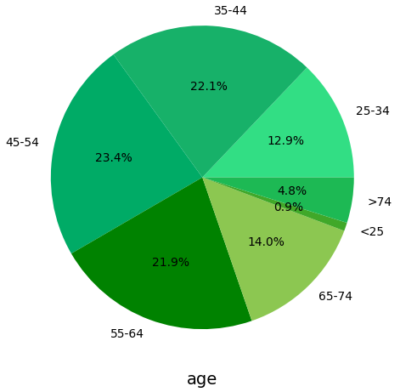
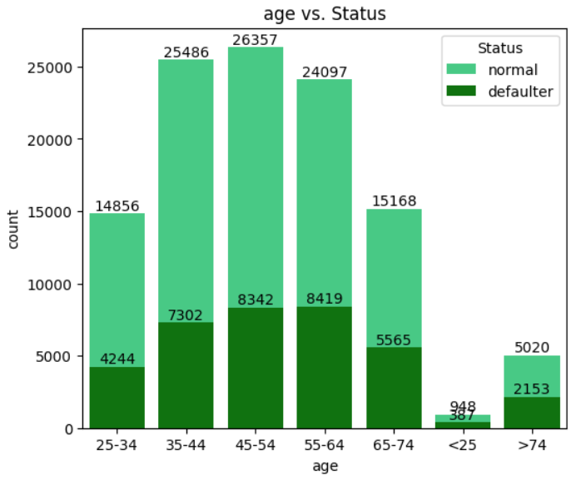
AGE ANALYSIS
Most applicants fall within the middle-age range, particularly between 35 and 64. Younger and older age groups are underrepresented.
The default risk seems to increase with age beyond 55, especially for the 65-74 and >74 age groups, where defaulters make up a significant portion of the total. The younger age groups, though fewer in number, show higher sensitivity to economic stress, reflected in their default numbers.
Recommendation:
Develop tailored financial education and support programs for middle-aged (45-54) and near-retirement (55-64) borrowers, as these groups have both the highest loan participation and default risks.

Slide 16
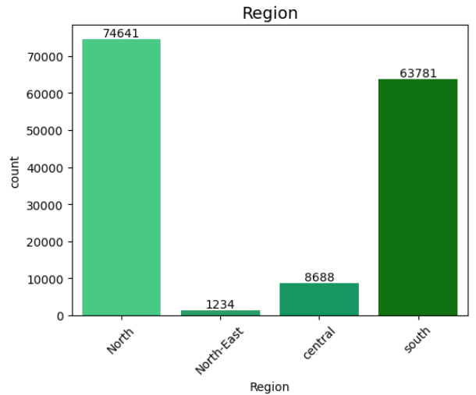
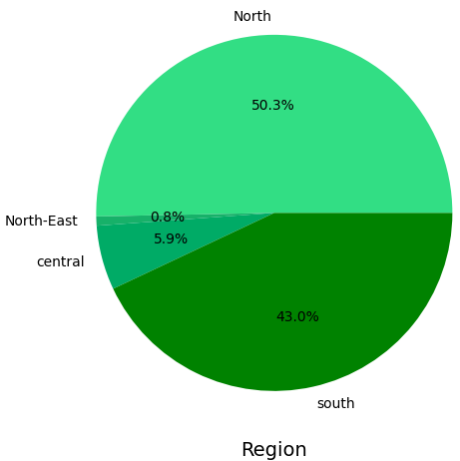
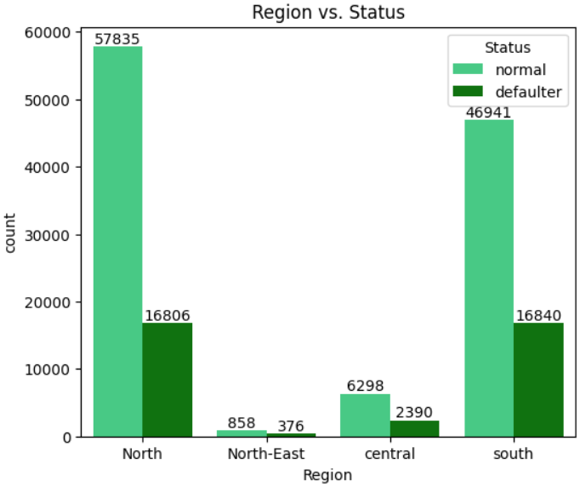
REGION ANALYSIS
The majority of applicants are from the North and South regions, with very few from the Central and North-East regions.
North Region shows a strong performance with the highest number of normal loans and a relatively lower default rate.
North-East Region is the highest-risk area, with nearly a third of loans in default despite having the smallest number of loans.
Recommendation:
Since the North-East and Central regions show significantly higher default rates, the business should consider implementing stricter loan approval criteria or higher collateral requirements in these areas.

Slide 17
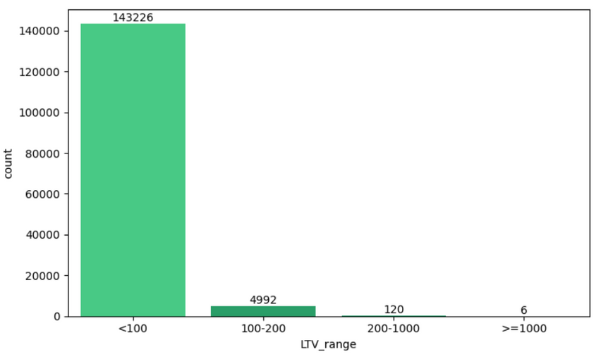
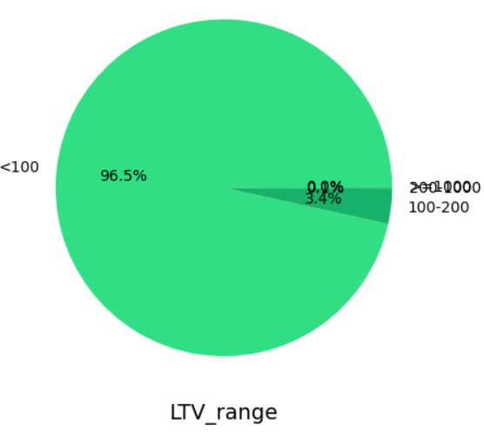
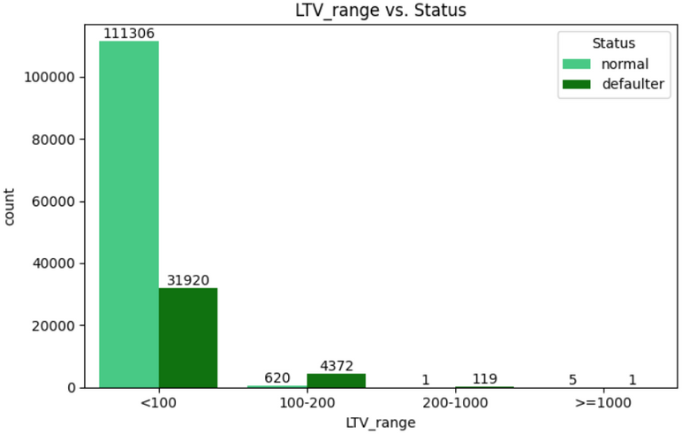
LTV RANGE ANALYSIS
(<100): The majority of loans have an LTV ratio of less than 100%, indicating that borrowers generally have more equity in the property than the loan amount.
(>=1000): Very few loans (6 loans) have an LTV ratio greater than 1000%, which is a rare and extremely high-risk situation.
Almost all loans with LTV between 200 and 1000% are in default (99.17%), showing that excessively high LTV ratios lead to an extremely high risk of default.
Recommendation:
Lenders should be cautious in approving loans where LTV exceeds 100, as these loans are prone to default. Special attention should be given to loans with LTV > 200, as they are almost guaranteed to default.

Slide 18
INSIGHTS AND RECOMMENDATIONS BASED ON HYPOTHESIS TESTING
Loan amount Vs. Status, Mann-Whitney U test (Right tailed):
Insight:
Borrowers in the Normal group tend to have higher loan amounts compared to those in the Defaulter group, indicating that larger loans are associated with more responsible repayment behavior.
Recommendation:
Focus on strengthening risk assessment criteria for smaller loan amounts, as borrowers with smaller loans show a higher likelihood of default. Offering financial literacy programs or additional credit counseling for smaller loan applicants may help mitigate this risk.
Rate of Interest Vs. Status, Mann-Whitney U test (Right tailed):
Insight:
The Normal group tends to have loans with a higher rate of interest compared to the Defaulter group. suggesting that borrowers who manage to pay back their loans successfully are more likely to do so even when faced with higher interest rates.
Recommendation:
Increase vigilance for borrowers with lower interest rates, as they might pose a higher risk of default. Consider reviewing the loan approval criteria for lower-interest loans and enhancing support mechanisms, such as offering financial counseling, to reduce the risk of default in this segment.
Upfront charges Vs. Status, Mann-Whitney U test (Left tailed):
Insight:
Borrowers in the Defaulter group tend to have higher upfront charges compared to those in the Normal group, indicating that higher initial costs may be associated with an increased likelihood of default.
Recommendation:
Consider offering loans with lower or flexible upfront charges to reduce the financial burden on borrowers. This could improve repayment rates and lower the default risk, particularly for those who might struggle with high initial loan costs.

Slide 19
INSIGHTS AND RECOMMENDATIONS BASED ON HYPOTHESIS TESTING
Property Value Vs. Status, Mann-Whitney U test (Right tailed):
Insight:
The Normal group tends to have a higher property value compared to the Defaulter group, suggesting that borrowers with more valuable properties are less likely to default on their loans.
Recommendation:
Implement a policy to conduct thorough evaluations of property values during the loan application process, prioritizing loans secured by higher-value properties. This could enhance risk assessment strategies and potentially reduce default rates by focusing on more stable asset backing.
Income Vs. Status, Mann-Whitney U test (Right tailed):
Insight:
The Normal group has a higher average income compared to the Defaulter group, indicating that borrowers with greater income levels are less likely to default on their loans.
Recommendation:
Consider implementing income-based lending criteria that favor borrowers with higher income levels, as this could improve loan performance and reduce default rates. Additionally, targeted financial education programs could be developed for lower-income borrowers to enhance their financial literacy and repayment capabilities.
LTV Vs. Status, Mann-Whitney U test (Left tailed):
Insight:
The Normal group has a lower loan-to-value (LTV) ratio compared to the Defaulter group, suggesting that borrowers who take on less debt relative to the value of the collateral (property) are less likely to default.
Recommendation:
Implement stricter LTV limits for loan approvals to mitigate risk. Encourage borrowers to maintain a lower LTV ratio, which could improve loan stability and reduce the likelihood of defaults. Consider providing additional support or incentives for borrowers who achieve lower LTV ratios.

Slide 20
THANK YOU

