Slide 1
https://github.com/Kasia-hue/AI-DS

Slide 2

Artificial Intelligence & Decision Systems
20.03.2024

Slide 3
Agenda
Classification algorithms
Scikit-learn implementation
Exercise!

Slide 4
Classification algorithms
Eager learners:
Naive Bayes Classifier
Logistic Regression
Support Vector Machine
Decision Tree
SGD
Lazy learners:
K-Nearest Neighbors
Linear models:
Logistic Regression
Support Vector Machine
SGD
Non-linear models:
K-Nearest Neighbors
Decision Tree
Naive Bayes Classifier

Slide 5

Naive Bayes Classifier
based on applying Bayes’ theorem with the “naive” assumption of conditional independence between every pair of features given the value of the class variable
$$P\left(h | D\right)=\frac{P\left(D | h\right)P(h)}{P(D)}$$
P(h): the probability of hypothesis h being true (regardless of the data). This is known as the prior probability of h.
P(D): the probability of the data (regardless of the hypothesis). This is known as the prior probability.
P(h|D): the probability of hypothesis h given the data D. This is known as posterior probability.
P(D|h): the probability of data d given that the hypothesis h was true. This is known as posterior probability.

Slide 6
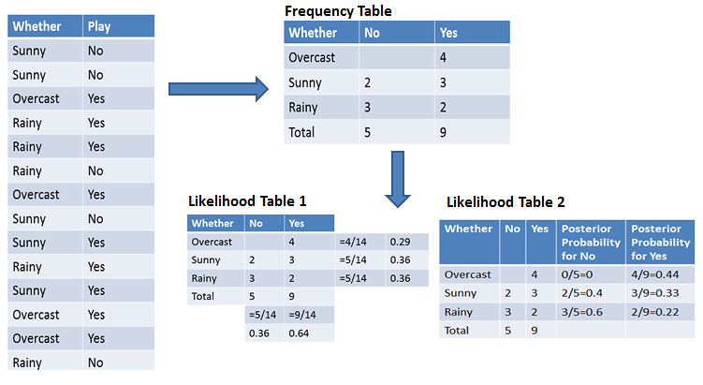
P(Yes | Overcast) = ?

Slide 7

P(Yes | Overcast) = P(Overcast | Yes) P(Yes) / P (Overcast) = 0,44*0,64/0,29=0,98 P(No|Rainy)=?

Slide 8
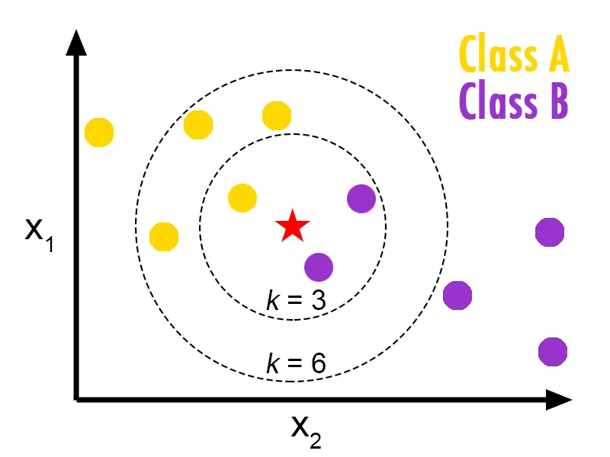
K-Nearest Neighbors
Instance-based learning with local approximation
Stores instances of training data
Simple and explainable algorithm
2 hyperparameters: K value and distance function

Slide 9
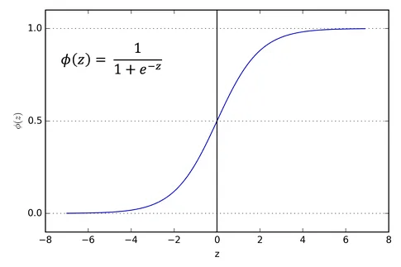
Logistic Regression
The most important hyperparameters - solver, penalty and C.
For binary and multi-class classification (ovo, ovr).
Classes estimated using Maximum Likelihood Estimation (MLE) approach.

Slide 10

Regularization
Constraining the coefficient estimates towards zero. Discourages learning a more complex model – reduces the risk of overfitting.
l0 norm – total number of nonzero elements in a vector
l1 norm (Manhattan distance).
l2 norm (Euclidean norm).
l-infinity norm - the largest magnitude among each element of a vector.
Elastic Net (l1 and l2).

Slide 11
Ridge Classifier
Classifier using Ridge regression - a penalized with l2 norm linear regression.
Converts the target values into {-1, 1} and then treats the problem as a regression task.
Alpha - regularization strength.

Slide 12

Support Vector Machine
Fitting the widest possible margin between the classes.
Sensitive to outliers.
Works on linearly speparable data.
Solutions:
Soft margin
Kernel trick

Slide 13
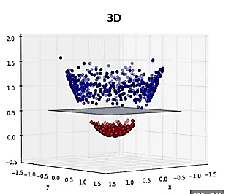
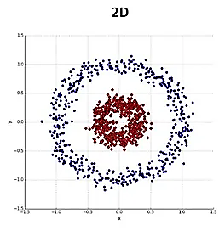
Kernel trick and soft margin
Soft marigin
Maximise decision boundary (small C value)
Minimise missclassification (large C value)
Kernels:
Linear
Polynomial
RBF
Sigmoid
Kernel trick

Slide 14
Root Node
Branches
Leaf Node
Internal Node
Branches
Leaf Node
Leaf Node

Slide 15

Decision Tree
Predicting the class by learning simple decision rules inferred from the data features
Explainable
Prone to overfitting
Pruning improves generalization and reduces computational cost:
Prepruning – stop growth by setting constrains
Postpruning – cost complexity pruning - ccp_alpha hyperparameter

Slide 16
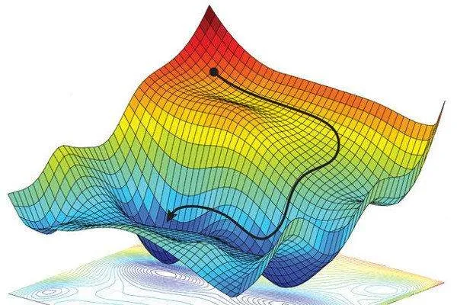
Stochastic Gradient Descent
Fitting linear classifiers under convex loss functions such as (linear) Support Vector Machines and Logistic Regression.
Introduces randomness into learning process

Slide 17
Questions?

Slide 18


