Slide 1
https://github.com/Kasia-hue/AI-DS

Slide 2

Artificial Intelligence & Decision Systems
27.03.2024

Slide 3

Agenda
Ensemble learning
Types of ensemble learning
Exercises

Slide 4
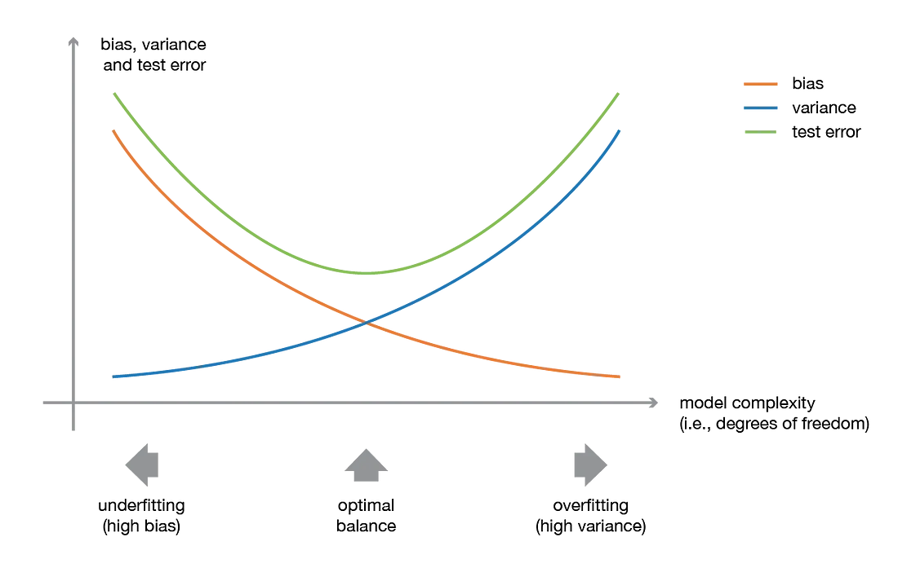
Bias -variance tradeoff

Slide 5




Ensemble learning
Pick your base model/s
Train every model
Combine a group of weak learners and form a strong learner.
Minimizing risk of model overfitting to one group of data.
Aggregate models
Evaluate

Slide 6
Weak learner
Strong learner
Easier to prepare
Slightly better than random/ naive guessing
Harder to prepare
Arbitrarily good accuracy – better than random guessing

Slide 7
Weak learners
Strong learners
Linear models (SGD, Logistic Regression)
Decision trees – decision stumps
Naive Bayes
Percepton
K-Nearest Neighbors with 1-3 neighbours
SVM
K-Nearest Neighbors with >3 neighbours
Random Forest
XGBoost
Deep Neural Networks
Convolutional Neural Networks

Slide 8
Types of ensemble learning
Voting
Bagging
Boosting
Stacking

Slide 9
Voting Classifier
Used to combine the predictions of multiple base learners into a final prediction.
Hard – based on the most frequent class predicted by individual models.
Soft/ weighted – considers the probability scores of each base model for each class and calculates the weighted average of these to make the final prediction

Slide 10
Bootstrap Aggregation
Homogeneous weak learners’ model that learns from each other independently in parallel.
Mainly focus at getting less variance than its components.
Voting for predictions.
Bootstrap data into samples.
Train the models on different data samples.
Predict.

Slide 11
Random Forest
Deep trees fitted on samples combined to produce an output with lower variance.
For each bootstrap sample, a decision tree is grown using a subset of features selected randomly at each split.
Bootstrap data into samples.
Train deep trees on the samples.
Predict.

Slide 12
Boosting
Homogeneous weak learners’ model. Models learn sequentially and adaptively to improve model predictions of a learning algorithm.
Train a single weak learner.
Figure out which examples the weak learner got wrong.
Build another weak learner that focuses on the areas the first weak learner got wrong.
Continue until a predetermined stopping condition is met.

Slide 13
AdaBoost
First boosting algorithm invented. Each learner is trained on a subsample of the dataset.
Initialize weights - every observation gets the same weight.
Train the model.
Icrease weights: identify missclassificated observations and increase their weights.
Update weights of the classifier based on its bias.
Repeat 2-4 until conditions satisfied.
Combine.

Slide 14
Gradient Boosting
Initialize predictions on dataset based on classes distribution.
Compute residuals and gradients between the predicted and actual labels for each prediction - as the negative gradient of the loss function with respect to the predicted probabilities.
Fit to the negative gradient, aiming to minimize the loss function and compute learning rate.
Add new model, weighted by a learning rate, which controls the contribution of each model.
Repeat 2-4 until conditions satisfied.
Combine.

Slide 15
XGBoost
Similar to GB with some enhancements: reguralization, early stopping, cross-validation, pruning, data sparse, pararelization.
Initialize prediction is made as the class distribution for classification tasks.
Compute residuals, gradients and Hessians of the loss function with respect to the current model's predictions.
Fit to the loss function: model is trained to minimize the loss function.
Update the model weights based on their learning rate.
Repeat 2-4 until conditions satisfied.
Predict.

Slide 16
Bagging vs boosting
Feature | Bagging | Boosting
Objective | Reduce variance and prevent overfitting | Reduce bias and improve accuracy
Base Learners | Independent models trained in parallel | Sequentially trained weak learners
Weighting | Equal weight for all base learners | Weighted based on performance
Error Correction | Independent errors; no re-weighting | Emphasis on correcting mistakes
Training Speed | Parallel training; faster | Sequential training; slower
Final Model | Average or voting of base models | Weighted sum of base learners
Robustness | Less prone to overfitting | Prone to overfitting if not controlled

Slide 17
Stacked generalization
Train heterogeneous weak learners to create a meta-model to output a prediction based on the weak models’ predictions.
Split data into multiple subsets.
Train different models on subsets.
Train meta-learner on predictions of base models as input.
Predict.

Slide 18
Questions?

Slide 19


