Slide 1

Artificial Intelligence & Decision Systems
3.04.2024

Slide 2

Agenda
Artificial Neural Networks
Types of ANN
Deep Learning in supervised learning

Slide 3
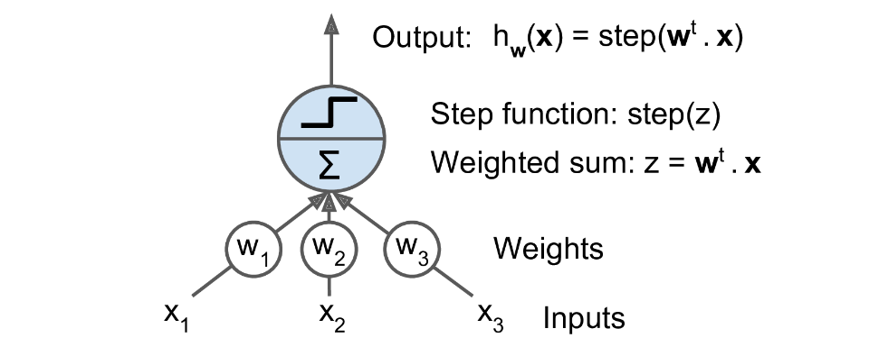
Linear Treshold Unit

Slide 4
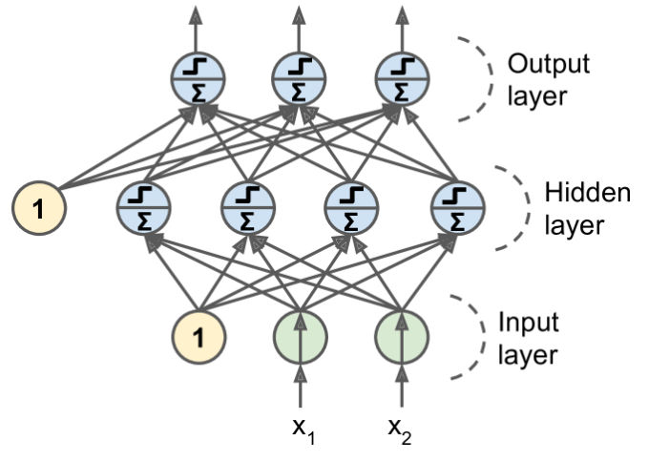
Remember ensemble learning?

Slide 5
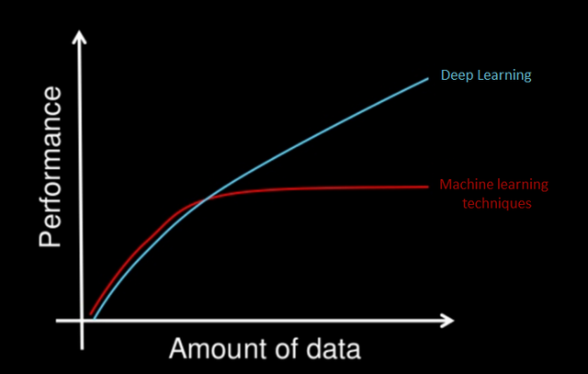
Deep Learning
At least 2 hidden layers of NN.
When you need to train a lot of data.
Use for:
Speech recognition
image classification
natural language processing

Slide 6
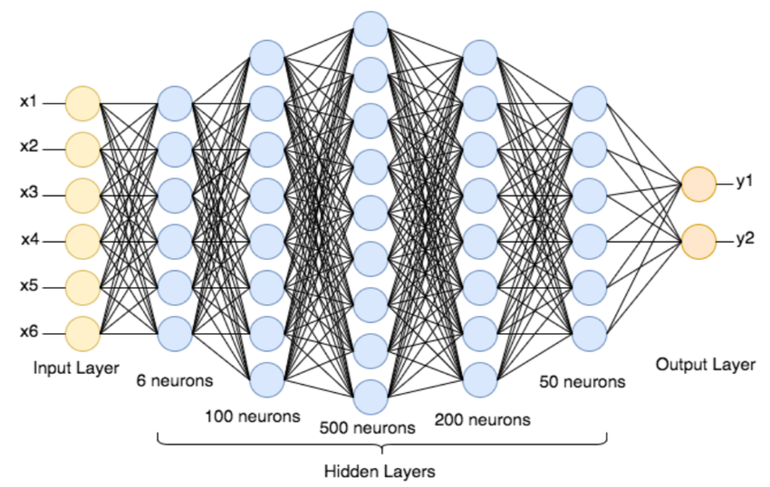
Deep Neural Network
Input layer
Hidden layers
Output layer

Slide 7
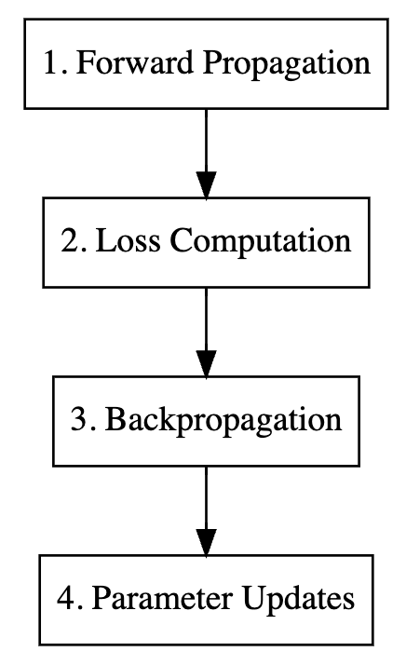
ANN training
Feed forward
Different loss functions for classification (Binary/ Categorical Cross-Entropy) and regression (MAE, MSE).
Optimalization (SGD, ADAM):
Backpropagation (chain rule)
Parameter Update
Problems:
Exploding gradients
Vanishing gradients

Slide 8
Neural Networks types
Feed-forward
Recurrent

Slide 9

ANN Hyperparameters
Number of hidden layers
Number of neurons in hidden layers
Activation functions
Optimizer, learning rate
Batch size
Number of epochs

Slide 10
Optimizers
Improve weights and learning rates. Optimizers used in Deep Neural Networks:
Gradient Descend
Stochastic Gradient Descend
SGD with momentum
Adam – Adaptive Moment Estimator
Adagrad - Adaptive Gradient Descent

Slide 11
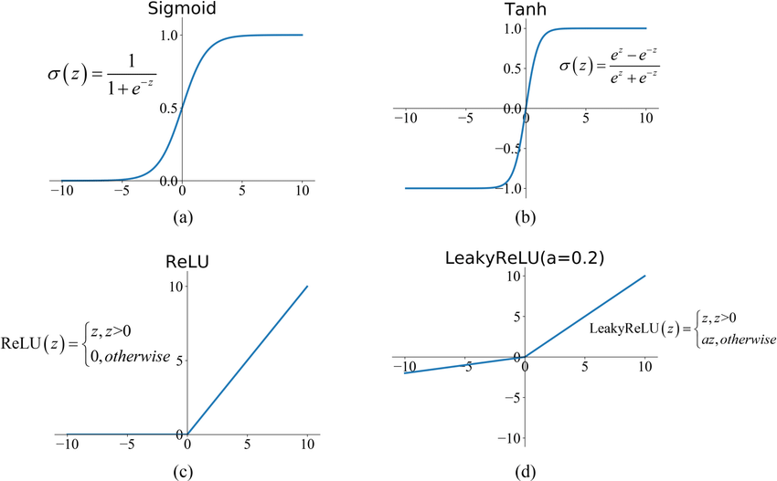
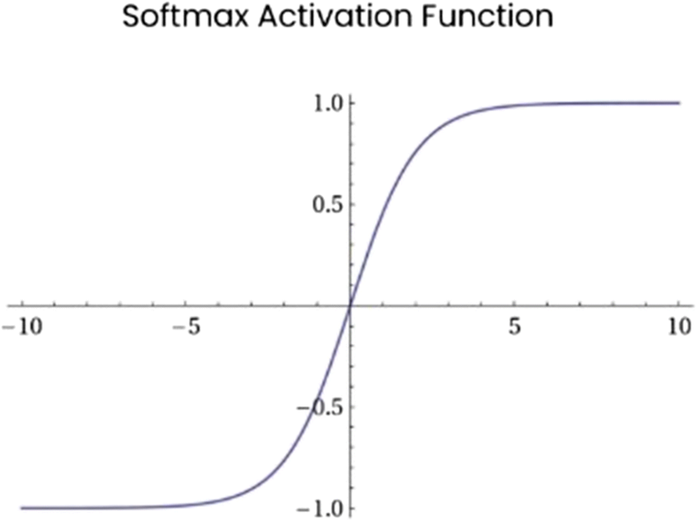
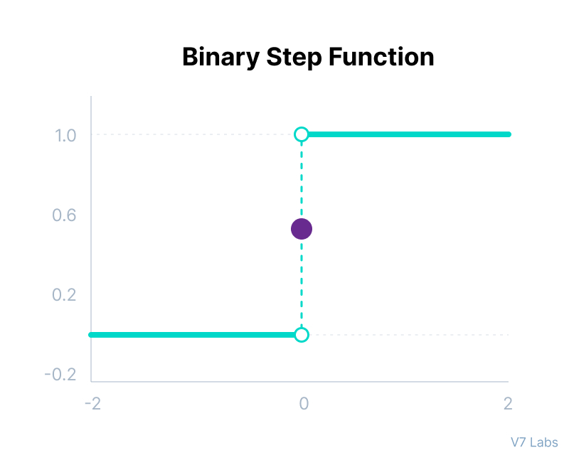
Activation functions
Binary step
Linear
Sigmoid
Softmax
Tanh
Recified Linear Unit (RELU)

Slide 12
ANN Hyperparameters
Epoch – The number of times the algorithm runs on the whole training dataset.
Batch size – denotes the number of samples to be taken to for each iteration in epoch.
Learning rate – for optimizer, controls the step size for a model to reach the minimum loss function.

Slide 13


Practice time

Slide 14
Questions?

Slide 15


