Slide 1

Artificial Intelligence & Decision Systems
14.05.2024

Slide 2

Agenda
WSKN overview
Projects check
Exercise

Slide 3
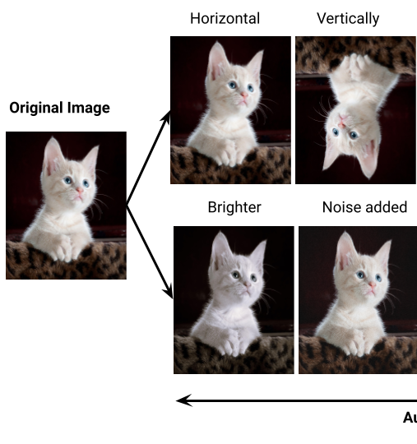
Preventing overfitting
1. Data Augmentation:
Geometric transformations
Colour space transformations
Filters
Random erasing
Mixing

Slide 4
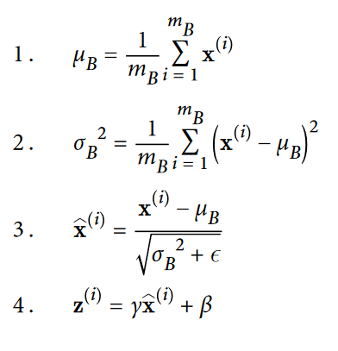
Preventing overfitting
Cross-Validation
Normalizarion:
Batch Normalization
Regularizarion:
Dropout
Early Stopping

Slide 5
Questions?

Slide 6


