Slide 1

Artificial Intelligence & Decision Systems
3.04.2024

Slide 2

Agenda
Regression types
Algorithms
Evaluation
Implementation
Ensemble learning
Exercise

Slide 3

Regression
Prediction of the continuous output variables based on the independent input variable.
$$y= β_{1}x+β_{0}+ε$$
$y$ - dependent variable
$x$ - independent variable
$β_{0}$ - intercept
$β_{1}$ - slope
$ε$ – error

Slide 4
Regression types

Slide 5
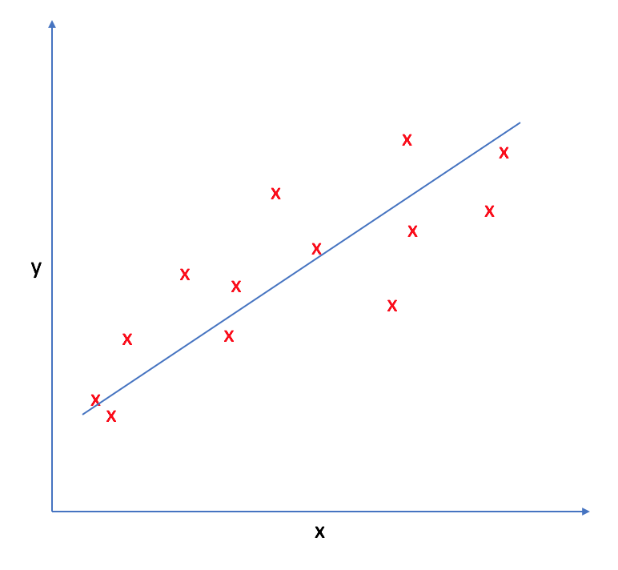
Linear Regression
Fit a hyperplane by minimizing the error for each data point.
Assumptions:
Weak exogeneity.
Linearity.
Homoscedasticity.
Independance.
No perfect multicollinearity.

Slide 6

Multiple Linear Regression
Two or more independent variables (features) used to predict the outcome.
$$y=β_{0}+β_{1}x_{1}+β_{2}x_{2}+…+β_{n}x_{n}+ε$$
$x_{1}$, $x_{2}$,…, $x_{n}$ - independent variables
$y$ - dependent variable
$β_{0}$, $β_{1}$,…,$β_{n}$ -​ coefficients associated with each independent variable
𝑛 – numer of independent variables

Slide 7

Polynomial regression
Extension of linear regression where the relationship between the variables is modeled using a polynomial equation.
$$y=β_{0}+β_{1}x+β_{2}x^{2}+…+β_{n}x^{n}+ε$$
$x$- independent variable
$y$ - dependent variable
$β_{0}$, $β_{1}$,…,$β_{n}$ - coefficients associated with each term in the polynomial.
$ε$ - error
𝑛 – degree of polynomial

Slide 8
Algorithms
Ordinary Least Squares
Ridge Regression
LASSO Regression
Elastic Net Regression
Logistic Regression
K-Nearest Neighbors
Bayesian Regression
Gradient Descent
Decision Tree
Random Forest
Gradient Boosting
Support Vector Regression
Percepton
Neural Networks

Slide 9
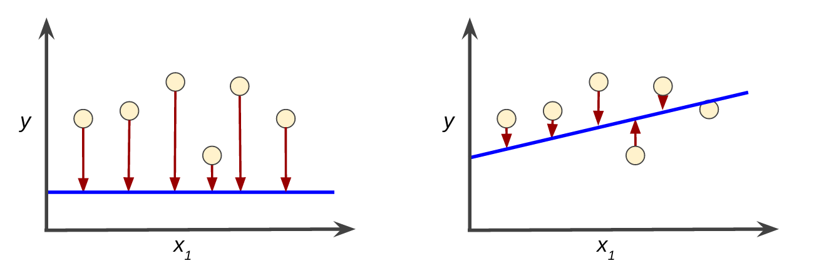
Loss function

Slide 10
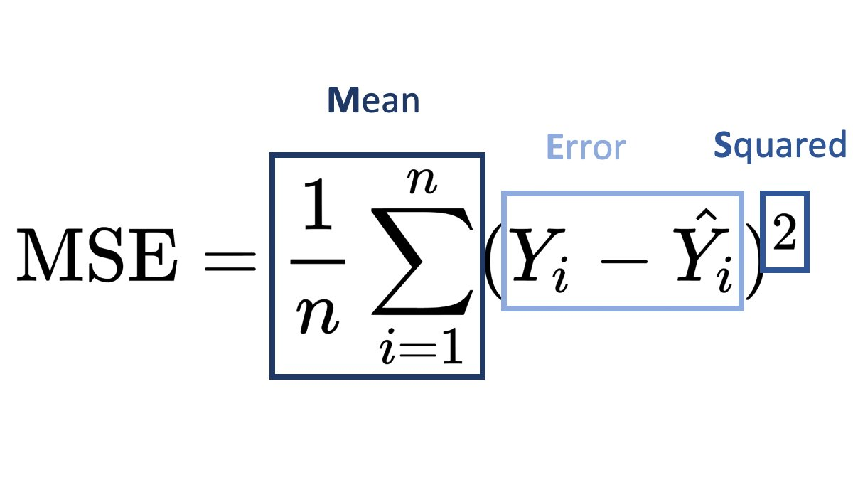
Evaluation
Mean Squared Error (MSE)
Root Mean Squared Error (RMSE)
Mean Absolute Error (MAE)
n - number of observations

Slide 11
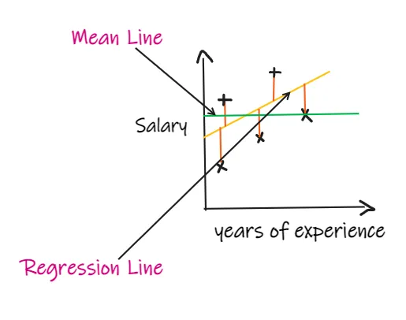

Evaluation
R-squared (R²)
$$1−\frac{\sum_{i=1}^{n}{{(y_{i}−\hat{y_{i}})}^{2}}}{\sum_{i=1}^{n}{{(y_{i}−\overline{y})}^{2}}}$$
Adjusted R-squared
$$1−\frac{(1−R^{2})(n−1)}{(n−p−1)}$$
p - number of independent features

Slide 12

Provides classes and functions for:
implementation of machine learning models
estimation of statistical models
conducting statistical tests
statistical data exploration
result statistics for each estimator

Slide 13
Ensemble learning
Voting - fits several base regressors, averages the individual predictions (and their weights) to form a final prediction.
Bagging – fits base regressors, aggregate their individual predictions (either by voting or by averaging) to form a final prediction.
Boosting, Stacking – works the same.

Slide 14
Questions?

Slide 15


