Slide 1

Artificial Intelligence & Decision Systems
6.03.2024

Slide 2
Roadmap
Introduction
Meetings
Exercises
Projects

Slide 3
Agenda
AI subdomains
Technologies
Data Exploration
Data Preprocessing

Slide 4
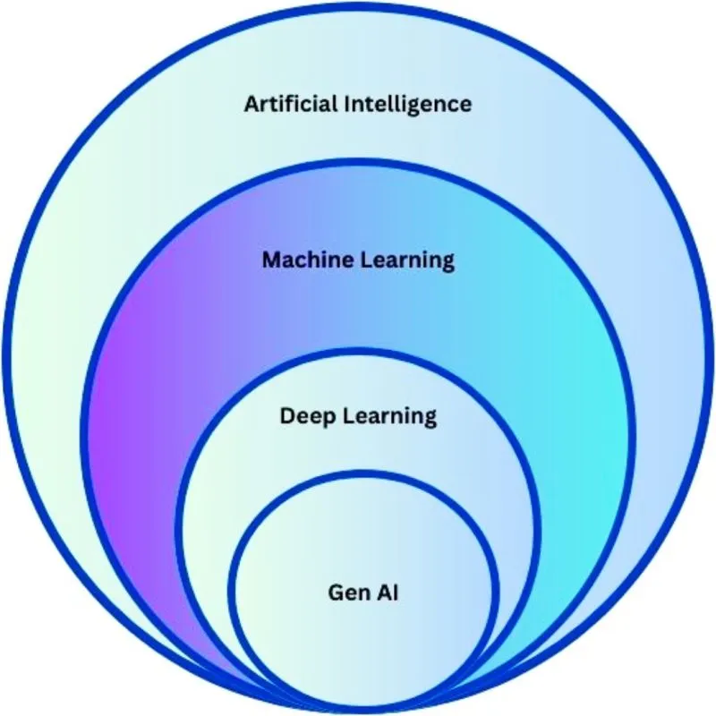
Introduction
AI subdomains

Slide 5
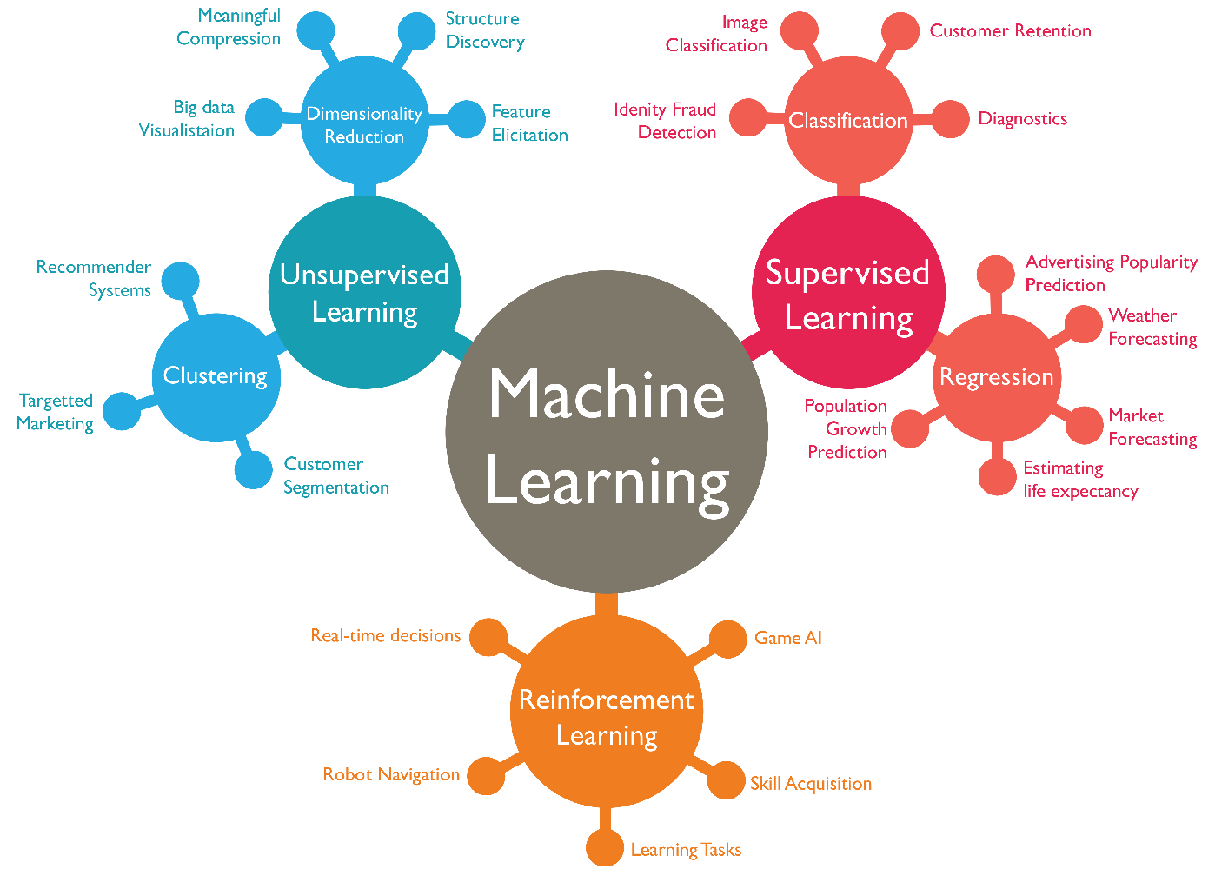

Slide 6
Machine Learning
Traditional programming
Data
Data
Computer
Computer
Output
Program
Program
Output

Slide 7
Model as function
Machine learning algorithms are described as learning a target function that best maps input variables to an output variable.
Y = f(X)
Y – output variable
f – target function
X – input variable
e – error of the input data
Y = f(X)+e

Slide 8
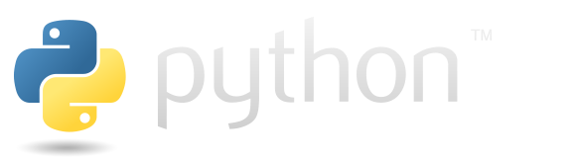

Python vs R
General-purpose
Open-source
Easy to learn
Many packages
Active community
Worse for visualisation
Designed for statistical computing and graphics
Open-source
More difficult to learn
Many modules
Academic user community

Slide 9


Jupyter Notebook vs Google Colab
Open-source
Depends on user’s resources
Offline
Intuitive UI
Needed configuration
Limited free version
Cloud computing
Intuitive UI
Compatible with Jupyter Notebooks’ extensions
No configuration need

Slide 10
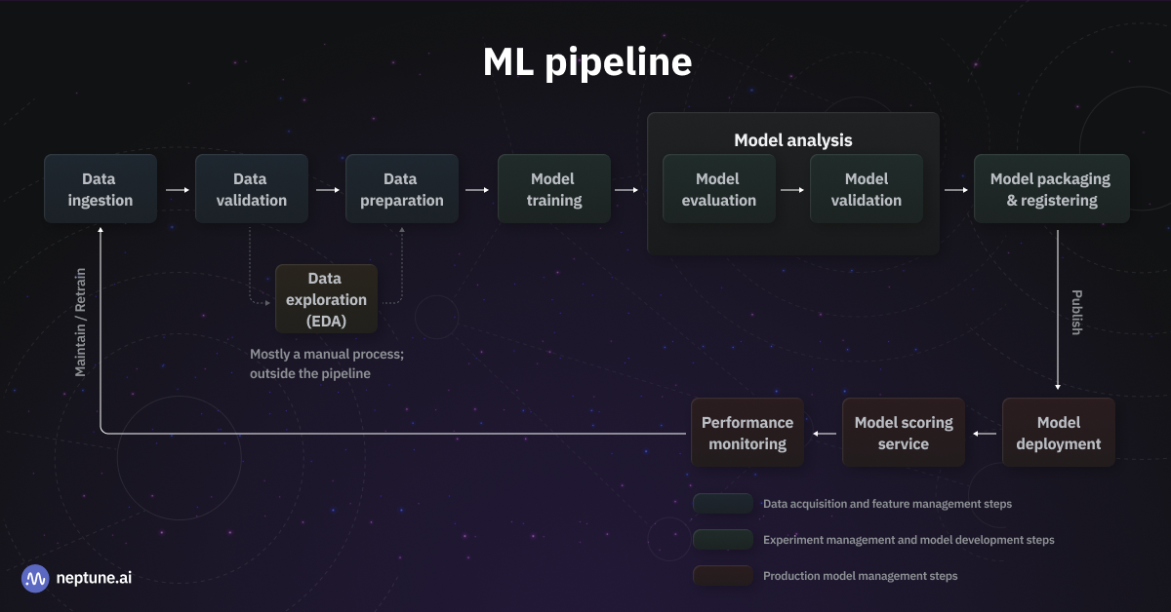

Slide 11
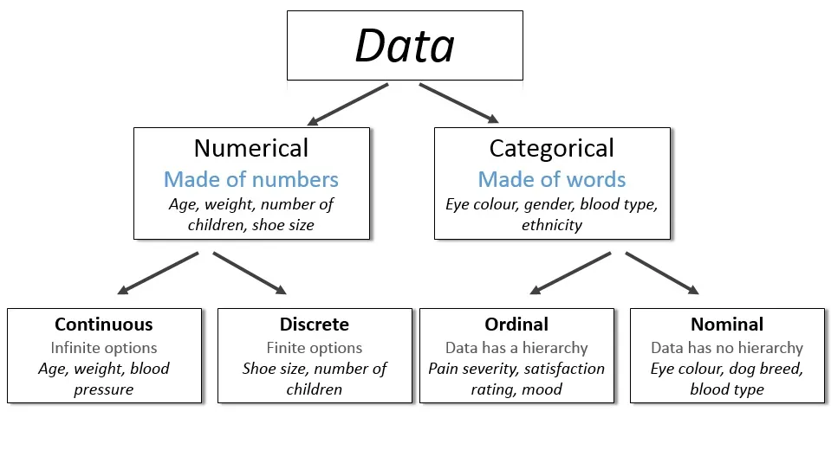
Data types in Machine Learning

Slide 12
Data
May have many forms
Algorithms have different requirements
Garbage in, garbage out
Table | Feature | Feature | Feature
Instance | Value | Value | Value
Instance | Value | Value | Value
Exploration
Preparation
EDA
Statistical data analysis
Data cleaning
Data transformation
Feature engineering/ selection
Dimensionality reduction

Slide 13

Numpy
Python library for scientific computing - arrays, matrices, linear algebra.
Arrays
Fixed size at creation
Fast
arr1d = np.array([data])

Slide 14

Notebook s1_NumPy

Slide 15

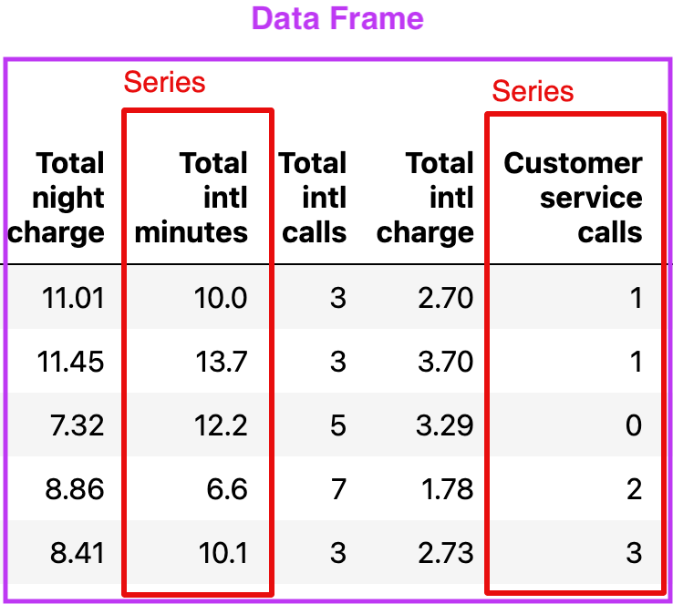
Series
One-dimensional data array with name parameter and index.
s = pd.Series(data=None, index=None, dtype=None, name=None)
DataFrame
Two-dimensional, size-mutable, potentially heterogeneous tabular data with name and index.
df = pd.DataFrame(data=None, index=None, columns=None, dtype=None)

Slide 16


Visualisation
Based on matplotlib
High level intefrace
Integrated with Pandas, NumPy, ect.
Low level plotting library
Integrated with Pandas, NumPy, ect.

Slide 17
Notebook s1_EDA

Slide 18
Notebook s1_EDA_exercise

Slide 19
Questions?

Slide 20

Zapisy do Koła
http://tinyurl.com/zapisy-skn

Slide 21


