Slide 1


Slide 2
Process:
Data Cleaning
Hypothesis Testing
Linear Regression Moadel
Conclussions
Exploratory Data Analysis

Slide 3
Data cleaning

Slide 4
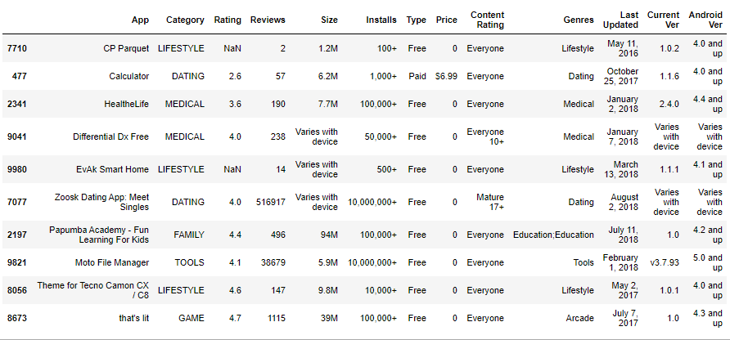


Data set 1
The Data Set comes from Kaggle and was last updated in 2019.

Slide 5
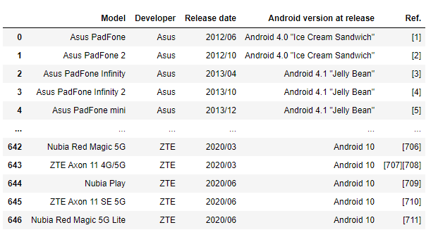
Data set 2
Scraped data: List of Android smartphones with Android version specified:

Slide 6
Category – suspicious value of 1.9 checked and corrected
Rating – suspicious value checked and corrected, type is already float-good
Reviews - type to int
Size - strip k,m * 1024
Installs - strip +,, type to int
Type - 0 value checked and corrected
Price – stripped $, type to float, got rid of outliers
Genres –dummies created for Regresssion Model
Last Updated - type to date
Android Ver – stripped
Adding „Income” column as a product of „Installs” and „Price”
Adding Iog columns for Installs, Reviews, Price, Income (for Regression Model)
Release date – extracted year
Android ver – stripped

Slide 7
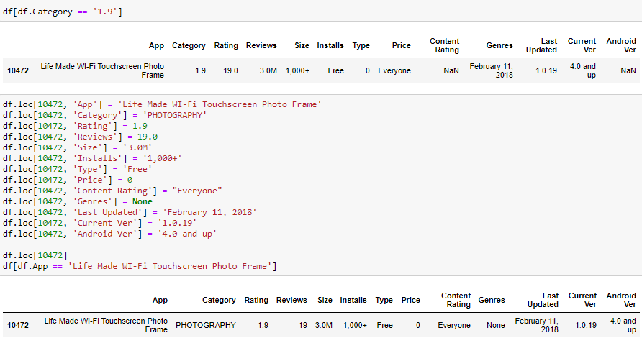
2. Category – suspicious values to be checked

Slide 8
Exploratory data analysis

Slide 9
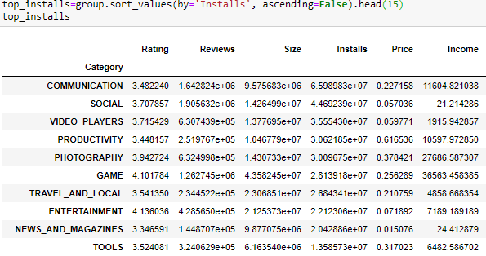
Top categories by installs

Slide 10
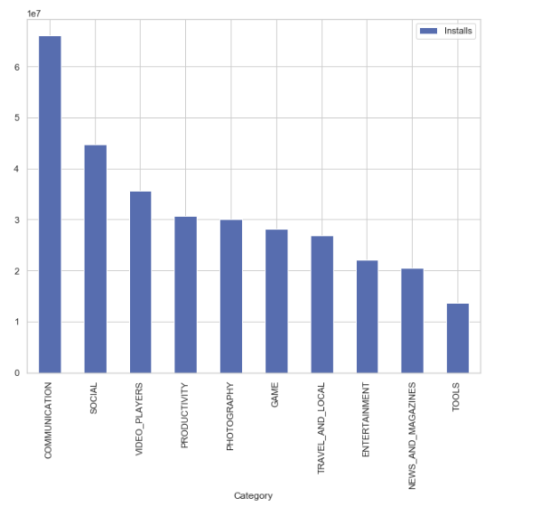





Top categories by installs

Slide 11
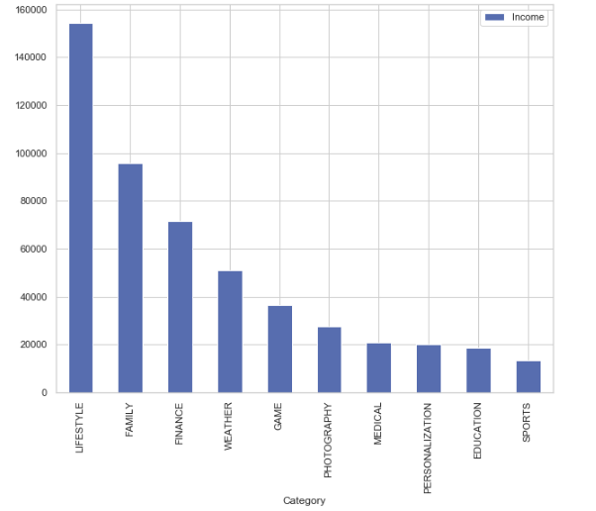






Top categories by income

Slide 12
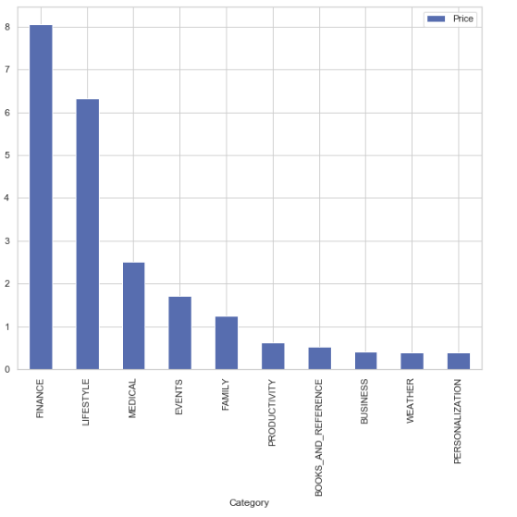
Top categories by price

Slide 13
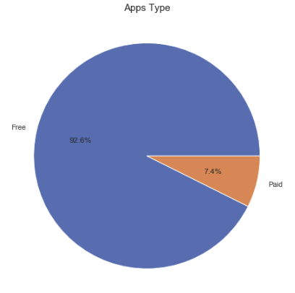
APPS pricing

Slide 14
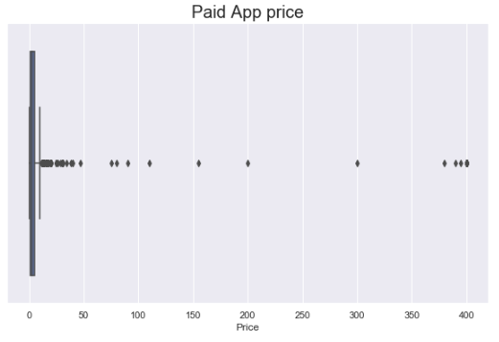
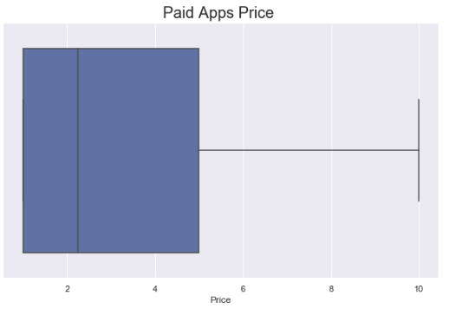

Paid APPS pricing

Slide 15
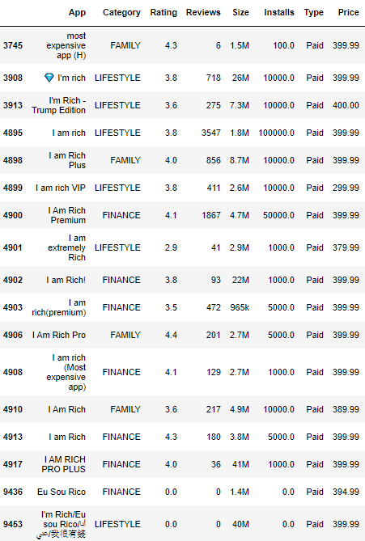

Paid APPS pricing – I’m rich
I am rich I deserve it I am good, healthy & successful
Originally priced $999 (2008), bought by 8 people and taken down by App Store after one day.
Google store have its several versions till today.
I didn’t check the other versions, maybe they have more meanig than the precursor.

Slide 16
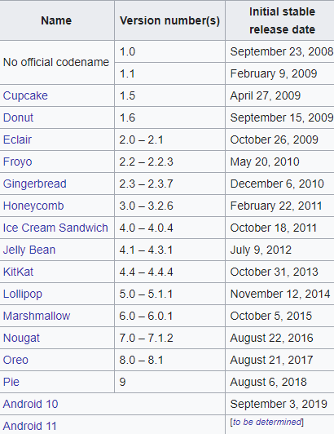
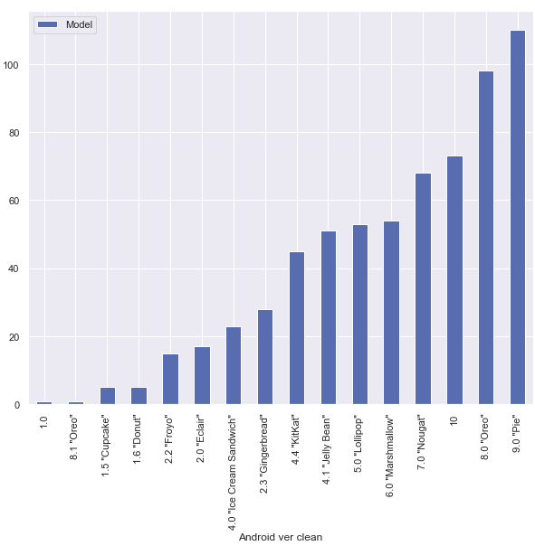
Nb of Phones released with different android versions

Slide 17
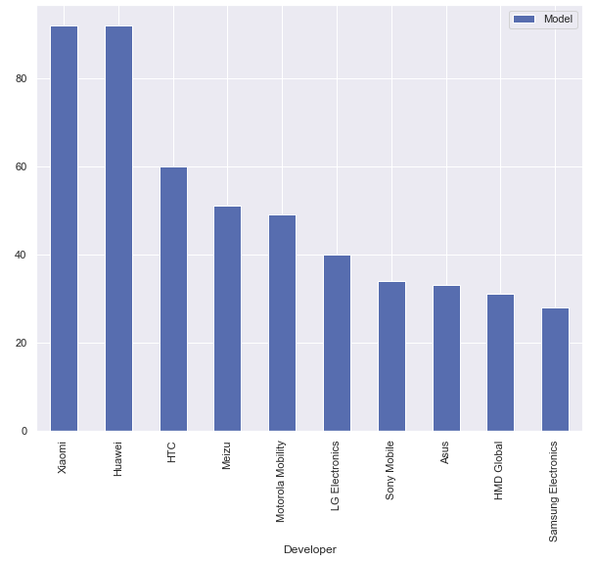
Nb of Phones models releases for android - by developper

Slide 18
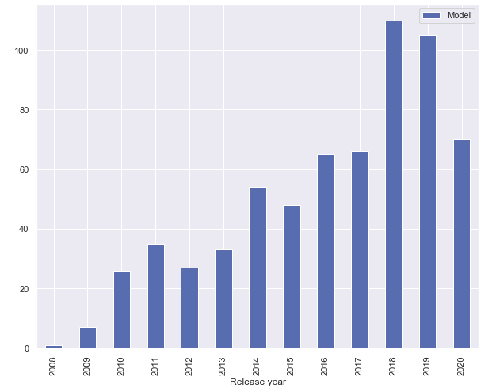
Android supported phone models – by year

Slide 19
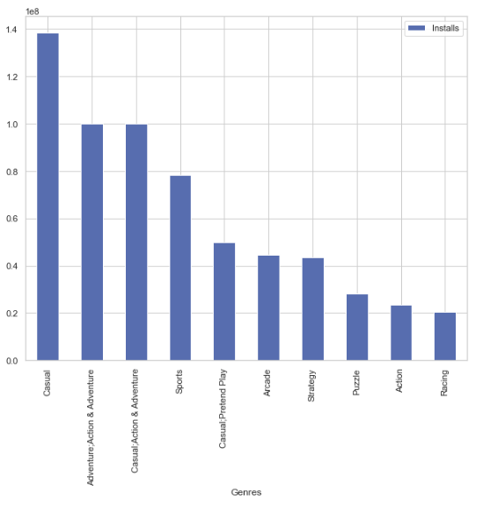
Closer look at gaming apps – Top genres by installs

Slide 20
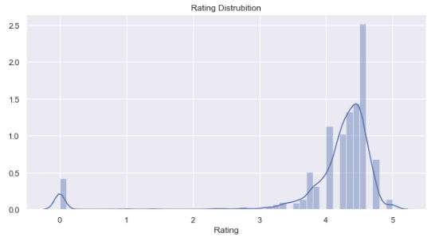
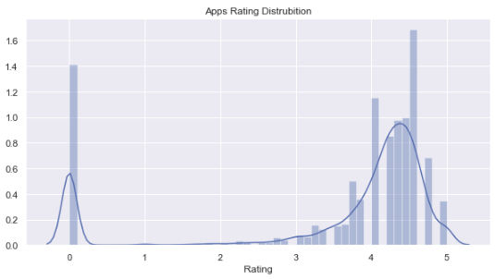
Closer look at gaming apps – Rating distribution

Slide 21
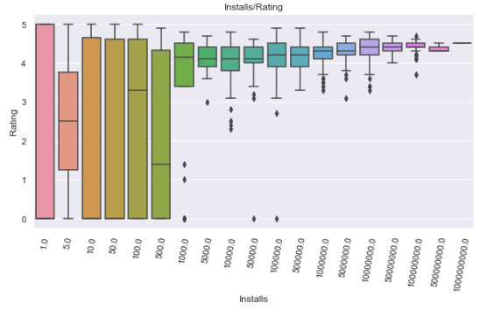
Closer look at gaming apps – installs vs rating

Slide 22
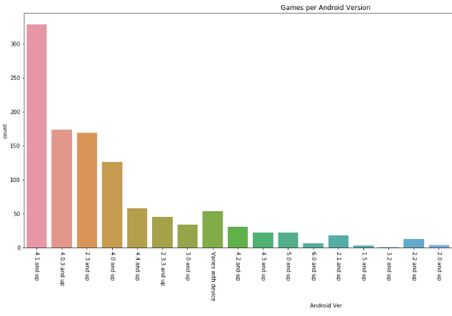
Closer look at gaming apps – apps supporting android version
Most gaming apps suport higher than 4.1 ver. (2012)

Slide 23




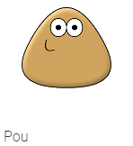



Top installs gaming apps

Slide 24
Hypothesis testing

Slide 25
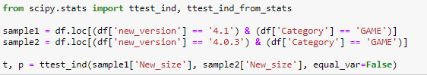
I took two samples of game apps from two different Android Versions and I checked if the average size off games were the same in both samples.
I performed the T-test for the means of two independent samples: scipy.stats.ttest_ind
Ho: avg of Sample1.Size = avg of Sample2.Size

Slide 26
T-test result:
Conclussions:
P-value < 0,05, therefore, we can reject Ho that average Size in Game category for 4.0.3 version is equal to average app. size for 4.1 version.
We could draw a conclussion that maybe app. developers are well following the expanded possibilities that new Android versions give.

Slide 27
Linear regression model

Slide 28
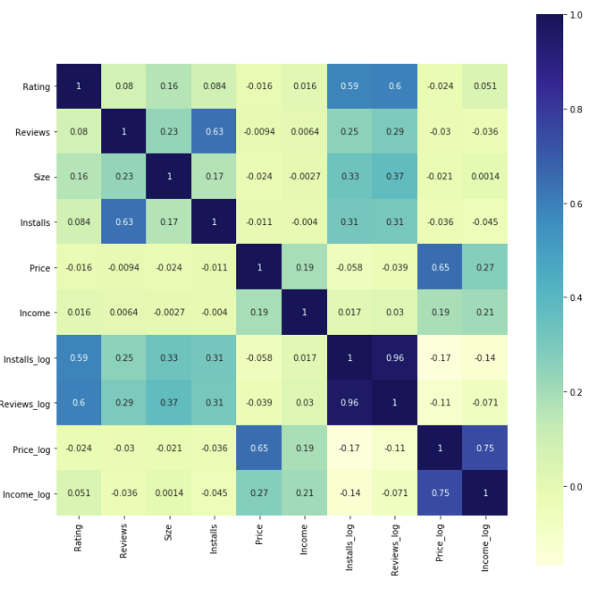
Correlation heatmap

Slide 29
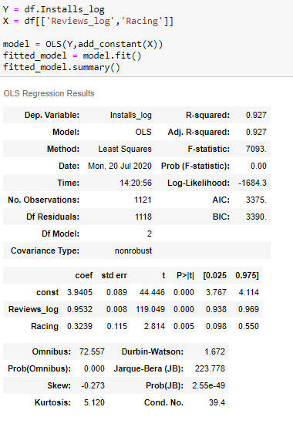


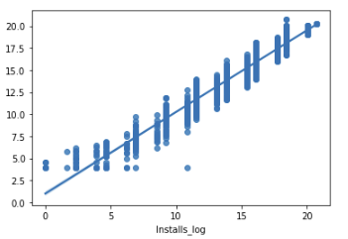
OLS Model – on v.6

Slide 30
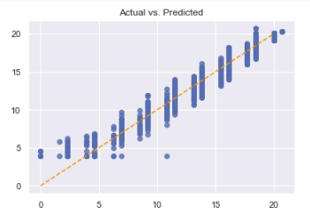
CHECKING Model’s assumptions:
Assumption 1: Linear relationship between target and features

Slide 31
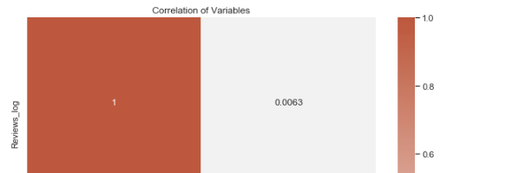

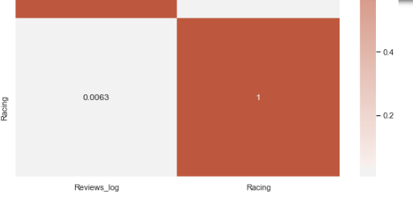
Assumption 2: Little or no multicolinearity between features

Slide 32

Assumption 3: No autocorrelation

Slide 33
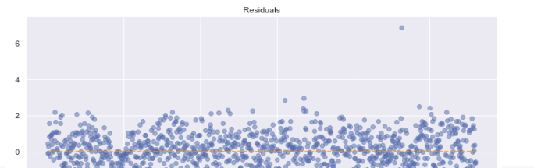
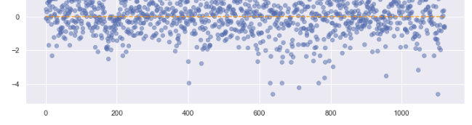
Assumption 4: Homoskedasticity of Error (residuals should have relatively constant variance)

Slide 34
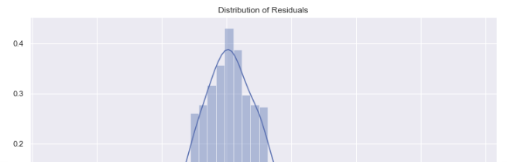
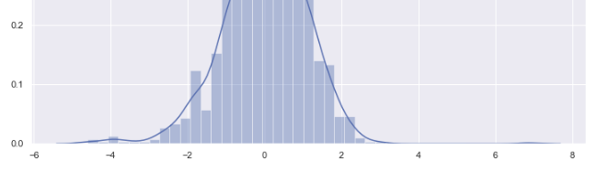
Assumption 5: Errors should be almost normally distributed

Slide 35
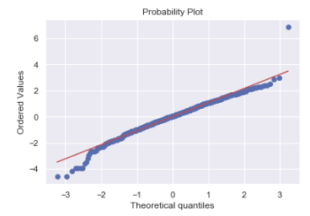
Assumption 6:

Slide 36
challenges

Slide 37
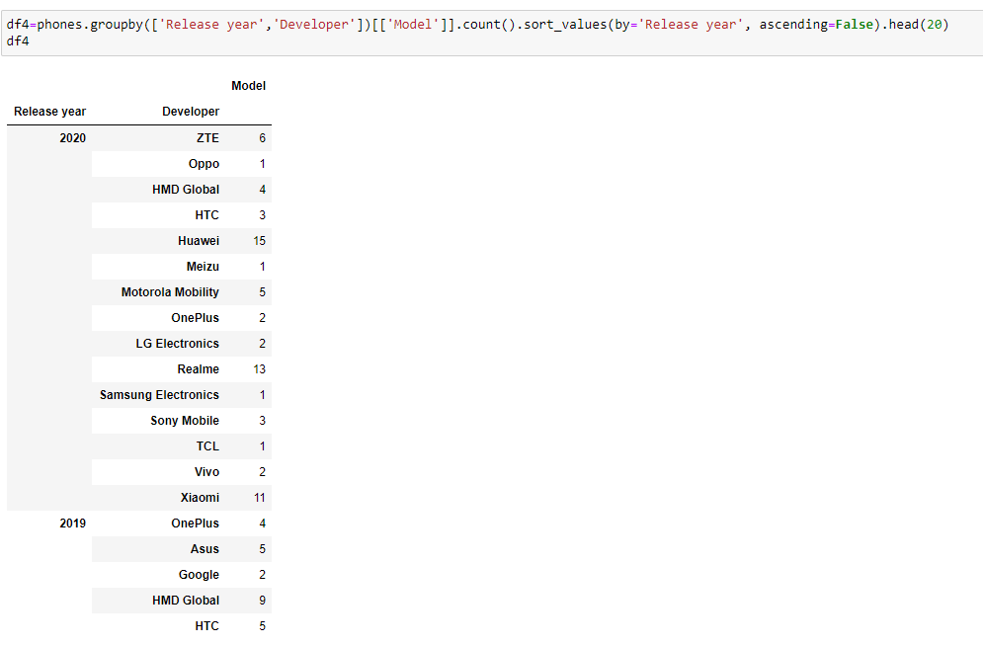
Main challegenges:
Complexity of project vs time organization and cleanness in jups
Charts for very specyfic things

Slide 38

Thank you!

Slide 39
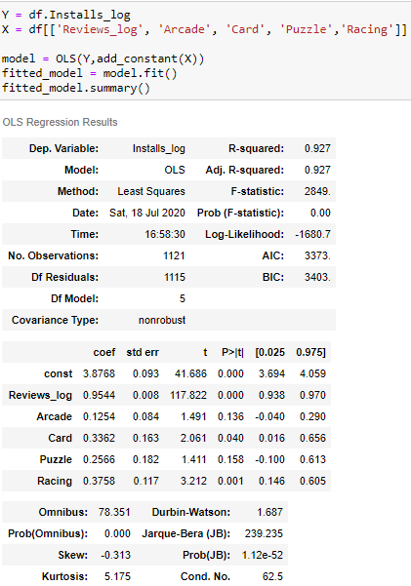

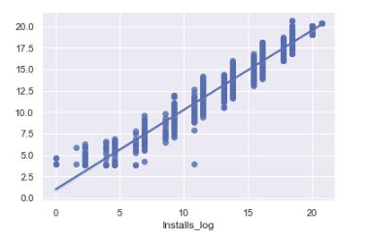
OLS Model – on v.1

Slide 40
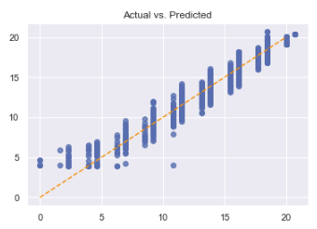
CHECKING Model’s assumptions:
Assumption 1: Linear relationship between target and features

Slide 41
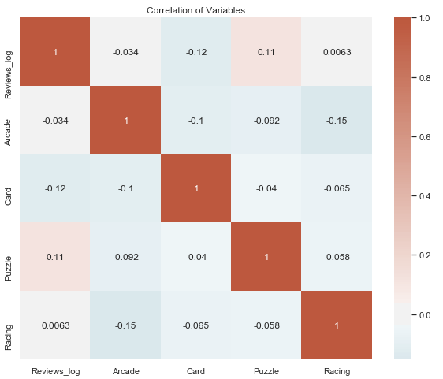
Assumption 2: Little or no multicolinearity between features

Slide 42
Assumption 3: No autocorrelation

Slide 43
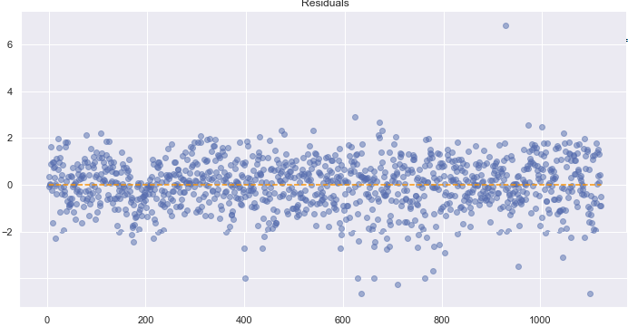
Assumption 4: Homoskedasticity of Error (residuals should have relatively constant variance)

Slide 44
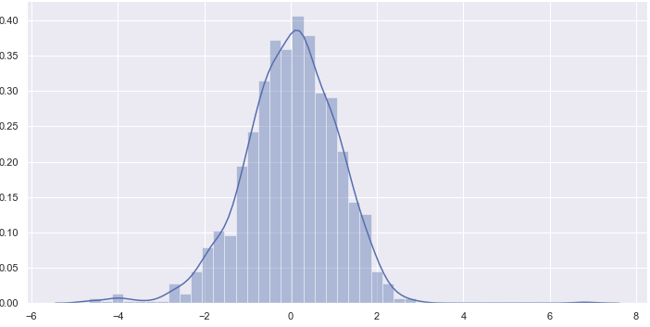
Assumption 5: Errors should be almost normally distributed

Slide 45
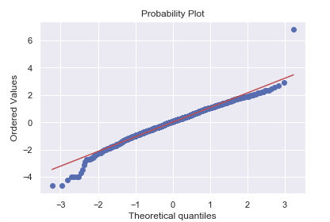
Assumption 6:

Slide 46
Corrected below:

