Slide 1










22°C
47%
101 kPa
78%
123ppm
35dB
Smart Monitoring of Air Quality

Slide 2

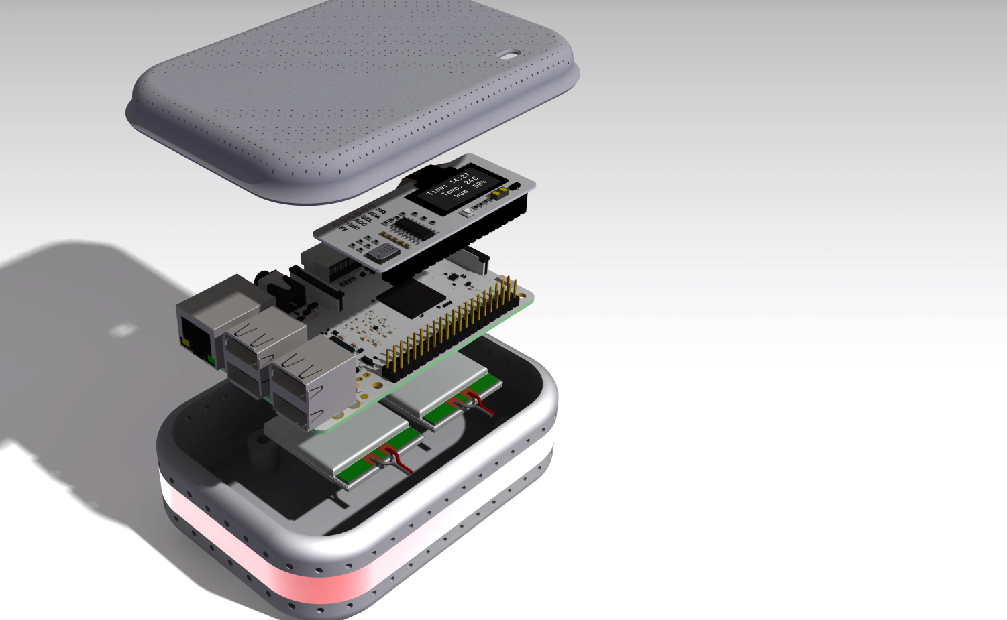
Why SMAQ?
Temperature
Humidity
Pressure
Air Quality (CO, NO2)
Light Intensity
Noise Level

