Slide 1
PURPLLE STORE INTELLIGENCE
Edge-to-API Computer Vision Telemetry & Retail Analytics Suite
HACKATHON SUBMISSION DECK | PRODUCTION ARCHITECTURE

Slide 2
THE RETAIL BLIND SPOT
Why physical retail stores operate in data silos
• Siloed Data Flow: CCTV streams and POS registers operate independently. Shoper behavior data is disconnected from final transactions.
• Tracking Blindspots: Stores lack analytics on shopper dwell times, layout zone interactions, and conversion pipelines.
• Operational Delays: No real-time triggers for long checkout lines, customer wait times, or line abandonments.
BUSINESS IMPACT OF SILOED DATA
Lost Conversion Opportunities: Cannot analyze shopper drops between product shelf browsing and queue checkouts.
Inefficient Staffing Allocation: Cannot optimize cashier stations or allocate helpers dynamically during checkout spikes.
Layout Friction: No visual feedback on dead displays or crowded aisles.

Slide 3
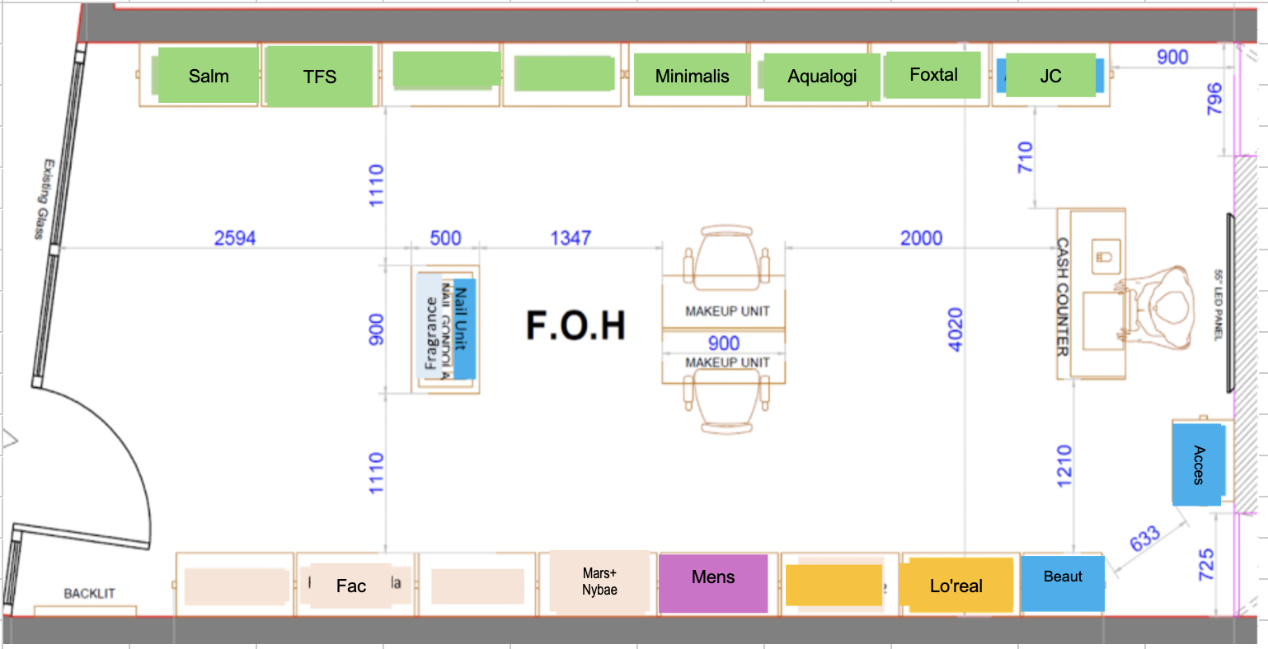
SYSTEM ARCHITECTURE & LAYOUT FLOW
Decoupled edge client processing and spatial coordinate mapping
1. Edge CCTV Ingestion: Processes frames locally using YOLOv8. Tracks centroids and calculates IoU bounds to maintain ID continuity during occlusions.
2. Spatial Polygon Mapping: Maps bottom-center footprints to layout zones using OpenCV pointPolygonTest. Emits state transition events to reduce network traffic.
3. FastAPI Analytics Gateway: Ingests batch payloads (up to 500 events). Enforces unique database constraints for idempotent deduplication.
4. Storage & Processing: SQLite database handles aggregations. Dedicated metrics, funnel, and anomaly engines compute live indicators.

Slide 4
REAL-TIME TELEMETRY DASHBOARD
Modern responsive interface serving analytics and operational alerts
• Real-Time KPI Tracking: Aggregates conversion rates, visitors (excluding staff), total transactions, and revenues, updating metrics every 5 seconds.
• Session-Based Funnels: Displays conversion progression down the funnel steps (Entry -> Browse -> Queue -> Sale) with visitor-level re-entry deduplication.
• Operational Alert Logs: Directly flags queue bottlenecks and layout dead zones, displaying severity levels and suggested actions for store managers.
Dashboard Snapshot UI [Live dashboard interface displaying real-time shopper analytics and conversion charts]

Slide 5
OPERATIONAL DIAGNOSTICS & ANOMALIES
Real-time alerts classification and suggested manager actions
CRITICAL SEVERITY
• Conversion Drop
Triggers when visitor conversion rates drop below threshold. Suggests checking checkout lanes and POS connection states.
• Queue Abandonment
Triggered when visitors exit queue lines before checkout, suggesting active cashier backup deployment.
WARNING SEVERITY
• Queue Line Spike
Triggered when active queue length or wait times exceed limits. Suggests opening dynamic checkouts.
• Long wait times
Tracks customers waiting in line for more than 15 seconds, alerting managers to direct helpers.
INFO SEVERITY
• Dead Zone Alerts
Flags display stands or layout zones getting zero visitor interactions despite high footfalls.
• Layout Congestion
Identifies shelves causing traffic bottlenecks (dwell times > 45s) to suggest layout widening.

Slide 6
PRODUCTION READINESS & ARCHITECTURE CHOICES
Engineered for robust operations and low setup friction
OBSERVABILITY & INTEGRATION
• Structured JSON Logging: HTTP requests trace telemetry (trace_id, store_id, latency_ms) printed cleanly in stdout for collector pipes (e.g. FluentBit).
• Graceful DB Degradation: Intercepts SQLiteOperationalErrors during write locks to cleanly return HTTP 503 rather than breaking server runtime.
• Stack Trace Suppression: Global catch-all exception middleware catches unhandled python runtime exceptions to mask raw tracebacks from public clients.
VALIDATION & DEPLOYMENT
• Docker Compose Works: Builds containers in single command. Automatically mounts local volumes and handles database seed imports.
• 14/14 Pytest Test Coverage: Validates special compliance test scenarios (Empty Store, All-Staff Clips, Zero Purchases, Re-entry Funnels).
• Portability & Portings: Custom Centroid/IoU tracking replaces C++ libraries (DeepSORT/ByteTrack), running out-of-the-box on CPU without compilers.

