Slide 1
Integrated Development Environment (IDE) & Build Automation Tools for Java
IDEs (Integrated Development Environments): NetBeans, Eclipse, IntelliJ
Build Automation Tools: Ant, Maven, Gradle

Slide 2
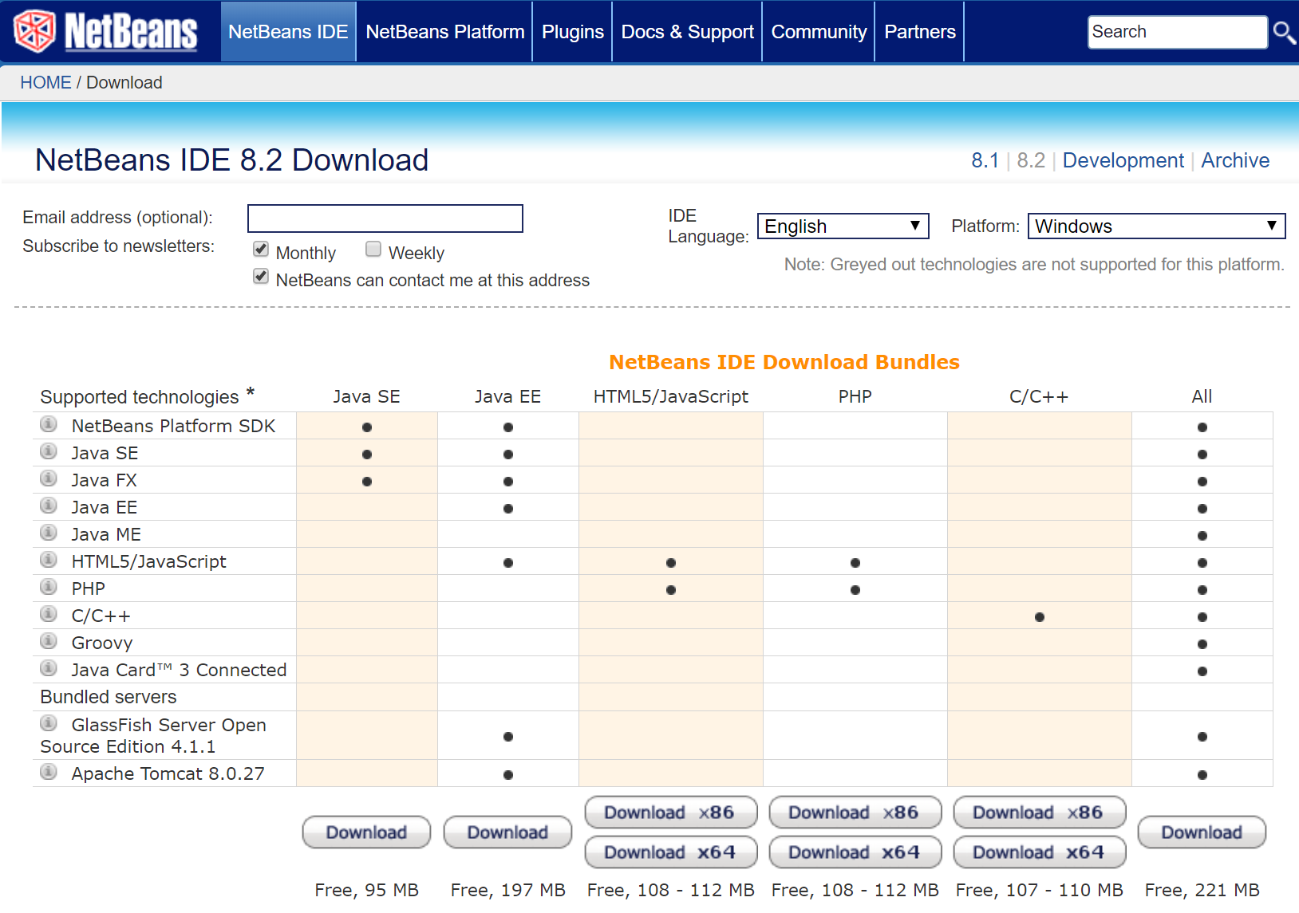
NetBeans 8
Search: netbeans 8
https://netbeans.org/downloads/8.2/

Slide 3
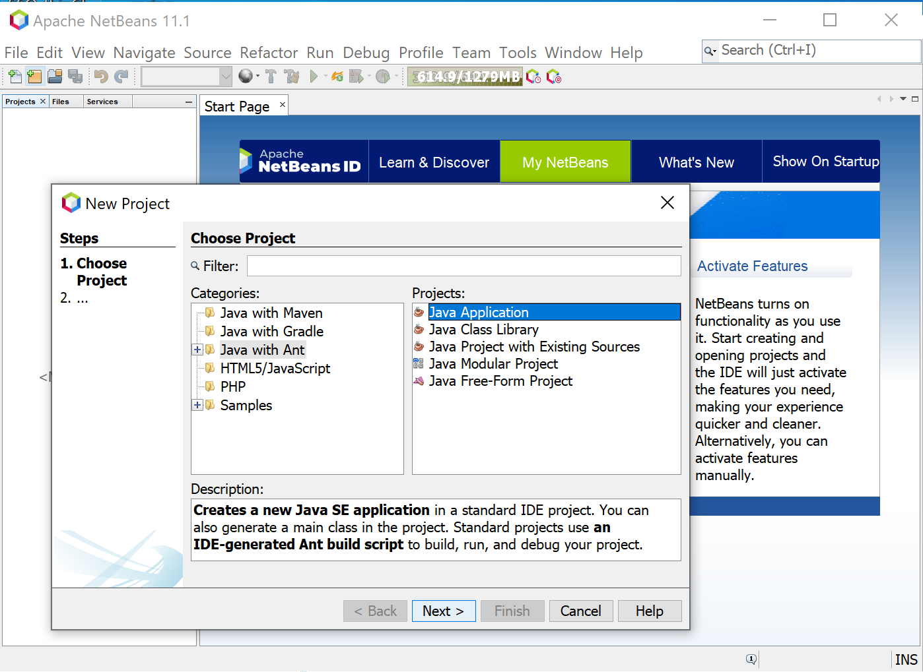
NetBeans 11
Search: netbeans
How to Install NetBeans 11 IDE & Java JDK on Windows 10/8/7
https://www.youtube.com/watch?v=yX-qG2Ooqzk

Slide 4

Eclipse
Search: Eclipse
https://www.eclipse.org/

Slide 5
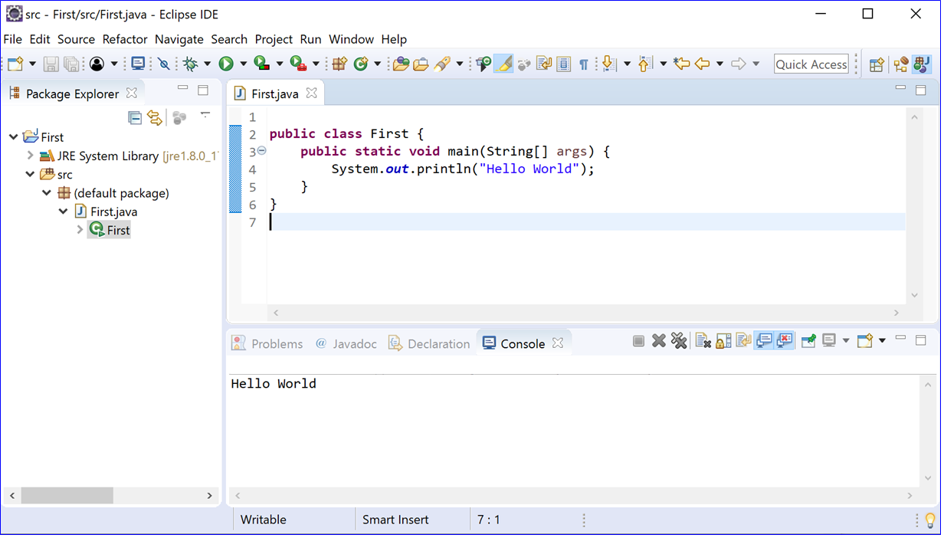
Eclipse

Slide 6
Build Automation Tools: Ant, Maven, Gradle
History of build automation tools:
make with makefile (text file)
Build Automation Tool:
Apache Ant : ant with build.xml (flexibility)
Build Automation and Dependency Management Tool
Apache Maven : maven with pom.xml (convention over configuration)
Gradle : gradle with build.gradle (domain-specific language)
https://www.baeldung.com/ant-maven-gradle
https://technologyconversations.com/2014/06/18/build-tools/

