Slide 1
IDEA 1
Meeting agenda builder

Slide 2
Login page with FB

Slide 3


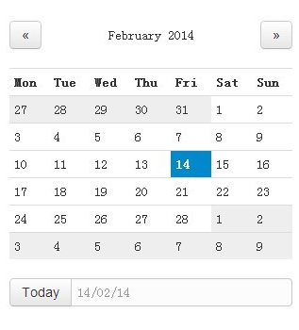
Do you want to add a day?
+ Add day
Date:
2016-04-06
Torsdag
Fredag
Måndag
Start time:
08:00
Start time:
08:00
Start time:
08:00
End time: 11:10
End time: 11:10
End time: 11:10
Total length: 190 min
Total length: 190 min
Total length: 190 min
Date:
2016-04-06
08:00 | Introduction
08:10 | Idea 1
08:40 | Working in groups
09:15 | Idea 1 discussion
09:30 | Coffee break
10:00 | Idea 2
10:20 | Working in groups
10:45 | Idea 2 discussion
11:00 | Conclusion
08:00 | Introduction
08:10 | Idea 1
08:40 | Working in groups
09:15 | Idea 1 discussion
09:30 | Coffee break
10:00 | Idea 2
10:20 | Working in groups
10:45 | Idea 2 discussion
11:00 | Conclusion
08:00 | Introduction
08:10 | Idea 1
08:40 | Working in groups
09:15 | Idea 1 discussion
09:30 | Coffee break
10:00 | Idea 2
10:20 | Working in groups
10:45 | Idea 2 discussion
11:00 | Conclusion
+ Add avtivity
+ Add avtivity
+ Add avtivity
Notes:
Gemensam vy som alla ser i nuläget. Senare är det endast sådana med admin rättigheter som kan redigera denna vy.

Slide 4



Title
Ja
Add guests
Length
min
Jakob 1
Type
Jakob 2
Description
Jakob 3
Jakob 4
Cancel
Save
By clicking on the "Add Activity" on the previous screen you get this form to input the information about the activity. You can choose yourself if this will be a new screen, or popup dialog, or edit in place. This also depends on which platform you use and what's most natural for the users of that platform.
Notes:
The creating/editing of activity can happen in a new window/dialog or directly in the interface (with a element that appears). You can choose what you think is the best way for the users to interact with your application. This choice is also a bit dependent on the platform you are using.

Slide 5

Introduction
Jakob 1 and 3 more…
10
min
Presentation
Give the introduction to the meeting and present the agenda
Cancel
Save
You fill in some data for the new activity. The type of activity can be of the following: Presentation, Discussion, Group Work, Break.
Notes:
You fill in some data for the new activity. The type of activity can be of the following: Presentation, Discussion, Group Work, Break.

