Slide 1




Members
Aaryan aditya Singh
(20BCS004)
Aryan Bhat
(20BCS042)
Aayush Choudhary
(20BCS005)
Raj Karan Singh
(20BCS172)
Abu Saleh Khan
(20BDSM002)
Arnav Solanki
(20BEC19)
Signal Actuation Circuit in
Capacitive
Gas Sensors
Under Supervision of Dr. Koushik Dutta
Group No:
21

Slide 2




Start
Gas Sensor
Capacitive
Resistive
YES
NO
YES
Justification
And Identification
Selectively detecting
Simple structure
Cost effective
Concept

Slide 3


High Selectivity
using Resonant Frequency Tuning Technique
High Response Magnitude
Fast Detection
Concept Generation
Bigger Picture
Design
Capacitive
Gas sensors
Capacitive Type
Gas Sensor Have Bright Future
Oscillator
Circuit

Slide 4

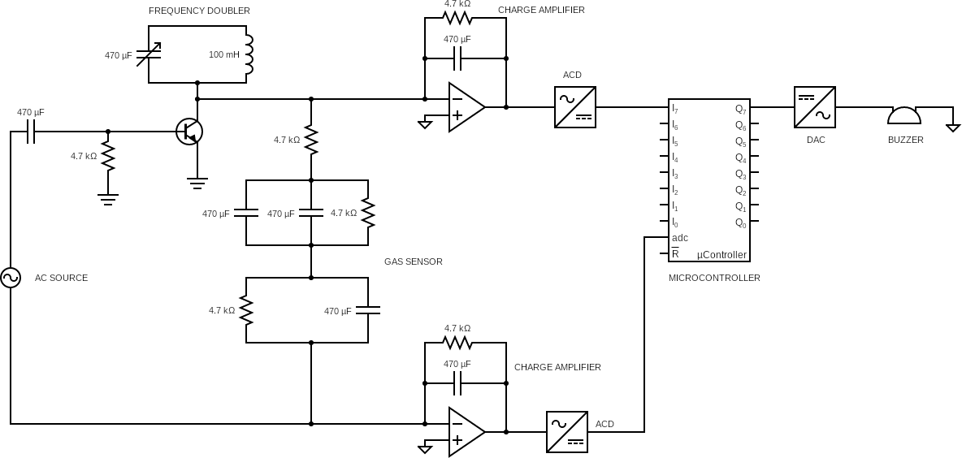
Design Detailing
Gas Sensors

Slide 5


Need For Microcontroller !
Range Of Values
Not a Problem !
YES
YES
Distinguishable
We used
Op Amplifier ?

Slide 6

Signal Actuation
Circuit Flow Chart
Analog To Digital Converter
Alarm
Charge Amplifier

Slide 7




Functionality
Capacitive Gas Sensor
START
Capacitive gas Sensor
Capacitance
amplification
Analog Digital
Converter
Working
Matching
MCU
Inputs
Interfacing Circuit
Buzzer
Some Challenges

Slide 8
Capacitive Gas Sensor
Commercial Aspects !
Gas sensors are employed in factories.
Automotive Emission Control.
Food Industry and Agriculture.
Research and development department.

Slide 9
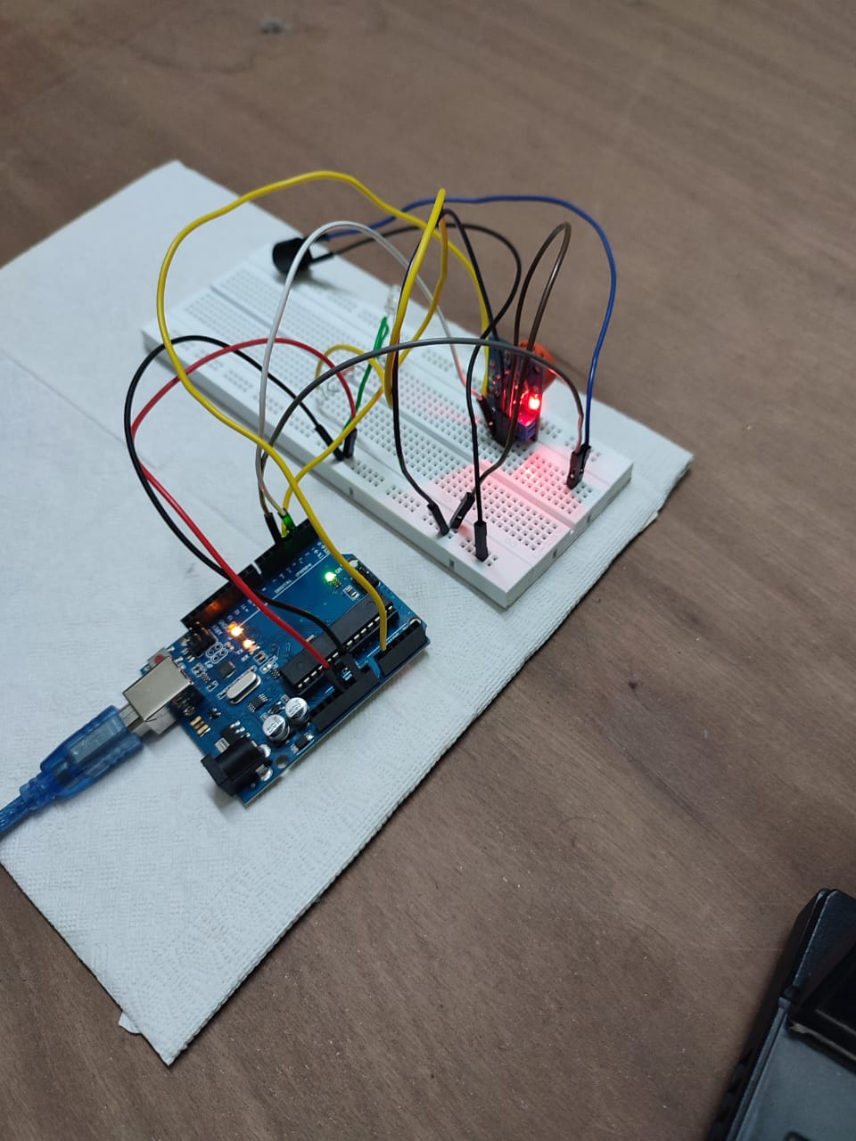
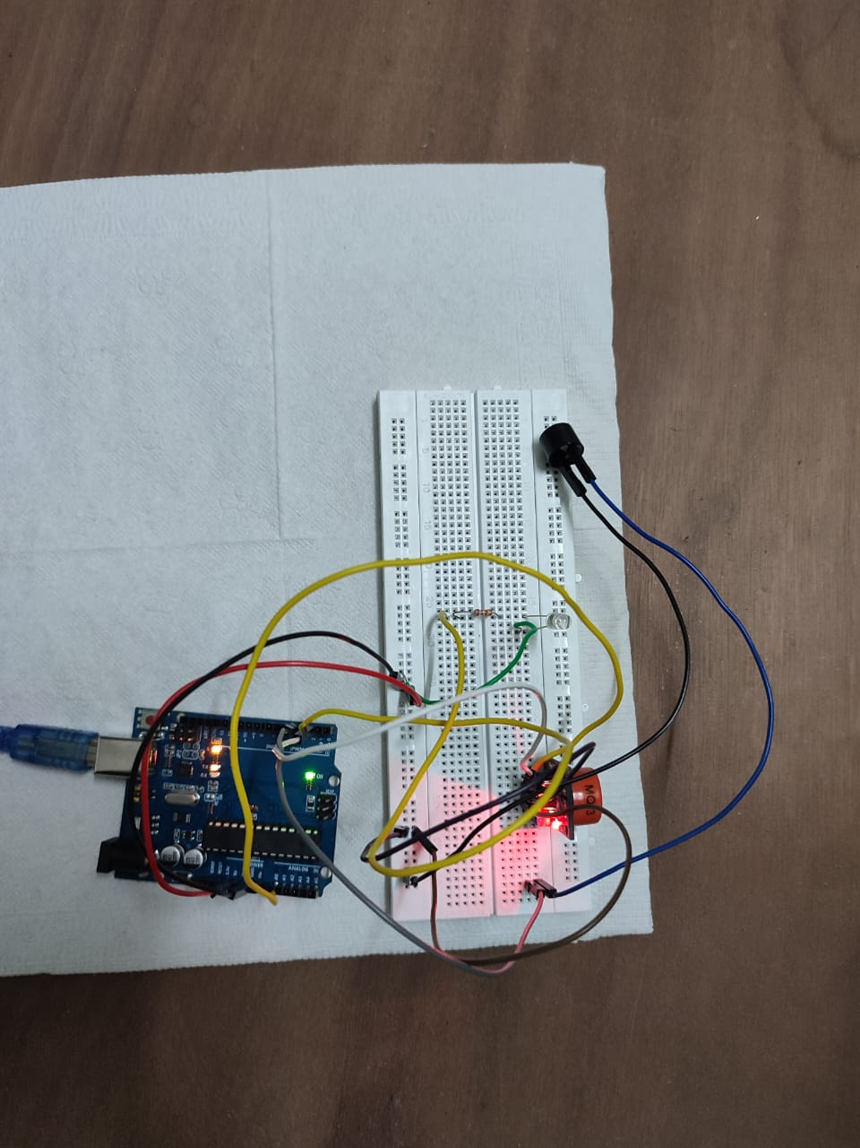
Project Circuit
Gas sensors

Slide 10
Brochure
THANK YOU !!
By Group 21

