Slide 1




Members
Abu Saleh Khan
(20bsm002)
Rajesh Shashank Masham
(20bec083)
Faiyzulla Shaik
(20bec038)
Aabir Bhattacharya
(20bme001)
Satyam Gupta
(20bec098)
BURGLAR ALARM
using PIR Sensor
Under Supervision of Dr. Rakesh Kumar Jha
Group No:
07

Slide 2


Introduction:
A simple cost effective solution for Security Systems is implemented in this project where We will explain about a PIR based Security Alarm System, in which a PIR sensor is used instead of transmitter or receiver. This saves power consumption as well as it is a low cost implementation. PIR sensor is the short form of Passive Infrared Sensor.

Slide 3


Principle:
This is based on PIR sensor with a buzzer that produces siren. The PIR sensor detects the IR radiations emitted from the humans and it produces a digital output. This digital output is applied to the Arduino UNO.
Based on the digital signal from the PIR Sensor, Arduino UNO then triggers the buzzer. Thus it produces the sound when any human is detected.

Slide 4


Components:
PIR sensor : Detects motion and sends signal to microcontroller.
Arduino UNO :
Resistors 10KΩ
Buzzer
Breadboard
Connecting Wires

Slide 5
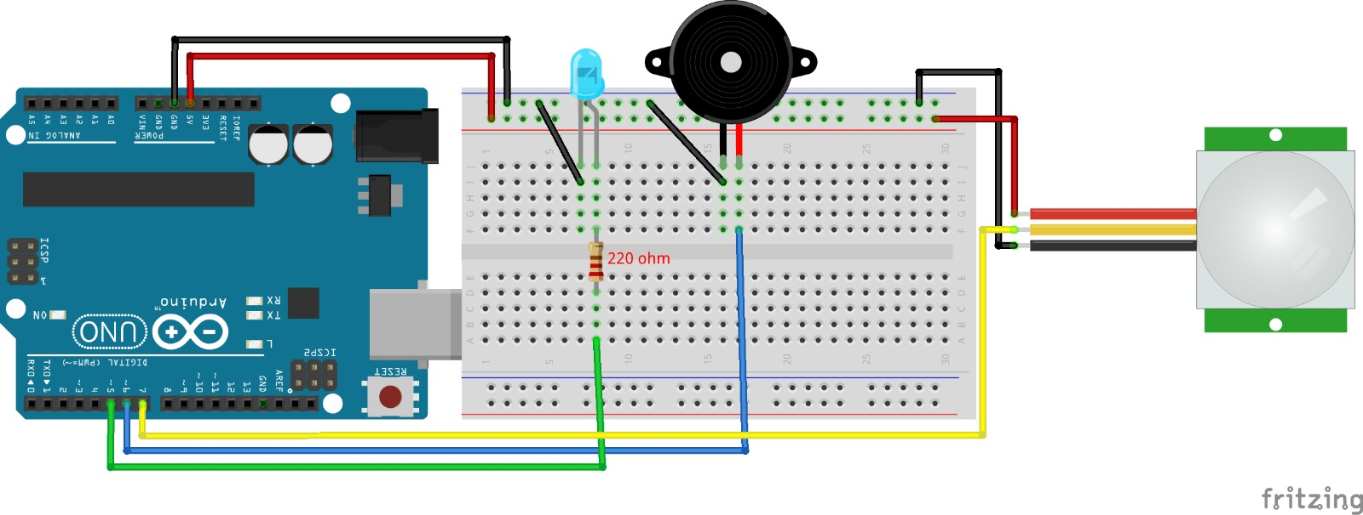
Design Detailing
Burglar Alarm

Slide 6
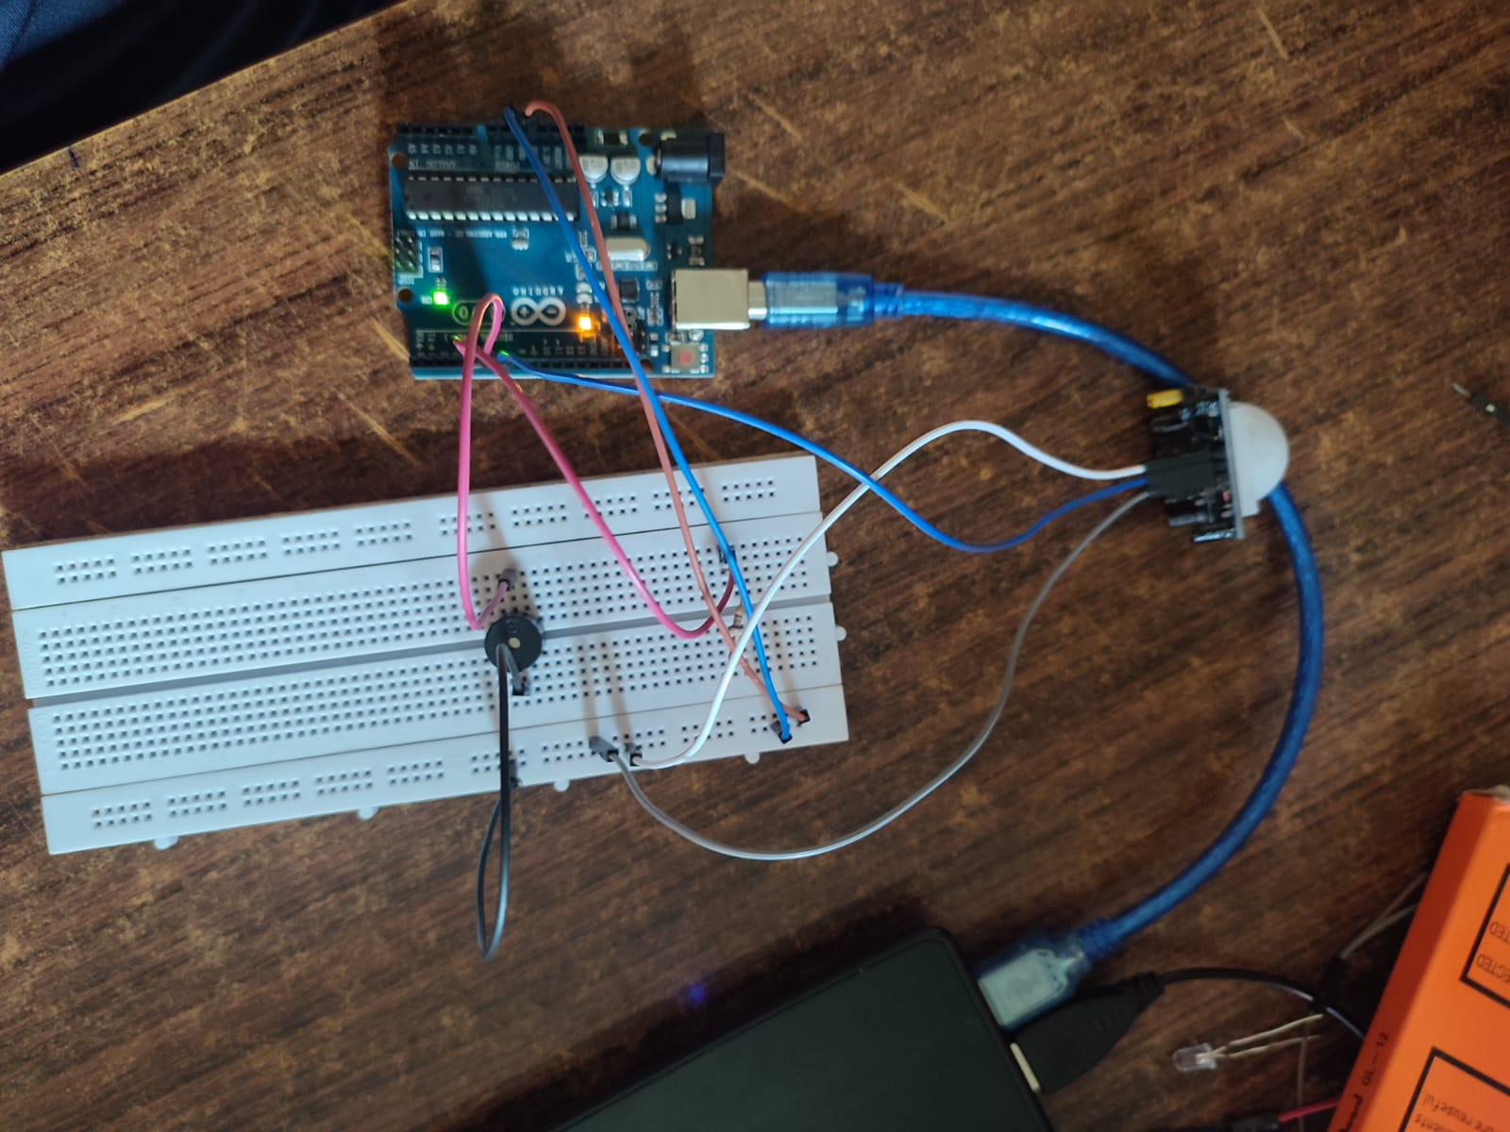
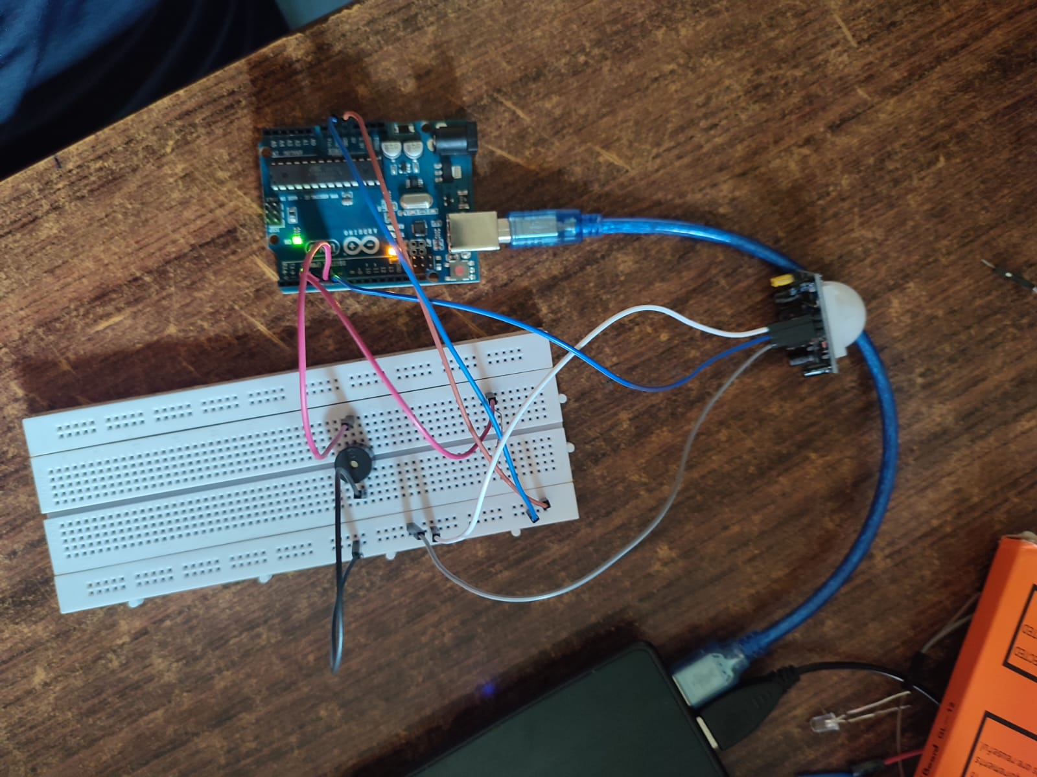
Project Circuit
Burglar Alarm

Slide 7

Testing methodology :
We tested the circuit by placing the PIR sensor in a room and moving around in the room to simulate a home intrusion. When the PIR sensor detected motion, it triggered the microcontroller which sounded the alarm.

Slide 8
Burglar Alarm
Commercial Aspects !
This can be used in the museums to protect the valuable things.
This can also be used as an automatic door bell circuit that rings the bell when human is detected
This can be used in defense applications to detect the humans in war field..
This can be used in toy applications that produce sound..

Slide 9
Morality
Enhanced security: PIR sensors are designed to detect motion and changes in infrared radiation. When integrated into a security alarm system, they can effectively detect unauthorized movement and trigger alarms, helping to deter potential intruders and enhance the security of homes, businesses, and public spaces.
Crime deterrence: the presence of visible security systems, including pir sensors, can act as a deterrent to potential criminals. Knowing that a property is monitored by such systems may discourage them from attempting unauthorized access or activities.
Customization: modern pir sensor-based systems often come with features that allow users to customize settings, such as sensitivity and alarm triggers. This customization can help reduce false alarms and tailor the system to the specific needs of the environment.

Slide 10
Results !
The circuit worked successfully and the alarm was triggered when motion was detected.

Slide 11
THANK YOU !!

