Slide 1
FORMS
LAYOUTS

Slide 2
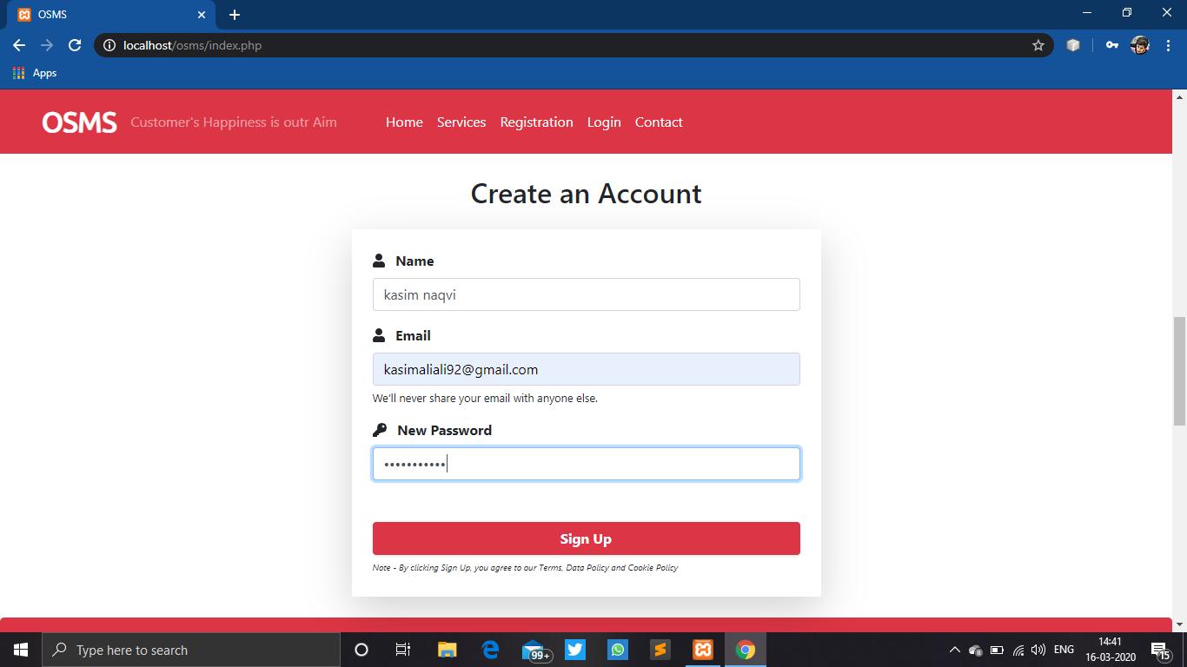
USER SIGN UP

Slide 3
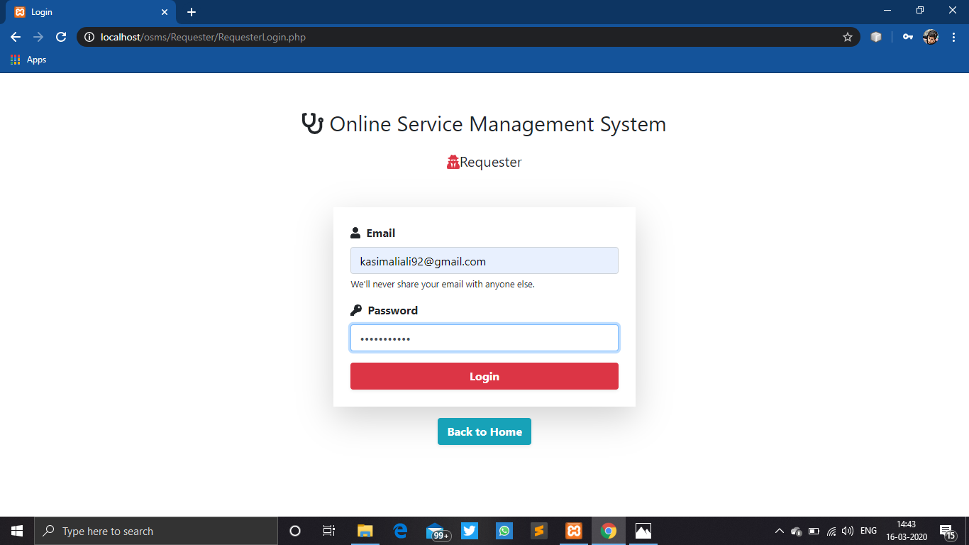
USER LOGIN

Slide 4
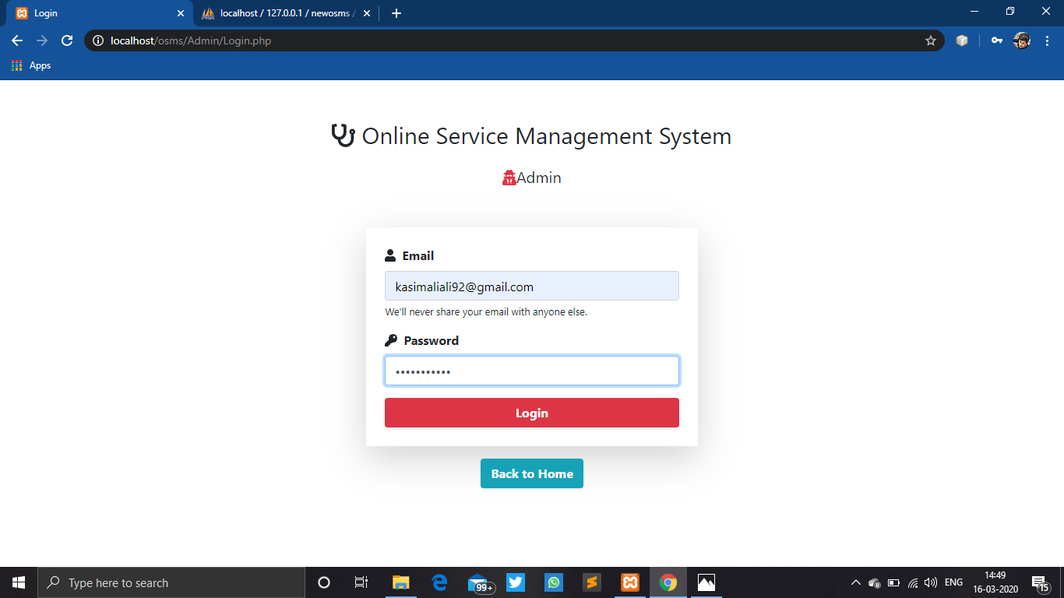
ADMIN LOGIN

Slide 5
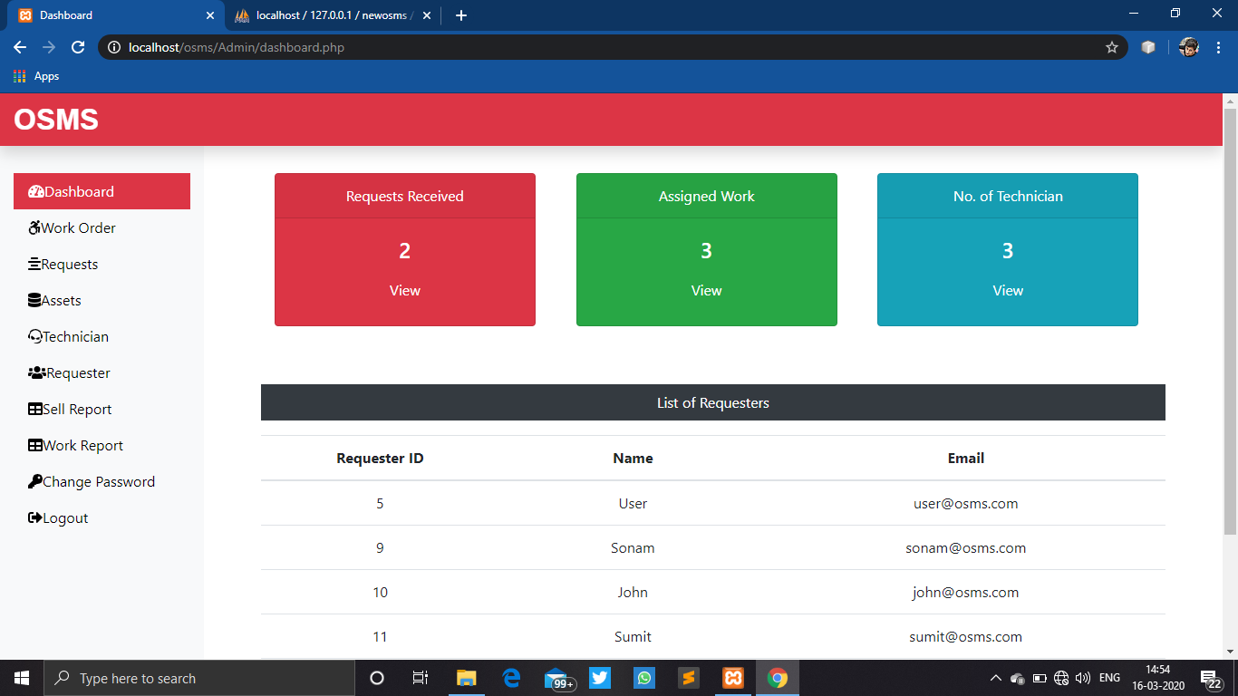
ADMIN DASHBOARD

Slide 6
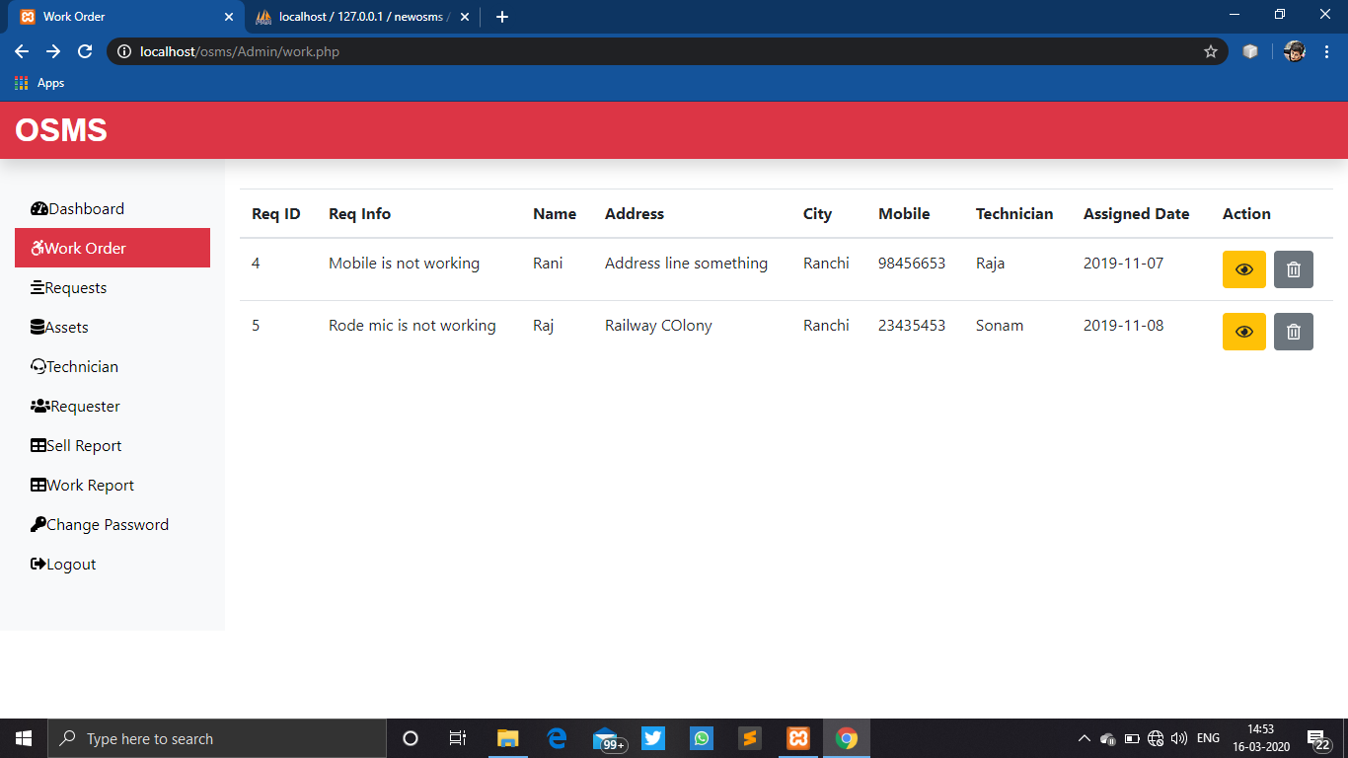
WORK ORDER VIEW

Slide 7
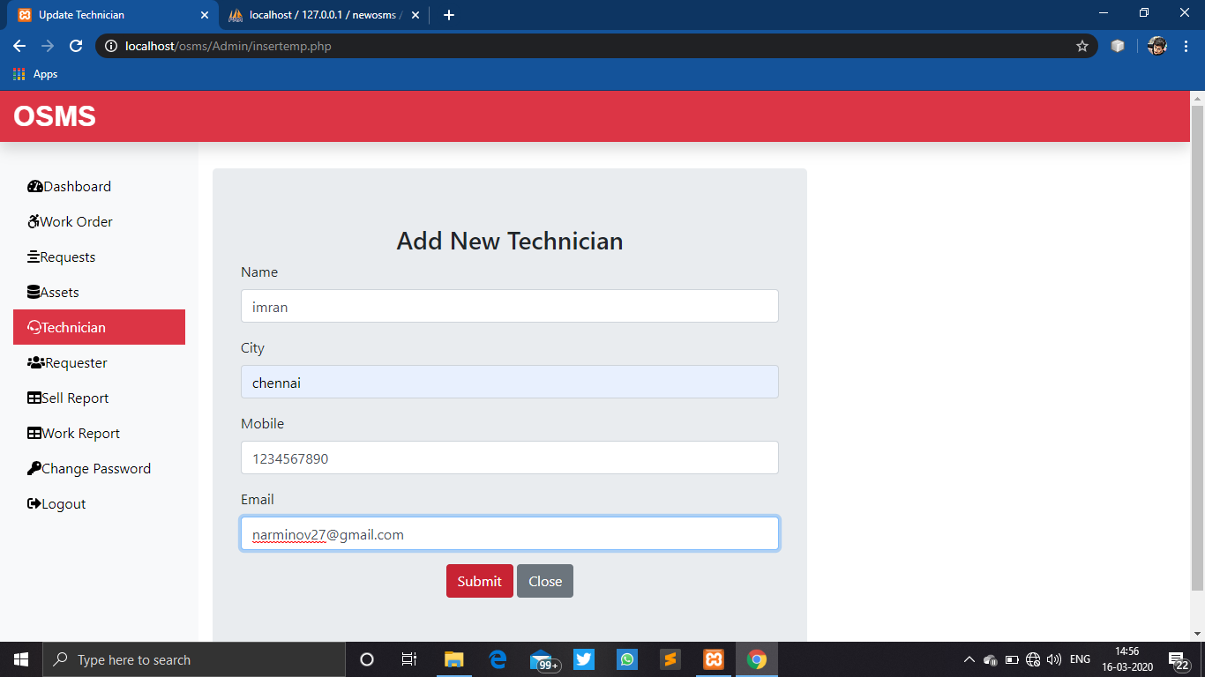
REGISTRATION OF TECHNICIAN

Slide 8
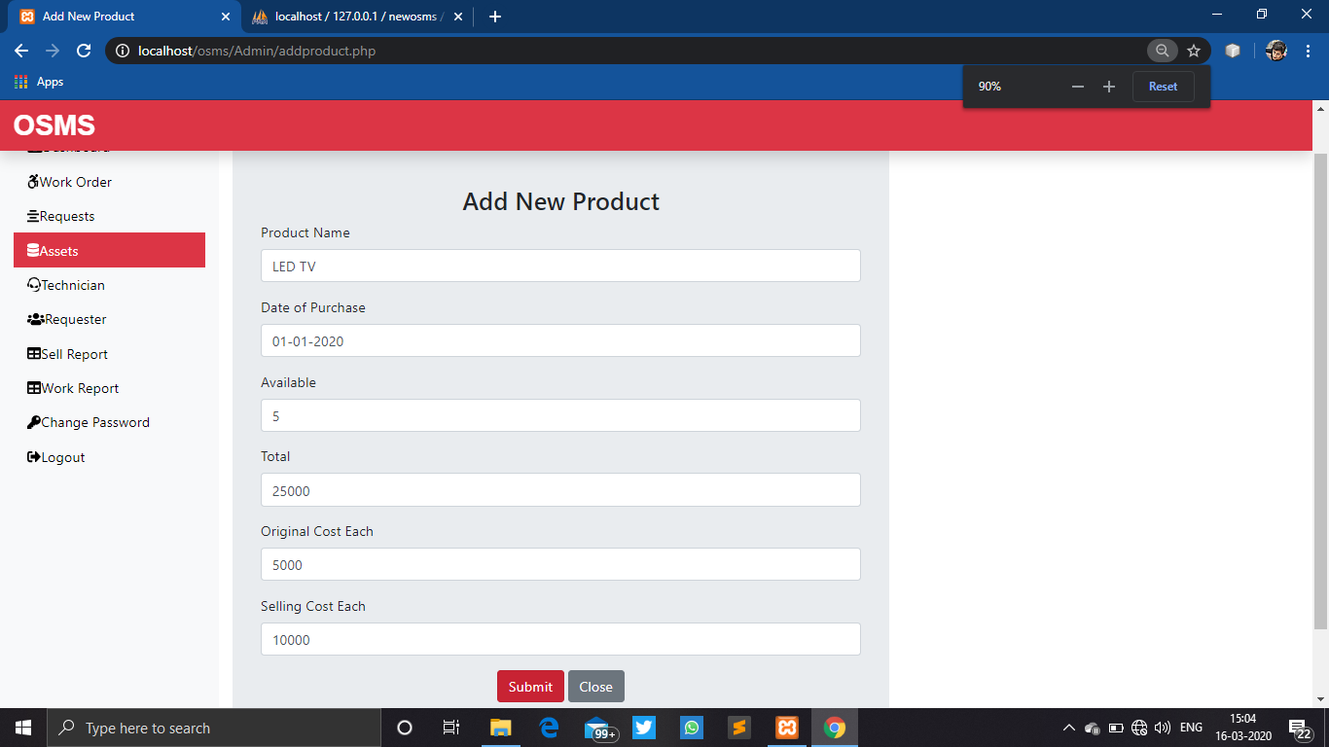
ASSET REGISTRATION

Slide 9
SOURCE
CODE

Slide 10
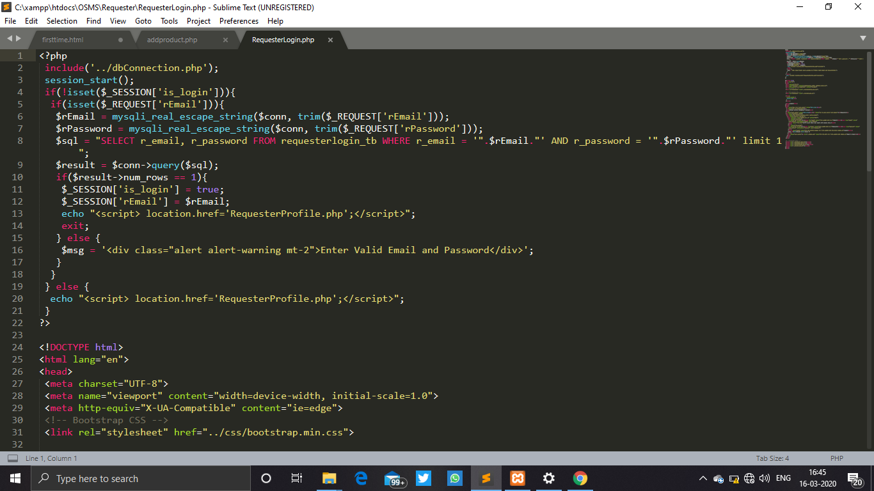
USER LOGIN CODE

Slide 11
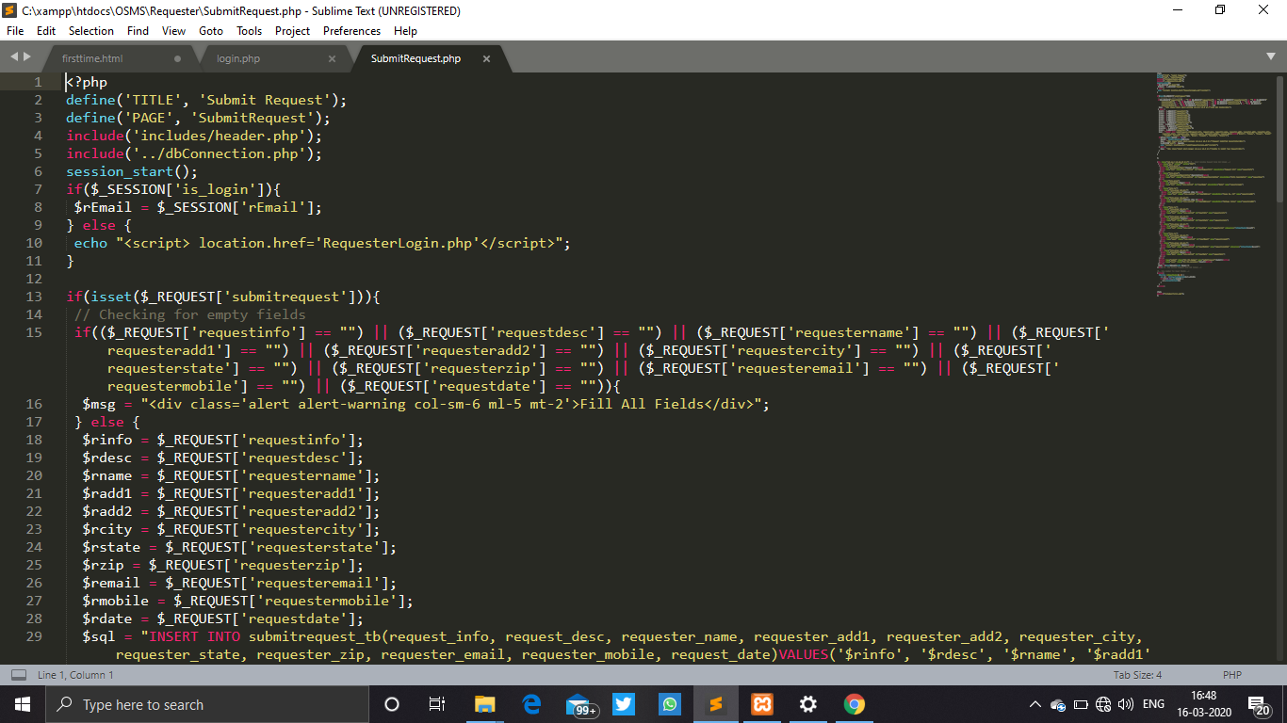
USER REGISTRATION CODE

Slide 12
