Slide 1

Project Title - Healthcare Analytics For Doctor Visit TIRTC
Student Name – Kasim Venkata Yamini Priya

Slide 2

PROBLEM STATEMENT
Healthcare organizations need to understand patterns in doctor visits to support effective healthcare planning.
This project analyses healthcare data to identify patterns in doctor visits and examine their association with gender, illness levels, chronic conditions, and reduced activity.
The main objective is to use Python-based data analysis and visualization to discover meaningful insights from healthcare data.

Slide 3
Project Description
This project analyses healthcare data to understand patterns in recorded doctor visits. The cleaned dataset contains 5,190 records and 12 columns. Python libraries are used for data cleaning, exploratory data analysis (EDA), statistical summaries, and visualisation.
Project objective:
. Understand the structure and characteristics of the dataset.
. Analyse the distribution of recorded doctor visits.
. Compare visit patterns across gender and illness levels.
. Examine associations with chronic conditions and reduced activity.

Slide 4

WHO ARE THE END USERS?
Hospitals and Clinics: To understand patient doctor-visit patterns.
Healthcare Administrators: To support healthcare service planning.
Healthcare Researchers: To study healthcare utilisation patterns.
Public Health Planners: To identify areas for further investigation.
Data Analysts: To analyse healthcare data and identify useful insights.

Slide 5

Technology Used
Programming Language
Python
Libraries
Pandas — Data cleaning and data manipulation
NumPy — Numerical calculations
Matplotlib — Creating charts and graphs
Seaborn — Statistical data visualisation
Tools and Techniques
Jupyter Notebook
Exploratory Data Analysis (EDA)

Slide 6
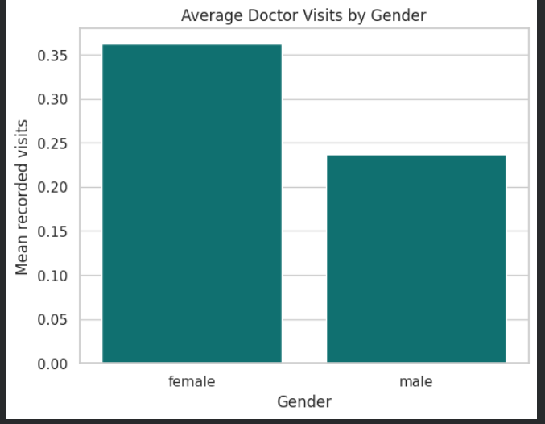
RESULTS
Chart1- Gender Analysis
Interpretation: Female records have a higher average number of recorded doctor visits than male records in this dataset. Female records also account for a larger share of the total recorded visits; this association does not establish causation.
Key findings:
Average visits: female 0.36; male 0.24.
Total visits: female 978 (62.45%); male 588 (37.55%).

Slide 7
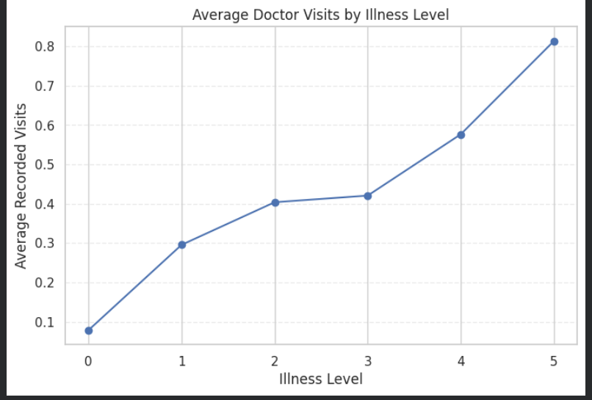
RESULTS
Chart2- Illness Level Analysis
Interpretation: Average recorded doctor visits generally increase across the recorded illness levels, rising from 0.08 at level 0 to 0.81 at level 5.
Key findings:
Illness level 0: 0.08 average visits.
Illness level 5: 0.81 average visits.

Slide 8
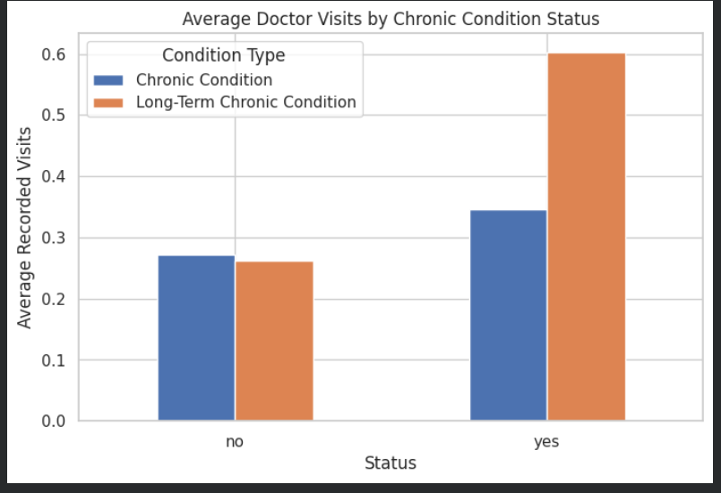
RESULTS
Chart3- Doctor Visits by Chronic Condition Status
Interpretation: Records with chronic conditions show higher average doctor visits than records without them. The difference is larger for long-term chronic conditions.
Key findings:
Chronic conditions: 0.35 average visits versus 0.27 without.
Long-term chronic conditions: 0.60 average visits versus 0.26 without.

Slide 9
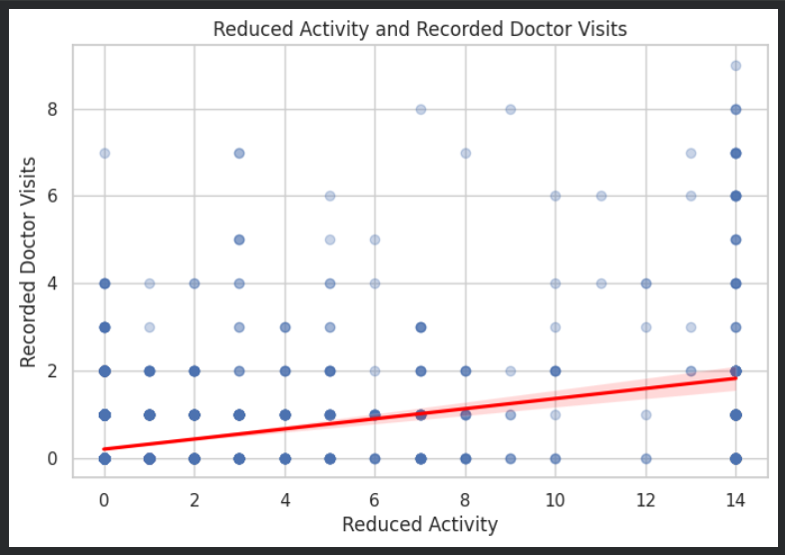
RESULTS
Chart4- Reduced Activity
Interpretation: Reduced activity has a positive association with recorded doctor visits in this dataset. Further investigation is needed before drawing conclusions or changing healthcare operations.
Key findings:
Correlation between reduced activity and visits: 0.419.
The relationship does not prove that reduced activity causes more doctor visits.

Slide 10
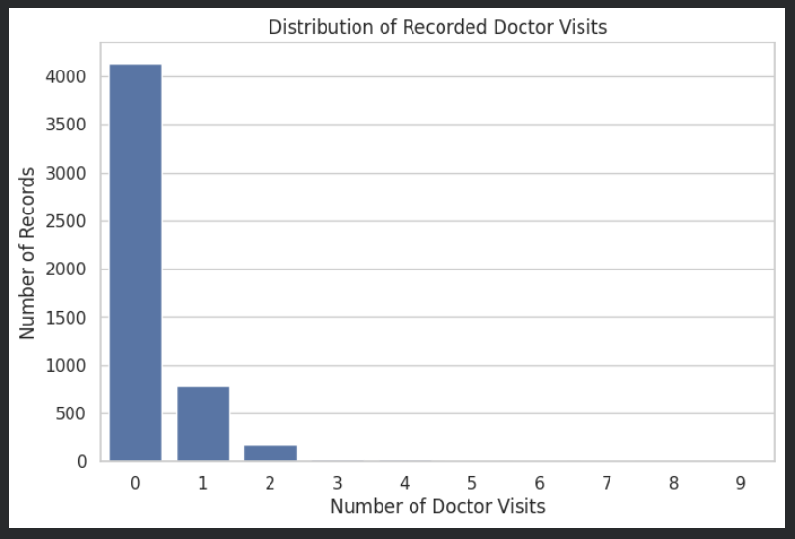
RESULTS
Chart 5- Distribution of Recorded Doctor Visits
Interpretation: Most records (79.79%) have zero recorded doctor visits in this dataset.
Key findings:
Total records: 5,190
Zero recorded visits: 4,141 (79.79%)
Total recorded visits: 1,566

Slide 11
Link

Slide 12
Thank you

