Slide 1



Virtual Pathology Assistant
Team Members: Kasis Rana Guide: Jay Rathod
Mansi Solanki
Darshil Sabhaya
Disclaimer: The content is curated for educational purposes only.

Slide 2
OUTLINE
Abstract
Problem Statement
Aims, Objective & Proposed System/Solution
System Design/Architecture
System Development Approach (Technology Used)
Algorithm & Deployment
Conclusion
Future Scope
References
Video of the Project

Slide 3
Abstract
This project aims to develop an accurate and efficient virtual pathology system using machine learning techniques, specifically leveraging Support Vector Classification (SVC) for predictive modeling and Flask for deployment. The system will provide disease predictions based on user input, and offer comprehensive information including disease descriptions, recommended medications, precautions, workouts, dietary guidelines, and will support speech recognition for enhanced user interaction. This robust platform ensures seamless user experience and efficient performance, aiming to support individuals in managing their health effectively and conveniently.

Slide 4
Problem Statement
Accessing accurate disease predictions and personalized healthcare guidance is often difficult due to barriers like limited access to healthcare professionals, time constraints, and overwhelming medical information. Our project aims to solve the challenge of accessing accurate disease predictions and personalized healthcare guidance by creating a Virtual Pathology System (VPS). This smart tool predicts diseases and offers tailored advice based on user input, making healthcare guidance accessible to all, regardless of access to doctors or medical centers, and simplifying complex medical information for easier understanding.

Slide 5
Aim and Objective
Aim: The aim of our project is to enhance accessibility to healthcare guidance by developing a Virtual Pathology System (VPS) that predicts diseases and offers personalized advice based on user input, thereby empowering individuals to make informed decisions about their health.
Objective:
Enhance accessibility to healthcare guidance by creating a system that predicts diseases and offers personalized advice.
Provide comprehensive information about diseases, including descriptions, medications, precautions, workouts, and dietary recommendations.
Ensure ease of interaction for users, enabling them to input their symptoms or queries effortlessly.
Make healthcare guidance available to all individuals, irrespective of geographical location or access to traditional healthcare resources.
Empower individuals to make informed decisions about their health and well-being.

Slide 6
Proposed Solution
Our proposed solution is to develop a Virtual Pathology System (VPS) that utilizes advanced algorithms to predict diseases and provide tailored healthcare guidance. The system will consist of the following components:
Data Collection: Gather a diverse dataset containing information about various diseases, including symptoms, diagnoses, medications, and lifestyle factors. This dataset will serve as the foundation for training our prediction model.
Data Preprocessing: Cleanse and preprocess the collected data to remove any inconsistencies, missing values, or outliers. This step ensures that the data is of high quality and suitable for training our machine learning model.
Model Development: Select an appropriate machine learning algorithm, such as Support Vector Classifier (SVC), and train it on the preprocessed dataset to predict diseases based on user input. Fine-tune the model parameters and evaluate its performance using cross-validation techniques to ensure robustness and accuracy.
Integration with User Interface: Integrate the trained model with a user-friendly interface that allows users to input their symptoms or queries easily. Develop an intuitive interface using HTML, CSS, and JavaScript to facilitate seamless interaction with the system.
Deployment: Deploy the Virtual Pathology System using Flask or another web framework to make it accessible via web browsers.

Slide 7
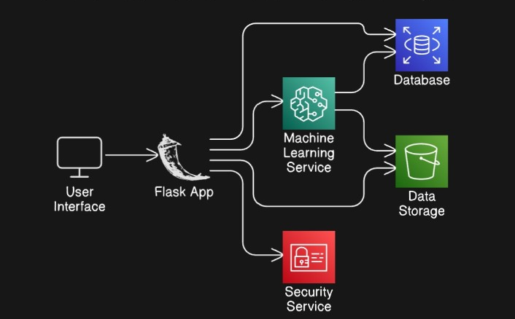
System Architecture

Slide 8
System Deployment Approach
Deployment Environment: Configure the deployment environment, ensuring compatibility with the chosen technology stack (e.g., Flask for backend, HTML/CSS for frontend). Install necessary software dependencies and libraries required for running the VPS, such as Python, Flask, and machine learning libraries (e.g., scikit-learn).
Model Deployment: Deploy the trained machine learning model to the deployment environment, ensuring that it is properly integrated with the backend of the VPS. Set up endpoints or APIs to allow communication between the frontend interface and the deployed model, enabling users to input their symptoms and receive predictions.
Web Interface Deployment: Develop the user interface (UI) components using HTML, CSS, and JavaScript, ensuring an intuitive and visually appealing design. Deploy the UI components to the deployment environment, configuring the frontend to interact with the backend APIs for sending user input and receiving predictions.

Slide 9
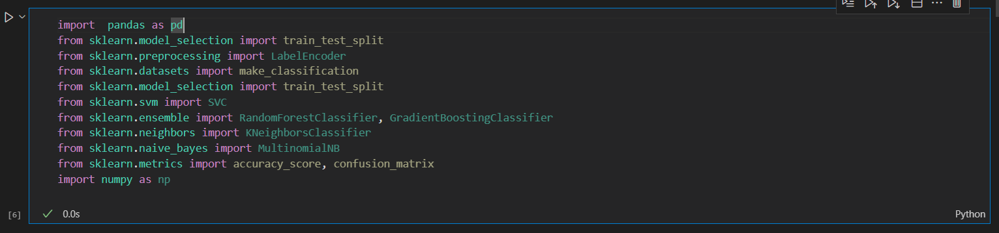
Algorithm

Slide 10
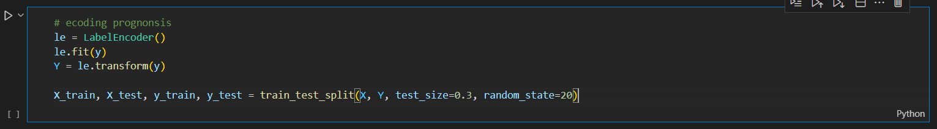
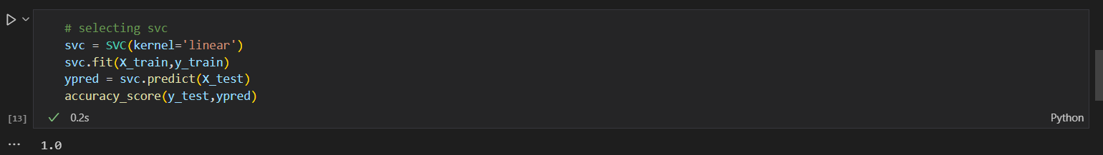
Algorithm

Slide 11
Conclusion
Through the integration of advanced machine learning techniques and a user-friendly interface, the VPS(Virtual pathology System) offers individuals the ability to receive tailored healthcare advice based on their symptoms or queries.
In Conclusion, The VPS project represents a significant step towards democratizing access to healthcare information and improving health outcomes. By leveraging technology to provide personalized guidance, the VPS has the potential to positively impact the lives of individuals and contribute to the broader goal of enhancing public health worldwide.

Slide 12
Future Scope
The Virtual Pathology System (VPS) project lays the groundwork for several future enhancements and expansions, including:
Integration of more Data Source
Enhanced Prediction Model
Integration of Remote Healthcare Services
Expansion of Language support
Additionally, privacy-preserving techniques, cross-platform compatibility, and security offer promising avenues for further development and integration

Slide 13
Reference
https://www.eraser.io/diagramgpt
https://ijcrt.org/papers/IJCRT2204694.pdf
https://www.ijraset.com/research-paper/health-care-chatbot-using-nlp-and-flask
Notes:
Reference
These are the references for this session.
13

Slide 14
Project Links
Code: https://github.com/Kasis11/Virtual-Pathology-System
Video: https://drive.google.com/file/d/1cjI4mfiXc-ADy5xBDp9-05mBAtfUaNyy/view?usp=drive_link

Slide 15
Thank you!
Notes:
thank you very much for joining this PPT, keep learning.
15

