Slide 1
GraphRAG
Paul
Microsoft
2025/5/26

Slide 2
Table of Contents
Introduction
Method
Experiment
Conclusion

Slide 3
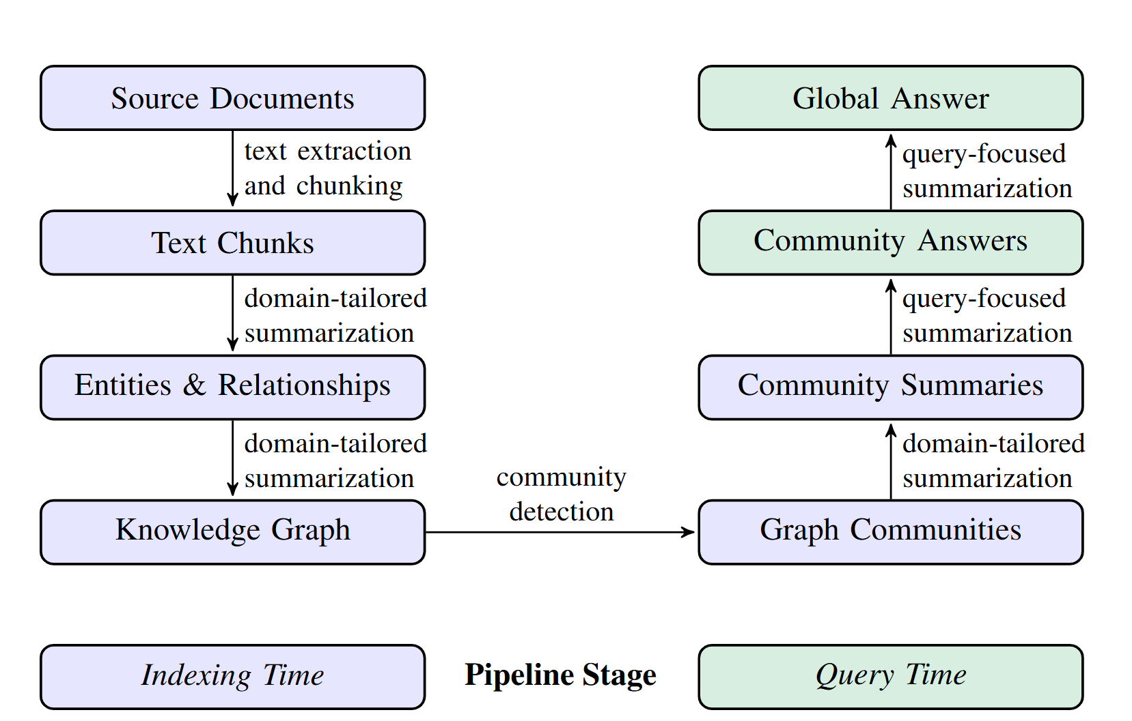
Introduction
GraphRAG is a structured, hierarchical approach to Retrieval Augmented Generation (RAG), as opposed to naive semantic-search approaches using plain text snippets. The GraphRAG process involves extracting a knowledge graph out of raw text, building a community hierarchy, generating summaries for these communities, and then leveraging these structures when perform RAG-based tasks.。

Slide 4
Method
GraphRAG Workflow
To start, the documents in the corpus are split into text chunks. The LLM extracts information fromeach chunk for downstream processing.
In this step, the LLM is prompted to extract instances of important entities and the relationshipsbetween the entities from a given chunk. Additionally, the LLM generates short descriptions for theentities and relationships.
The use of an LLM to extract entities, relationships, and claims is a form of abstractive summarization – these are meaningful summaries of concepts that, in the case of relationships and claims, maynot be explicitly stated in the text. The entity/relationship/claim extraction processes creates multiple instances of a single element because an element is typically detected and extracted multipletimes across documents.

Slide 5
Conclusion
We have presented GraphRAG, a RAG approach that combines knowledge graph generation andquery-focused summarization (QFS) to support human sensemaking over entire text corpora. Initialevaluations show substantial improvements over a vector RAG baseline for both the comprehensiveness and diversity of answers, as well as favorable comparisons to a global but graph-free approachusing map-reduce source text summarization. For situations requiring many global queries over thesame dataset, summaries of root-level communities in the entity-based graph index provide a dataindex that is both superior to vector RAG and achieves competitive performance to other globalmethods at a fraction of the token cost.

Slide 6
Thank you for listening!

