Slide 1
Effect of Yogurt on the Vaginal Microbiome After Antibiotic Treatment
Group A — Yogurt Study Linear models adjusting for baseline 2026-06-05

Slide 2
Research Question
Does eating yogurt (vs. an unchanged diet) help restore a healthier vaginal microbiome after antibiotic treatment? Study design: 51 women (26 yogurt, 25 unchanged diet) Each participant sampled at baseline and after antibiotics Outcomes measured: • Total bacterial load (16S rRNA gene copies) • L. crispatus abundance • L. iners abundance

Slide 3
Table 1 — Participant Characteristics by Study Arm
Characteristic | unchanged_diet N = 25¹ | yogurt N = 26¹ | p-value²
days_since_last_sex | 6 (3, 10) | 5 (3, 11) | 0.8
birth_control |  |  | 0.017
Depoprovera | 8 (32%) | 17 (65%)
no hormonal birth control | 17 (68%) | 9 (35%)
age | 30.4 (3.3) | 31.0 (3.3) | 0.5
education |  |  | 0.8
grade 10-12, matriculated | 6 (24%) | 4 (15%)
grade 10-12, not matriculated | 9 (36%) | 12 (46%)
less than grade 9 | 4 (16%) | 5 (19%)
post-secondary | 6 (24%) | 5 (19%)
¹Median (Q1, Q3); n (%); Mean (SD)
²Wilcoxon rank sum test; Pearson's Chi-squared test; Welch Two Sample t-test; Fisher's exact test

Slide 4
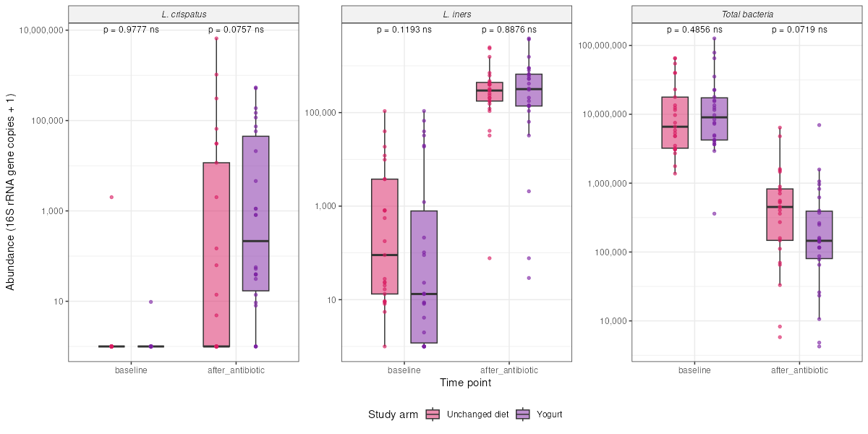
Figure 2 — qPCR Results: Yogurt vs Unchanged Diet
Wilcoxon rank-sum test p-values shown above each comparison

Slide 5
Linear Model — Total Bacteria
Characteristic | Beta | 95% CI | p-value
arm
unchanged_diet | — | —
yogurt | -0.37 | -0.77, 0.02 | 0.061
log_bacteria_baseline | 0.55 | 0.16, 0.94 | 0.007
Abbreviation: CI = Confidence Interval
Formula: log10(after_antibiotic) ~ arm + log10(baseline) Key finding: Yogurt group had 0.37 log-units LESS total bacteria after antibiotics (adjusting for baseline). p = 0.061 — borderline, not quite statistically significant.

Slide 6
Linear Model — L. crispatus
Characteristic | Beta | 95% CI | p-value
arm
unchanged_diet | — | —
yogurt | 0.82 | -0.40, 2.0 | 0.2
log_crispatus_baseline | -0.30 | -1.6, 0.99 | 0.6
Abbreviation: CI = Confidence Interval
Formula: log10(after_antibiotic) ~ arm + log10(baseline) Key finding: Yogurt group had 0.82 log-units HIGHER L. crispatus after antibiotics (adjusting for baseline). p = 0.2 — not significant. Wide confidence interval (-0.40, 2.0) means we are very uncertain about this estimate.

Slide 7
Linear Model — L. iners
Characteristic | Beta | 95% CI | p-value
arm
unchanged_diet | — | —
yogurt | -0.17 | -0.78, 0.44 | 0.6
log_iners_baseline | -0.03 | -0.22, 0.16 | 0.8
Abbreviation: CI = Confidence Interval
Formula: log10(after_antibiotic) ~ arm + log10(baseline) Key finding: No meaningful difference between groups. Beta = -0.17, p = 0.6. Yogurt does not appear to affect L. iners levels after antibiotics.

Slide 8
Summary of Findings
1. Randomisation worked — arms balanced on age, birth control, education, and baseline bacterial levels (Table 1). 2. Antibiotics caused a dramatic ~20-30× drop in total bacterial load in both groups. 3. Yogurt effect: None of the three models reached p < 0.05 • Total bacteria: Beta = -0.37, p = 0.061 (borderline) • L. crispatus: Beta = +0.82, p = 0.2 • L. iners: Beta = -0.17, p = 0.6 4. The total bacteria result hints that yogurt may help reduce bacterial load after antibiotics, but a larger study is needed to confirm this.

