Slide 1


Debugging and debuggers
Universidade dos Açores
Kasper Østerbye
December 2018

Slide 2
Copy of slides at
https://github.com/KasperAtAzores/0_Debugging

Slide 3
Runtime organization
The primary structures at runtime are:
Call stack that holds method frames
The heap that holds objects
Each stack frame holds:
Links to previous frame and line of code
this (unless a static/global)
Parameters
Local variables
Struct data (in C# and C++)
Return values and temporary values

Slide 4
Values vs. objects
Most programming languages make a difference between a
Value which is stored in the variable
An object referenced by a variable
References are values
Structs are values
With objects you can have “alias”, the same object referenced by two variables.

Slide 5
Pythontutor.com I
Despite its name, it is also for other languages as well.
((Show example 1 from notes))
((Show the coordinate program))

Slide 6
Pythontutor.com II
Recursion
I snapped this task from codingbat.com
Given an array of ints, compute recursively if the array contains a 6.
(( Show in pythontutor ))

Slide 7
IDE - IntelliJ
All IDE’s I know about have a debugger. The debugger can:
Show the call stack
Show objects on the heap
It will not run backwards like pythontutor, but it:
Step – into, over, to end
Run until breakpoint
Set “conditionals” – breaks based on values
(( Show coordinate example in intelliJ ))

Slide 8
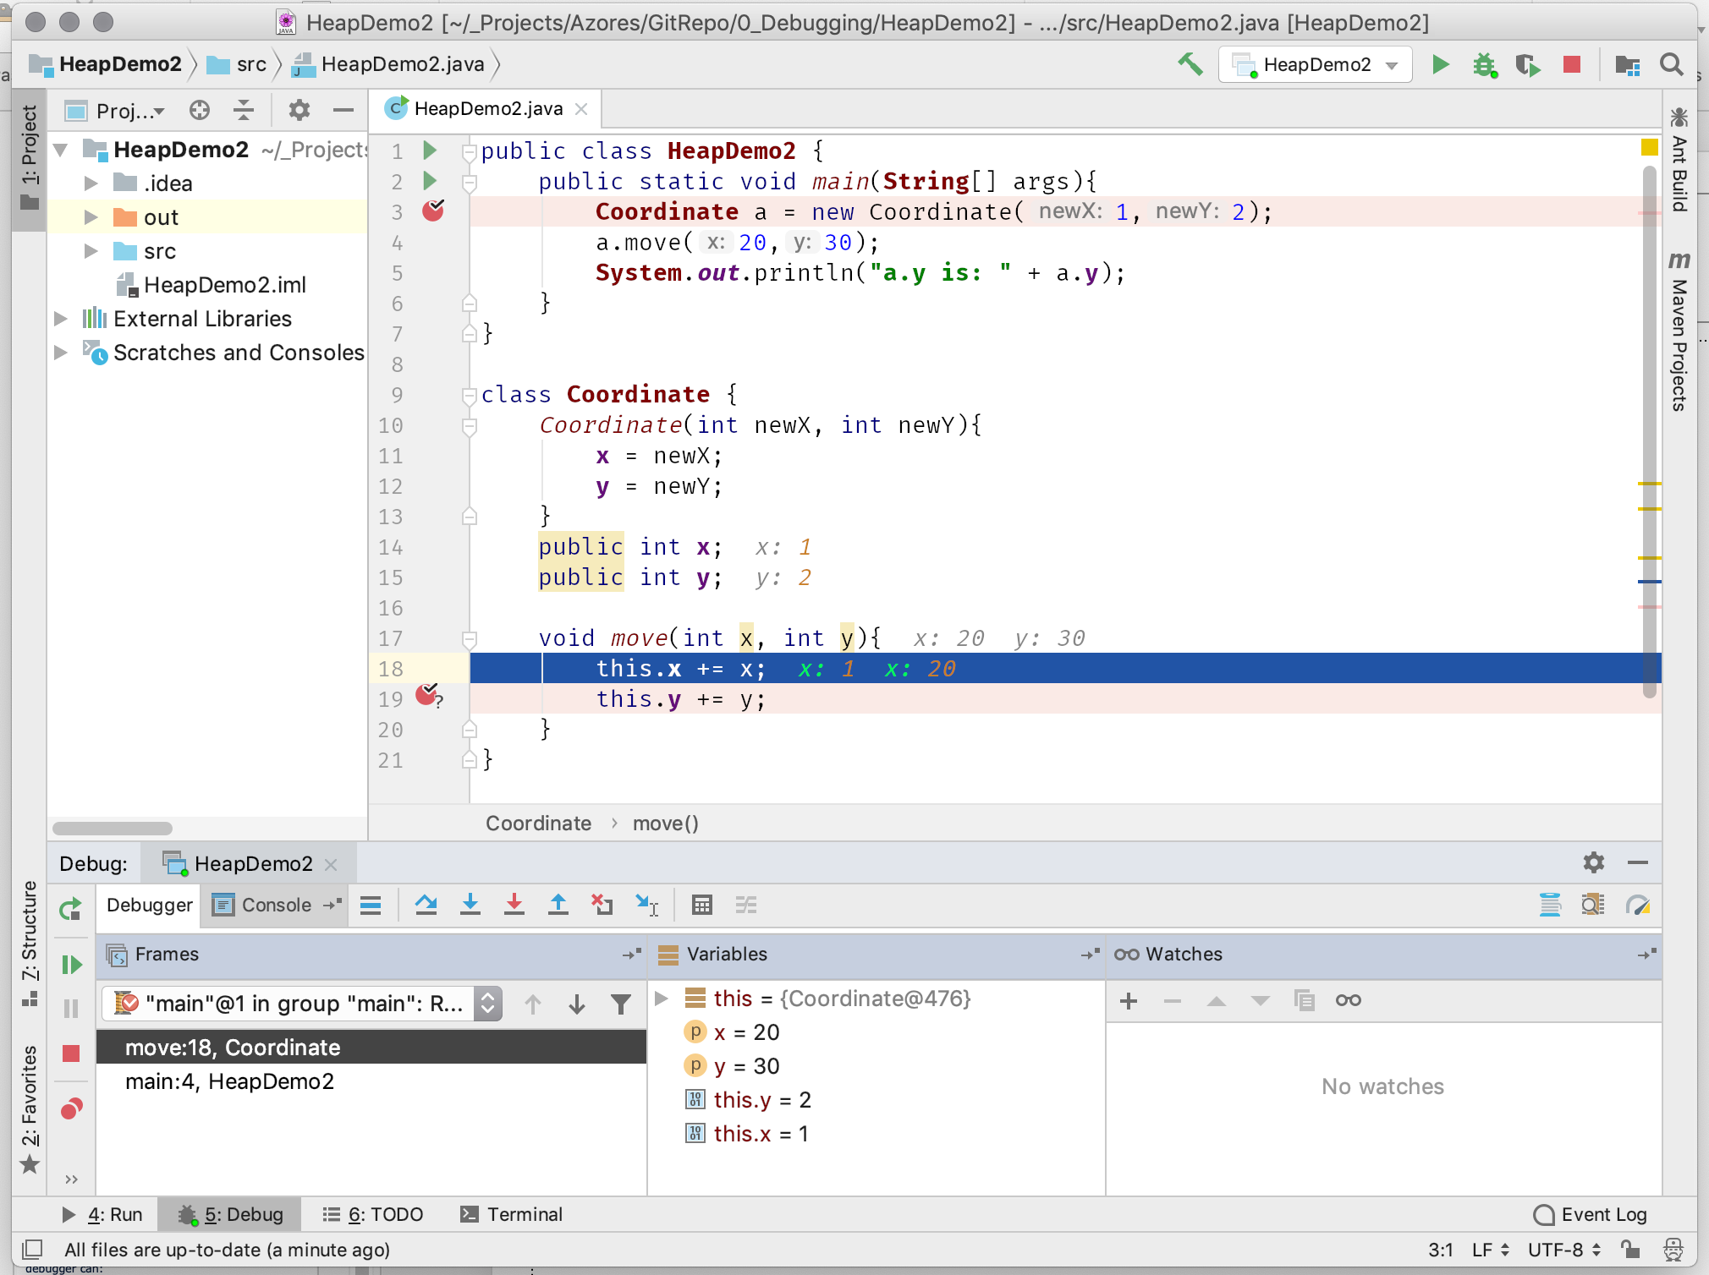
Breakpoints marked with red (conditional marked by ?)
Stepping
Tools
Start/
Stop
Stack frames
Selected stack frame

Slide 9
Debugging a slightly larger program
(( DemoArrayList ))
Break on exceptions

Slide 10
Implementation of a debugger
The runtime of the program has stack and heap.
In addition, it has the program – in the form of instructions in memory.
CPU does this loop:
inst = Mem[ip] #ip= instruction pointer
execute(inst)
If you want the debugger to break at instruction 78, you swap the instruction at location 78 with a call to the debugger. That is it.

Slide 11
Implementation of debugger II
If the program is run using byte code, it is the same way. You swap the instruction at byte index 78 with a call to the debugger.
If the byte code is translated into native instructions on the fly, you… change at 78 to a call to the debugger. This call is then translated into native instructions.

Slide 12
How it is really done
There are some obstacles that must be addressed:
The debugger must have the rights to change memory of a different process.
If a virtual machine, there is a debugging API to allow Netbeans, IntelliJ, etc. to all implement debuggers consistently.
If a virtual machine, it need to be started in debug mode.

Slide 13
Mapping from runtime to source
When programs are compiled, mostly variable names, class names, line numbers etc. are removed.
The debugger must be able to “recover” this info.
It must be able to map runtime structures to source

Slide 14
Instrumentation
Most modern virtual machines allow them to be instrumented. That is, to allow them to be partly controlled by external processes.
Instrumentation is used for performance monitoring
Number of processes
Load
Database connections
…

Slide 15
A few pointers for blender & python
Jetbrains own explanation for remote debugging.
Remote debugging of blender using pycharm.

