Slide 1
Theory of Algorithms
Post correspondence problem
[Michael Sipser. Introduction to the Theory of Computation. Chapter 5.2]

Slide 2
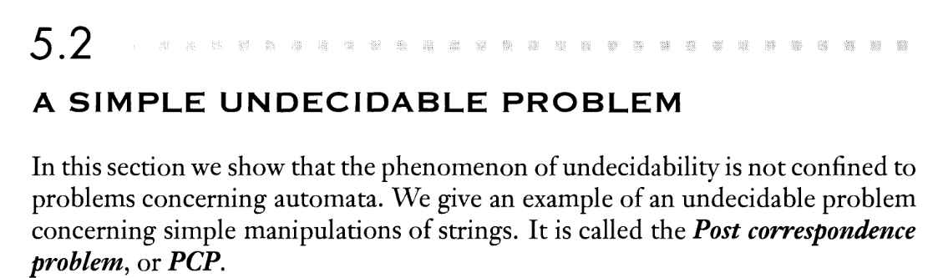

Slide 3
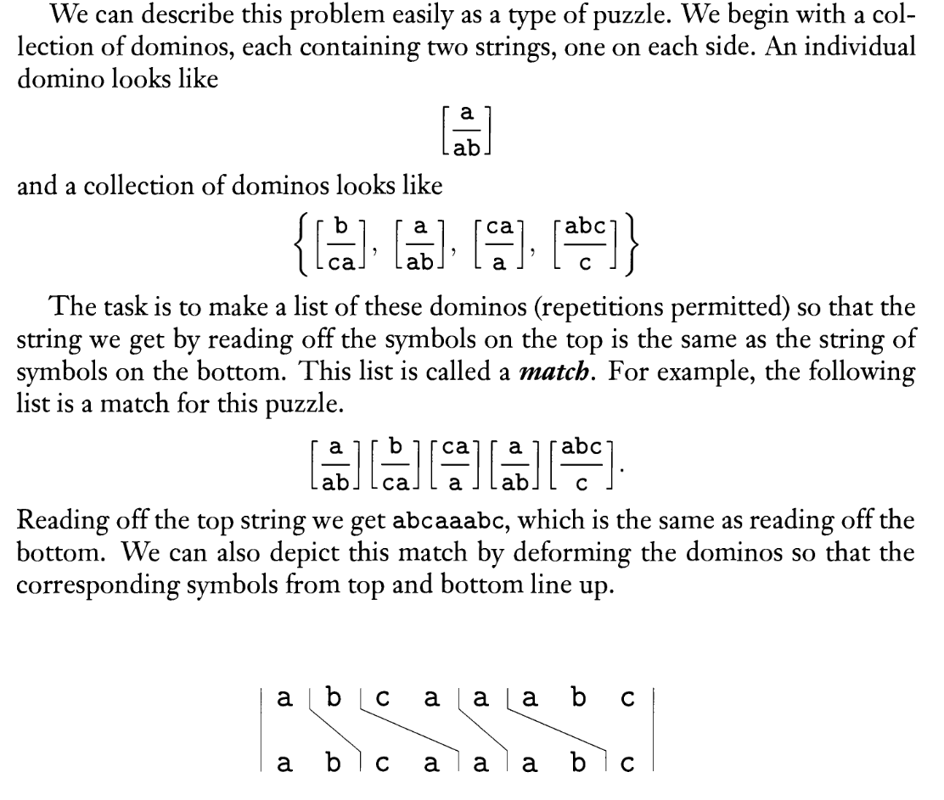

Slide 4
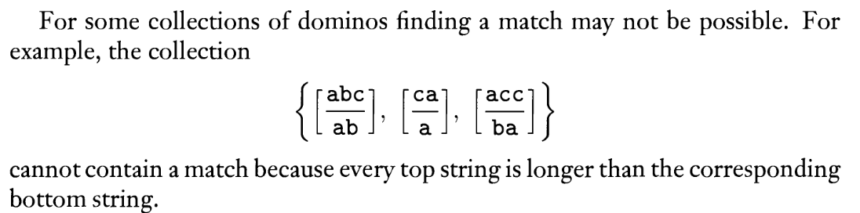

Slide 5
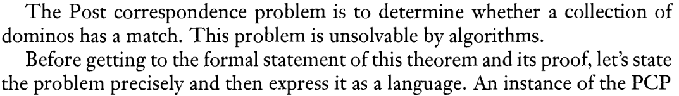
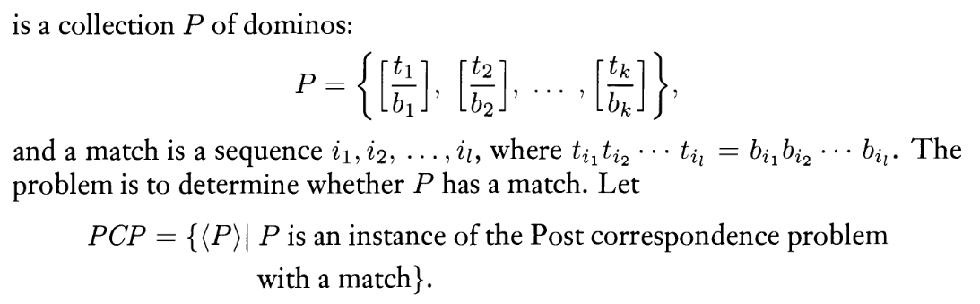


YES
NO

Slide 6
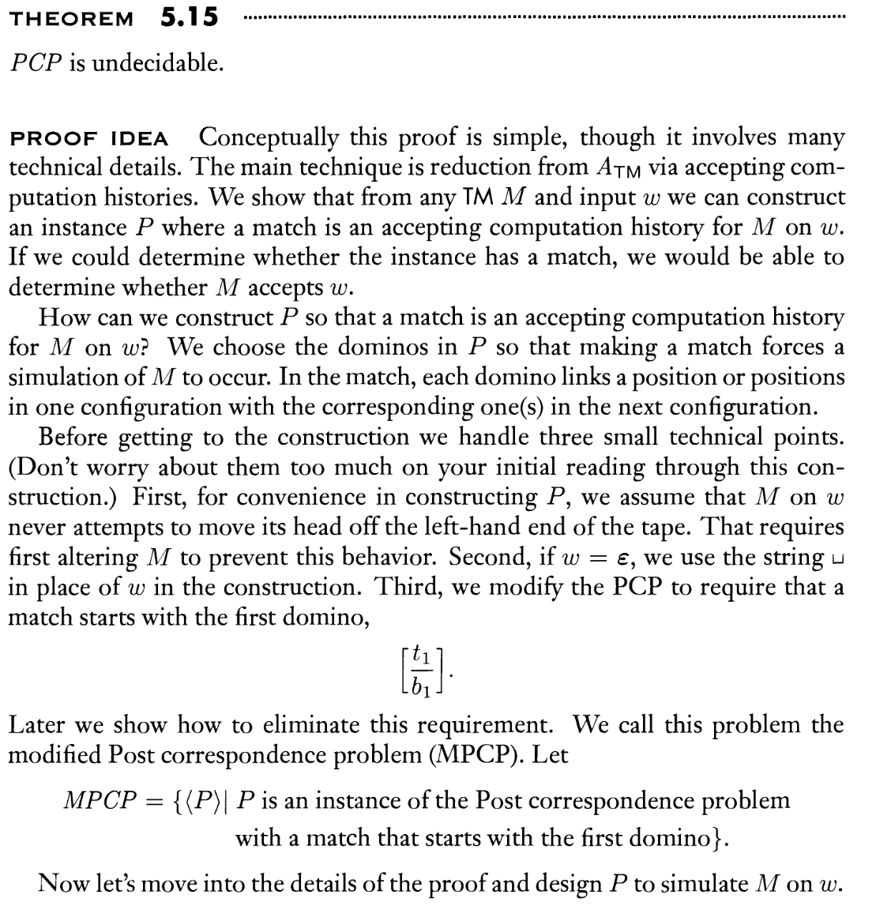

Slide 7
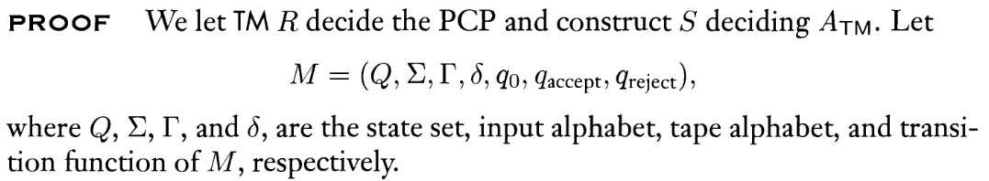
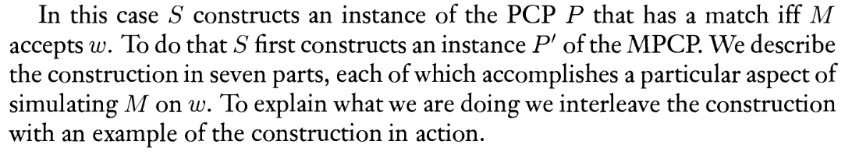
(M,w) – reduction -> (set of dominos P’)
M accepts w iff P’ has a match

Slide 8
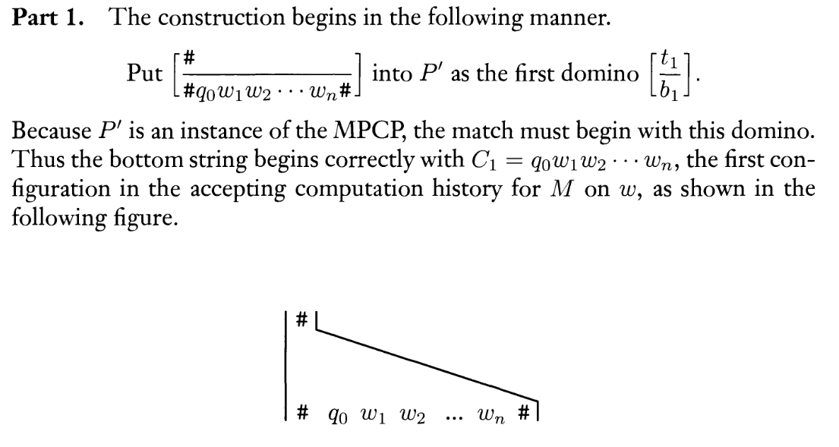

Slide 9
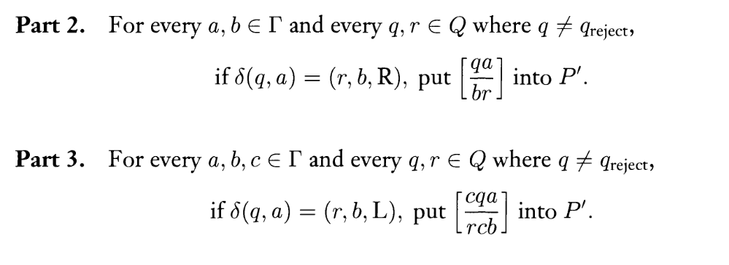
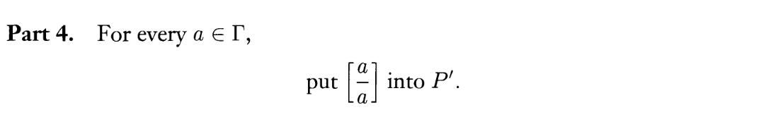

Slide 10
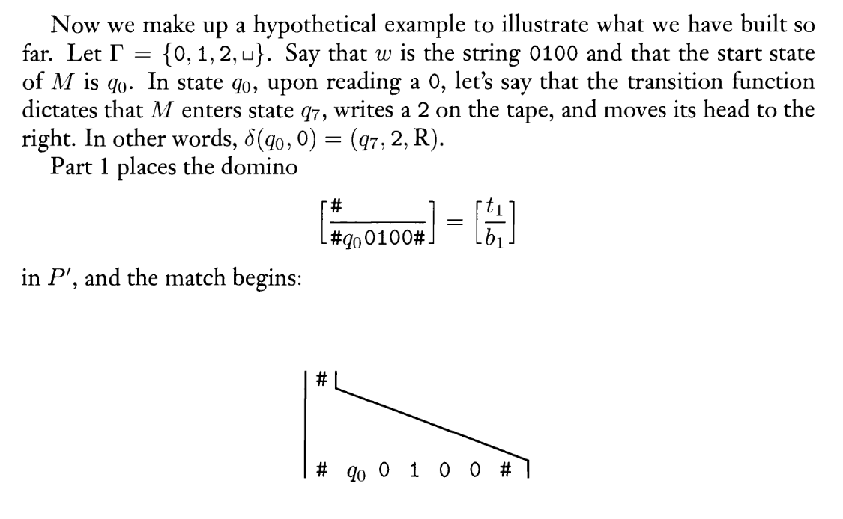

Slide 11
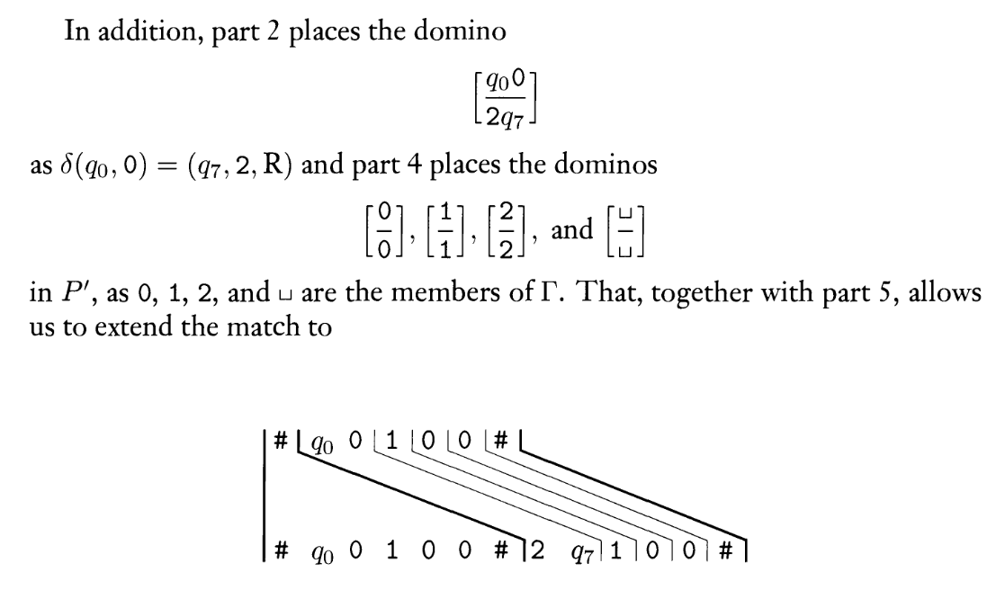

Slide 12
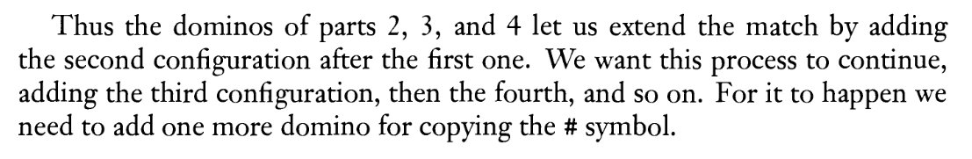
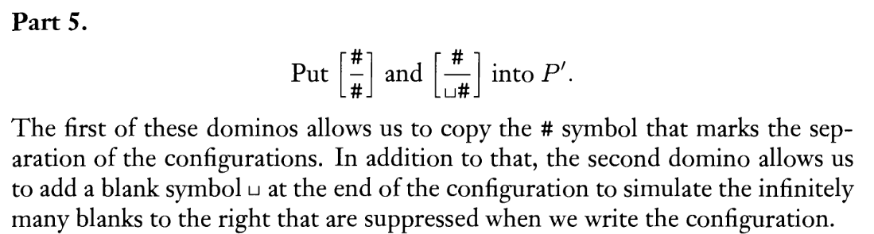

Slide 13
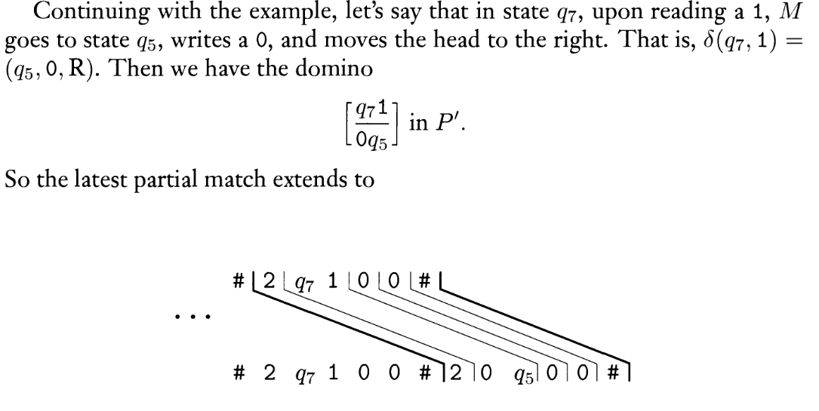

Slide 14
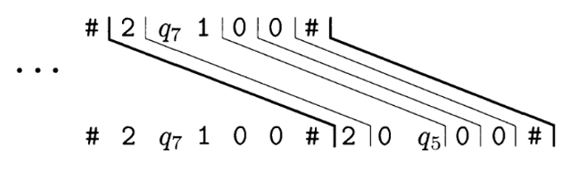
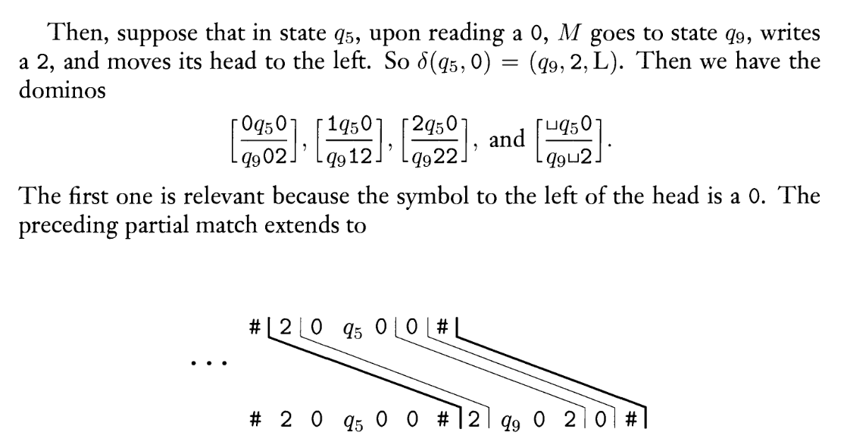

Slide 15
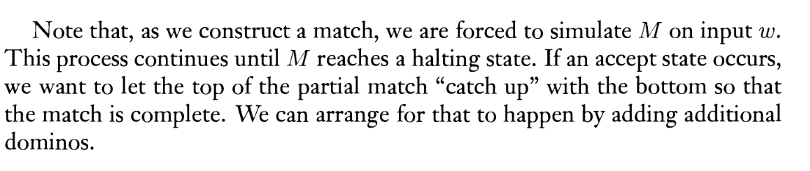
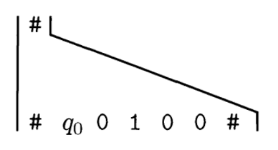
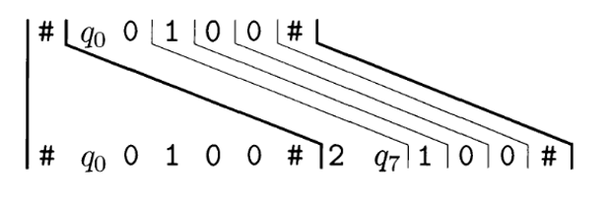
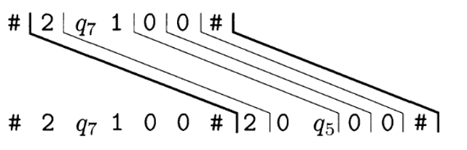

Slide 16
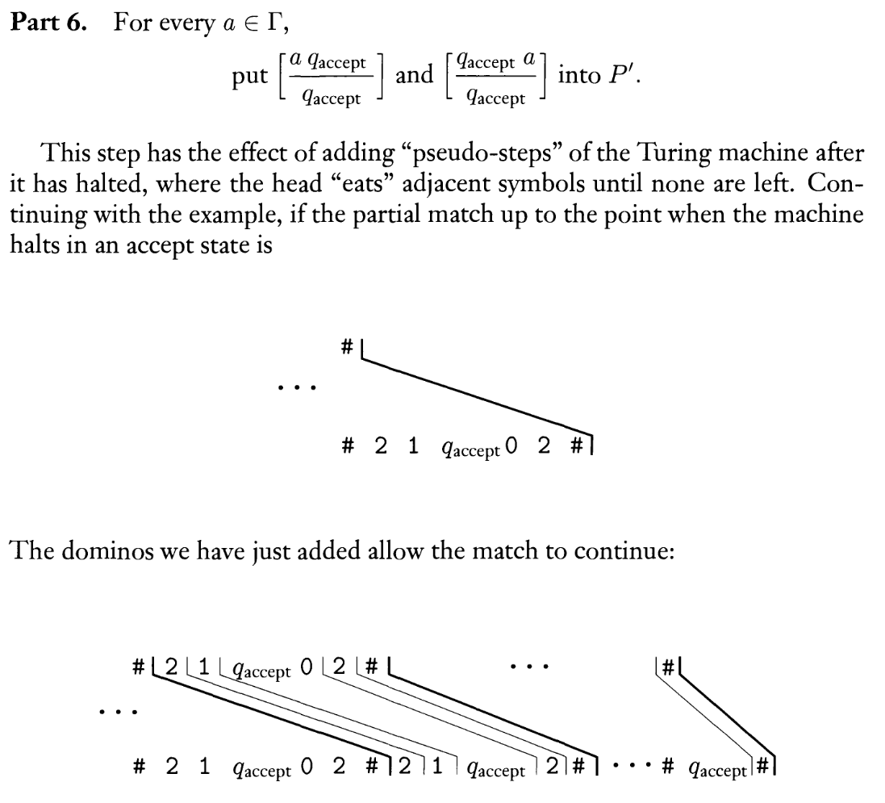

Slide 17
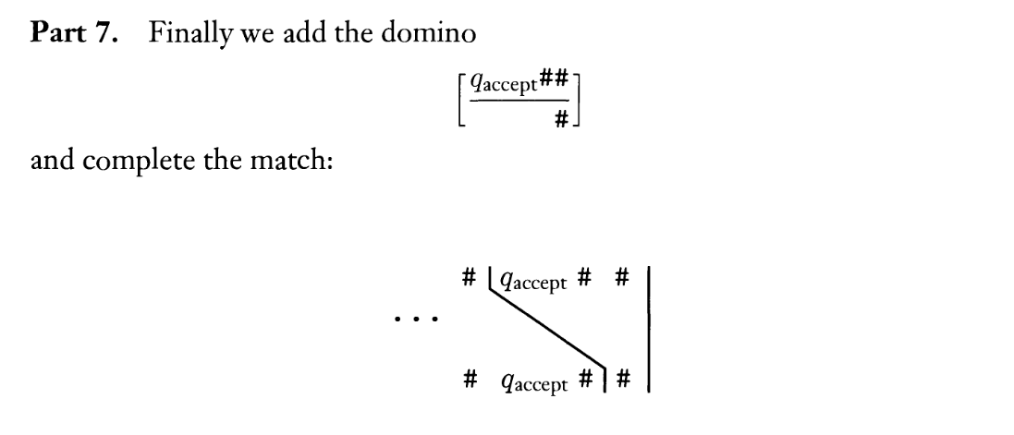
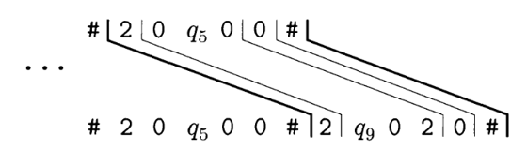
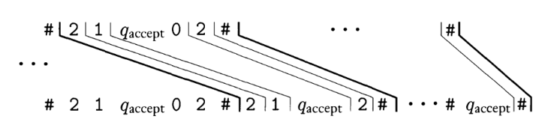
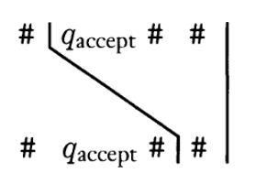

Slide 18
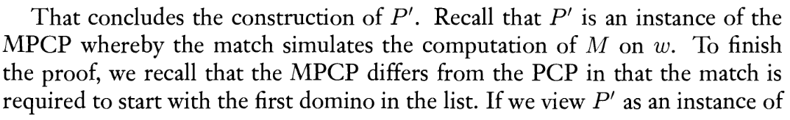
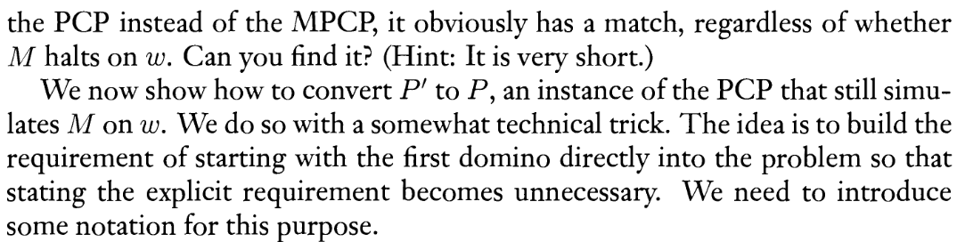

Slide 19
Example
_ → 0, R
0 → 0, R
X
1 → 1, R
Y
1 → 1, L
A
_ → 0, R
0 → 0, R

Slide 20
Example
_ → 0, R
0 → 0, R
X
1 → 1, R
Y
1 → 1, L
A
# #X1011#
Part 1
Part 2
Part 3
Part 4 Part 6
Part 5 # # Part 7
_ → 0, R
0 → 0, R
X_ 0X
X0 0X
X1 1Y
Y_ 0X
Y0 0X
1Y1 A11
_ _
0 0
1 1
_A A
A_ A
0A A
A0 A
1A A
A1 A
# #
# _#
A## #

Slide 21
Example
_ → 0, R
0 → 0, R
X
1 → 1, R
Y
1 → 1, L
A
_ → 0, R
0 → 0, R
# #X1011#
X_ 0X
X0 0X
X1 1Y
Y_ 0X
Y0 0X
1Y1 A11
_ _
0 0
1 1
# #
# _#
_A A
A_ A
0A A
A0 A
1A A
A1 A
A## #

Slide 22
Example
_ → 0, R
0 → 0, R
X
1 → 1, R
Y
1 → 1, L
A
_ → 0, R
0 → 0, R
# #X1011#
X_ 0X
X0 0X
X1 1Y
Y_ 0X
Y0 0X
1Y1 A11
_ _
0 0
1 1
# #
# _#
_A A
A_ A
0A A
A0 A
1A A
A1 A
A## #
# X1 0 1 1 # 1 Y0 1 1 # 1 0 X1 1 # 1 0 1Y1 # 1 0 A1 1 # 1 0 A1 # 1 0A # 1A # A## #X1011# 1Y 0 1 1 # 1 0X 1 1 # 1 0 1Y 1 # 1 0 A11 # 1 0 A 1 # 1 0 A # 1 A # A # #

Slide 23
Example
_ → 0, R
0 → 0, R
X
1 → 1, R
Y
1 → 1, L
A
_ → 0, R
0 → 0, R
# #X1011#
X_ 0X
X0 0X
X1 1Y
Y_ 0X
Y0 0X
1Y1 A11
_ _
0 0
1 1
# #
# _#
_A A
A_ A
0A A
A0 A
1A A
A1 A
A## #
# X1 0 1 1 # 1 Y0 1 1 # 1 0 X1 1 # 1 0 1Y1 # 1 0 A1 1 # 1 0 A1 # 1 0A # 1A # A## #X1011# 1Y 0 1 1 # 1 0X 1 1 # 1 0 1Y 1 # 1 0 A11 # 1 0 A 1 # 1 0 A # 1 A # A # #

Slide 24
Example
_ → 0, R
0 → 0, R
X
1 → 1, R
Y
1 → 1, L
A
_ → 0, R
0 → 0, R
# #X1011#
X_ 0X
X0 0X
X1 1Y
Y_ 0X
Y0 0X
1Y1 A11
_ _
0 0
1 1
# #
# _#
_A A
A_ A
0A A
A0 A
1A A
A1 A
A## #
# X1 0 1 1 # 1 Y0 1 1 # 1 0 X1 1 # 1 0 1Y1 # 1 0 A1 1 # 1 0 A1 # 1 0A # 1A # A## #X1011# 1Y 0 1 1 # 1 0X 1 1 # 1 0 1Y 1 # 1 0 A11 # 1 0 A 1 # 1 0 A # 1 A # A # #

Slide 25
Example
_ → 0, R
0 → 0, R
X
1 → 1, R
Y
1 → 1, L
A
_ → 0, R
0 → 0, R
# #X1011#
X_ 0X
X0 0X
X1 1Y
Y_ 0X
Y0 0X
1Y1 A11
_ _
0 0
1 1
# #
# _#
_A A
A_ A
0A A
A0 A
1A A
A1 A
A## #
# X1 0 1 1 # 1 Y0 1 1 # 1 0 X1 1 # 1 0 1Y1 # 1 0 A1 1 # 1 0 A1 # 1 0A # 1A # A## #X1011# 1Y 0 1 1 # 1 0X 1 1 # 1 0 1Y 1 # 1 0 A11 # 1 0 A 1 # 1 0 A # 1 A # A # #

Slide 26
Example
_ → 0, R
0 → 0, R
X
1 → 1, R
Y
1 → 1, L
A
_ → 0, R
0 → 0, R
# #X1011#
X_ 0X
X0 0X
X1 1Y
Y_ 0X
Y0 0X
1Y1 A11
_ _
0 0
1 1
# #
# _#
_A A
A_ A
0A A
A0 A
1A A
A1 A
A## #
# X1 0 1 1 # 1 Y0 1 1 # 1 0 X1 1 # 1 0 1Y1 # 1 0 A1 1 # 1 0 A1 # 1 0A # 1A # A## #X1011# 1Y 0 1 1 # 1 0X 1 1 # 1 0 1Y 1 # 1 0 A11 # 1 0 A 1 # 1 0 A # 1 A # A # #

Slide 27
Example
_ → 0, R
0 → 0, R
X
1 → 1, R
Y
1 → 1, L
A
_ → 0, R
0 → 0, R
# #X1011#
X_ 0X
X0 0X
X1 1Y
Y_ 0X
Y0 0X
1Y1 A11
_ _
0 0
1 1
# #
# _#
_A A
A_ A
0A A
A0 A
1A A
A1 A
A## #
# X1 0 1 1 # 1 Y0 1 1 # 1 0 X1 1 # 1 0 1Y1 # 1 0 A1 1 # 1 0 A1 # 1 0A # 1A # A## #X1011# 1Y 0 1 1 # 1 0X 1 1 # 1 0 1Y 1 # 1 0 A11 # 1 0 A 1 # 1 0 A # 1 A # A # #
# #X101#
X_ 0X
X0 0X
X1 1Y
Y_ 0X
Y0 0X
1Y1 A11
_ _
0 0
1 1
# #
# _#
_A A
A_ A
0A A
A0 A
1A A
A1 A
A## #

Slide 28
Example
_ → 0, R
0 → 0, R
X
1 → 1, R
Y
1 → 1, L
A
_ → 0, R
0 → 0, R
# #X1011#
X_ 0X
X0 0X
X1 1Y
Y_ 0X
Y0 0X
1Y1 A11
_ _
0 0
1 1
# #
# _#
_A A
A_ A
0A A
A0 A
1A A
A1 A
A## #
# X1 0 1 1 # 1 Y0 1 1 # 1 0 X1 1 # 1 0 1Y1 # 1 0 A1 1 # 1 0 A1 # 1 0A # 1A # A## #X1011# 1Y 0 1 1 # 1 0X 1 1 # 1 0 1Y 1 # 1 0 A11 # 1 0 A 1 # 1 0 A # 1 A # A # #
# X1 0 1 # 1 Y0 1 # 1 0 X1 # 1 0 1 Y_ # 1 0 1 0 X_ # … #X101# 1Y 0 1 # 1 0X 1 # 1 0 1Y _# 1 0 1 0X _# 1 0 1 0 0X _# …
# #X101#
X_ 0X
X0 0X
X1 1Y
Y_ 0X
Y0 0X
1Y1 A11
_ _
0 0
1 1
# #
# _#
_A A
A_ A
0A A
A0 A
1A A
A1 A
A## #

Slide 30
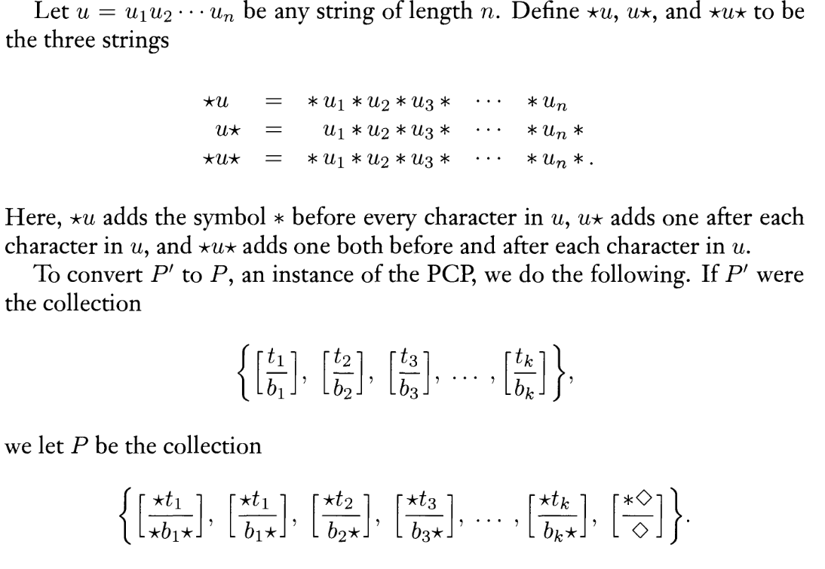

Slide 31
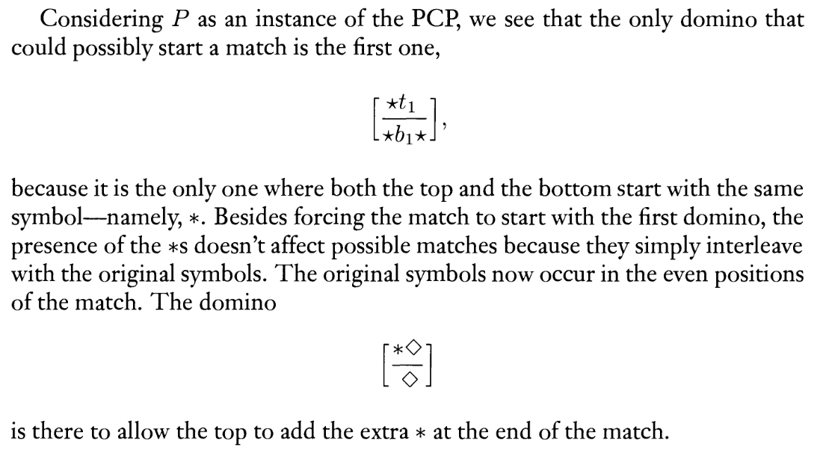

Slide 33
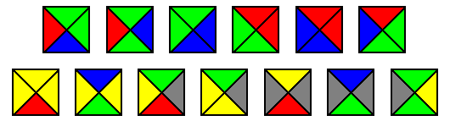
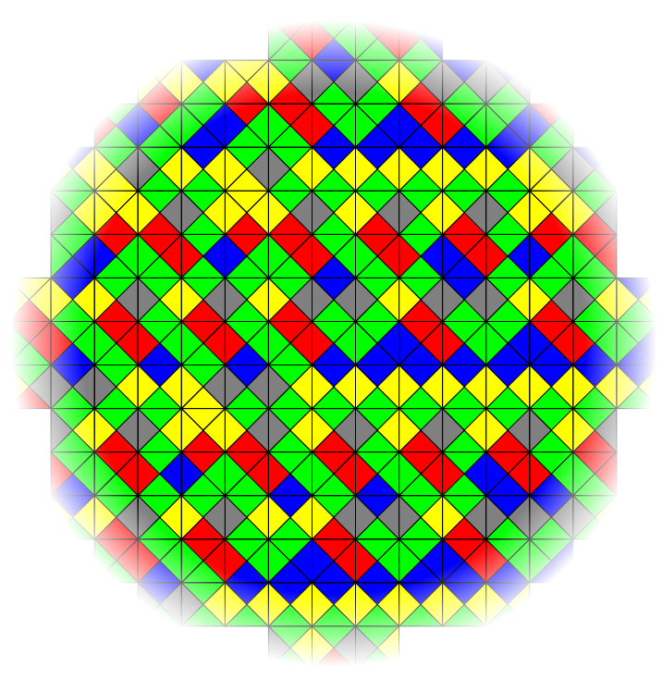
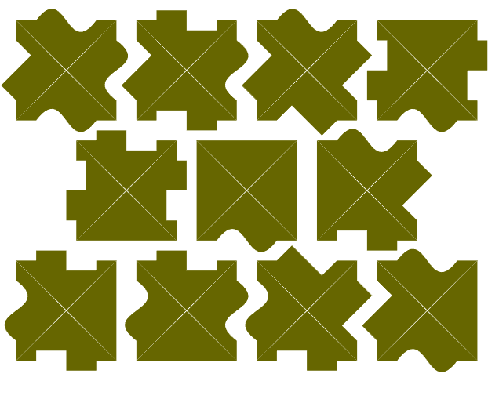
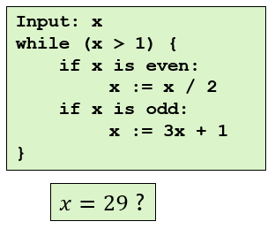
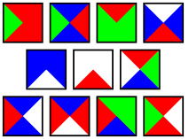
Wang tiles
Given a finite set of tiles, can they tile the plane?
i.e., whether an entire infinite plane can be filled using only these tiles
Adjacent tiles must have the same color at their common edge
Equivalent formulations – puzzle pieces, domino
This problem is undecidable
Similarly as PCP
Reduction
Pictures: https://en.wikipedia.org/wiki/Wang_tile https://academickids.com/encyclopedia/index.php/Wang_tile

Slide 34
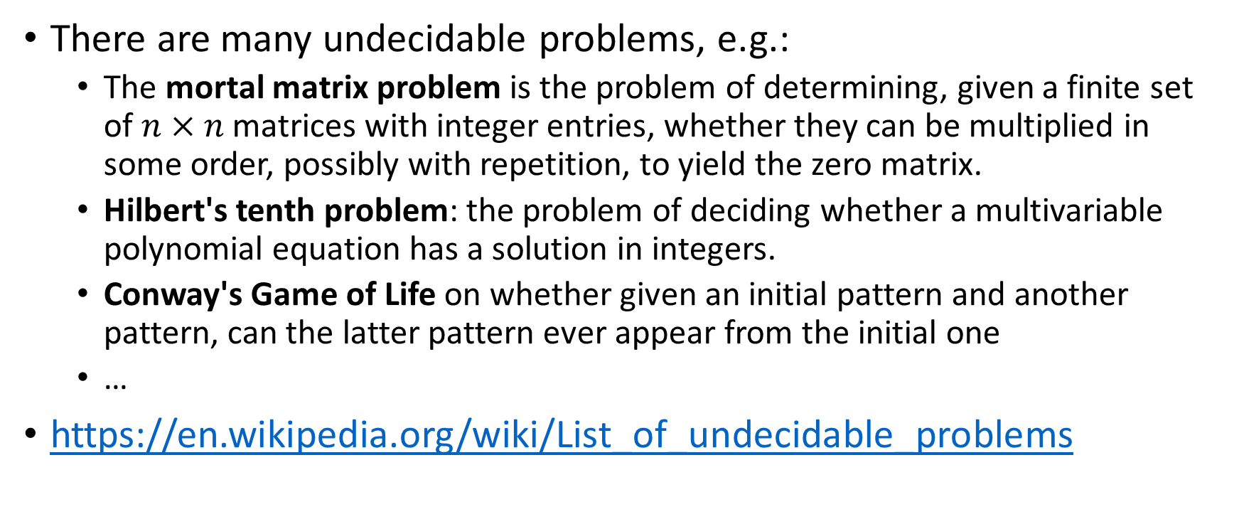
Some more undecidable problems
There are many undecidable problems, e.g.:
The mortal matrix problem is the problem of determining, given a finite set of $n×n$matrices with integer entries, whether they can be multiplied in some order, possibly with repetition, to yield the zero matrix.
Hilbert's tenth problem: the problem of deciding whether a multivariable polynomial equation has a solution in integers.
Conway's Game of Life on whether given an initial pattern and another pattern, can the latter pattern ever appear from the initial one
…
https://en.wikipedia.org/wiki/List_of_undecidable_problems

