Slide 1
Theory of Algorithms
Decidability of logical theories
[Michael Sipser. Introduction to the Theory of Computation. Chapter 6.2]

Slide 2
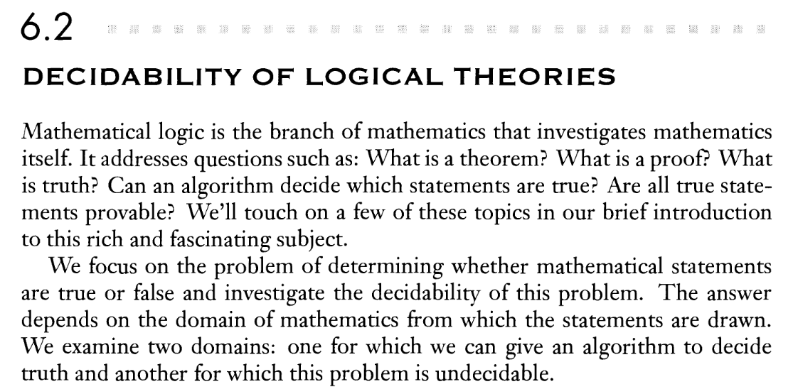

Slide 3


Slide 4



Slide 5
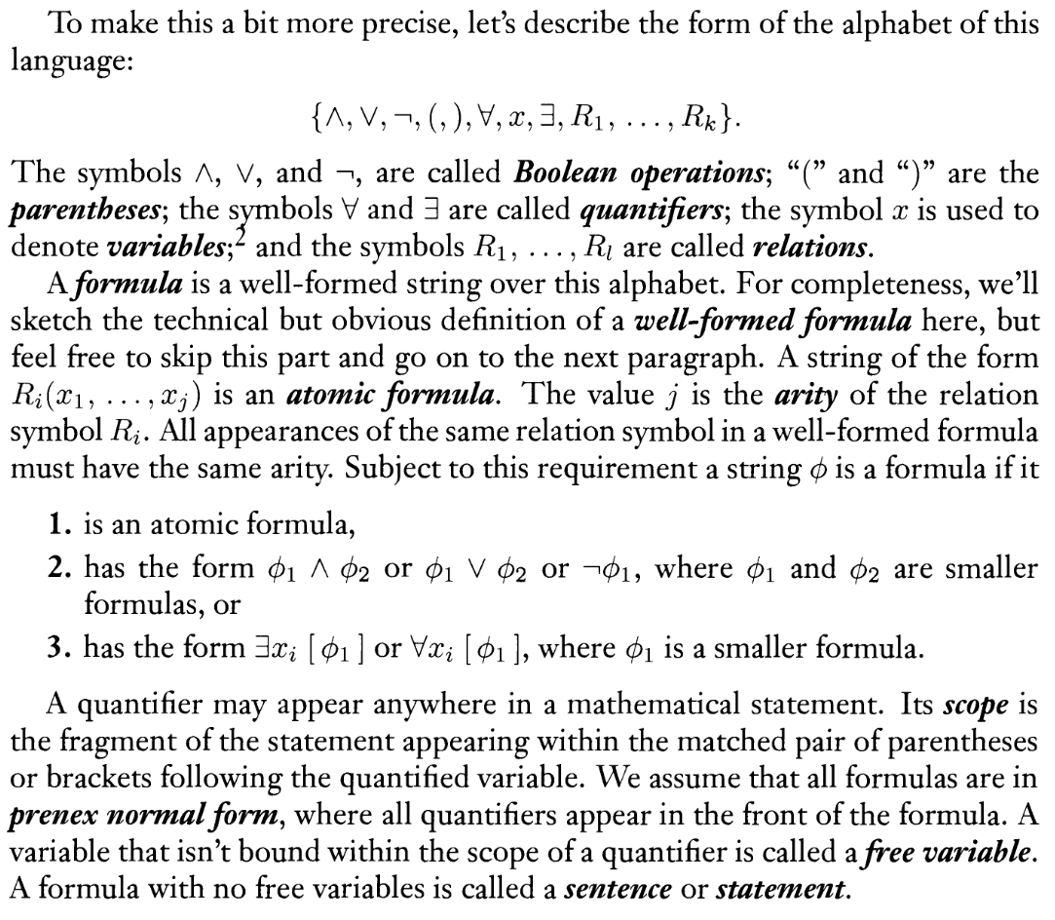



Slide 6

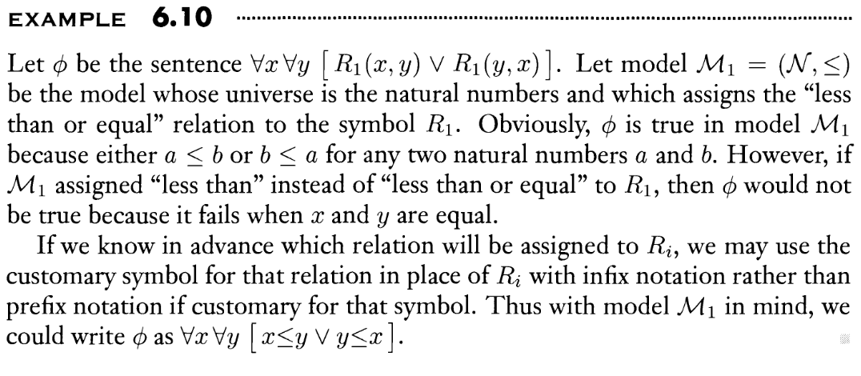
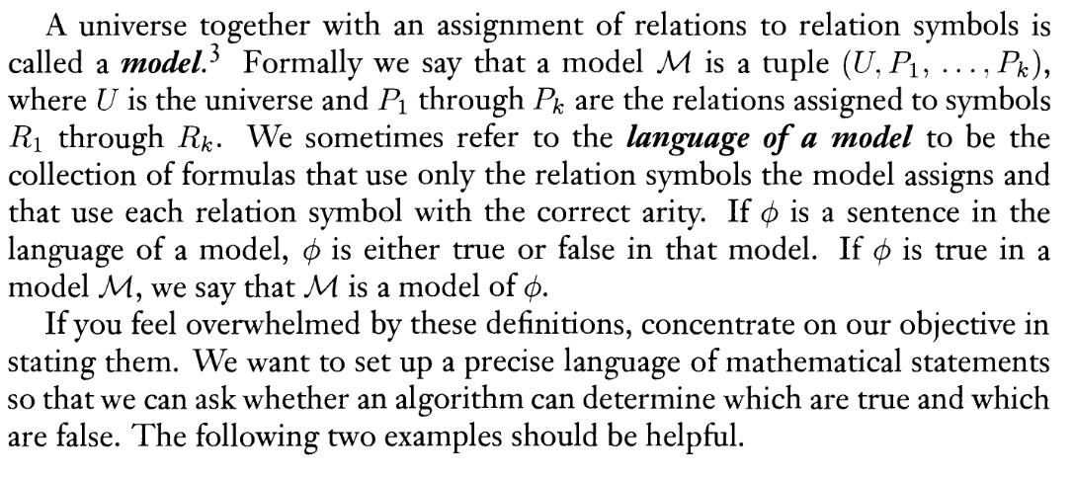



Slide 7
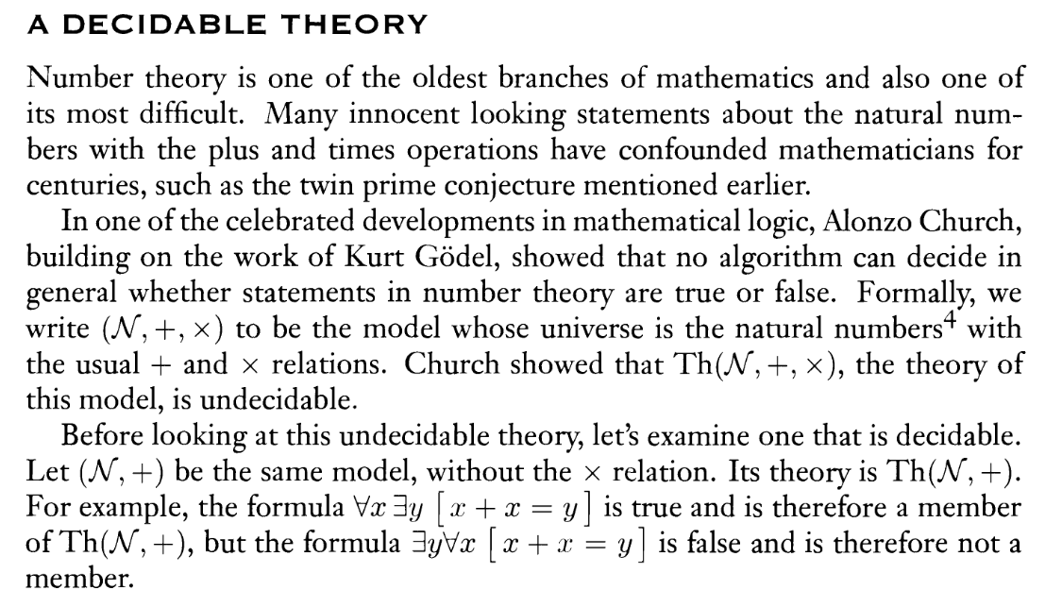


Slide 8
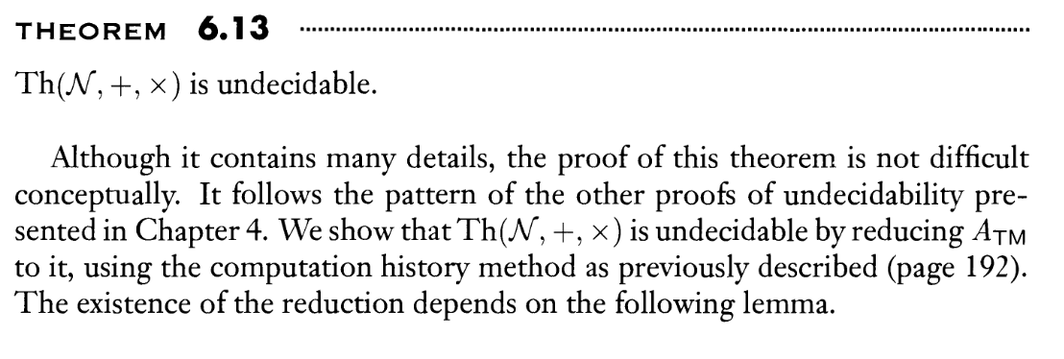


Slide 9


Slide 10




Slide 11
