Slide 1
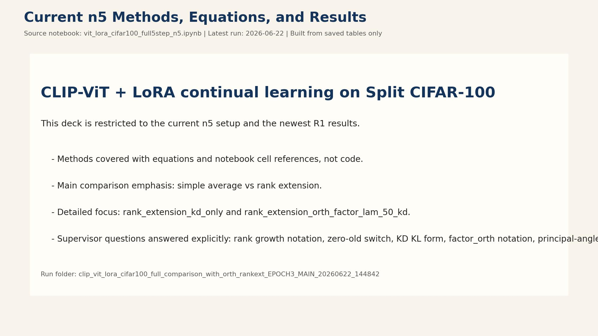
Notes:
This deck explains only the method logic implemented in vit_lora_cifar100_full5step_n5.ipynb. It is designed for supervisor discussion and code-method traceability. The focus methods are simple average merging, rank extension, DO-merging, and orthogonality.

Slide 2
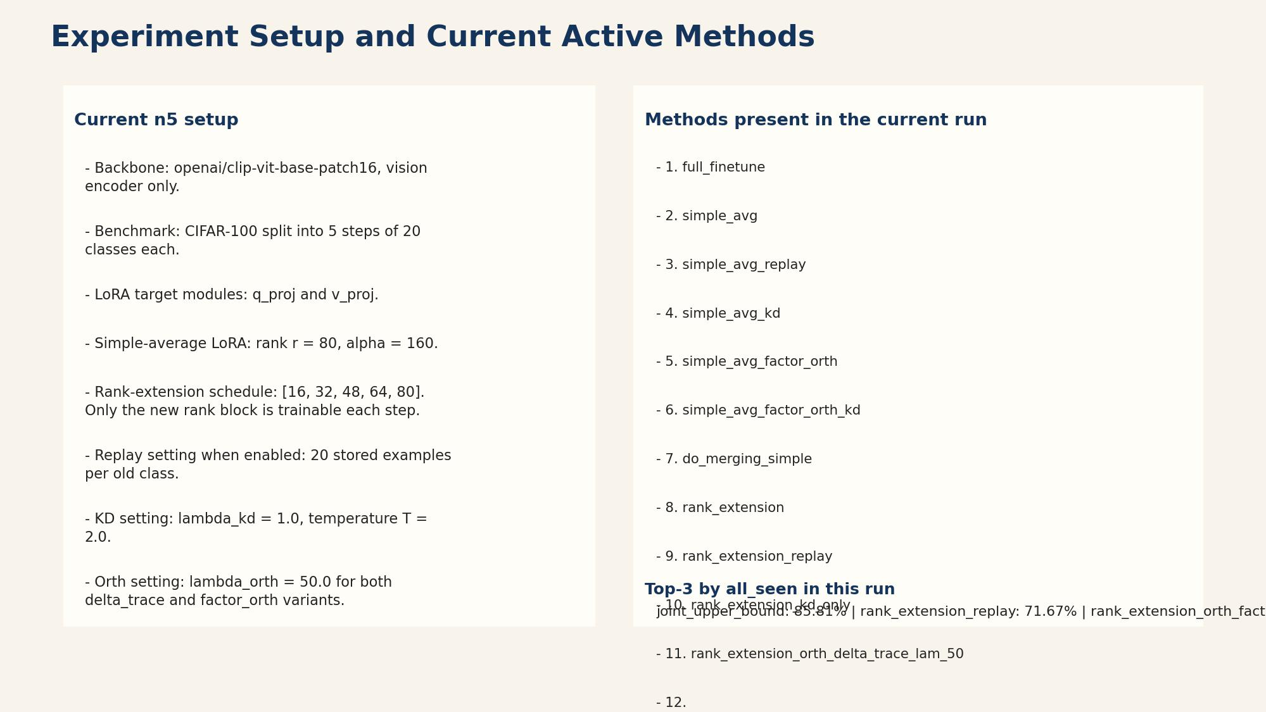
Notes:
Key configuration source: Cell 3 (full comparison configuration). Important variables: NUM_STEPS=5, CLASSES_PER_STEP=20, TARGET_MODULES=['q_proj','v_proj']. The methods differ in how per-step LoRA updates are trained/combined and whether replay/orth regularization is used.

Slide 3
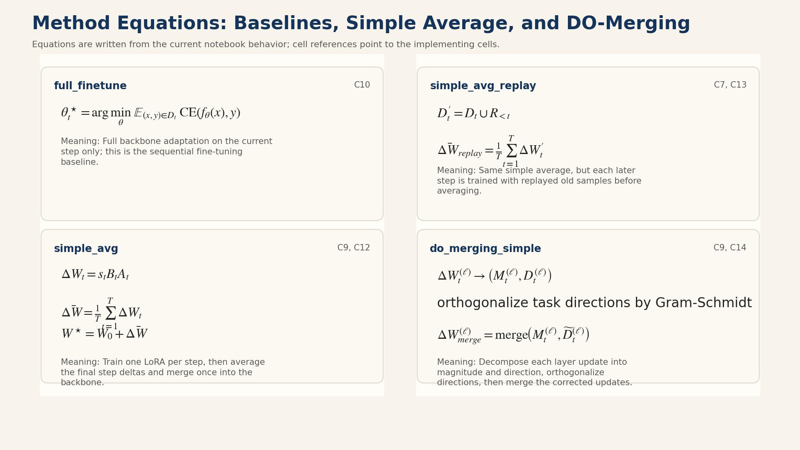
Notes:
Sources: - Cell 11: train_independent_loras(...) - Cell 12: simple_avg_no_replay and simple_avg_orth - Cell 13: simple_avg_replay This method keeps the final merge logic identical while changing only the training source states.

Slide 4
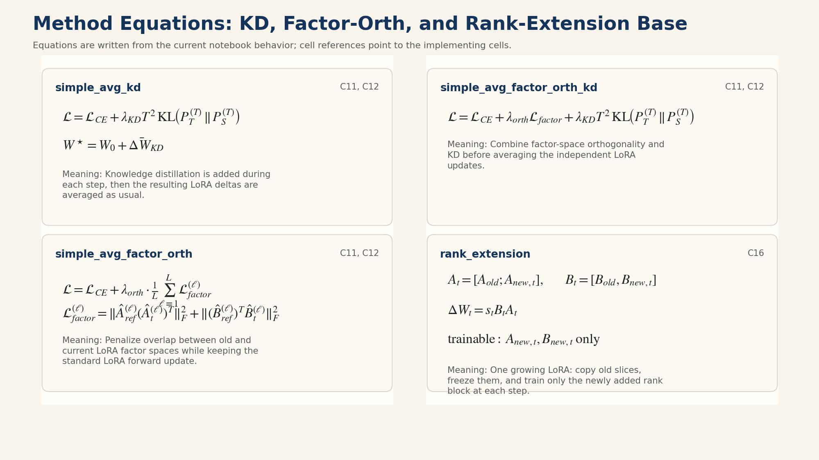
Notes:
Exact source lines: - Cell 9, function simple_average_deltas Execution blocks: - Cell 12 for simple_avg_no_replay - Cell 13 for simple_avg_replay Hyperparameters affecting this method: LR_LORA, LORA_EPOCHS, BATCH_LORA, REPLAY_PER_CLASS.

Slide 5
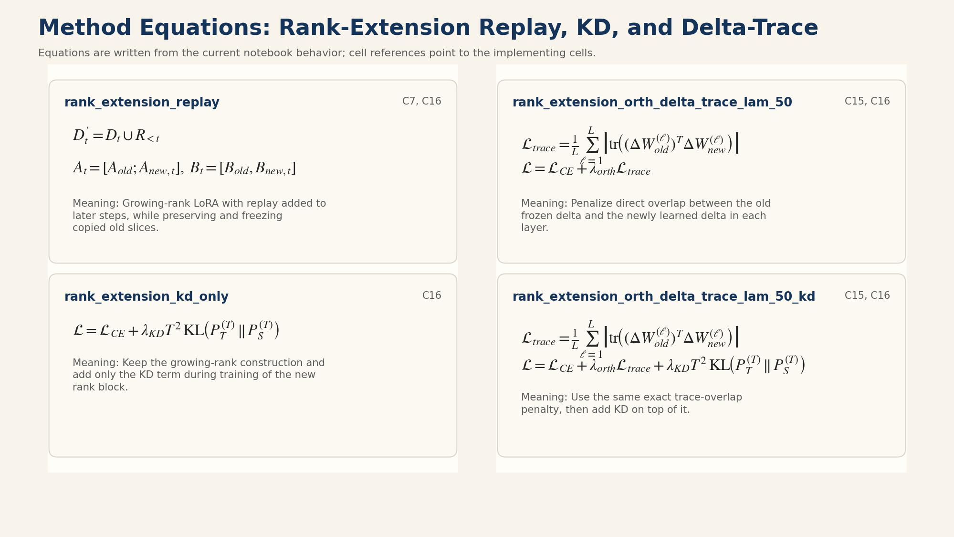
Notes:
Primary source: Cell 16. Core class: GrowingRankLoRALinear(nn.Module). Key variables: RANKEXT_NEW_RANK_PER_STEP, RANKEXT_ALPHA_PER_RANK, LR_RANKEXT. Variants are controlled through run_rank_extension_variant(...).

Slide 6
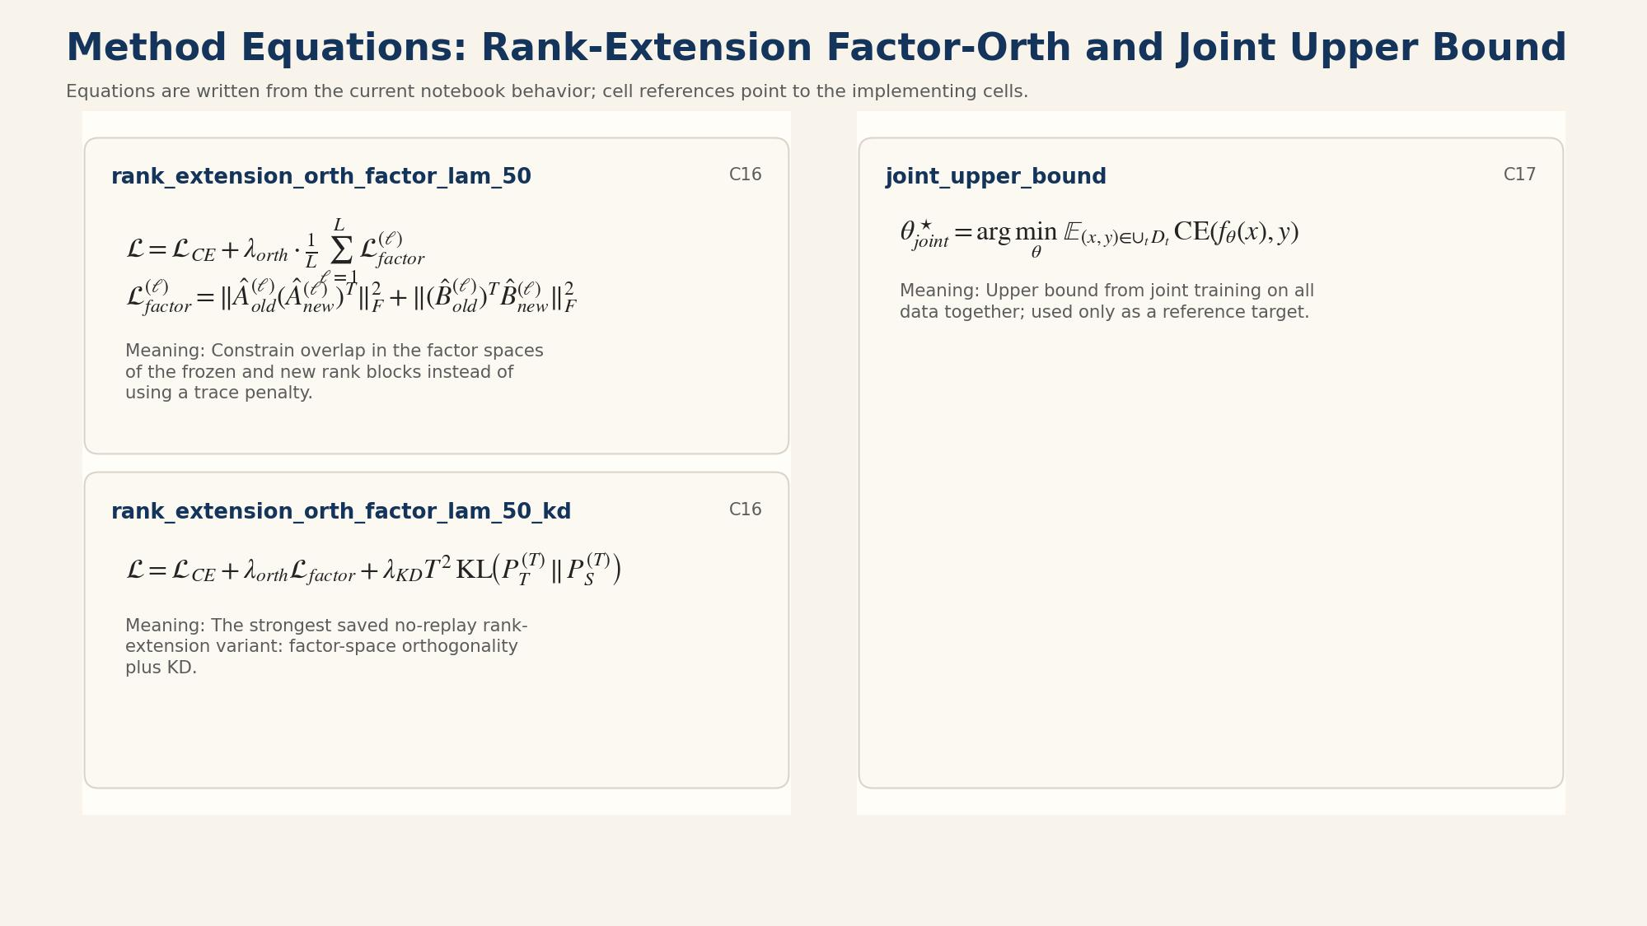
Notes:
Cell/function references: - Cell 16, GrowingRankLoRALinear class - Cell 16, build_rank_extension_model(previous_rank_state, step_idx) Copy/freeze behavior comes from passing previous_rank_state['lora'][module_name]['A'/'B'] into frozen_A/frozen_B.

Slide 7
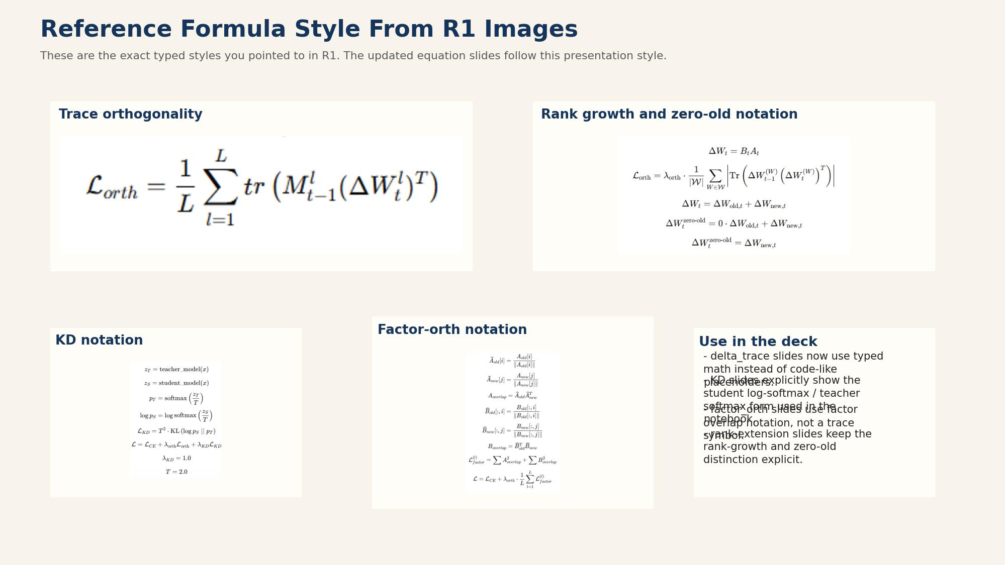
Notes:
Cell references: Cell 16. Relevant functions: - run_rank_extension_variant(...) - snapshot_frozen_rank_blocks(...) - check_frozen_rank_blocks_unchanged(...) - extract_rank_extension_state(...) This is the critical mechanism confirming old copied rank slices are preserved.

Slide 8
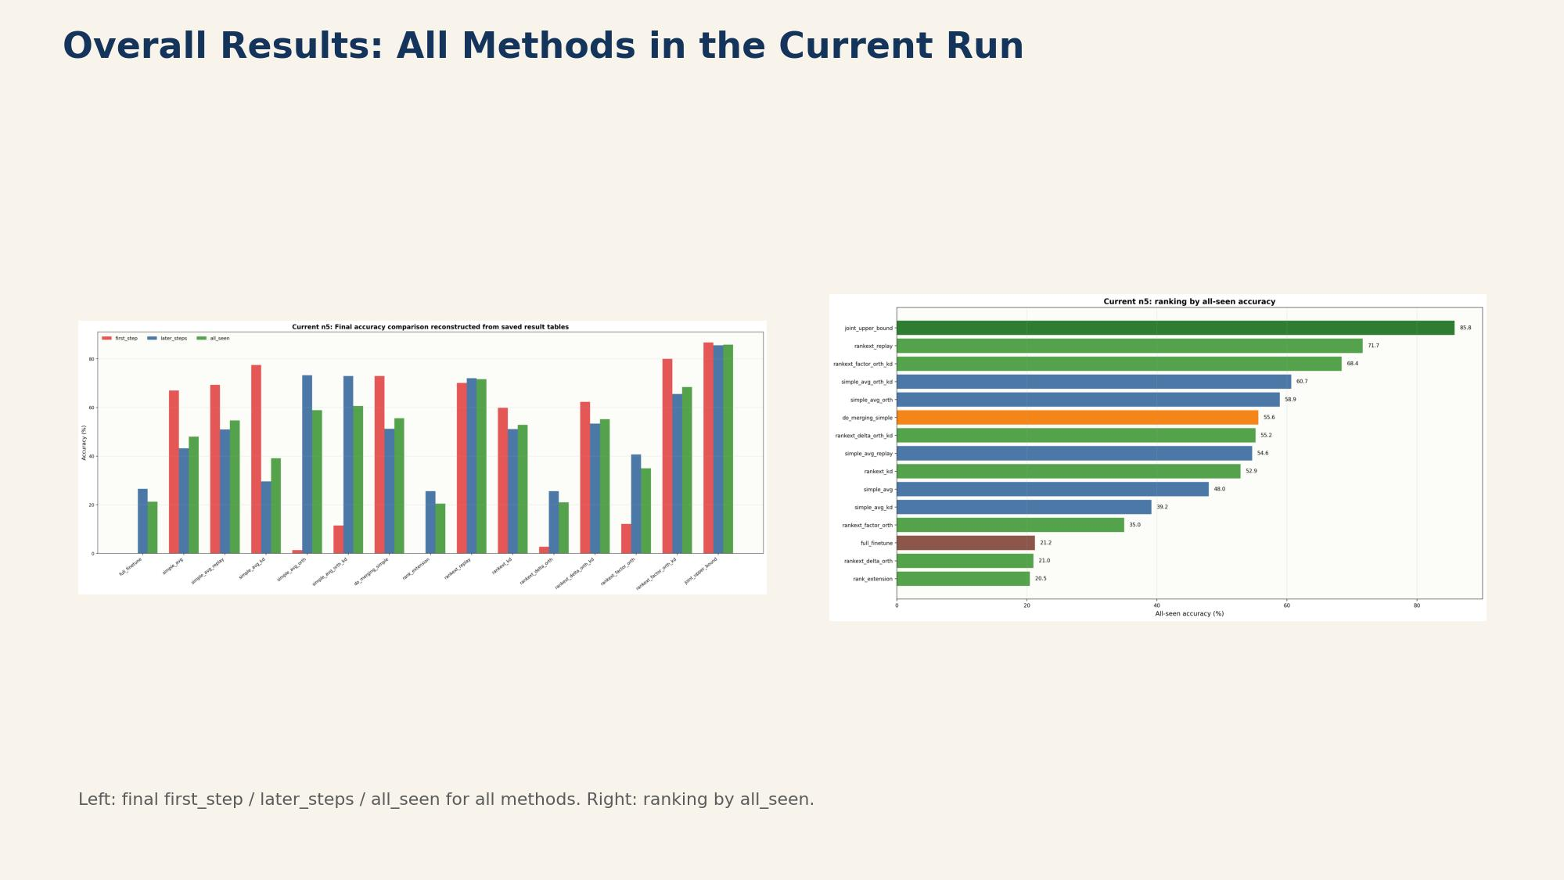
Notes:
Primary source: Cell 9 (do_merge_deltas, column_decouple_delta, orthogonalize_task_directions). Execution source: Cell 14 (do_merging_simple and do_merging_simple_orth). This is implemented as a merging rule over already trained independent step LoRAs.

Slide 9
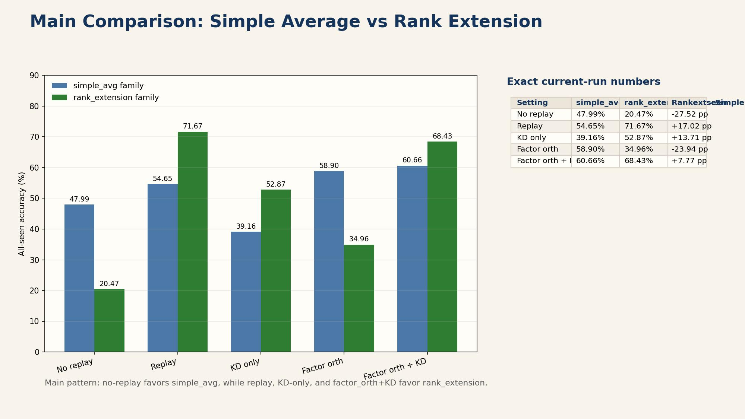
Notes:
Cell/function references: - Cell 9: do_merge_deltas(...), apply_deltas_to_base(...) - Cell 14: do_delta = do_merge_deltas(step_states_no_replay) Diagnostic prints include pairwise cosine before/after orthogonalization and column magnitude statistics.

Slide 10
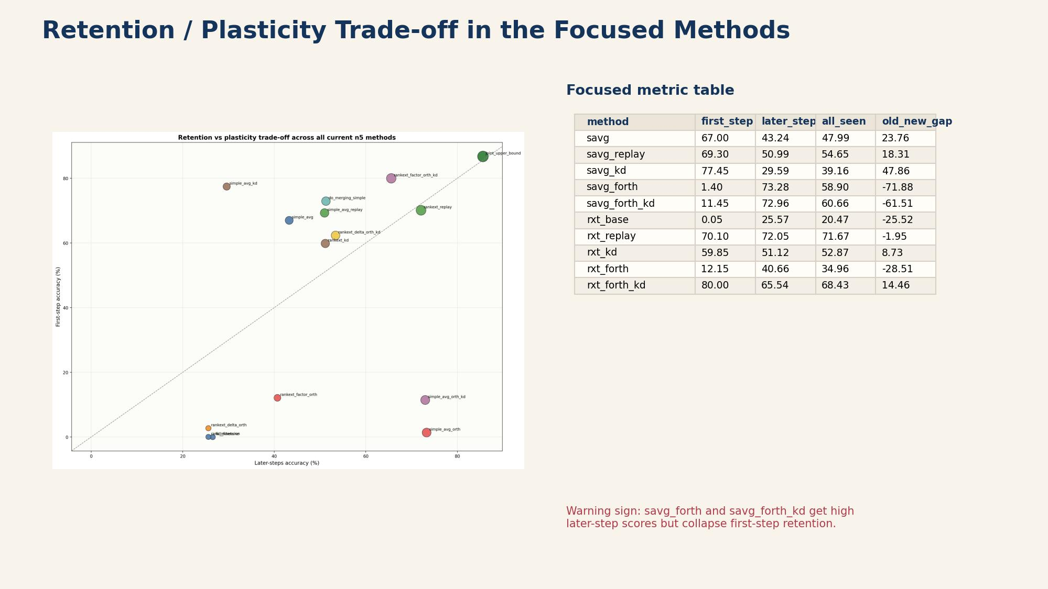
Notes:
Primary source: Cell 15. M_prev is extracted from base/current reference weights before training the current step LoRA. DeltaW_curr uses current LoRA factors (B @ A) with layer scaling.

Slide 11
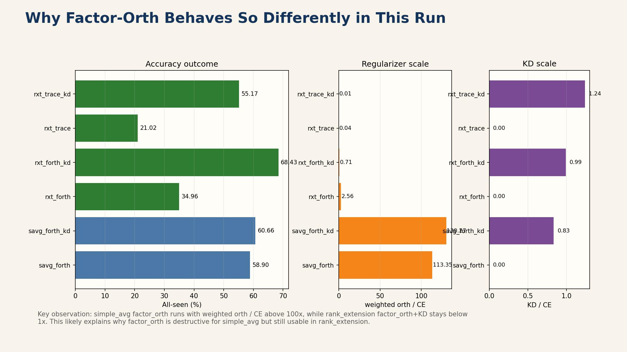
Notes:
Cell references: - Cell 15: orthogonal_loss method and diagnostics - Cell 11: IndependentLoraOrthTrainer for simple_avg_orth / do_merging_simple_orth source training - Cell 16: RankExtensionOrthTrainer path inside rank-extension variants This keeps orthogonality as an add-on regularizer rather than an isolated standalone method.

Slide 12
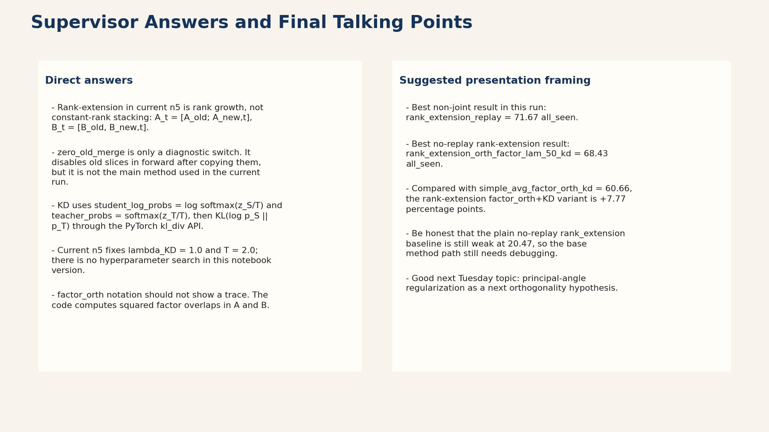
Notes:
Primary reporting source: Cell 19 (final pivot table + summary metrics). This slide explains exactly how the notebook quantifies method differences. Use this structure when discussing results with supervisor after cluster runs.

