Slide 1

Systèmes Embarqués Microprogrammés
NDSerum
Cassien Roth Beneton and Quentin Sandoz

Slide 2
NDS features: checklist (1/3)
ARM Processors
ARM9 controls the two screens, buttons except KEY_X / KEY_Y / touchscreen
ARM7 controls KEY_X / KEY_Y / touchscreen, sound
Timers / Interrupts
Timer 0 is used by the MaxMod sound streaming mode
Timer 1 is used by the sound gate functionality
Timer 2 is used by the wifi connexion status blinking
Graphics
Main screen: Mode 5 with Backgrounds 0, 2 and 3 (Ext. Rot. and Tiled modes)
Sub screen: Mode 5 with Backgrounds 0 and 2 (Ext. Rot. and Tiled modes)
Keypad
Control the wave played and displayed:
KEY_RIGHT / KEY_LEFT = Change the wave type
KEY_UP / KEY_DOWN = Change the number of wave periods displayed

Slide 3
NDS features: checklist (2/3)
KEY_L / KEY_R = Change the phase of the wave (fine tuning)
KEY_A = Mute/Unmute the sound
KEY_X / KEY_B = Increment/Decrement the wave frequency (fine tuning)
KEY_START = Enable/Disable the wireless sound synchronization
KEY_Y = Enable/Disable gate effect
Reading KEY_X / KEY_Y / KEY_START by polling
Touchscreen
Control of the wave parameters with the sliders/buttons (alternative to the keypad controls)
Control of the sound gate effect (on/off, gate speed)
Control of the wifi sync functionality
Control of the default parameters saving
Reading touchscreen by polling

Slide 4
NDS features: checklist (3/3)
Sound
Playing the wave displayed with the MaxMod sound streaming mode
WiFi
Possibility to synchronize all the wave properties, the mute functionality and the sound gate between multiple Nintendo DSi
Secondary Storage
Storing the wave parameters to load at startup in a text file
Reading the wave parameters to load at startup from a text file

Slide 5
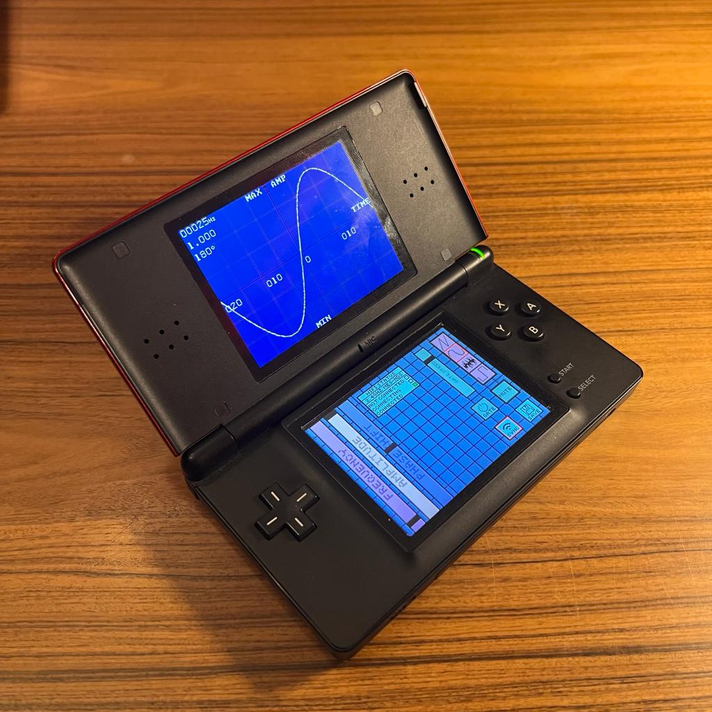
NDS project screenshot
Include an image with the final view/s of your project on the actual NDS device

