Slide 1


Slide 2




Verify - Vonage
Pros
Cons
Fall back functionality
Dashboard
1
Vonage offers a fallback feature where if a pin code isn’t used from text , the service will phone call once by WhatsApp, and after a time period will phone call a second time.
1
Limited dashboard features, offering nothing more than to view how many verification messages sent and the price of each verify request, and the number associated information.
API Availability
Customization
2
There are 3 primary APIs offered that offer the ability to make a verify request, view the status of a verify request as well as cancel a verify request.
2
There is a lack of control and customization over the verify message where an admin can only change the length of the pin sent between 4 and 6 digits, cannot just utilize Vonage for their WhatsApp service, there is a need to buy all other related products.
Fraud protection
Pricing
3
Vonage claims to have fraud protection by having “up to date intelligence” and adding more security to the 2FA authentication step.
3
The pricing is on the more expensive side of things with each successful verification request costing 0.5$.
*Credentials:
Username: privatekassem@gmail.com
Password: Demo@ccount1234_

Slide 3
Verify - Twilio
Pros
Cons
Customization
Documentation UI
1
With Twilio there are a variety of options an admin can select to customize the message such as the message template, pin code range from 4 to 10 digits.
1
The documentation is confusing and lacking with the proper explanation on how to implement and modify the necessary API requests.
Dashboard
Overview
2
Informative dashboard allowing features such as viewing all information of a verify request like time, phone number, location, expiry date. As well as fraud insights to view when and where a number has been detected as fraud
2
Twilio's overview section is very lacking and doesn’t over real value, only generic descriptions that are mostly unnecessary.
Fraud protection
Fallback
3
Twilio allows a free usage of their fraud protection that checks the number for malicious activity to prevent a potential SMS pumping attack (SMS pumping is when a high volume of request are sent to the verify service app).
3
No fallback service provided, as a result if a customer fails to activate/use the verification code then Twilio does not try another attempt.
*Credentials:
Username: kassem.faraj@apliman.com
Password: Demo@ccount1234_

Slide 4
Verify - Sinch
Pros
Cons
Documentation
Customization
1
Sinch provides a well written documentation with the expected inputs , outputs, and perimeters. As well as providing a variety of APIs for just the verification service.
1
Lack of features to customize the message, no options to modify the pin of the sinch verify code. nor an option to create a fallback feature.
Dashboard
Channels
2
The dashboard has a good structure that separates the different information such as analytics, reports etc., into categories making it easier to navigate and find the necessary data.
2
There are is only 1 message channel which is SMS that is available, and 2 phone call channels being Flash call and Phone Call.
Reports
Languages
3
Sinch allows the downloading of their reports as a CSV file, that contains the information of all charges, the methods , amount, currency, method, and more. Which lets the service user analyze their data thoroughly
3
There is a very limited selection of languages by which a verified message could be sent as, being a total of 16 languages provided by Sinch.
*Credentials:
Username: abdallah@apliman.com
Password: Apl!m@nn202

Slide 5
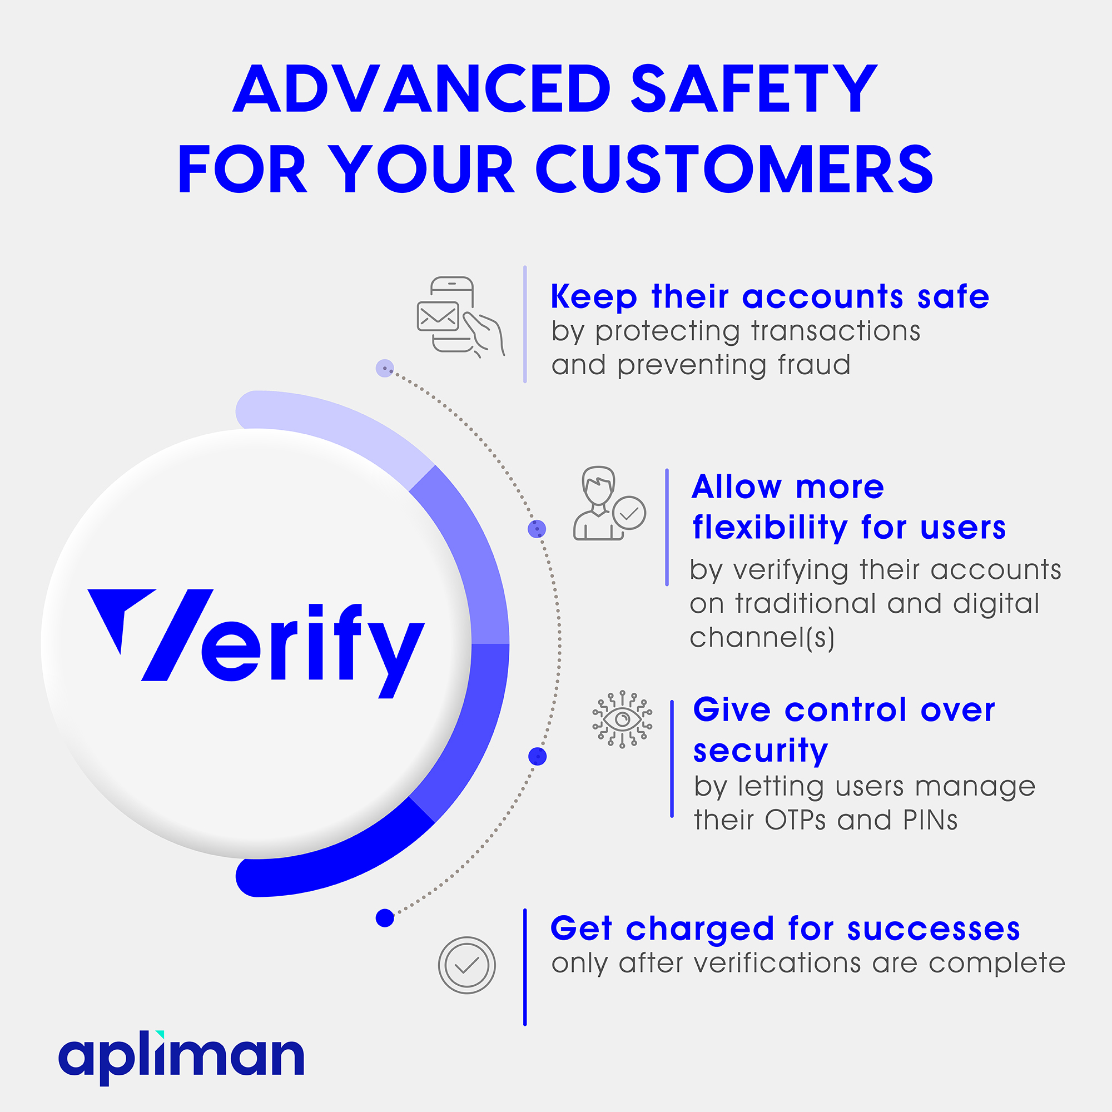
Verify
OTP Generation Logic – Backend
OTP Pushing – Channels
OTP Fall Back Logic – Channels
OTP Validation – Backend
Dashboard, Reports, & Service Management – Interface

Slide 6
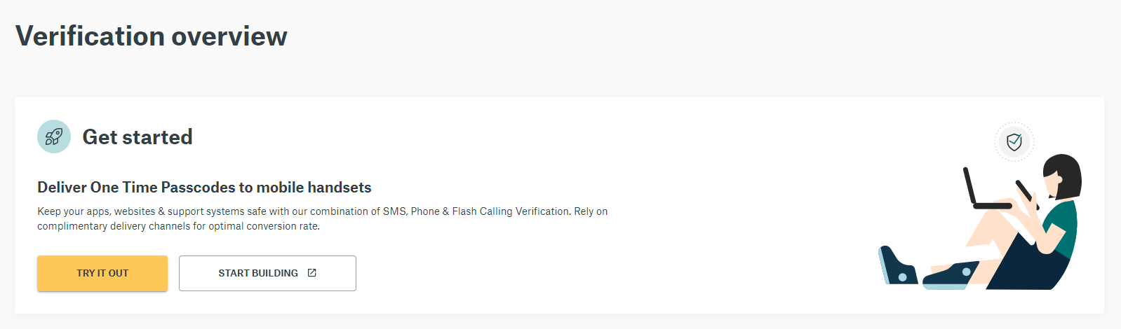
Verify
Admin Interface – Overview
Live Demo – TRY IT OUT
API Exploration
Support & Help

Slide 7
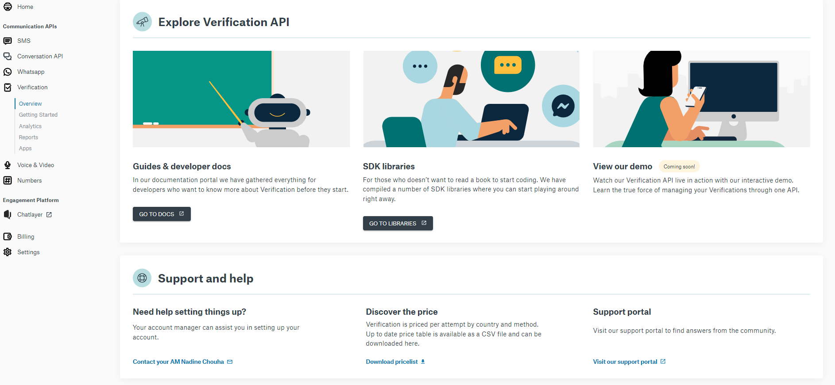
Verify
Admin Interface – Overview

Slide 8
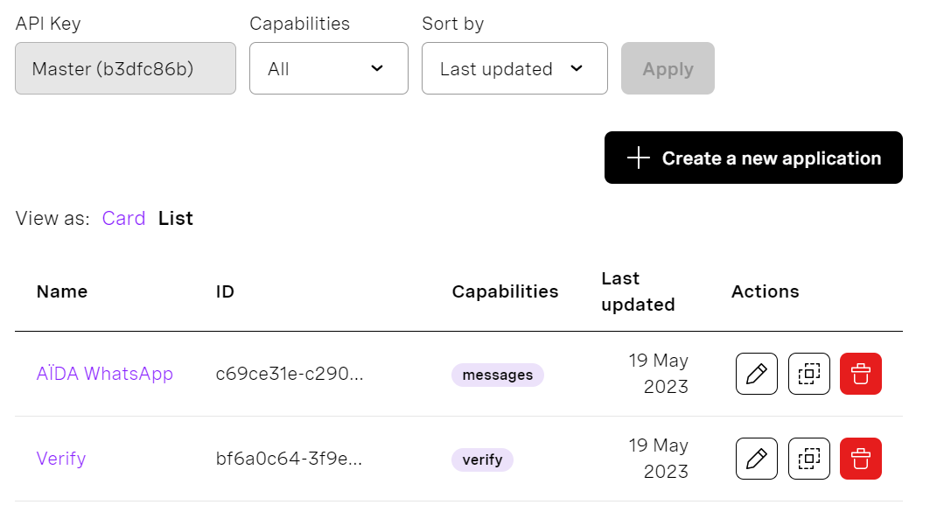
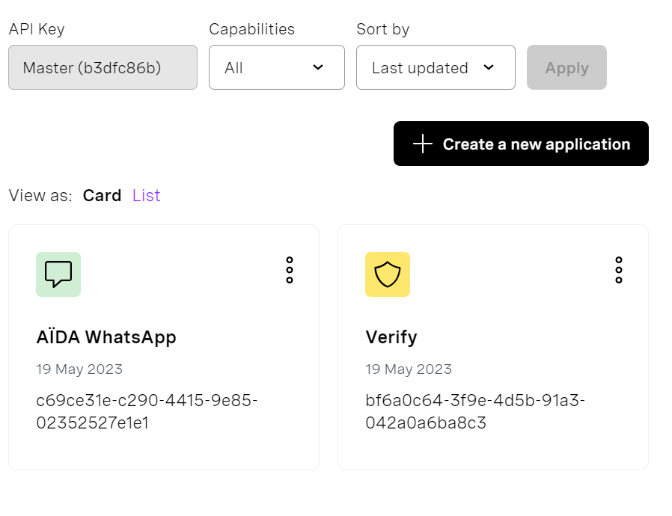
Verify
Admin Interface – Application View
Add New Application
Edit Application
Delete
Duplicate

Slide 9
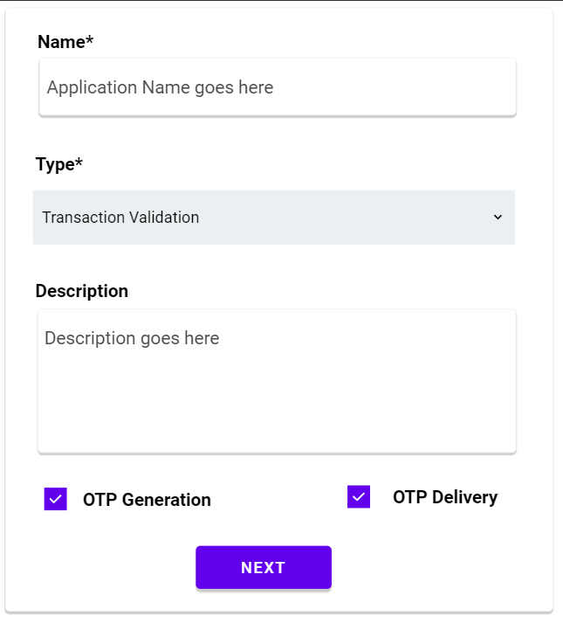
Verify
Admin Interface – Application Creation
Name – Mandatory
Type – Mandatory
Description – optional
Logic: Generation & Delivery

Slide 10
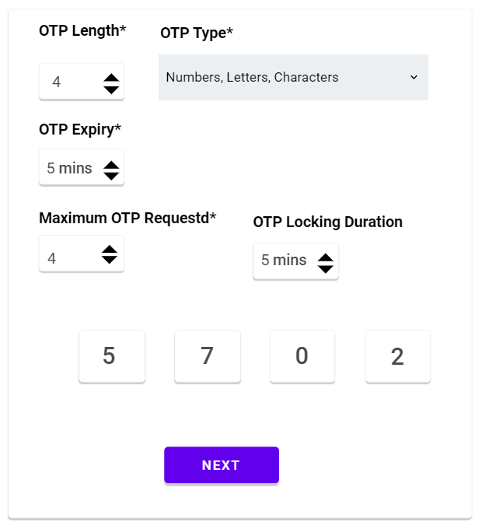
Verify
Admin Interface – OTP Settings
OTP Length – Mandatory
OTP Type – Mandatory
OTP Expiry – Mandatory
Maximum OTP Requests – Mandatory
OTP Locking Duration
OTP Preview

Slide 11
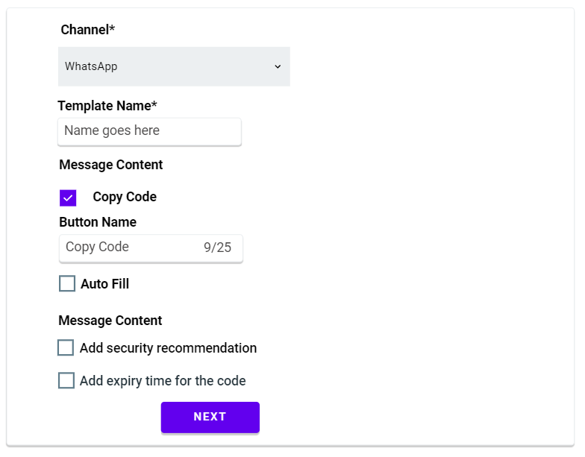

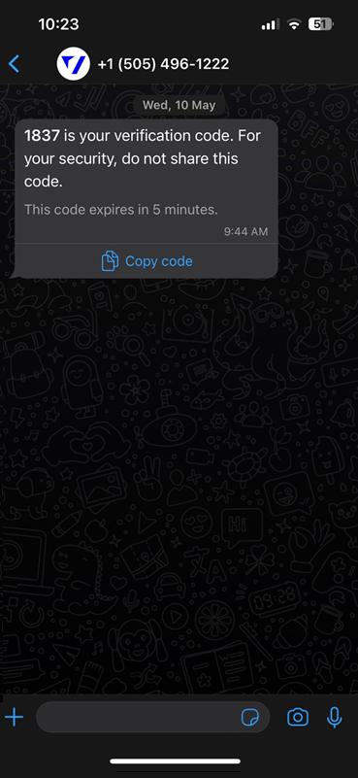
Verify
Admin Interface – Channel Selection
Channel Selection
Template definition
Preview
*WhatsApp OTP Templates could be directly created through Meta & the user only selects the template name from here.

Slide 12
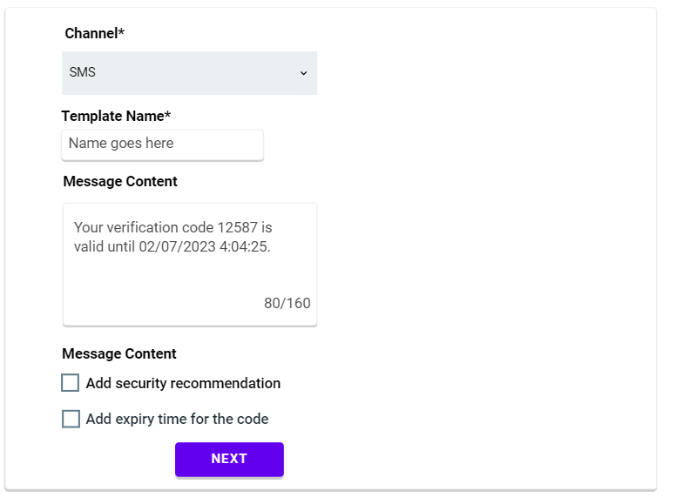

Verify
Admin Interface – Channel Selection
Channel Selection
Template definition
Preview
*SMS Recommendation to be shown.
*Channels could be IVR, Email, Viber, Telegram, WhatsApp, or SMS.
*For IVR, the user will be able to use TTS to define text and listen to it
*For email, a template will be filled with the ability to manage certain parameters and preview it

Slide 13
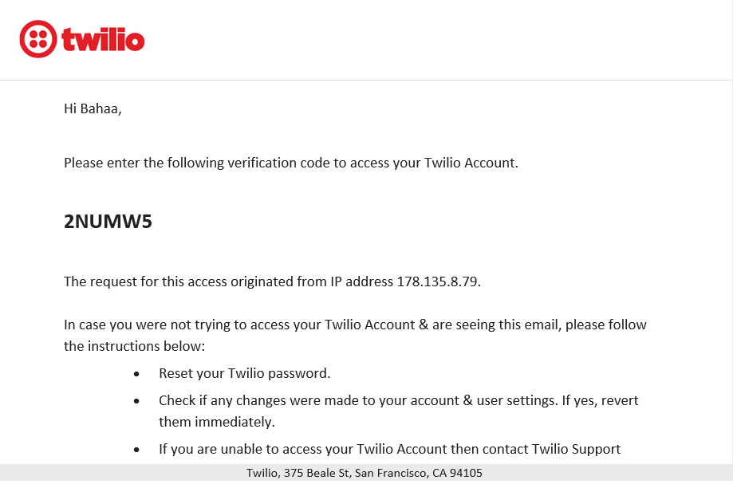
Verify
Admin Interface – Channel Selection

Slide 14
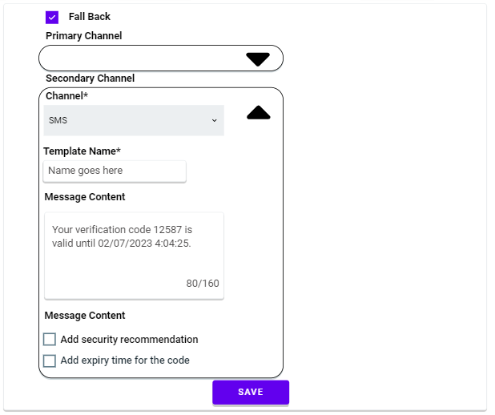
Verify
Admin Interface – Fall Back Logic
Enable/Disable
Primary Channel
Secondary Chanel
*Upon channel selection, once the user clicks on next, a popup could be displayed asking the user whether s/he would like to enable fallback logic or not. In case not this page is to be skipped.

Slide 15
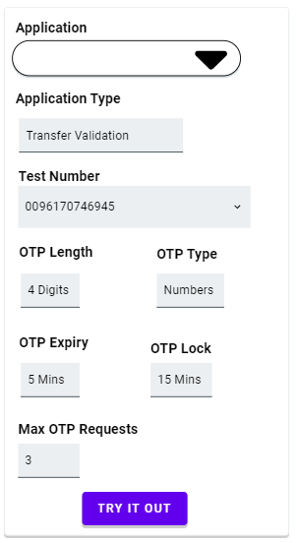
Verify
Admin Interface – Try it out
Application choice
App. Preview
Main Channel Preview
Fallback channels preview
Mobile Number display
*An edit button could be added, so the user can edit the settings.
*The edit button depends on the access right granted to the user

Slide 16
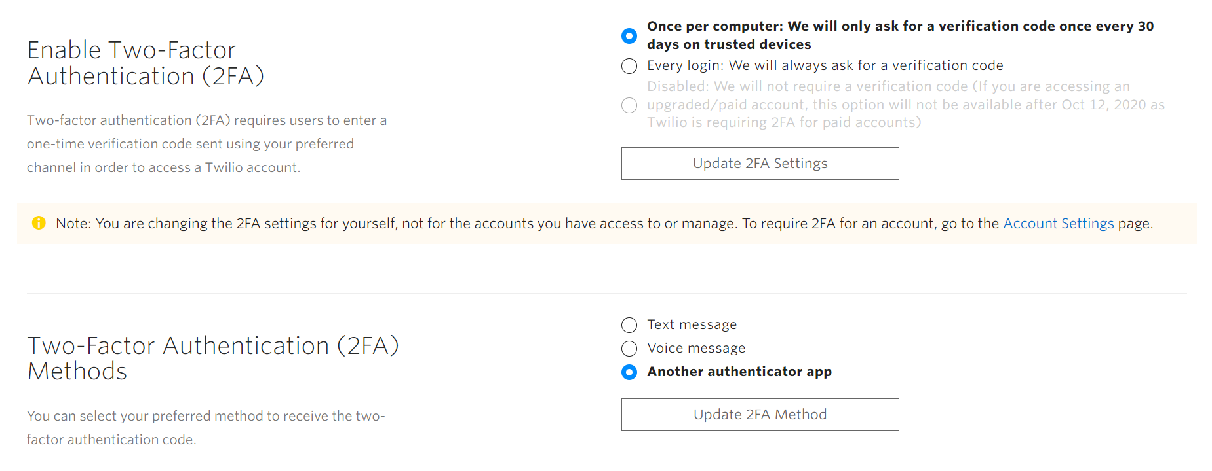
Verify
Admin Interface – 2FA Access Settings under user settings
Enable/Disable + Trigger
2FA Methods

Slide 17
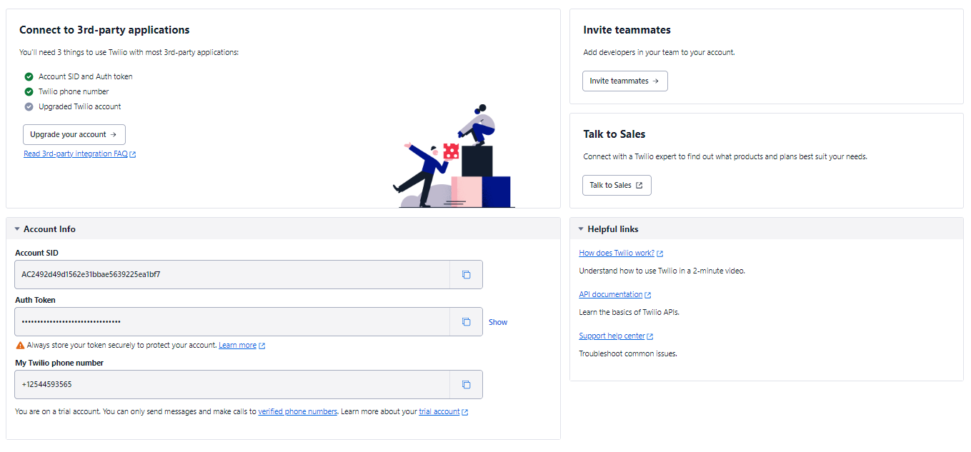
Verify
Admin Interface – Account info + test credits

Slide 18
Verify
Admin Interface – Settings Page
1
Application Type, Name & Details: Bank Transaction, Password Recovery, etc.
OTP Length Configuration: 4,6,8, etc. Digits.
OTP Type: Numbers, Characters, Combination of both, sequences allowed, etc.
OTP Expiry Time & count of OTP requests: 3, 5, 10, 15 Mins. 3 requests/20 mins
OTP Channel: WhatsApp, SMS, Email, IVR, etc. + Template
Fall Back Logic: Enable/Disable
Fall Back Primary & Secondary Channels: SMS, WhatsApp, Email, IVR.
2
3
4
5
6
7

Slide 19
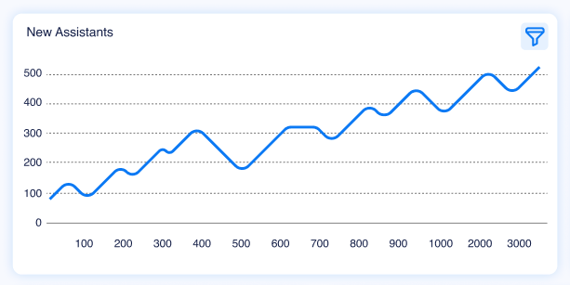
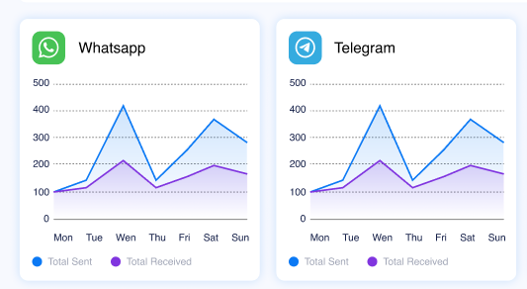
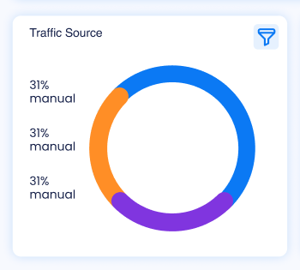
Verify
Admin Interface – Dashboard (Filter By App.)
1
OTPs Sent
OTPs Successfully Delivered
OTPs Used
OTPs Successfully Entered + reason
Invalid OTP
OTPs Distribution Per channel.
Fall Back channels
2
3
4
5
6
7

Slide 20
Verify
Admin Interface – Reports
1
OTPs Distribution: Total sent, delivered, used, success & failure
OTPs Distribution per channel: Total sent, WhatsApp, SMS, IVR, etc.
OTP Delivery – Fall Back logic: 1st channel, 2nd channel, 3rd channel
Fall Back Distribution: WhatsApp, SMS, IVR, etc.
Failed OTPs Distribution: Invalid, Expired, etc.
Account statement: Free credits, consumption, per-channel consumption, etc.
2
3
4
5
6

Slide 21
Verify
OTP Logic
1
OTPs Generation: Generating OTP Based on the admin configuration
OTPs Pushing per channel: Push OTP through the defined channel
OTP Fall Back Logic: main channel WhatsApp, 1st channel SMS, etc.
OTP Validation: The system shall validate the OTP once the user enters the pushed OTP.
2
3
4

Slide 22
Verify
OTP APIs
GetOTP: Generate OTP
Input(s):
Application ID
Output(s):
OTP Generated
VerifyOTP: Validate entered OTP
Input(s):
Application ID
OTP Entered
Output(s):
Status (Success, Wrong OTP, Expired)
*The OTP delivery and the fallback logic statistics APIs shall be handled at the channel level.

Slide 23
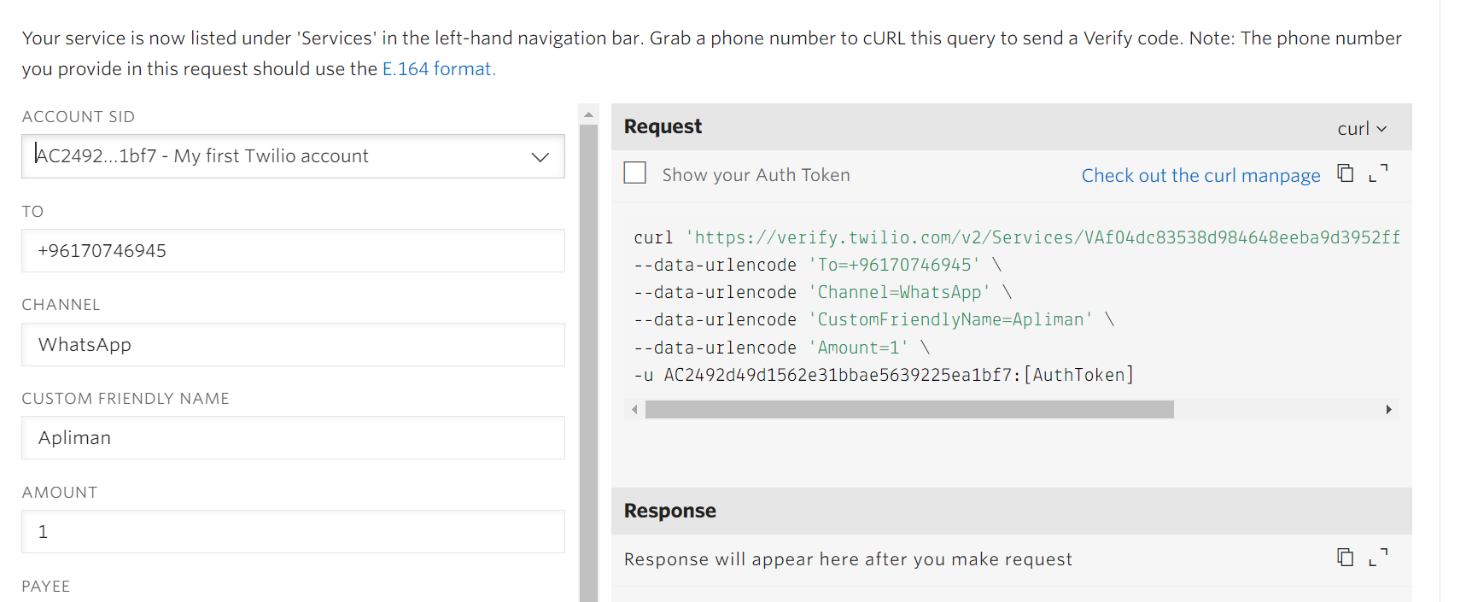
Verify
OTP APIs

Slide 24
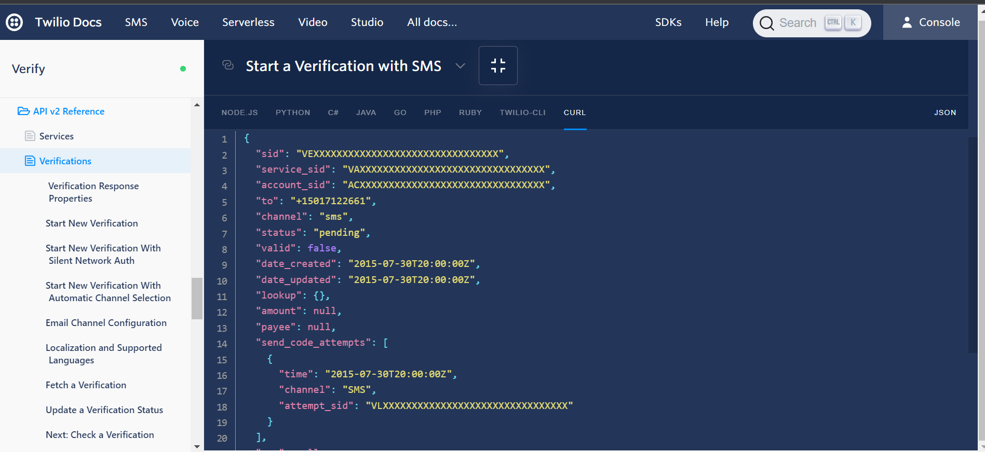
Verify
OTP APIs

Slide 25
THANK YOU

