Slide 1

Computation Method (MATLAB Programming)
Chul Min Yeum
Assistant Professor
Civil and Environmental Engineering
University of Waterloo, Canada
Notes:
Here is a brief introduction of the course material.

Slide 2

Module 01: Basic MATLAB Programming
Chul Min Yeum
Assistant Professor
Civil and Environmental Engineering
University of Waterloo, Canada
Notes:
Module 1 is introduction of matlab programming.

Slide 3
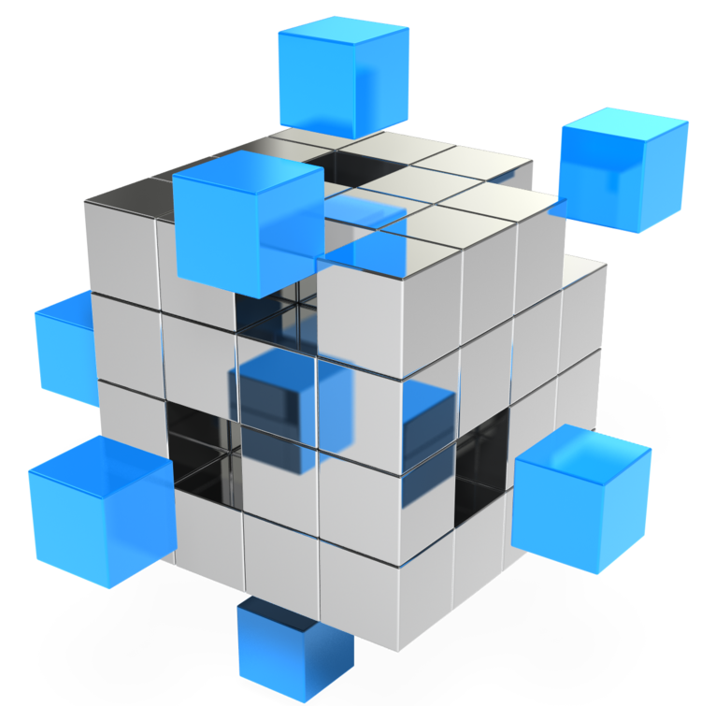
Module 02: Vectors and Matrices
Chul Min Yeum
Assistant Professor
Civil and Environmental Engineering
University of Waterloo, Canada
Notes:
We are going to talk about vectors and matrix.
Array operation, like vector and matrix, is the most important topic in MATLAB.
Actually, MATLAB stands for “matrix laboratory”
It is specialized in matrix involved operations.

Slide 4

Module 03: Selection Statement
Chul Min Yeum
Assistant Professor
Civil and Environmental Engineering
University of Waterloo, Canada
Notes:
Today, we’re going to talk about selection statement, as known as if-statement.

Slide 5

Module 04: Loop Statement
Chul Min Yeum
Assistant Professor
Civil and Environmental Engineering
University of Waterloo, Canada
Notes:
Loop statement is the most important programming structure.
Basically, if you know condition statement and loop statement, you can solve almost every programming problems.

Slide 6
Summation of Values in a Matrix
2 | 8 | 7 | 9
1 | 5 | 6 | 7
2 | 3 | 1 | 5
1 2 3 4 5 6 7 | mat1 = [2 8 7 9; 1 5 6 7;2 3 1 5]; sumv = 0; for ii=1:3 for jj=1:4 sumv = sumv + mat1(ii,jj); end end

Slide 7
Summation of Values in a Matrix
2 | 8 | 7 | 9
1 | 5 | 6 | 7
2 | 3 | 1 | 5
1 2 3 4 5 6 7 | mat1 = [2 8 7 9; 1 5 6 7;2 3 1 5]; sumv = 0; for ii=1:3 for jj=1:4 sumv = sumv + mat1(ii,jj); end end
ii → 1
jj → 1
sumv → 2
mat1(ii,jj)

Slide 8
Summation of Values in a Matrix
2 | 8 | 7 | 9
1 | 5 | 6 | 7
2 | 3 | 1 | 5
1 2 3 4 5 6 7 | mat1 = [2 8 7 9; 1 5 6 7;2 3 1 5]; sumv = 0; for ii=1:3 for jj=1:4 sumv = sumv + mat1(ii,jj); end end
ii → 1
jj → 2
sumv → 10
mat1(ii,jj)

Slide 9
Summation of Values in a Matrix
2 | 8 | 7 | 9
1 | 5 | 6 | 7
2 | 3 | 1 | 5
1 2 3 4 5 6 7 | mat1 = [2 8 7 9; 1 5 6 7;2 3 1 5]; sumv = 0; for ii=1:3 for jj=1:4 sumv = sumv + mat1(ii,jj); end end
ii → 1
jj → 3
sumv → 17
mat1(ii,jj)

Slide 10
Summation of Values in a Matrix
2 | 8 | 7 | 9
1 | 5 | 6 | 7
2 | 3 | 1 | 5
1 2 3 4 5 6 7 | mat1 = [2 8 7 9; 1 5 6 7;2 3 1 5]; sumv = 0; for ii=1:3 for jj=1:4 sumv = sumv + mat1(ii,jj); end end
ii → 1
jj → 4
sumv → 26
mat1(ii,jj)

Slide 11
Summation of Values in a Matrix
2 | 8 | 7 | 9
1 | 5 | 6 | 7
2 | 3 | 1 | 5
1 2 3 4 5 6 7 | mat1 = [2 8 7 9; 1 5 6 7;2 3 1 5]; sumv = 0; for ii=1:3 for jj=1:4 sumv = sumv + mat1(ii,jj); end end
ii → 2
jj → 1
sumv → 27
mat1(ii,jj)

Slide 12
Summation of Values in a Matrix
2 | 8 | 7 | 9
1 | 5 | 6 | 7
2 | 3 | 1 | 5
1 2 3 4 5 6 7 | mat1 = [2 8 7 9; 1 5 6 7;2 3 1 5]; sumv = 0; for ii=1:3 for jj=1:4 sumv = sumv + mat1(ii,jj); end end
ii → 2
jj → 2
sumv → 32
mat1(ii,jj)

Slide 13
Summation of Values in a Matrix
2 | 8 | 7 | 9
1 | 5 | 6 | 7
2 | 3 | 1 | 5
1 2 3 4 5 6 7 | mat1 = [2 8 7 9; 1 5 6 7;2 3 1 5]; sumv = 0; for ii=1:3 for jj=1:4 sumv = sumv + mat1(ii,jj); end end
ii → 2
jj → 3
sumv → 38
mat1(ii,jj)

Slide 14
Summation of Values in a Matrix
2 | 8 | 7 | 9
1 | 5 | 6 | 7
2 | 3 | 1 | 5
1 2 3 4 5 6 7 | mat1 = [2 8 7 9; 1 5 6 7;2 3 1 5]; sumv = 0; for ii=1:3 for jj=1:4 sumv = sumv + mat1(ii,jj); end end
ii → 2
jj → 4
sumv → 45
mat1(ii,jj)

Slide 15
Word Finder Puzzle
puzzle_size → 10
n_word → 6
puzzle_size-n_word+1 → 5
a | v | d | a | k | w | a | I | h | z
w | j | s | a | u | e | a | u | g | x
d | h | q | d | k | r | d | y | f | c
f | b | w | y | k | t | f | t | d | v
d | a | e | u | h | u | v | r | s | b
s | n | f | I | s | h | e | w | q | n
a | a | d | w | s | t | q | e | w | m
q | n | s | e | d | n | w | w | e | l
y | a | a | s | f | h | e | q | y | k
q | w | e | r | t | y | u | I | h | j
for ii=1:puzzle_size col_vec = puzzle(:,ii); for jj=1:(puzzle_size-n_word+1) test_loc = jj:(jj+n_word-1); test_word = col_vec(test_loc); end end
ii → 1
jj → 1
test_loc → [1:6]
test_word
col_vec

Slide 16
Word Finder Puzzle
puzzle_size → 10
n_word → 6
puzzle_size-n_word+1 → 5
a | v | d | a | k | w | a | I | h | z
w | j | s | a | u | e | a | u | g | x
d | h | q | d | k | r | d | y | f | c
f | b | w | y | k | t | f | t | d | v
d | a | e | u | h | u | v | r | s | b
s | n | f | I | s | h | e | w | q | n
a | a | d | w | s | t | q | e | w | m
q | n | s | e | d | n | w | w | e | l
y | a | a | s | f | h | e | q | y | k
q | w | e | r | t | y | u | I | h | j
for ii=1:puzzle_size col_vec = puzzle(:,ii); for jj=1:(puzzle_size-n_word+1) test_loc = jj:(jj+n_word-1); test_word = col_vec(test_loc); end end
ii → 1
jj → 2
test_loc → [2:7]
test_word
col_vec

Slide 17
Word Finder Puzzle
puzzle_size → 10
n_word → 6
puzzle_size-n_word+1 → 5
a | v | d | a | k | w | a | I | h | z
w | j | s | a | u | e | a | u | g | x
d | h | q | d | k | r | d | y | f | c
f | b | w | y | k | t | f | t | d | v
d | a | e | u | h | u | v | r | s | b
s | n | f | I | s | h | e | w | q | n
a | a | d | w | s | t | q | e | w | m
q | n | s | e | d | n | w | w | e | l
y | a | a | s | f | h | e | q | y | k
q | w | e | r | t | y | u | I | h | j
for ii=1:puzzle_size col_vec = puzzle(:,ii); for jj=1:(puzzle_size-n_word+1) test_loc = jj:(jj+n_word-1); test_word = col_vec(test_loc); end end
ii → 1
jj → 3
test_loc → [3:7]
test_word
col_vec

Slide 18
Word Finder Puzzle
puzzle_size → 10
n_word → 6
puzzle_size-n_word+1 → 5
a | v | d | a | k | w | a | I | h | z
w | j | s | a | u | e | a | u | g | x
d | h | q | d | k | r | d | y | f | c
f | b | w | y | k | t | f | t | d | v
d | a | e | u | h | u | v | r | s | b
s | n | f | I | s | h | e | w | q | n
a | a | d | w | s | t | q | e | w | m
q | n | s | e | d | n | w | w | e | l
y | a | a | s | f | h | e | q | y | k
q | w | e | r | t | y | u | I | h | j
for ii=1:puzzle_size col_vec = puzzle(:,ii); for jj=1:(puzzle_size-n_word+1) test_loc = jj:(jj+n_word-1); test_word = col_vec(test_loc); end end
ii → 1
jj → 4
test_loc → [4:8]
test_word
col_vec

Slide 19
Word Finder Puzzle
puzzle_size → 10
n_word → 6
puzzle_size-n_word+1 → 5
a | v | d | a | k | w | a | I | h | z
w | j | s | a | u | e | a | u | g | x
d | h | q | d | k | r | d | y | f | c
f | b | w | y | k | t | f | t | d | v
d | a | e | u | h | u | v | r | s | b
s | n | f | I | s | h | e | w | q | n
a | a | d | w | s | t | q | e | w | m
q | n | s | e | d | n | w | w | e | l
y | a | a | s | f | h | e | q | y | k
q | w | e | r | t | y | u | I | h | j
for ii=1:puzzle_size col_vec = puzzle(:,ii); for jj=1:(puzzle_size-n_word+1) test_loc = jj:(jj+n_word-1); test_word = col_vec(test_loc); end end
ii → 1
jj → 5
test_loc → [5:9]
test_word
col_vec

Slide 20
Word Finder Puzzle
puzzle_size → 10
n_word → 6
puzzle_size-n_word+1 → 5
a | v | d | a | k | w | a | I | h | z
w | j | s | a | u | e | a | u | g | x
d | h | q | d | k | r | d | y | f | c
f | b | w | y | k | t | f | t | d | v
d | a | e | u | h | u | v | r | s | b
s | n | f | I | s | h | e | w | q | n
a | a | d | w | s | t | q | e | w | m
q | n | s | e | d | n | w | w | e | l
y | a | a | s | f | h | e | q | y | k
q | w | e | r | t | y | u | I | h | j
for ii=1:puzzle_size col_vec = puzzle(:,ii); for jj=1:(puzzle_size-n_word+1) test_loc = jj:(jj+n_word-1); test_word = col_vec(test_loc); end end
ii → 2
jj → 1
test_loc → [1:6]
test_word
col_vec

Slide 21
Word Finder Puzzle
puzzle_size → 10
n_word → 6
puzzle_size-n_word+1 → 5
a | v | d | a | k | w | a | I | h | z
w | j | s | a | u | e | a | u | g | x
d | h | q | d | k | r | d | y | f | c
f | b | w | y | k | t | f | t | d | v
d | a | e | u | h | u | v | r | s | b
s | n | f | I | s | h | e | w | q | n
a | a | d | w | s | t | q | e | w | m
q | n | s | e | d | n | w | w | e | l
y | a | a | s | f | h | e | q | y | k
q | w | e | r | t | y | u | I | h | j
for ii=1:puzzle_size col_vec = puzzle(:,ii); for jj=1:(puzzle_size-n_word+1) test_loc = jj:(jj+n_word-1); test_word = col_vec(test_loc); end end
ii → 2
jj → 2
test_loc → [2:7]
test_word
col_vec

Slide 22
Word Finder Puzzle
puzzle_size → 10
n_word → 6
puzzle_size-n_word+1 → 5
a | v | d | a | k | w | a | I | h | z
w | j | s | a | u | e | a | u | g | x
d | h | q | d | k | r | d | y | f | c
f | b | w | y | k | t | f | t | d | v
d | a | e | u | h | u | v | r | s | b
s | n | f | I | s | h | e | w | q | n
a | a | d | w | s | t | q | e | w | m
q | n | s | e | d | n | w | w | e | l
y | a | a | s | f | h | e | q | y | k
q | w | e | r | t | y | u | I | h | j
for ii=1:puzzle_size col_vec = puzzle(:,ii); for jj=1:(puzzle_size-n_word+1) test_loc = jj:(jj+n_word-1); test_word = col_vec(test_loc); end end
ii → 2
jj → 3
test_loc → [3:7]
test_word
col_vec

Slide 23

Word Finder Puzzle
puzzle_size → 10
n_word → 6
puzzle_size-n_word+1 → 5
a | v | d | a | k | w | a | I | h | z
w | j | s | a | u | e | a | u | g | x
d | h | q | d | k | r | d | y | f | c
f | b | w | y | k | t | f | t | d | v
d | a | e | u | h | u | v | r | s | b
s | n | f | I | s | h | e | w | q | n
a | a | d | w | s | t | q | e | w | m
q | n | s | e | d | n | w | w | e | l
y | a | a | s | f | h | e | q | y | k
q | w | e | r | t | y | u | I | h | j
for ii=1:puzzle_size col_vec = puzzle(:,ii); for jj=1:(puzzle_size-n_word+1) test_loc = jj:(jj+n_word-1); test_word = col_vec(test_loc); end end
ii → 2
jj → 4
test_loc → [4:8]
test_word
col_vec

Slide 24
Word Finder Puzzle
puzzle_size → 10
n_word → 6
puzzle_size-n_word+1 → 5
a | v | d | a | k | w | a | I | h | z
w | j | s | a | u | e | a | u | g | x
d | h | q | d | k | r | d | y | f | c
f | b | w | y | k | t | f | t | d | v
d | a | e | u | h | u | v | r | s | b
s | n | f | I | s | h | e | w | q | n
a | a | d | w | s | t | q | e | w | m
q | n | s | e | d | n | w | w | e | l
y | a | a | s | f | h | e | q | y | k
q | w | e | r | t | y | u | I | h | j
for ii=1:puzzle_size col_vec = puzzle(:,ii); for jj=1:(puzzle_size-n_word+1) test_loc = jj:(jj+n_word-1); test_word = col_vec(test_loc); end end
ii → 2
jj → 5
test_loc → [5:9]
test_word
col_vec

Slide 25

Built-in Functions
Chul Min Yeum
Assistant Professor
Civil and Environmental Engineering
University of Waterloo, Canada

Slide 26

Operators
Chul Min Yeum
Assistant Professor
Civil and Environmental Engineering
University of Waterloo, Canada

Slide 27

Function
Chul Min Yeum
Assistant Professor
Civil and Environmental Engineering
University of Waterloo, Canada

Slide 28

Plotting
Chul Min Yeum
Assistant Professor
Civil and Environmental Engineering
University of Waterloo, Canada

Slide 29

Data Structure
Chul Min Yeum
Assistant Professor
Civil and Environmental Engineering
University of Waterloo, Canada

Slide 30

File I/O
Chul Min Yeum
Assistant Professor
Civil and Environmental Engineering
University of Waterloo, Canada

Slide 31

Text Manipulation
Chul Min Yeum
Assistant Professor
Civil and Environmental Engineering
University of Waterloo, Canada

Slide 32
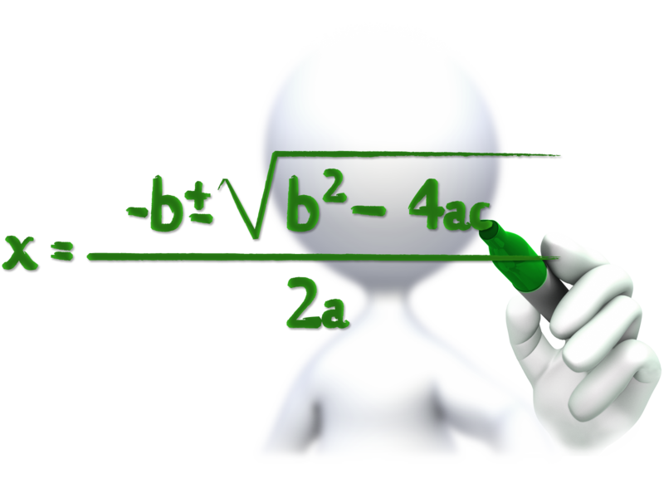
Symbolic Function
Chul Min Yeum
Assistant Professor
Civil and Environmental Engineering
University of Waterloo, Canada

