Slide 1
Review for Problem 3 in Lab06
Chul Min Yeum
Assistant Professor
Civil and Environmental Engineering
University of Waterloo, Canada
AE121: Computational Method
Last updated: 2019-06-18

Slide 2
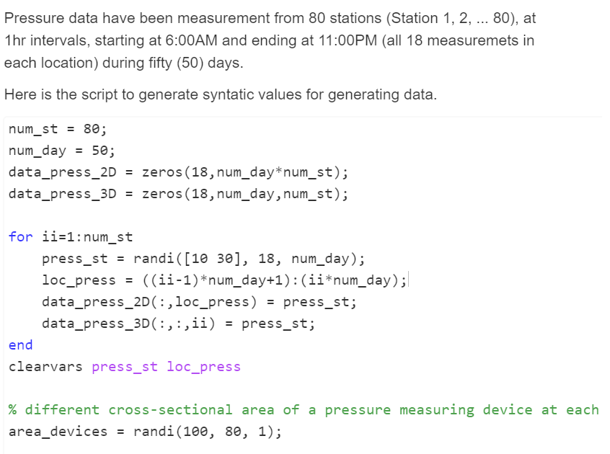
Problem 3: Pressure Calculation
In every iteration, a new ‘press_st’ is changed and assigned to ‘data_press_2D’ and ‘data_press_3D’.
ii:1
loc_press = ((1-1)*50+1) : (1*50)
data_press(:,1:50) = press_st
data_press(:,:,1) = press_st
1:50
ii:2
loc_press = ((2-1)*50+1) : (2*50)
data_press(:,51:100) = press_st
data_press(:,:,2) = press_st
51:100

Slide 3
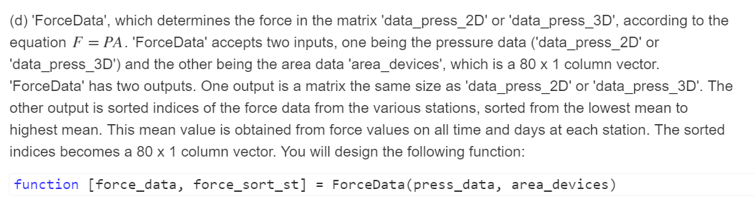
Question d)
press_data : a 18 x 50 x 80 matrix or a 18 x 4000 matrix
area_devices : a 80 x 1 column vector

Slide 4
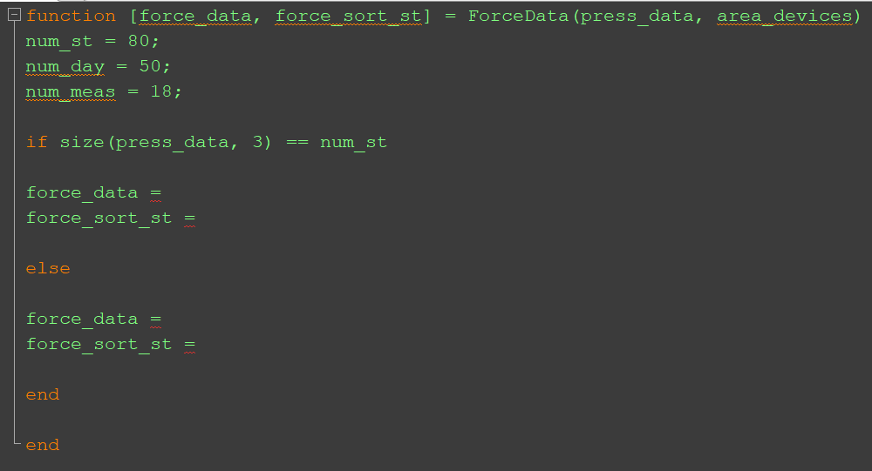
1) Selection Statement
Depending on the dimension of ‘press_data’, the operation is different.

Slide 5
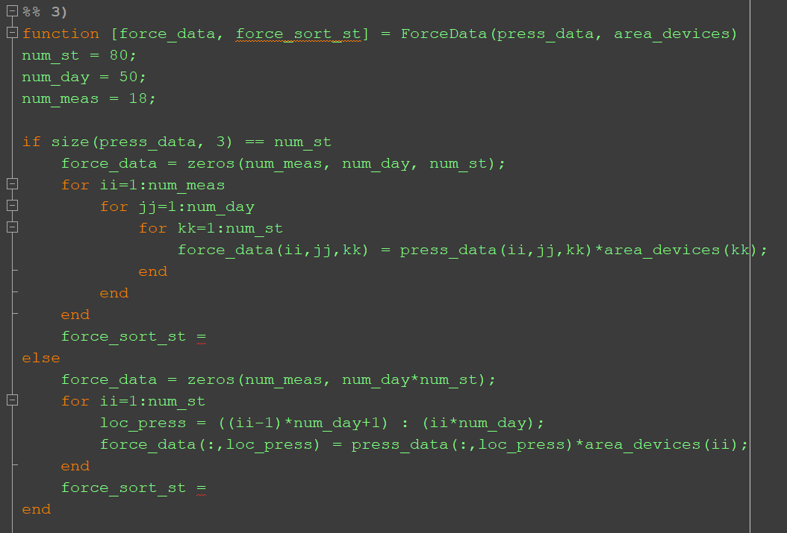
2) Force Computation

Slide 6
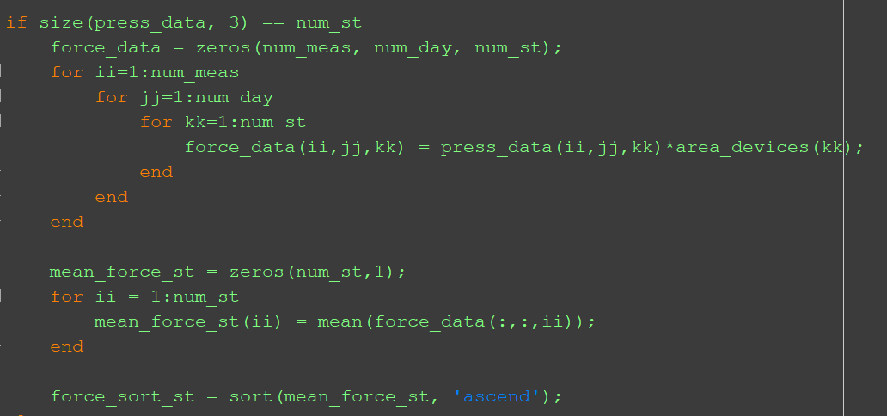
3) Sorting Average Force Values (3D Matrix)

Slide 7
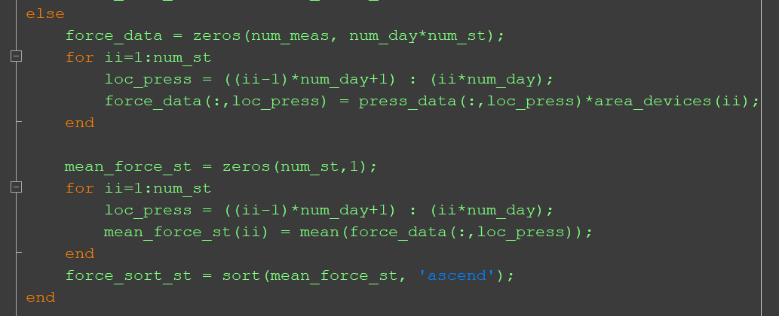
4) Sorting Average Force Values (2D Matrix)

Slide 8
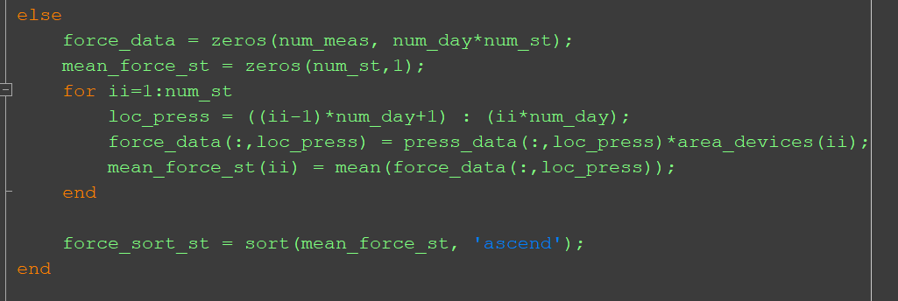
4) Sorting Average Force Values (2D Matrix) (Continue)

Slide 9
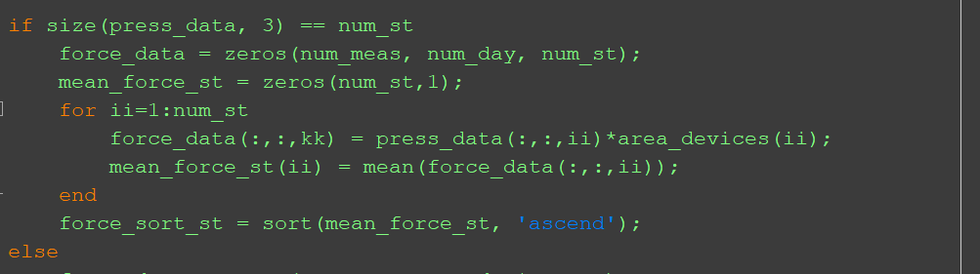
5) Simplifying Solutions
NEW
OLD

Slide 10
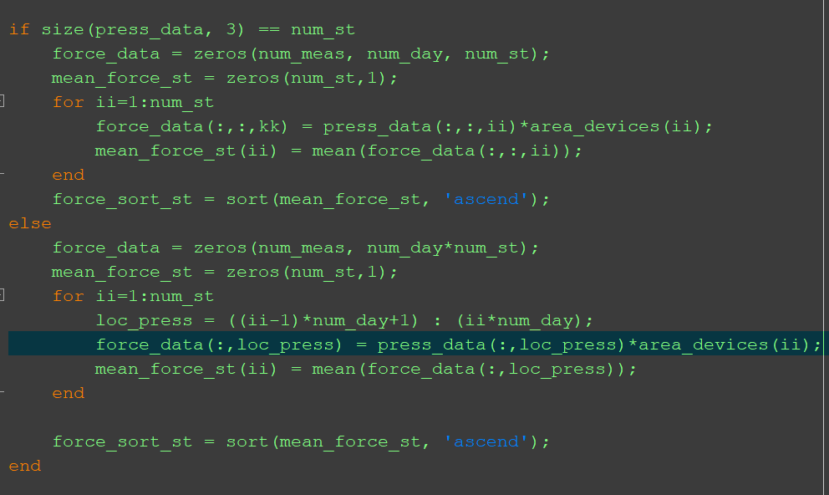
6) Additional Simplification

Slide 11
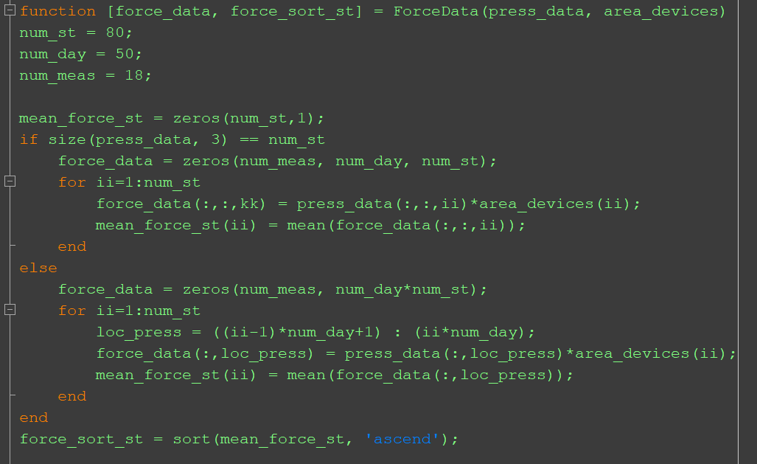
6) Additional Simplification (Continue)

