Slide 1
File Input and Output
Chul Min Yeum and Jason Connelly
Civil and Environmental Engineering
University of Waterloo, Canada
AE121: Computational Method
Last updated: 2019-07-08

Slide 2



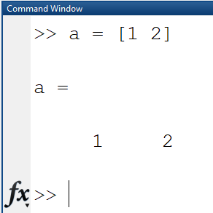

When Do We Use File Input and Output?
Input text
Text file
Excel file
Graph
Print
Text file
Excel file

Slide 3

When Do We Use File Input and Output?
Input text
Text file
Excel file
Graph
Print
Text file
Excel file

Slide 4
File Input & Output (I/O)
Lower-level file I/O functions are used to read from, write to, and append to files when load and save cannot be used
MATLAB has functions to read from and write to many different file types, for example, spreadsheets
MATLAB has a special binary file type that can be used to store variables and their contents in MAT-files

Slide 5
Using MAT-files for Variables
MATLAB has functions that allow reading and saving variables from files
These files are called MAT-files (because the extension on the file name is .mat)
Variables can be written to MAT-files, appended to them, and read from them
Rather than just storing data, MAT-files store variable names and their values
To save all workspace variables in a file, the command is:
save filename
To save just one variable to a file, the format is:
save filename variablename
To append:
save -append filename variablename
To read variables from a MAT-file into the base workspace:
load filename variable list

Slide 6
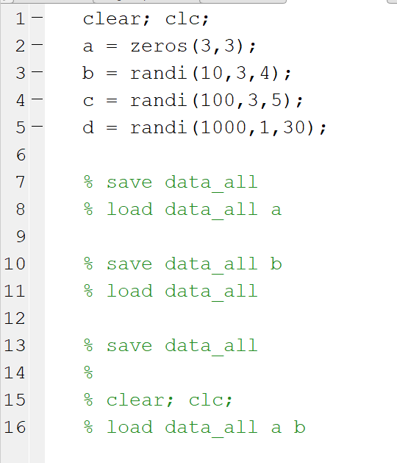
Live Demo: File Save

Slide 7
Importing Data from a .txt File
The text file must be saved in the current folder that you are working in on MATLAB
Delimiter: sequence of one or more characters used to specify boundaries between separate regions
Three importing scenarios:
Importing numeric data
Importing character (string) data
Importing numeric and character data

Slide 8
Print Formatting Operators
The print formatting operators specify in what layout and what data type a column of data will be imported/exported as – for multiple columns of data, use multiple print format operators
Common Print Formatting Operators:
%d –For integer numbers
%f –For floating point (decimal) numbers
%s –For entire character vectors or strings
Note that you can only use 1 operator per column (you cannot specify ‘%s’ for the first value in a column and ‘%f’ for all other values
Example: If you wanted your first column of data to be integer data, the second column to be stored as character data and the third to be floating point numbers, the correct format string would be:
‘%d %s %f’

Slide 9
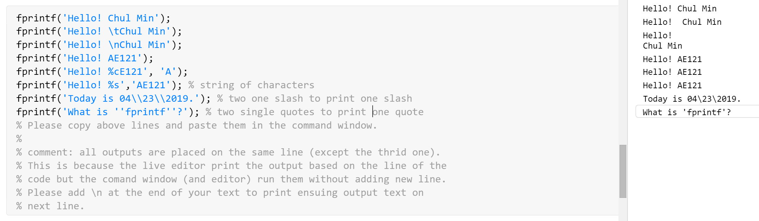
Revisit: Print Formatting

Slide 10
textscan function
The textscan function will create a cell array from the data read on the .txt file
This function can be used to import numeric data, text data and both types of data from the same file easily
When importing using textscan, the data is imported column-by-column
You can specify using print formatting operators what type of data you want each column to be
Data will be stored in a cell, where each column is a different cell array element
You have the option of specifying a delimiter. The default delimiter is white-space.

Slide 11

fopen function
Used to open a file for a specific purpose
You can specify your purpose using a permission specifier, which is the second input
The file does not have to already exist (although for reading data it should)
The default permission is read only
Read only access:
Write only access (discard original contents of a file):
Read and write access (discard original contents of file if writing):

Slide 12
General Procedure for Importing Data using textscan
Open the file to be read by creating a ‘fid’
This is creating a hidden ID that represents the file
Use the textscan function to import the data using the proper format string and delimiter. If the delimiter you want is whitespace, you do not need to specify a delimiter
Close the file you have just read
Comma delimiter:
White-space delimiter:

Slide 13
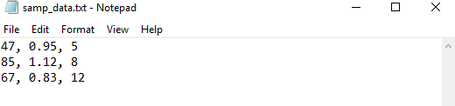
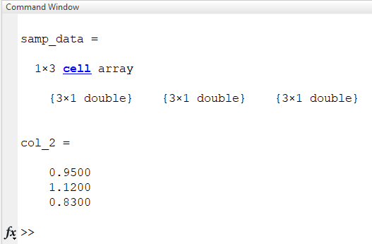
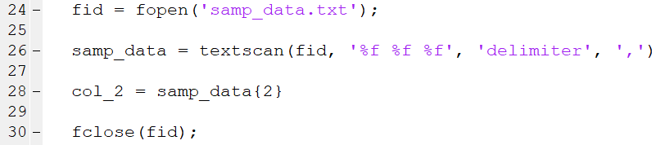
Example: Columns of Numeric Data
3 columns of data – when importing, you will need to specify 3 print formatting operators if you want the grouping to remain the same

Slide 14
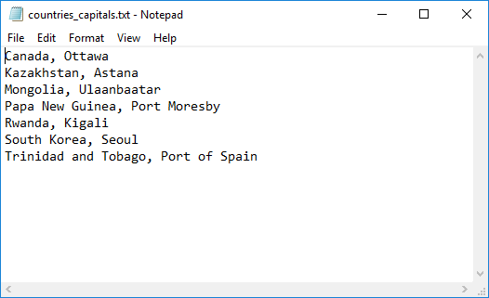
Question: Importing Text Data
Why isn’t the white-space delimiter used in this case???

Slide 15
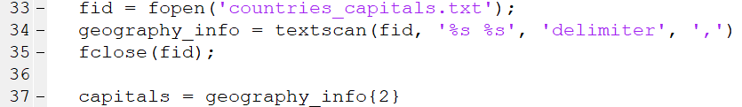
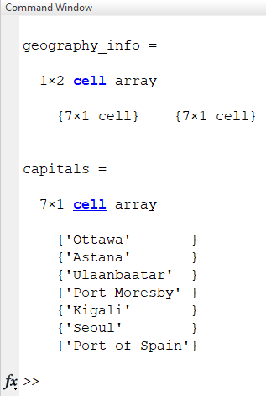
Example: Importing Text Data

Slide 16
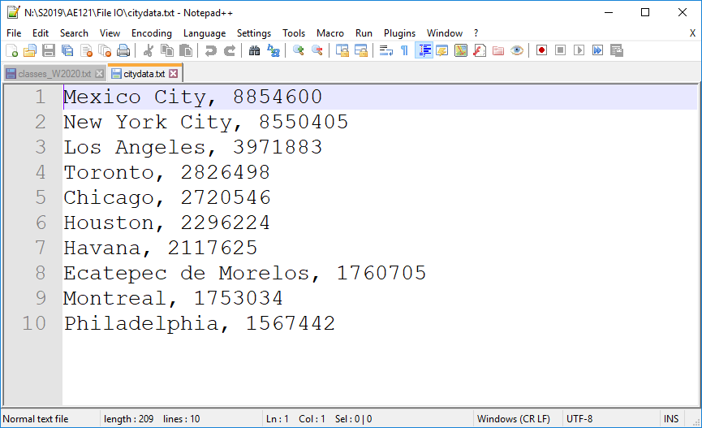
Example: Text and Numeric Data

Slide 17
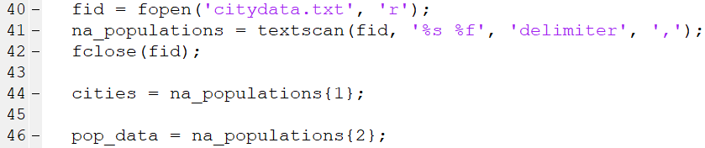
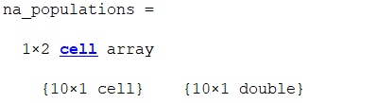
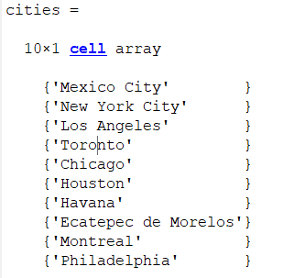
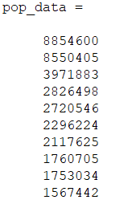
Example: Text and Numeric Data
Notes:
Could add .txt image

Slide 18
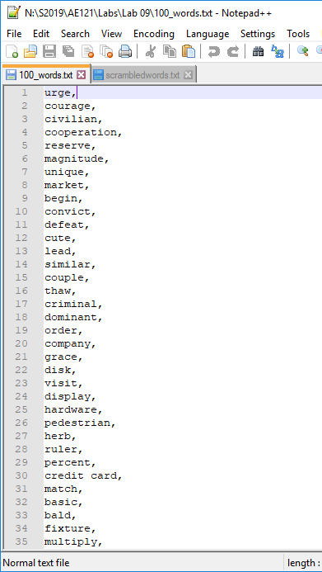

Example from Lab 09: Import Data from a .txt File
How to import a text file of words that have a comma as a delimiter?
How many columns are in this text file? What data type and size is ‘data_norm’?

Slide 19
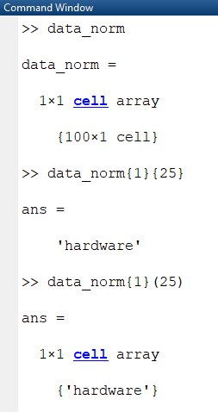
Example from Lab 09

Slide 20
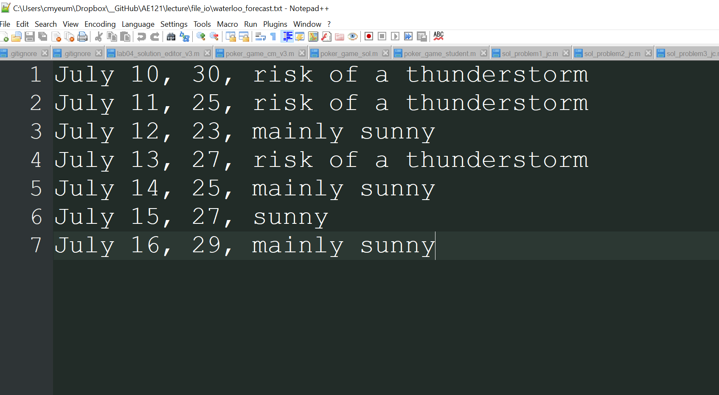
Demo

Slide 21

Exporting Data to a .txt File
The fprintf function provides a way of exporting numeric or character data to a .txt file
General Procedure:
Create a ‘fid’ : The second input of fopen specifies what you want to do to the file. ‘w’ is write and discard existing contents, ‘a’ is write and append the text to the end of the file if there is already content in the file
https://www.mathworks.com/help/matlab/ref/fopen.html#btrnibn-1-permission
Print data to the file using fprintf: Print data using the correct print format string for the data you are writing (remember %d is for integers, %s for multiples characters or strings and %f is for floating-point numbers)
https://www.mathworks.com/help/matlab/ref/fprintf.html#btf8xsy-1_sep_shared-formatSpec
Close the ‘fid’

Slide 22
fprintf Function
If you want data printed on different lines, you must include ‘\n’ to move to the next line!
The file you create will be saved in the same folder you are currently working in
When using the fprintf function, input
fprintf(filename, formatSpec, data)
The data you want to print. This can be a scalar, vector or matrix of strings, doubles, characters etc.
The filename you want to create
Your format string ex. ‘%d %f\n’
How would you add a delimiter to the text file you are writing?

Slide 23
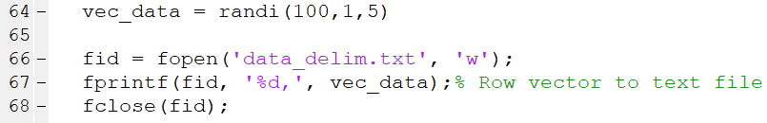
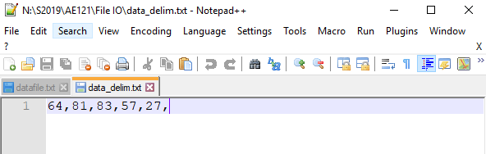
How would You Add a Delimiter to the Text File You are Writing?

Slide 24
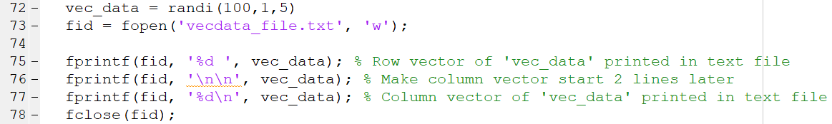
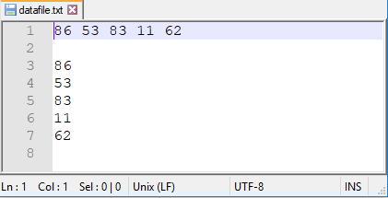
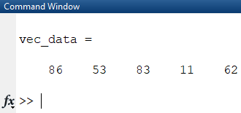
Example: Writing a Column Vector and Row Vector to a File

Slide 25
fprintf with Matrices
When you input a matrix to print, the order of the items will be printed follows linear indexing
That means all elements in the first column of a matrix will be printed before any element in the second column
If you want your matrix to appear as it does in your data, you must transpose your data

Slide 26
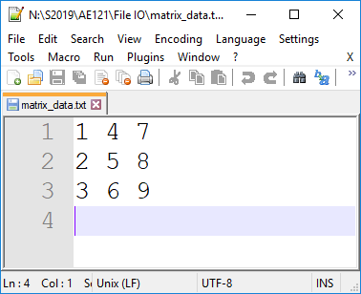
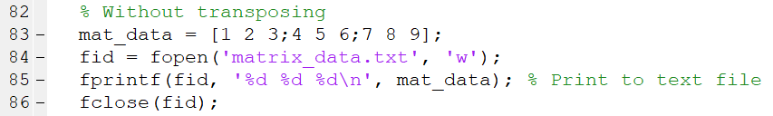
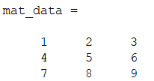
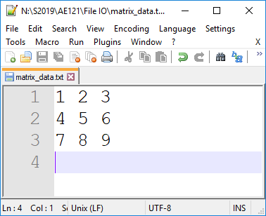
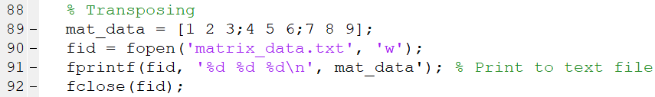
Example: Printing a Matrix of Values Without Transposing
Without transposing data
Transposing data

Slide 27
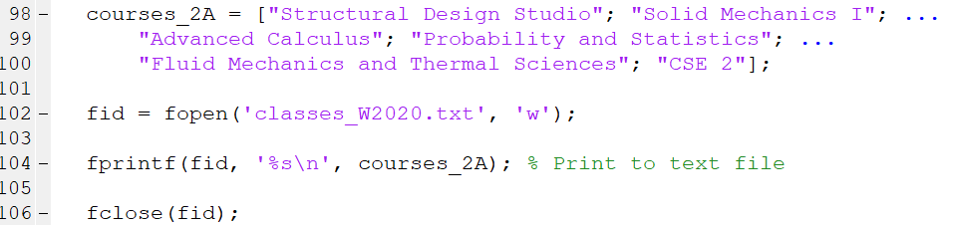
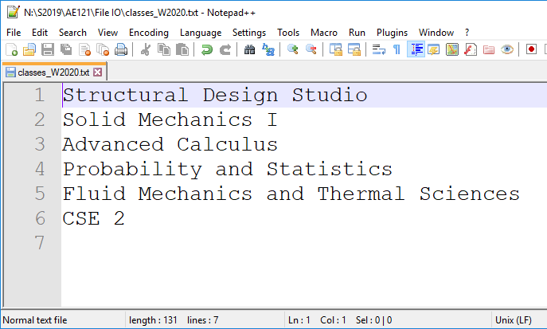
Example: Text Data

Slide 28
Reading Excel Data
The xlsread function can be used for importing Excel data into MATLAB.
For numeric data:
data = xlsread(filename, sheetname);
Ex. num_data = xlsread(‘file_01.xlsx’, ‘Force Calculations’)
For mixed text and numeric data, it is often easiest to download it as raw:
[num, txt, raw] = xlsread(filename, sheetname)
Ex. [~, ~, all_data] = xlsread(WheatonAve_project.xlsx’, ‘Sheet 1’)

Slide 29
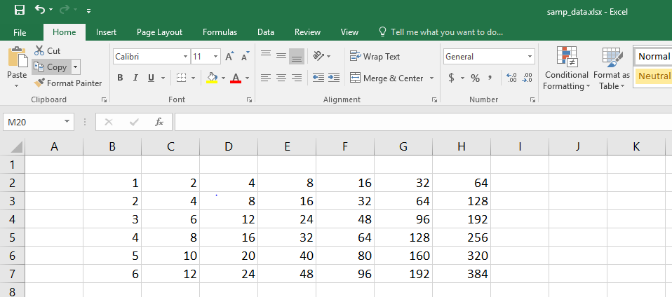
Example: Reading Numeric Data

Slide 30

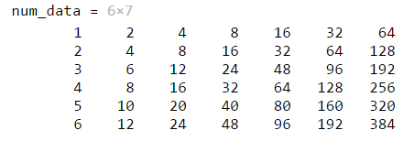
Numeric Data Example

Slide 31
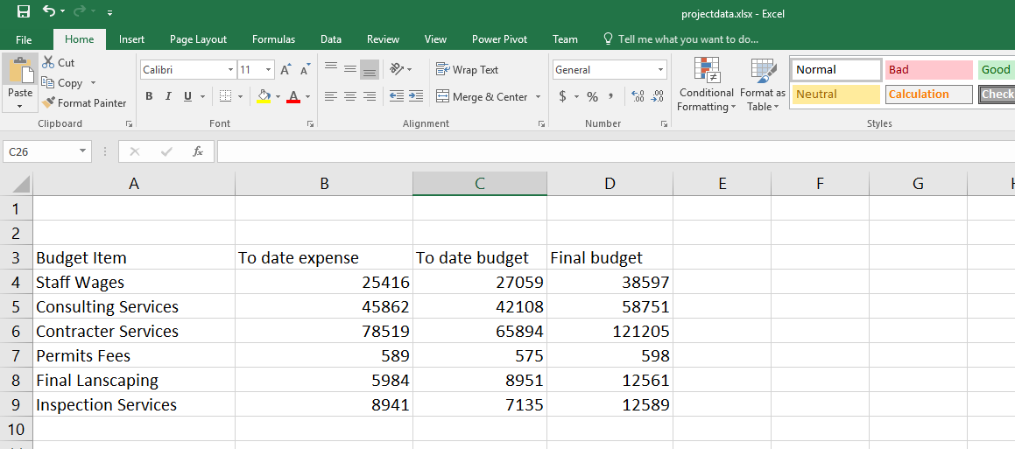
Example from Lab 09: Reading Mixed Data
Data from ‘Project Budget’ Excel spreadsheet

Slide 32
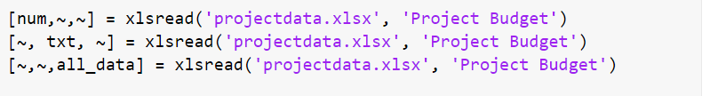
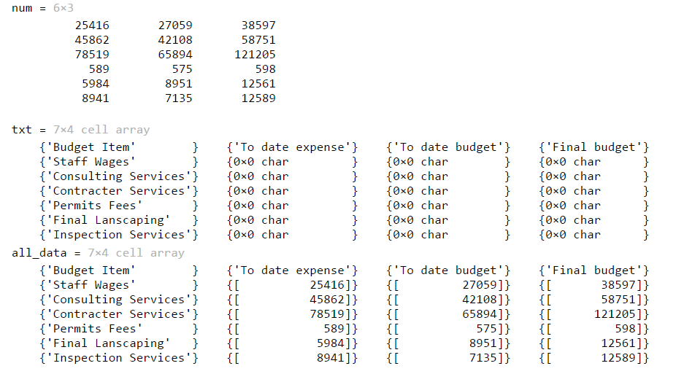
Mixed Data Type Example

Slide 33
Mixed Data Type Example
Numeric Data
All data (raw)

Slide 34
Mixed Data Type Example
Text data

Slide 35
Writing Excel Data
Writing Excel Data can be done using the xlswrite function
To write to a file in no specific location in the Excel file,
xlswrite(filename, data)
To specify what cells you want written to,
xlswrite(filename, data, ‘cell1:cell2’)
‘cell1’ is top left cell you want your data to cover and ‘cell2’ is the bottom right cell you want your data to cover
Filename should be in quotation marks
Ex. ‘file1.xlsx’

Slide 36
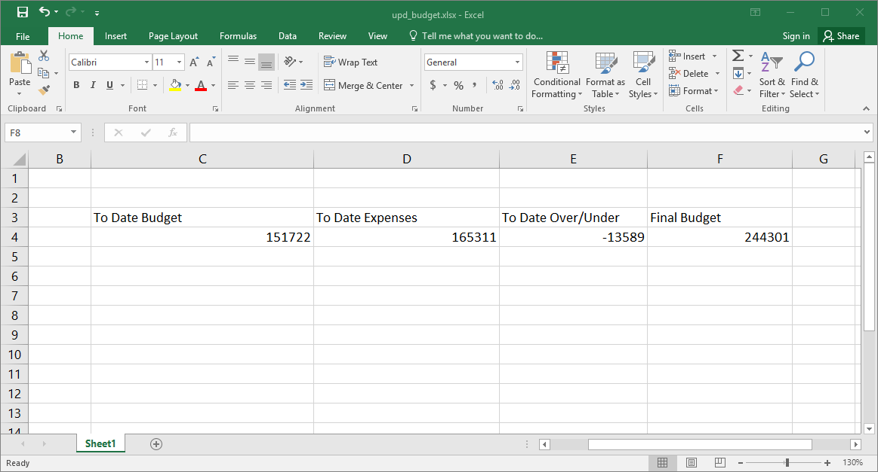
Example from Lab 09: Writing Tabular Data
Question: Write a row of text data and beneath it a row of numeric data to Excel in the locations shown.

Slide 37
Example from Lab 09: Tips
If you want to insert a row of data, make sure your data is a row vector
You can write on a file multiple times using xlswrite

Slide 38
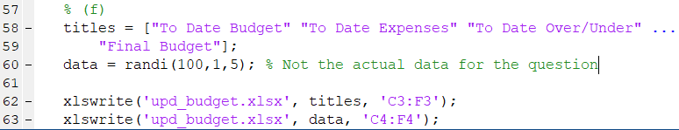
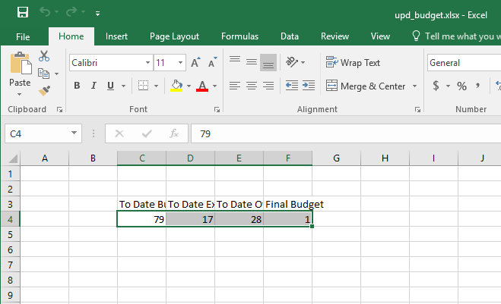
Example from Lab 09
File will appear in the directory you are currently working in

Slide 39
MATLAB 2019 Updates
MATLAB has new functions to work with Excel files, and others
Some of these functions are:
readtable
readmatrix
writetable
writematrix

