Slide 1
Review
Chul Min Yeum
Assistant Professor
Civil and Environmental Engineering
University of Waterloo, Canada
AE121: Computational Method
Last updated: 2019-06-17

Slide 2
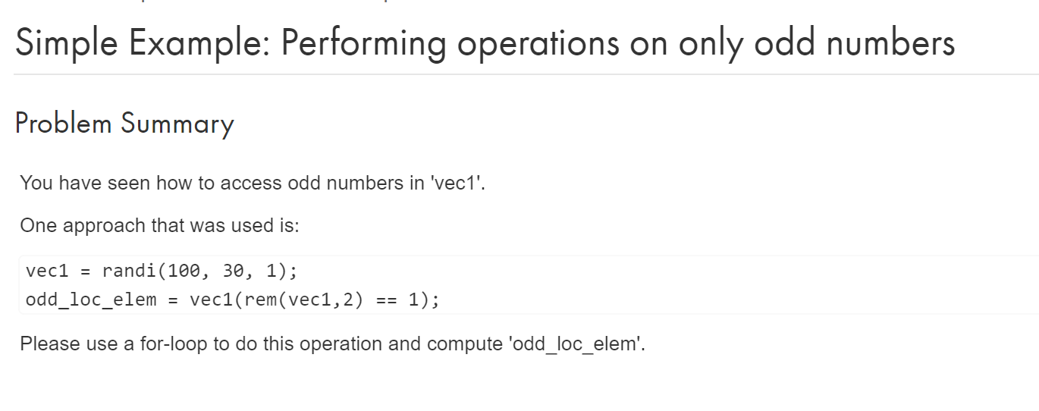
Sample Problem: Loop Statement

Slide 3
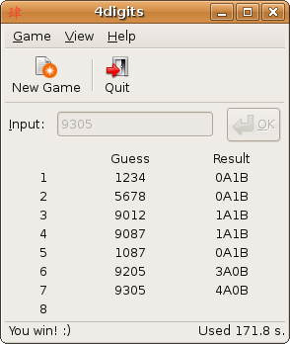
Quiz: Bulls and Cows
Bulls and Cows is a mind game played by two players. In the game, a random, 4-digit number is chosen and it's values are compared to those of another trial number. All four digits of the number are different. If any digit in the chosen number is the exact same value and in the exact same position as any digit in the trial number, this is called a bull. If the digit is present in both the trial number and chosen number, but is not in the same location, this is called a cow.
MATLAB Grader

Slide 4
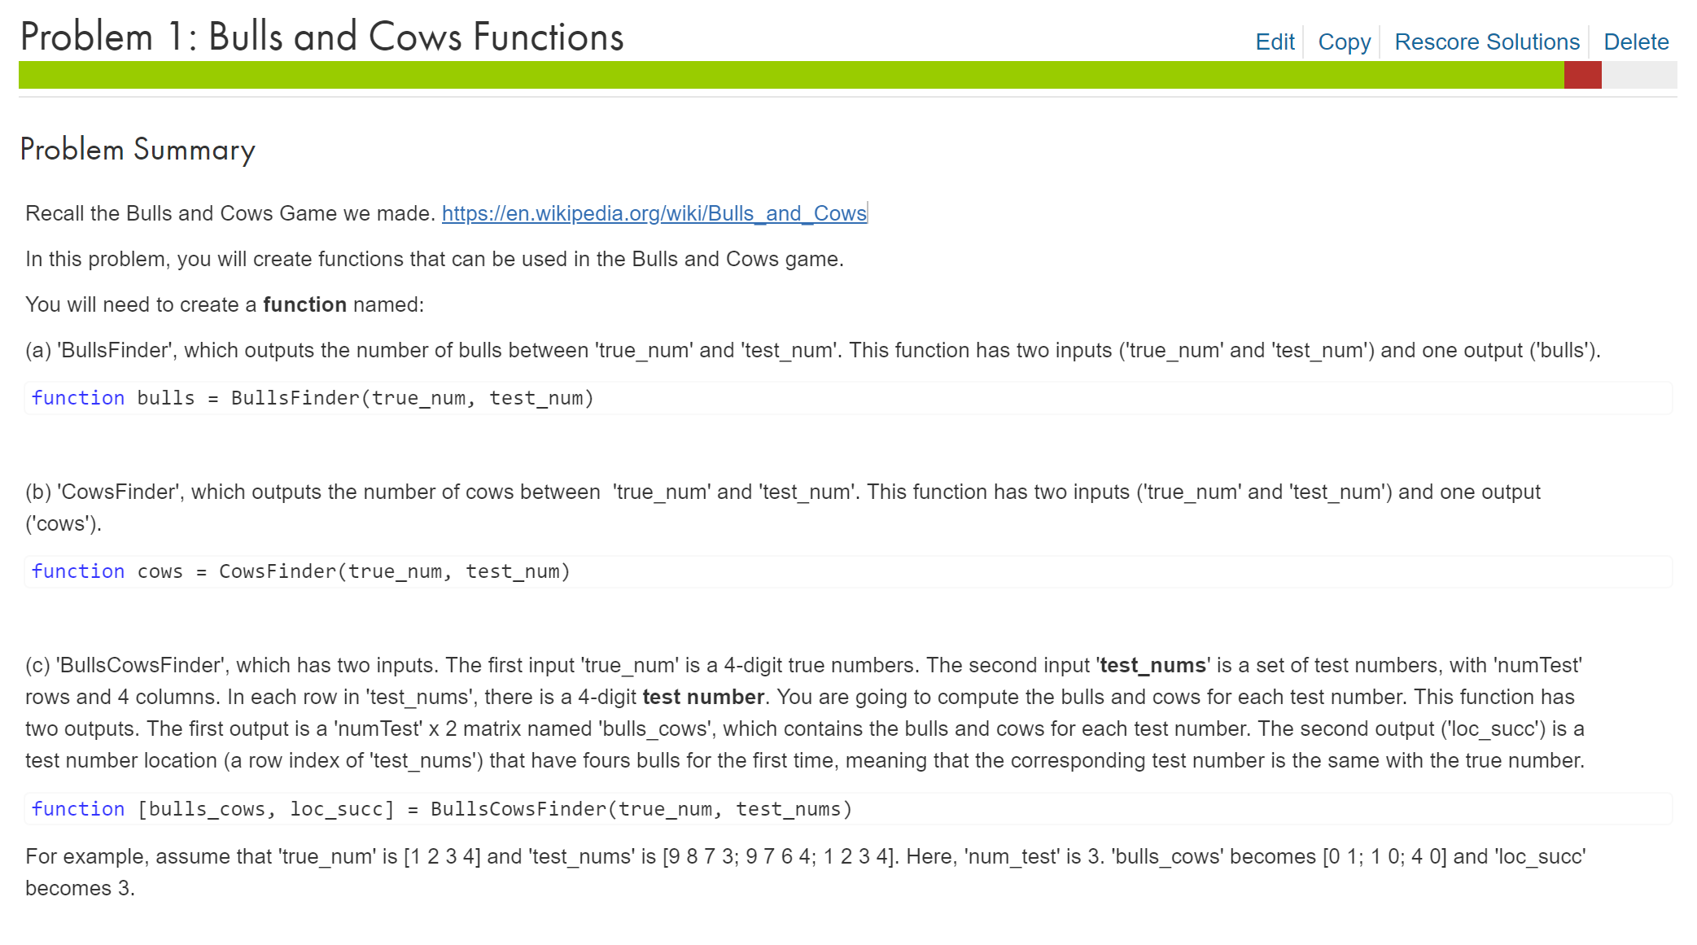

Slide 5
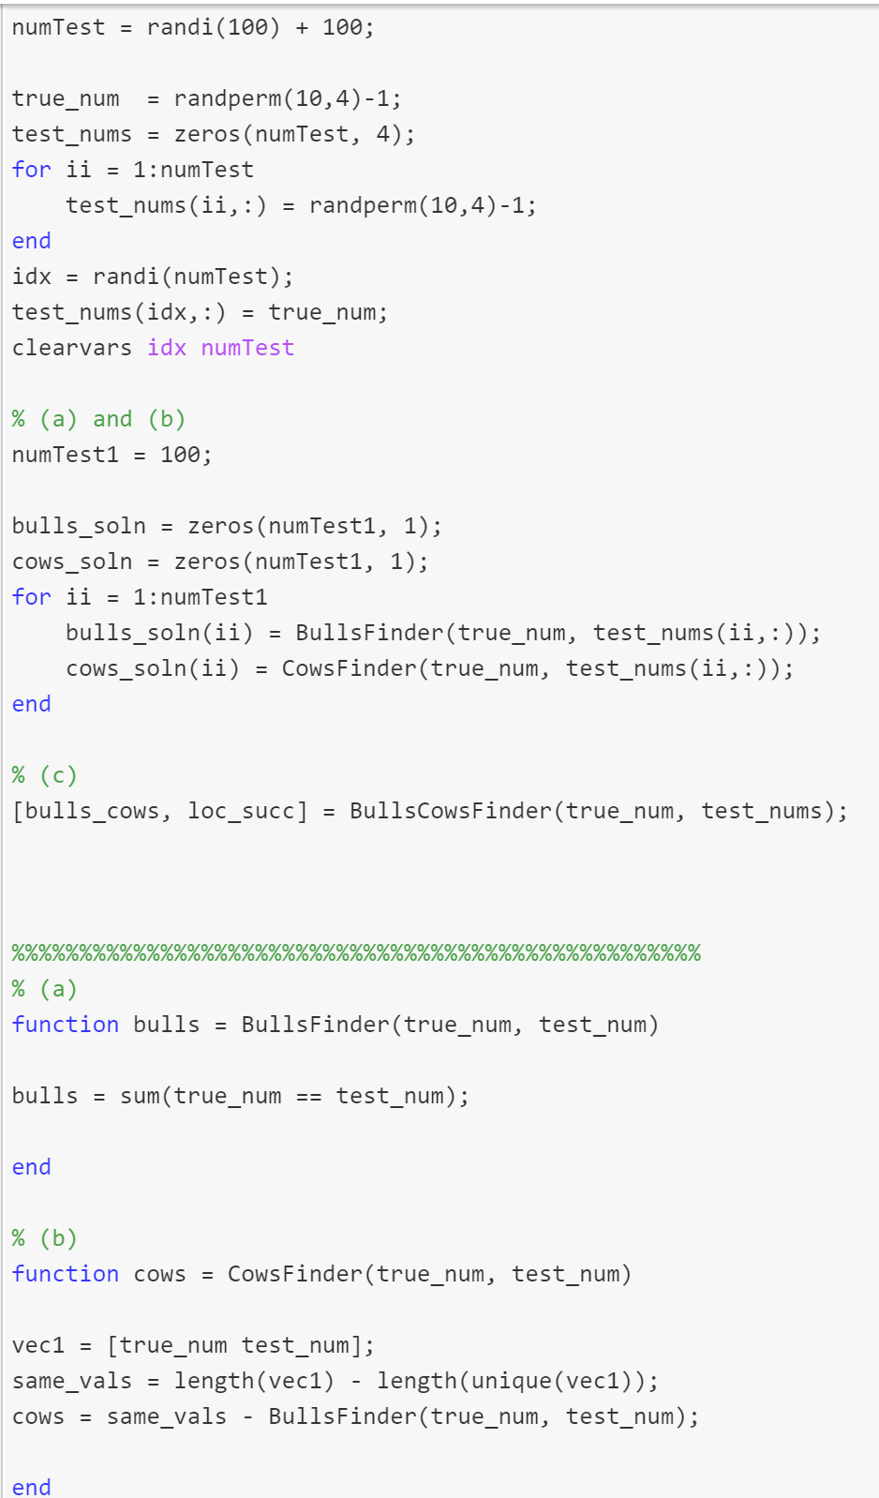
Script Section
Call multiple times
Function Section
or on different files

Slide 6
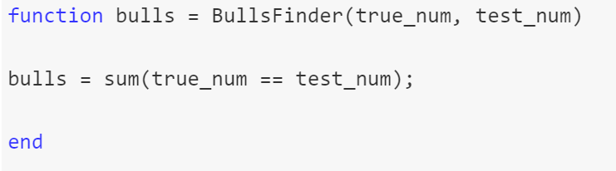
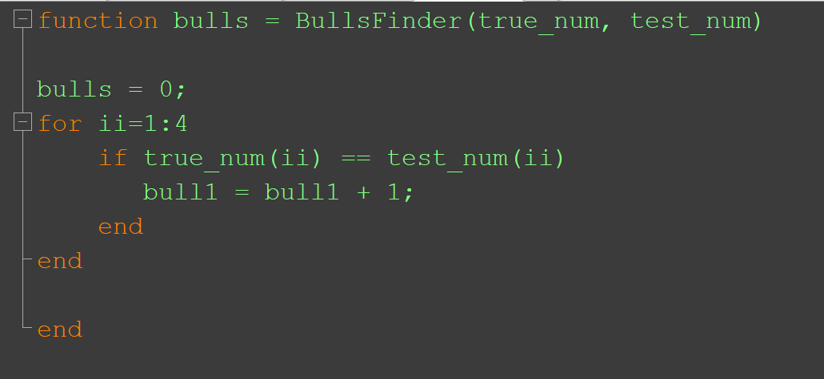
function bulls = BullsFinder(true_num, test_num)

Slide 7
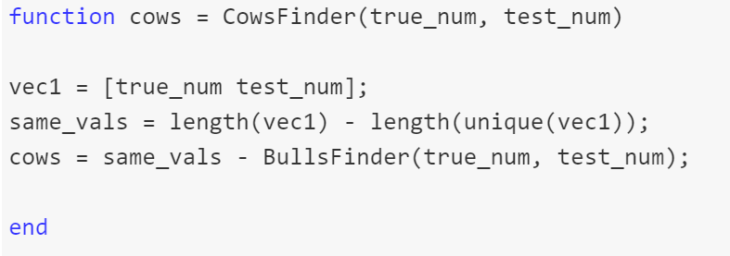
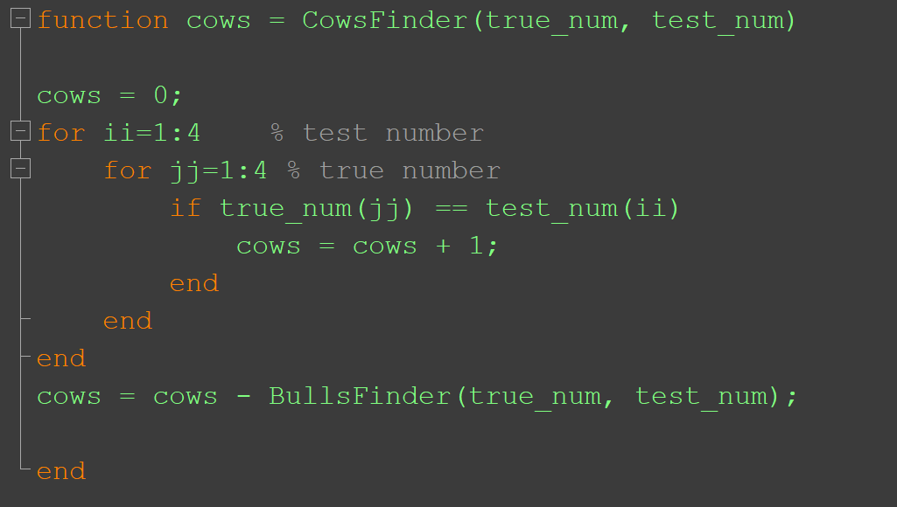
function cows = CowsFinder(true_num, test_num)

Slide 8
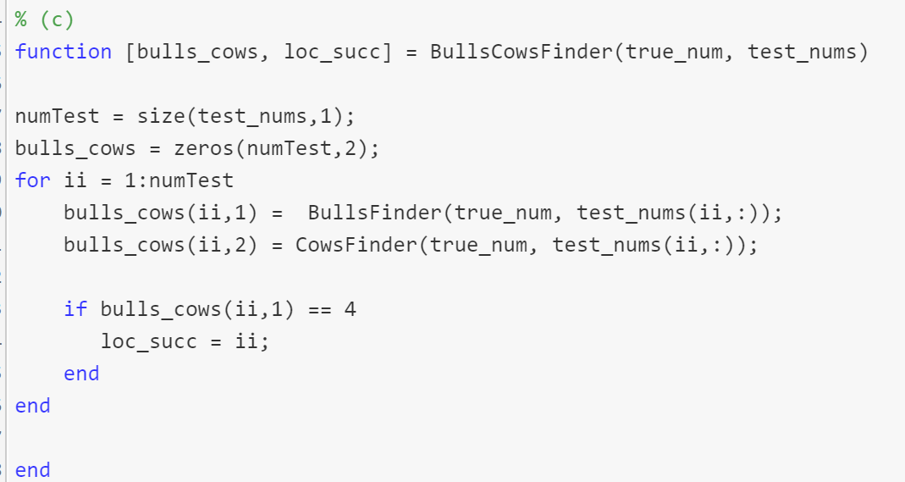
function [bulls_cows, loc_succ] = BullsCowsFinder(true_num, test_nums)

Slide 9
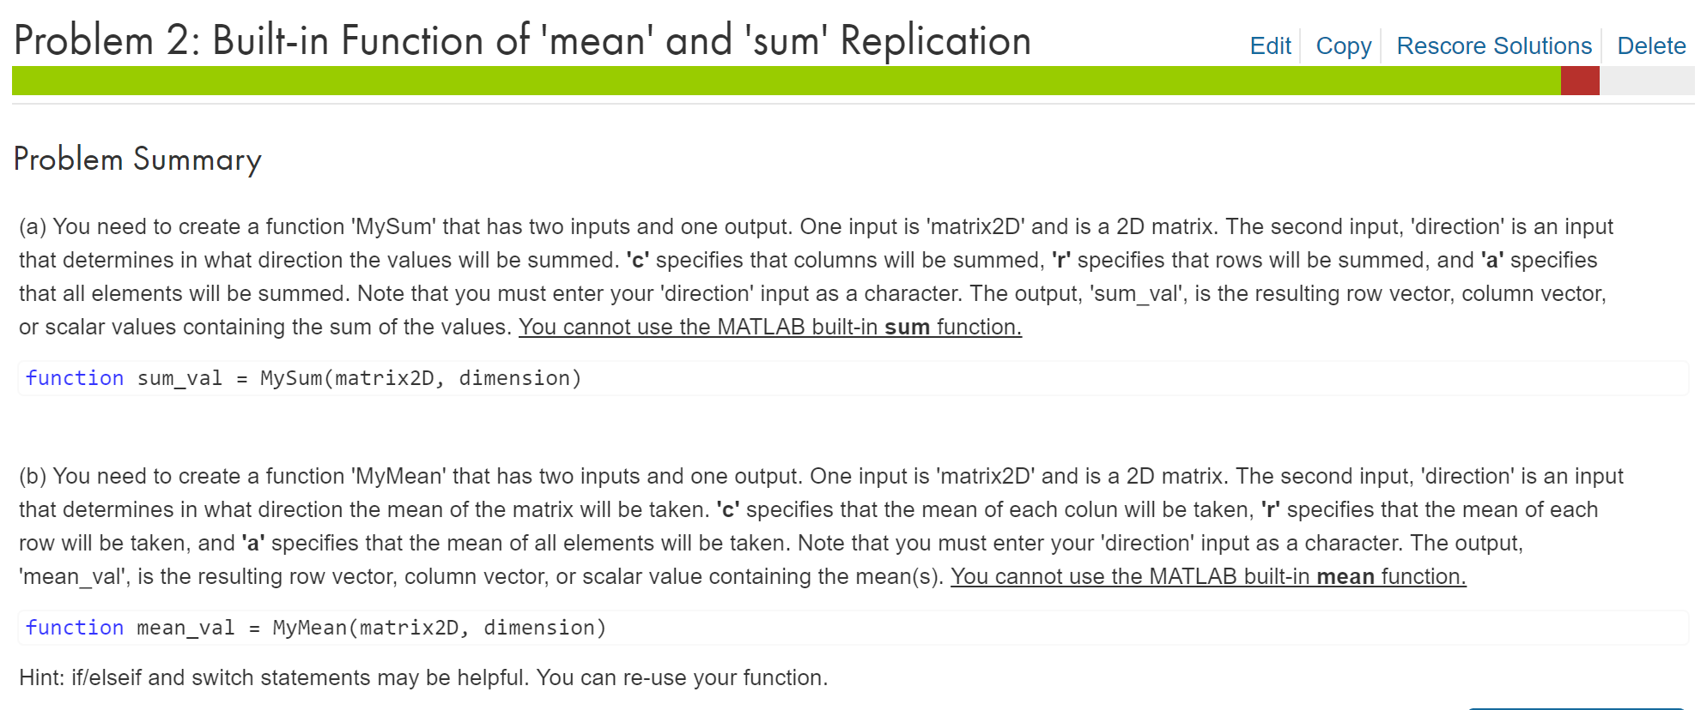

Slide 10
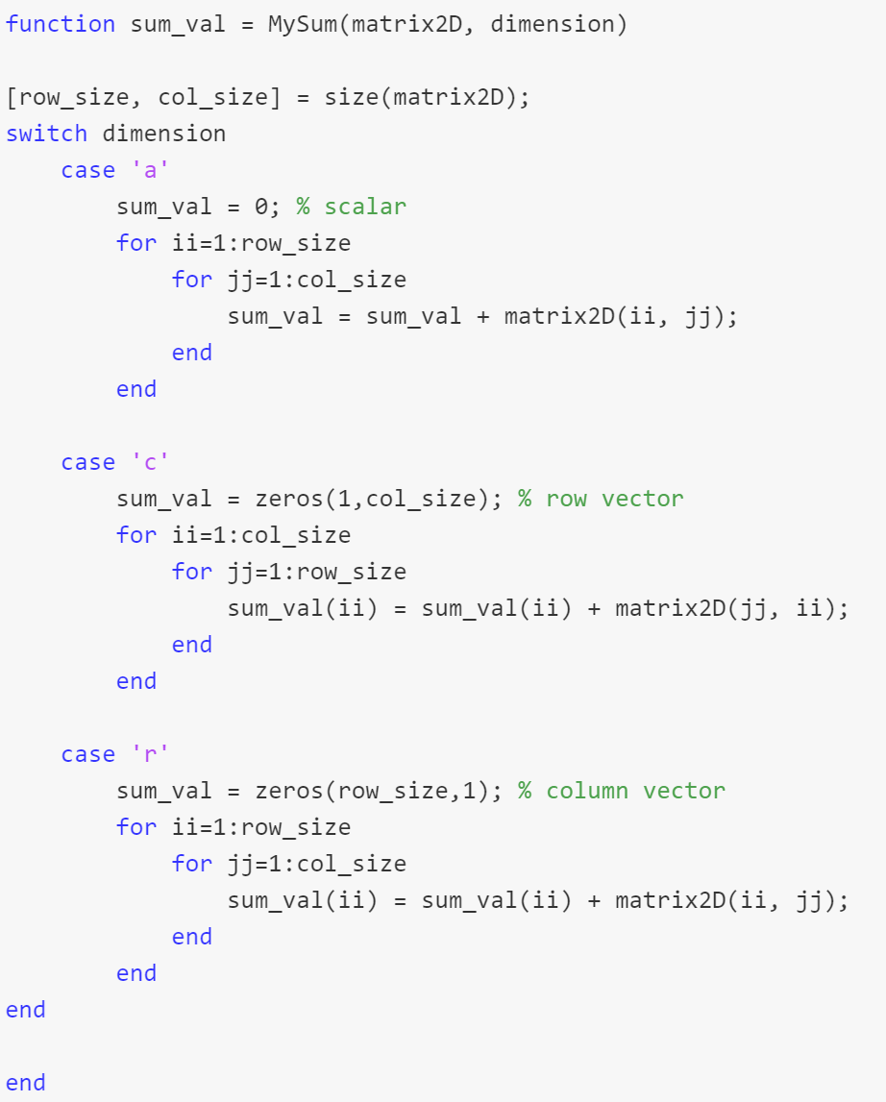
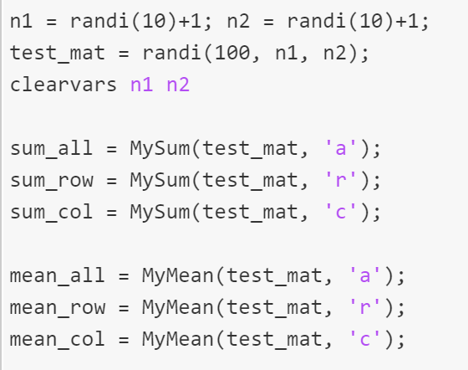
Problem 2 (a)

Slide 11
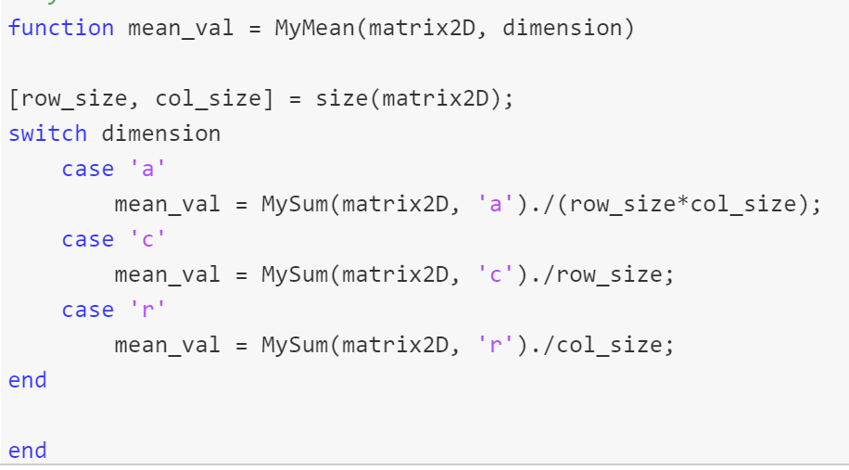
Problem 2 (b)

Slide 12
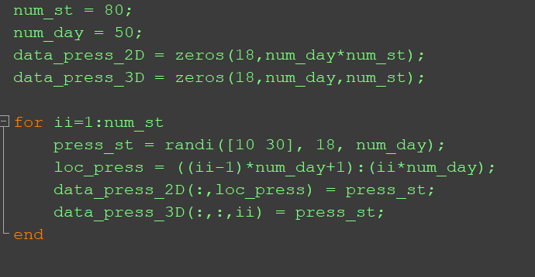
Pressure Data
St1
St2
St80
18
50
50
…
18
4000
18
50
data_press_2D
data_press_3D
50

Slide 13
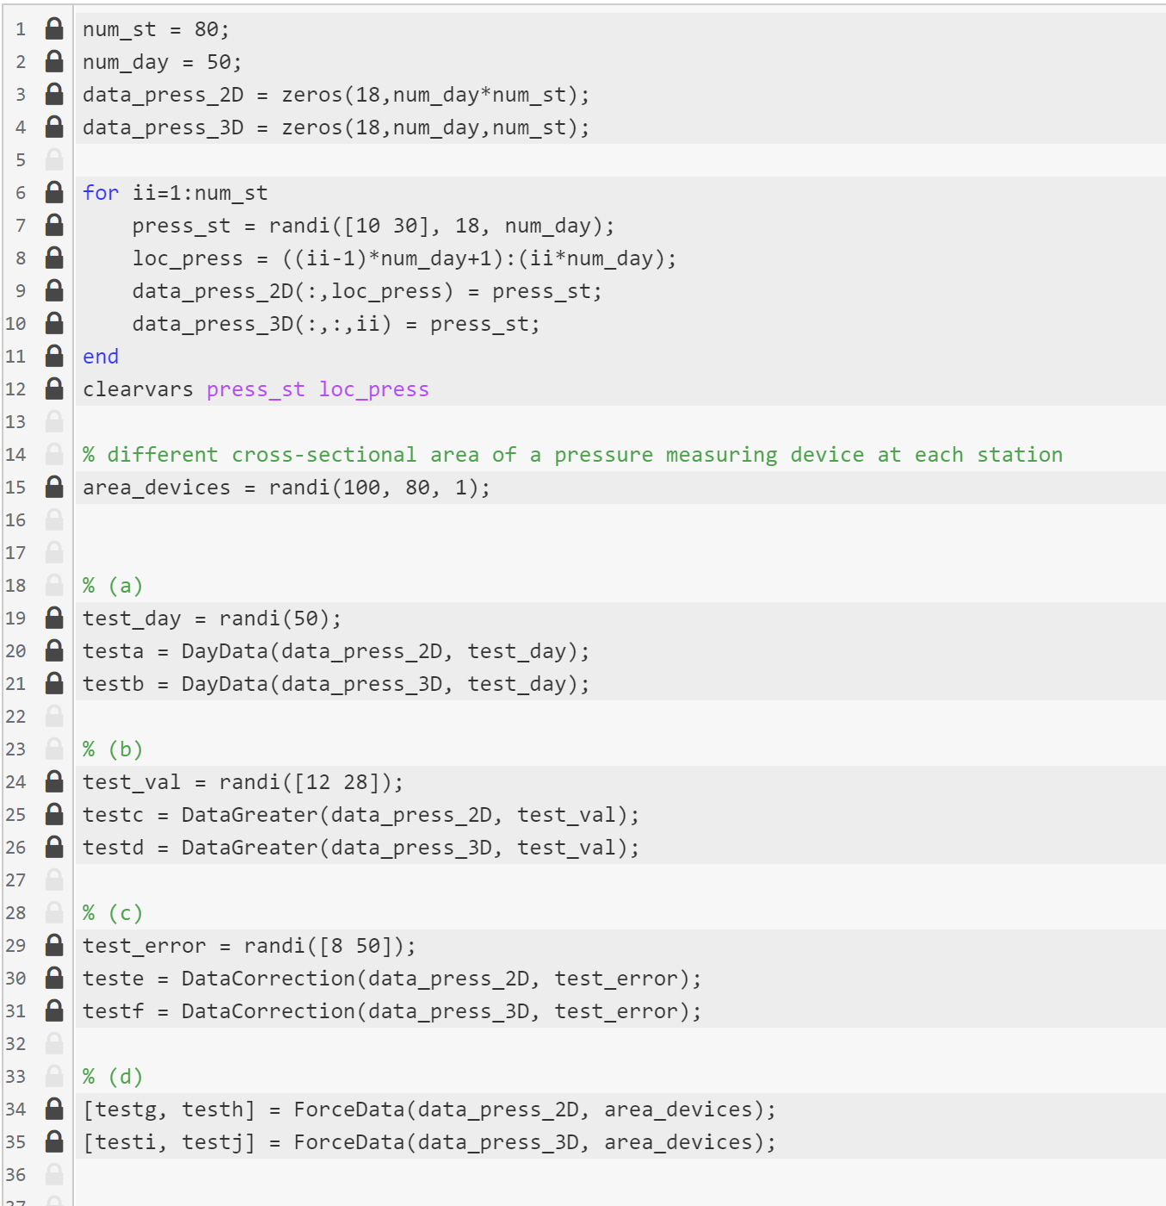

Slide 14
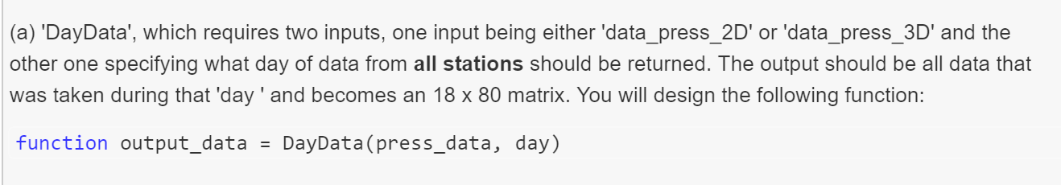
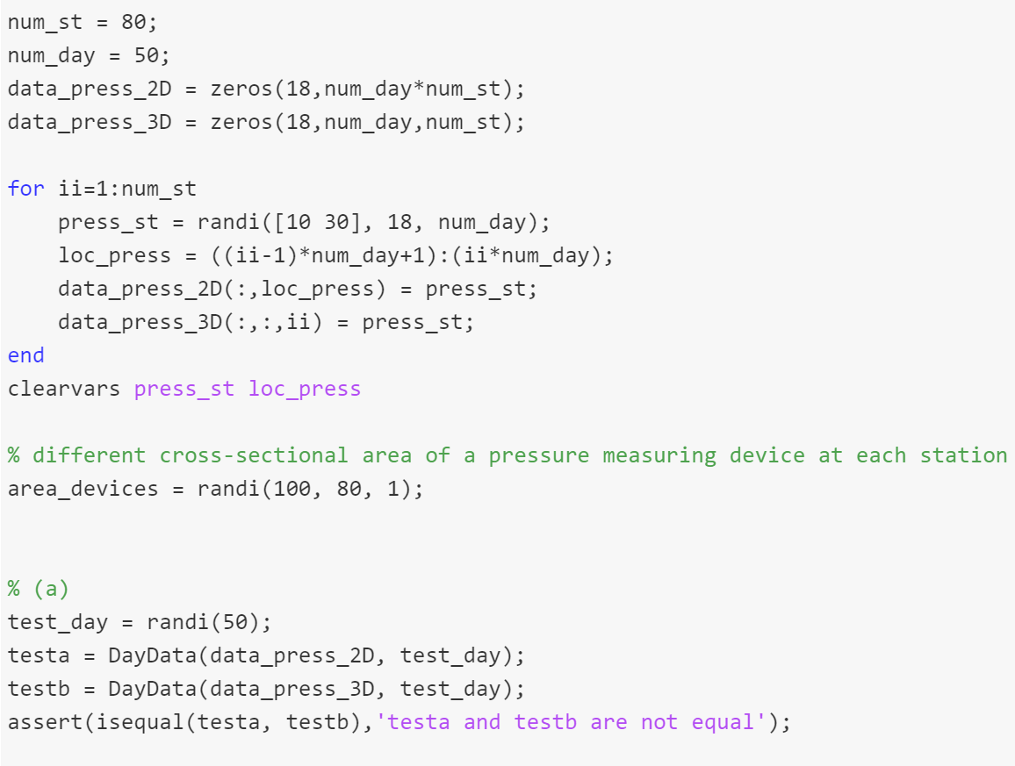
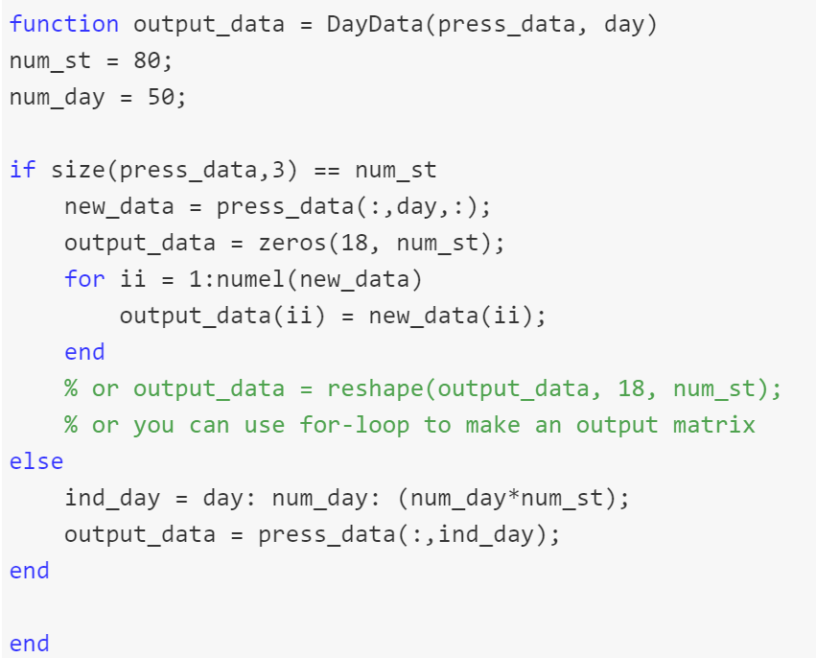

Slide 15
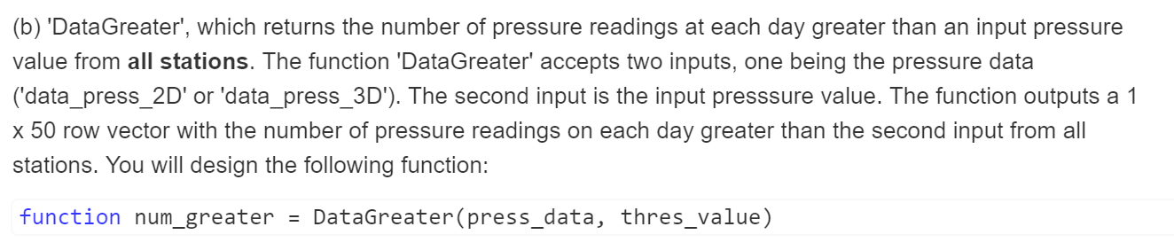
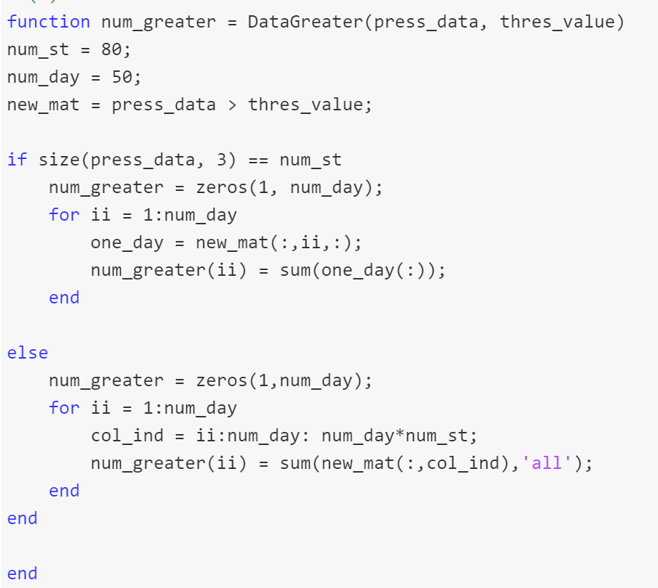
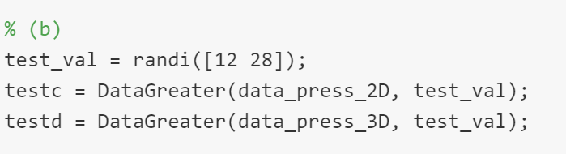

Slide 16
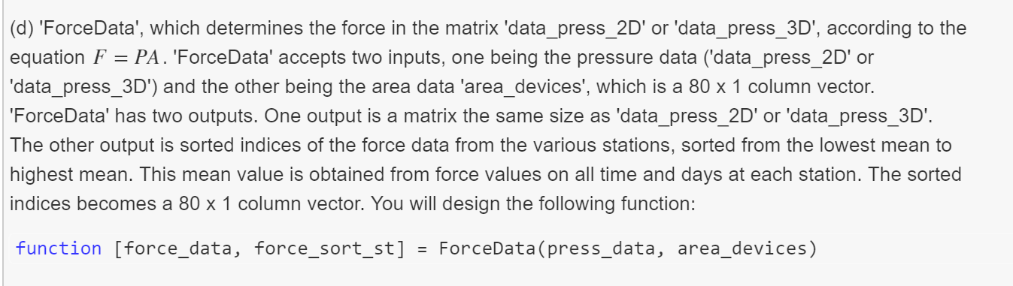
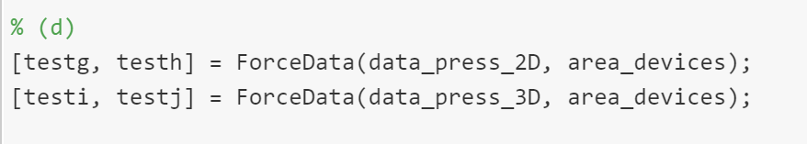

Slide 17
