Slide 1
Review for Problem 3 in Lab06
Chul Min Yeum
Assistant Professor
Civil and Environmental Engineering
University of Waterloo, Canada
AE121: Computational Method
Last updated: 2019-06-18

Slide 2

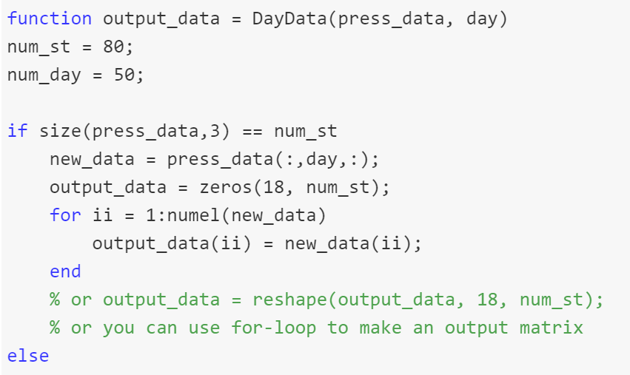
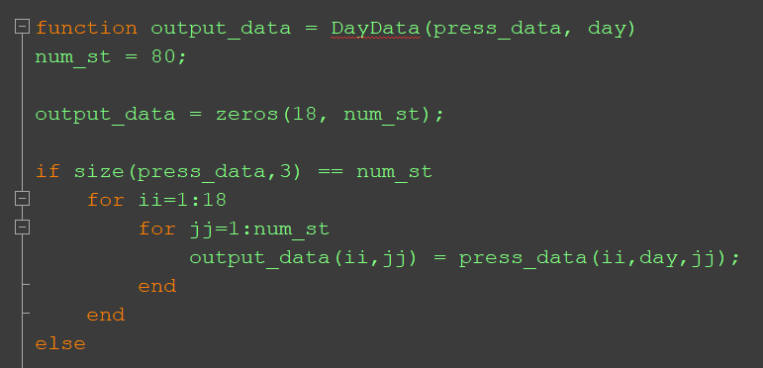

Slide 3

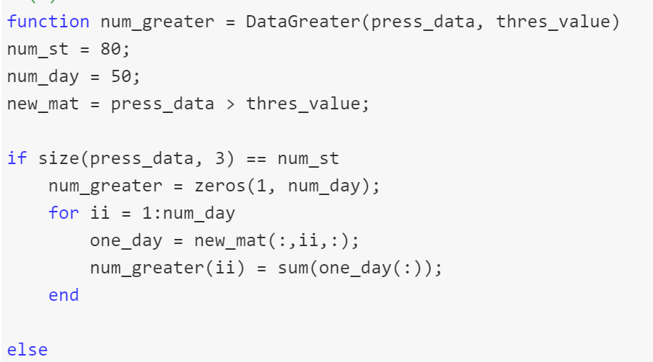

Slide 4



Slide 5
