Slide 1
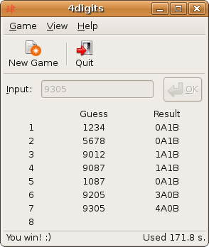
Quiz: Bulls and Cows
Bulls and Cows is a mind game played by two players. In the game, a random, 4-digit number is chosen and it's values are compared to those of another trial number. All four digits of the number are different. If any digit in the chosen number is the exact same value and in the exact same position as any digit in the trial number, this is called a bull. If the digit is present in both the trial number and chosen number, but is not in the same location, this is called a cow.

Slide 2
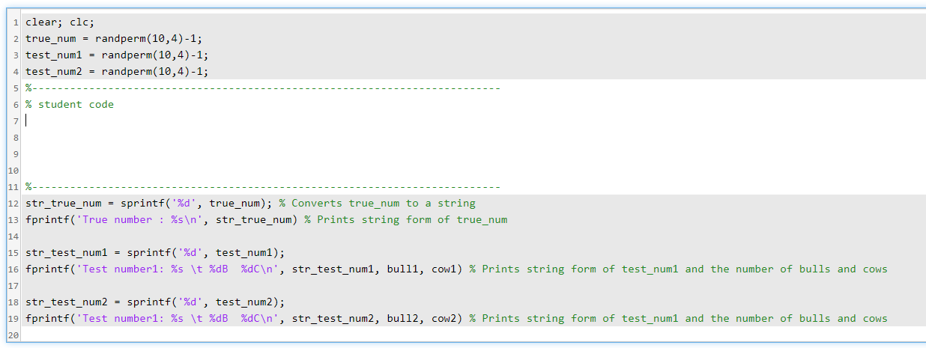
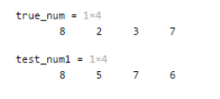

Quiz: Bulls and Cows (Continue)

Slide 3
Chul Min
true_num = randperm(10,4)-1;
test_num1 = randperm(10,4)-1;
test_num2 = randperm(10,4)-1;
%--------------------------------------------------------------------------
% student code
vec1 = zeros(1,10,'logical');
vec1(true_num+1) = 1;
bull1 = sum(~(true_num-test_num1));
cow1 = sum(vec1(test_num1+1))-bull1;
bull2 = sum(~(true_num-test_num2));
cow2 = sum(vec1(test_num2+1))-bull2;
%--------------------------------------------------------------------------

Slide 4
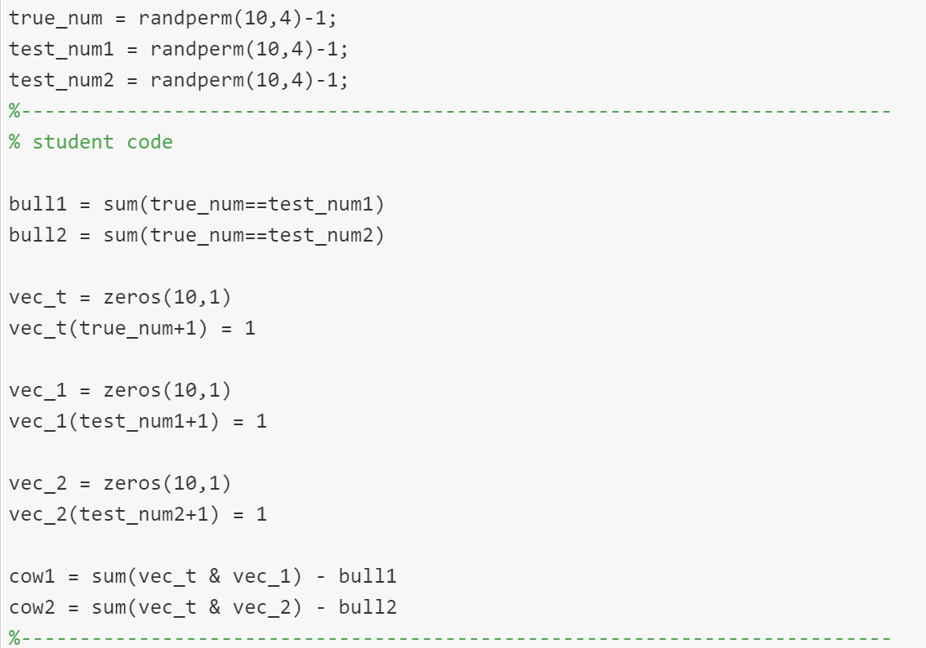
Serena

Slide 5
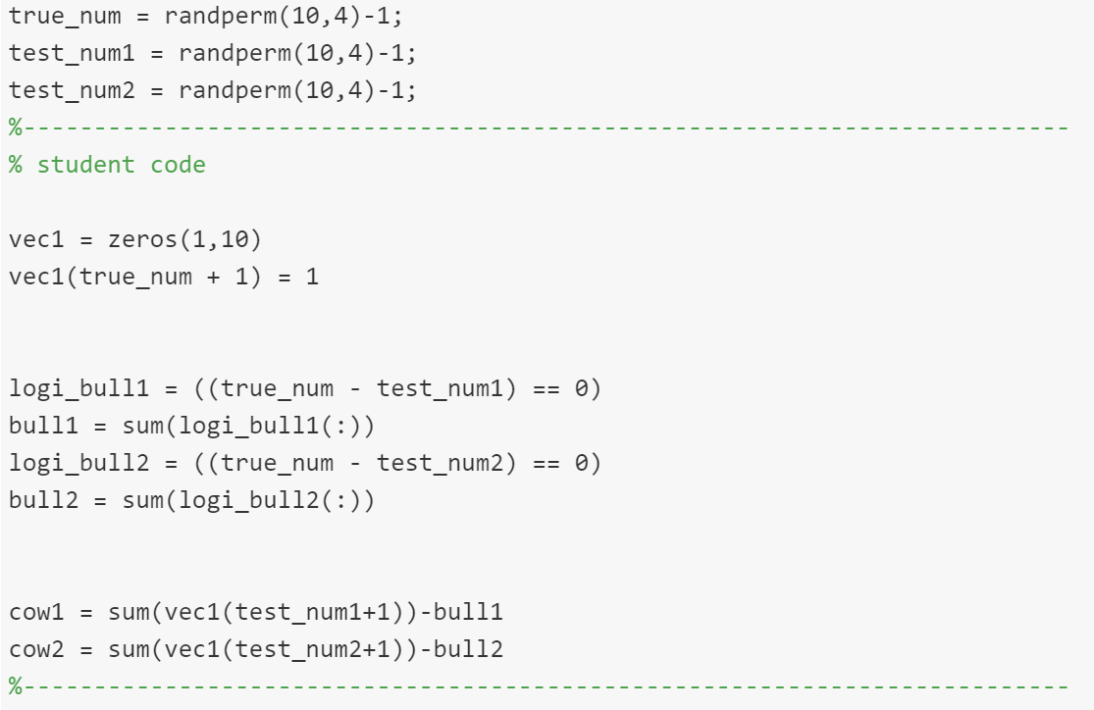
Alexa

Slide 6
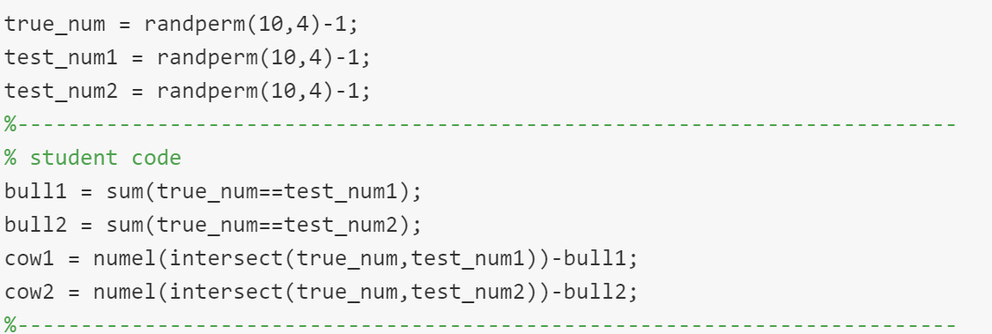
Mapendo

Slide 7
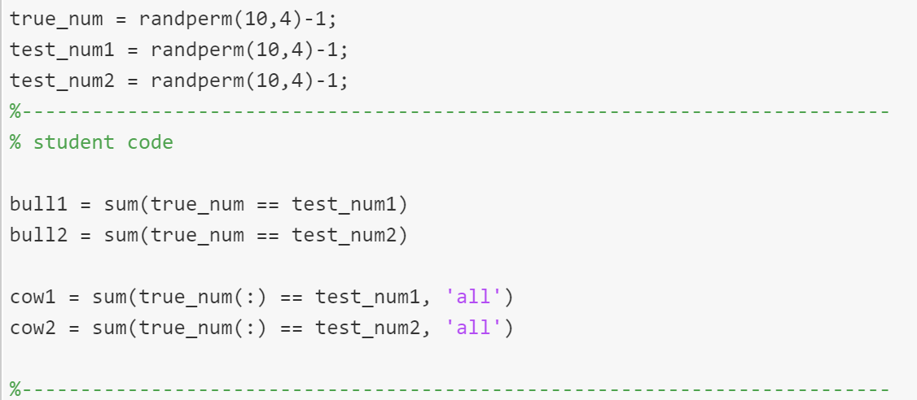
Susannah
Need to minus bull

Slide 8
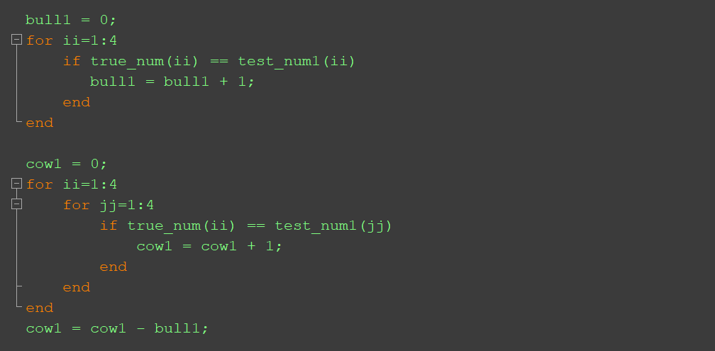
Using Loop and Section Statements

