Slide 1
Array Operations
reshape changes dimensions of a matrix to any matrix with the same number of elements
diag create diagonal matrix or get diagonal elements of matrix
rot90 rotates a matrix 90 degrees counter-clockwise
fliplr flips columns of a matrix from left to right
flipud flips rows of a matrix up to down
flip flips a row vector left to right, column vector or matrix up to down
repmat replicates an entire matrix; it creates m x n copies of the matrix
repelem replicates each element from a matrix in the dimensions specified

Slide 2
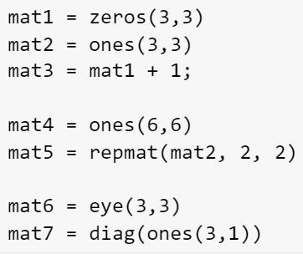
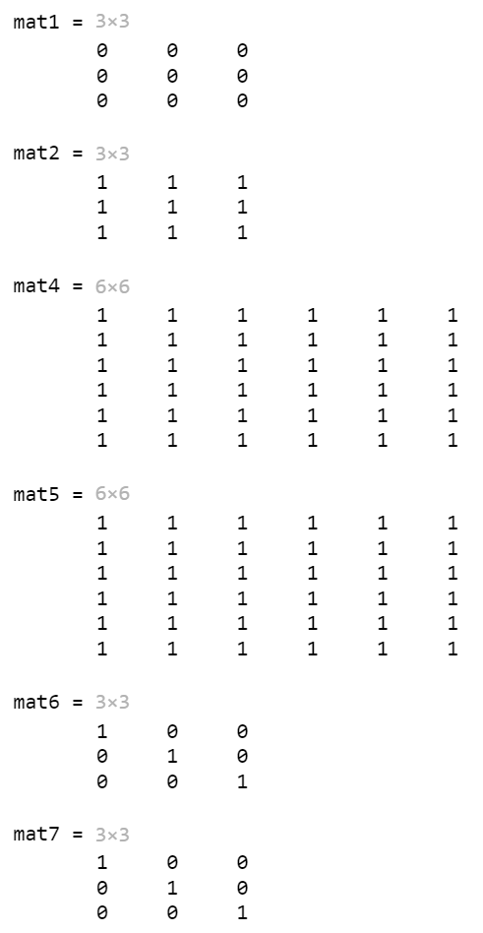
Example: Create and Index Arrays

Slide 3
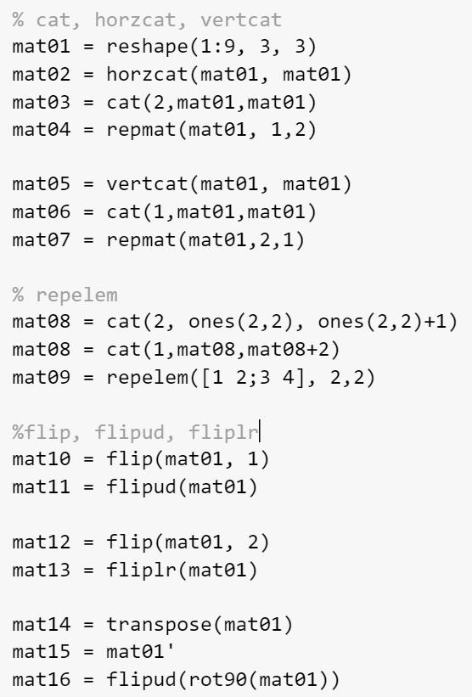
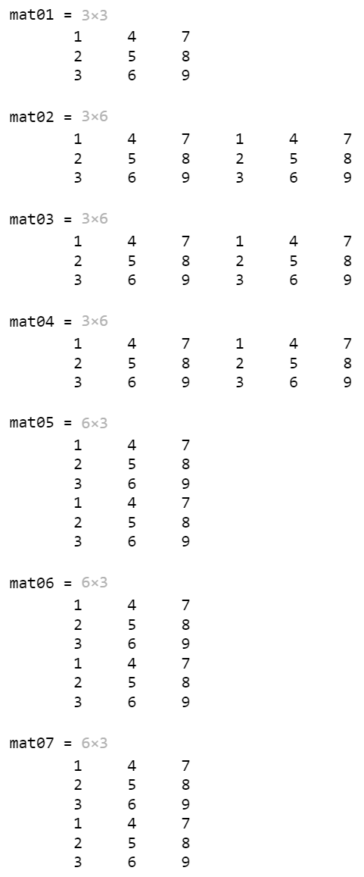
Example: Combine and Transform Array (horcat, vertcat, cat)
[mat01 mat01]
[mat01; mat01]
Readability

Slide 4
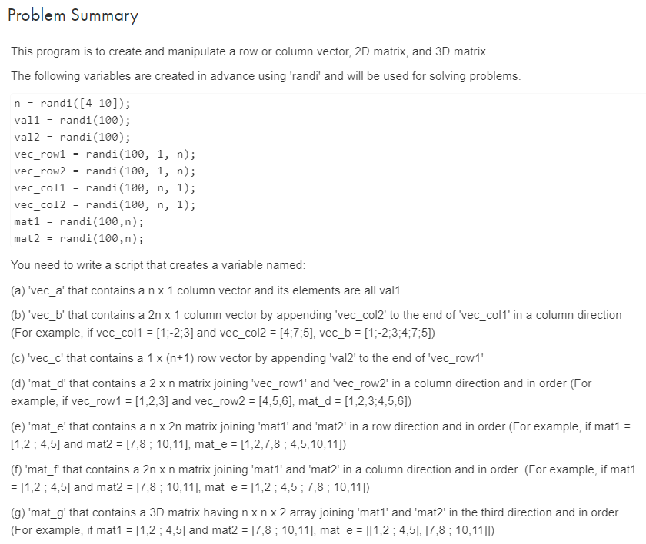
Example: Cat
mat_g = zeros(n,n,2);
mat_g(:,:,1) = mat1;
mat_g(:,:,2) = mat2;
mat_g = cat(3, mat1, mat2)

Slide 5
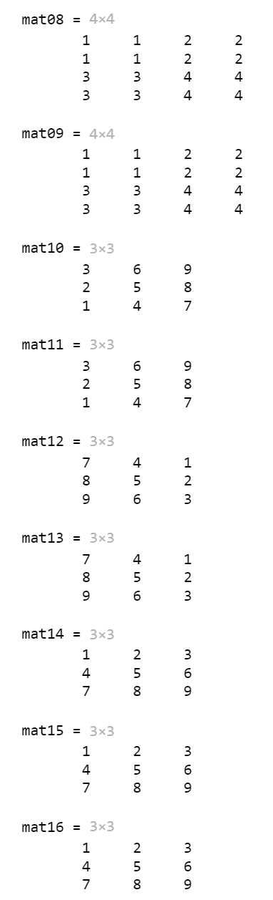
Example: Combine and Transform Array (repelem)
repelem replicates each element from a matrix in the dimensions specified
1 | 1
1 | 1
2 | 2
2 | 2
1 | 1
1 | 1
2 | 2
2 | 2
1 | 1
1 | 1
2 | 2
2 | 2
1 | 1
1 | 1
2 | 2
2 | 2
3 | 3
3 | 3
4 | 4
4 | 4
3 | 3
3 | 3
4 | 4
4 | 4
1 | 1
1 | 1
2 | 2
2 | 2
1 | 2
3 | 4
3 | 3
3 | 3
4 | 4
4 | 4

Slide 6
Example: Combine and Transform Array

Slide 7
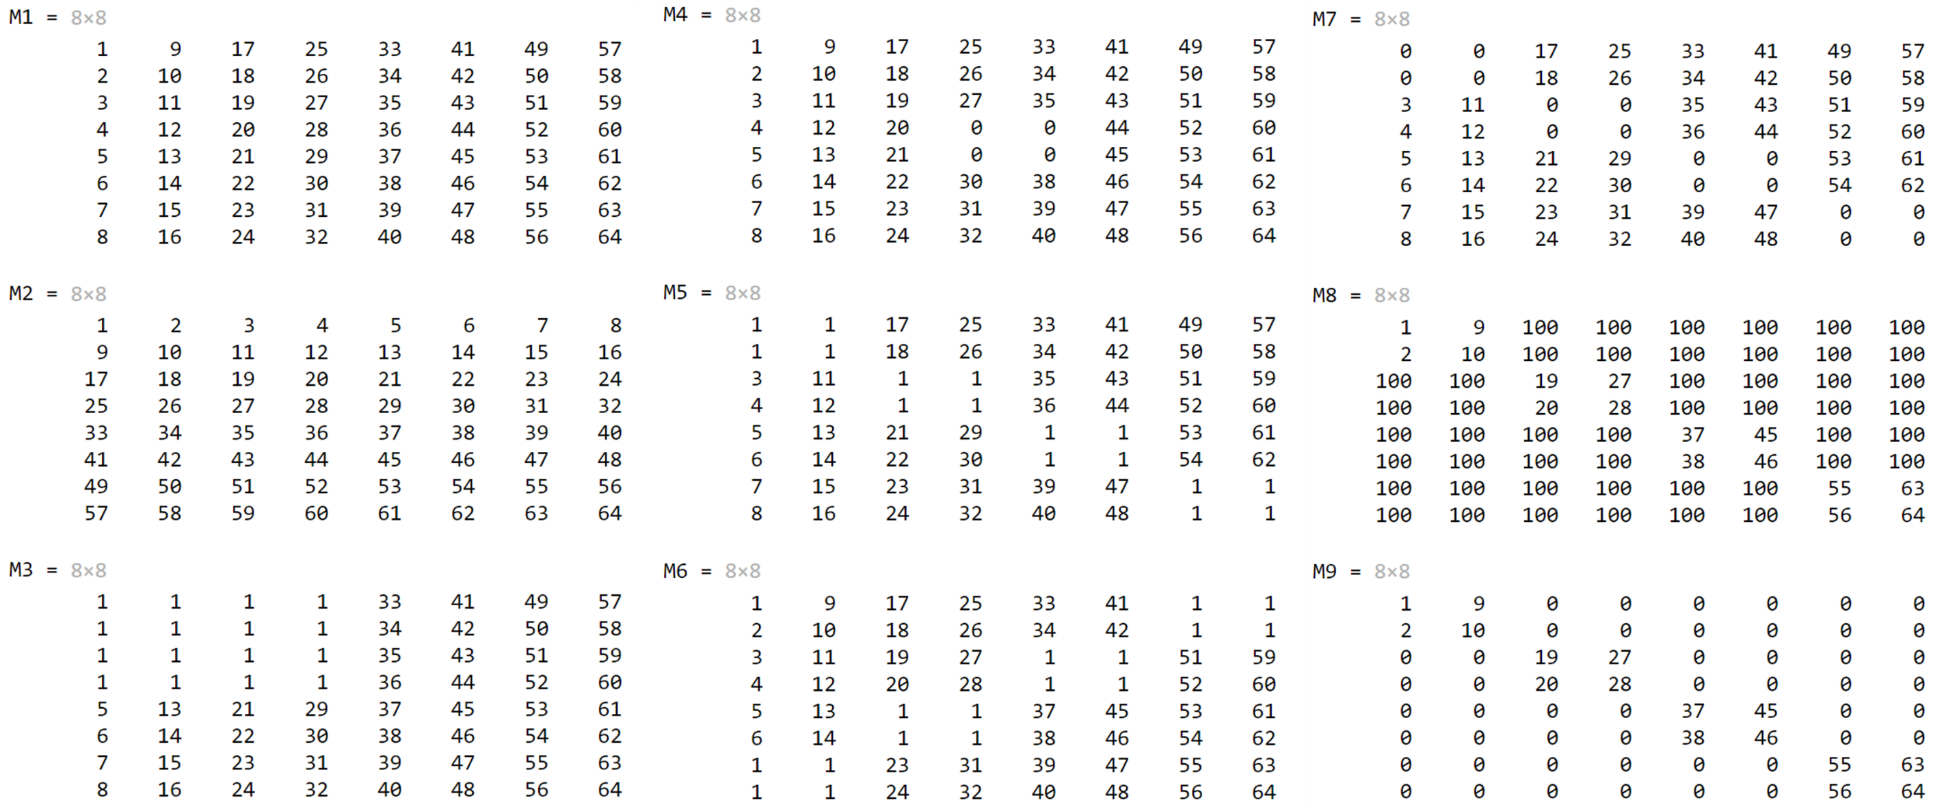
Quiz: Create Matrices

Slide 8
Quiz: Create Matrices (Hint)
1 | 0 | 0 | 0
0 | 1 | 0 | 0
0 | 0 | 1 | 0
0 | 0 | 0 | 1
eye(4,4)
1 | 1 | 0 | 0
1 | 1 | 0 | 0
0 | 0 | 1 | 1
0 | 0 | 1 | 1
0 | 0 | 0 | 0
0 | 0 | 0 | 0
0 | 0 | 0 | 0
0 | 0 | 0 | 0
repelem(eye(4,4), 2,2)
0 | 0 | 0 | 0
0 | 0 | 0 | 0
0 | 0 | 0 | 0
0 | 0 | 0 | 0
1 | 1 | 0 | 0
1 | 1 | 0 | 0
0 | 0 | 1 | 1
0 | 0 | 1 | 1

