Slide 1
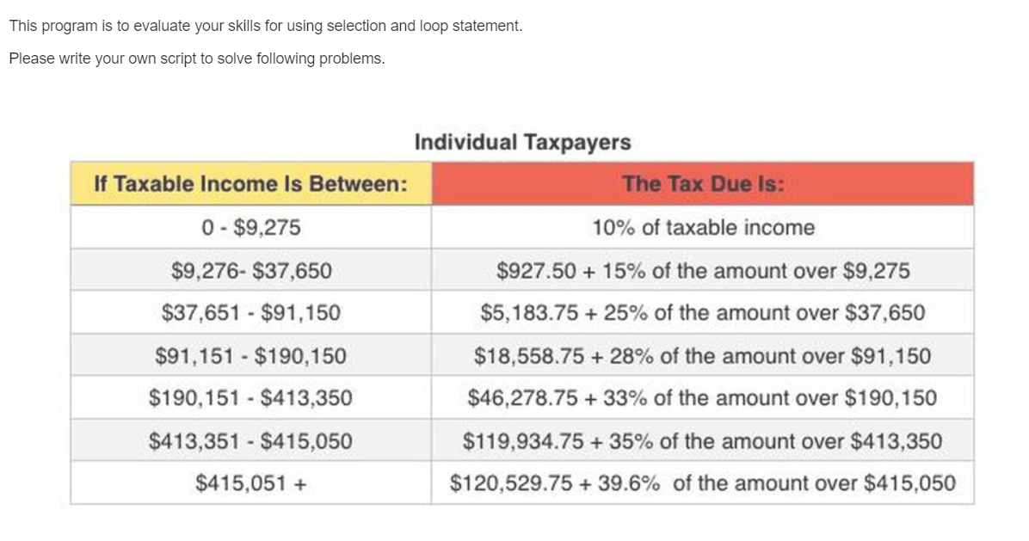
Problem 1: Income Tax

Slide 2
Problem 1: Comments
Use of an ‘ii’ index for a for-loop structure → read each value in a vector or a matrix to compute a new value(s)
income_tax < 1000 → No reason to use a loop-structure
Readability (check the value easily)
Debugging. (Where do we put 'round'?) (1) avoid mistake (2) correct mistake
Do not put a condition on 'else'
structures
for ii=1:num_income
for ii=[1 2 3 4]
Do not use this syntax
9276 < x < 37651

Slide 3
Problem 2: Comments
material_data inside character.
Read a character and make selection statements.
Model solution 2: We can make for-loop for materials.
When do we use ‘else’ in this problem?
strain_test = strain_data(ii);
if strain_test == 'c'
elseif strain_test == 'p'
elseif strain_test == 'w‘

Slide 4
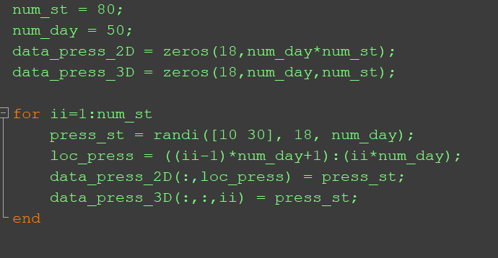
Problem 3: Comments
St1
St2
St80
18
50
50
…
18
4000
18
50
data_press_2D
data_press_3D
50

Slide 5
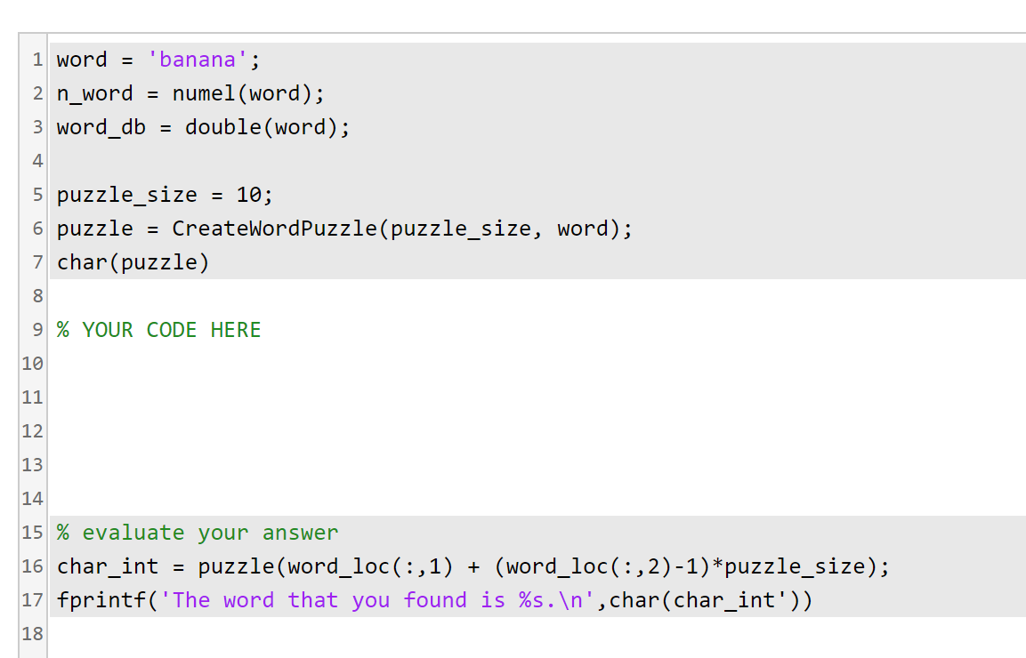
Problem 4: Word Finder Puzzle

Slide 6
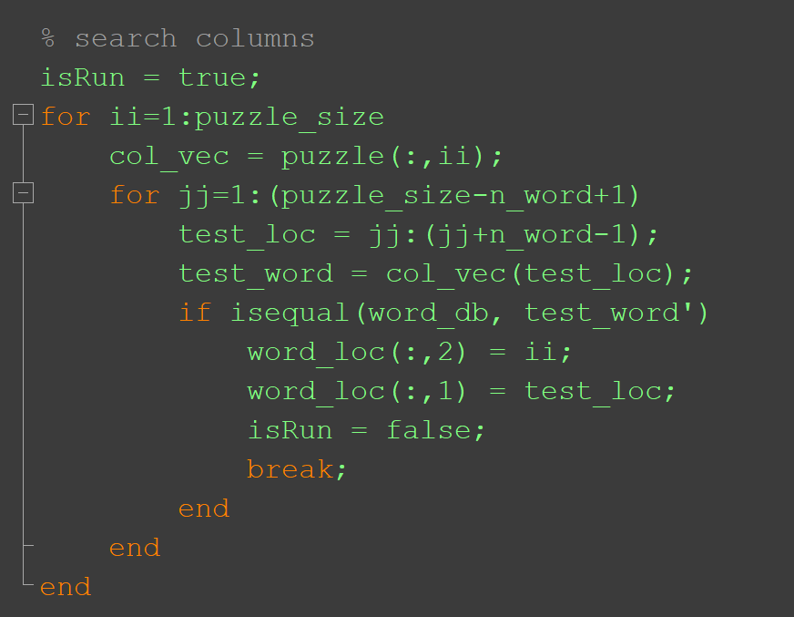
Problem 4: Comments
all(word_db == test_word’)

