Slide 1
HW05&LAB07 Solution
Chul Min Yeum
Assistant Professor
Civil and Environmental Engineering
University of Waterloo, Canada
AE121: Computational Method
Last updated: 2019-06-21

Slide 2
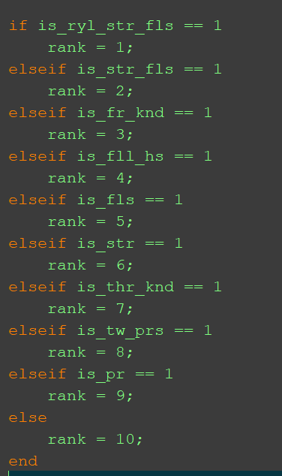
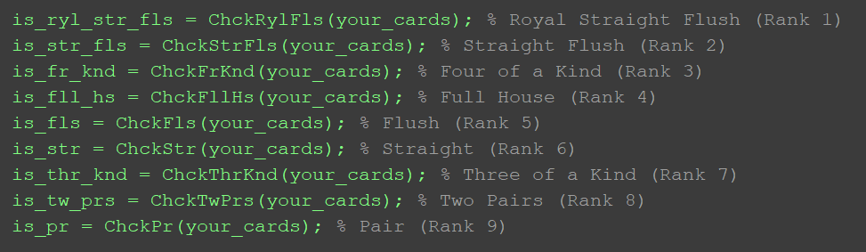
Template Code

Slide 3
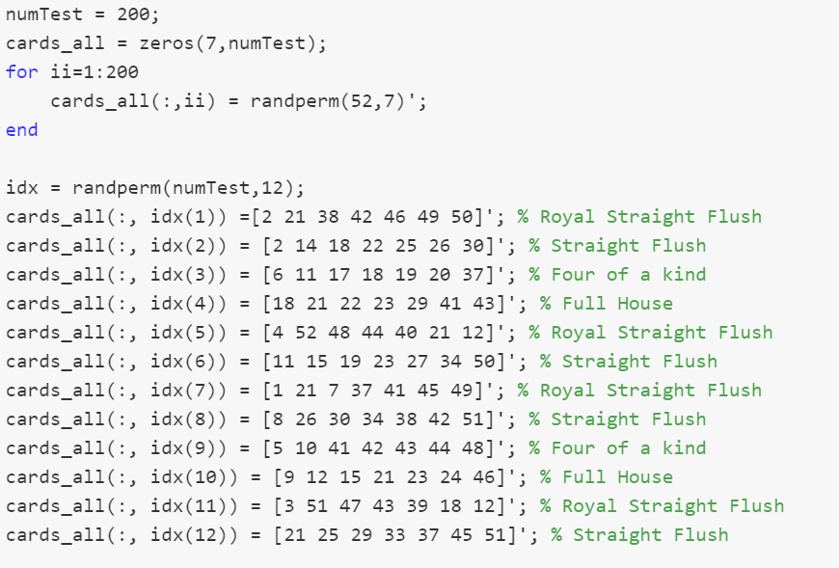
Template Code (Grader)

Slide 4
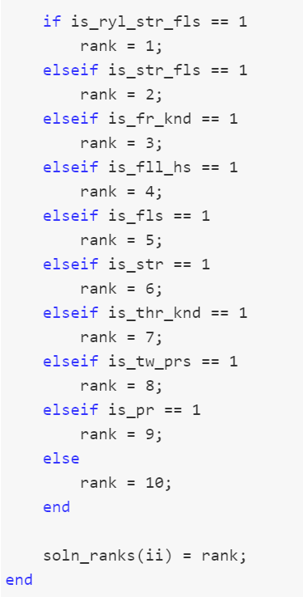
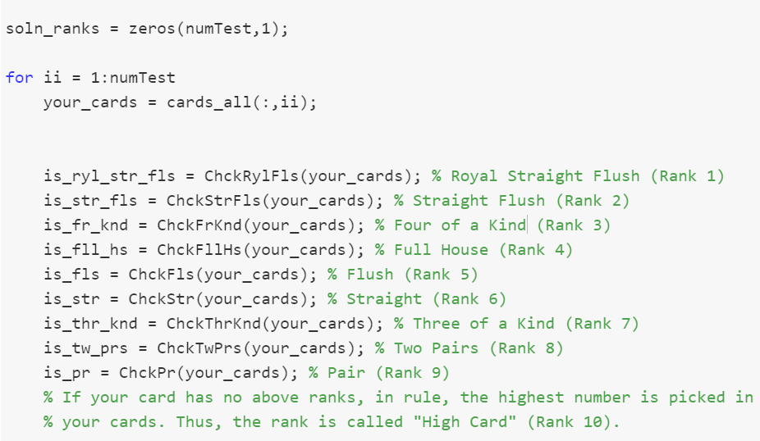
Template Code (Grader) - Continue

Slide 5
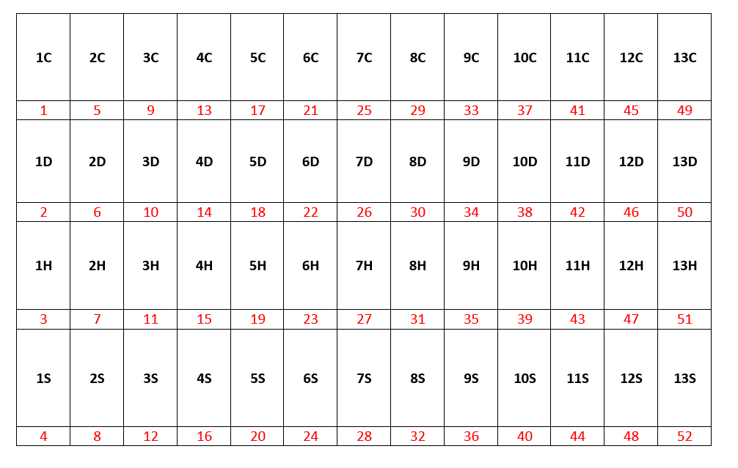
Introduction

Slide 6
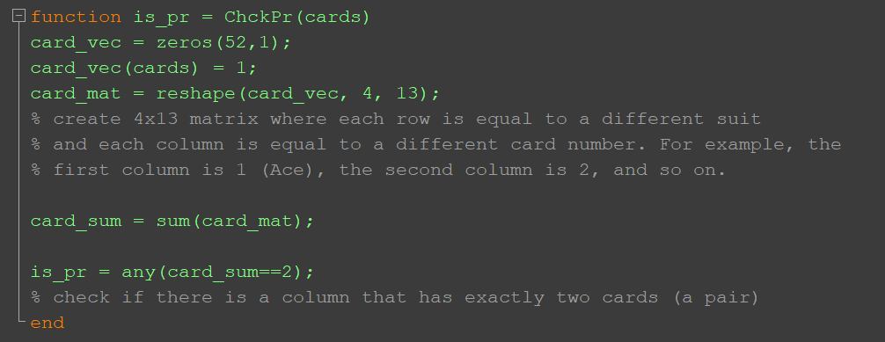
function is_pr = ChckPr(cards)

Slide 7
Example: One Pair
1C | 2C | 3C | 4C | 5C | 6C | 7C | 8C | 9C | 10C | 11C | 12C | 13C
1D | 2D | 3D | 4D | 5D | 6D | 7D | 8D | 9D | 10D | 11D | 12D | 13D
1H | 2H | 3H | 4H | 5H | 6H | 7H | 8H | 9H | 10H | 11H | 12H | 13H
1S | 2S | 3S | 4S | 5S | 6S | 7S | 8S | 9S | 10S | 11S | 12S | 13S

Slide 8
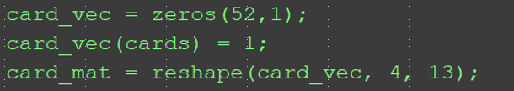
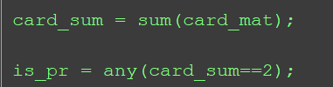
Example: One Pair
 |  |  |  |  |  |  | 1 |  |  |  | 1
 |  | 1
 |  | 1 |  |  |  |  |  |  |  | 1
 |  |  |  |  | 1 |  |  |  | 1
2
1
1
1
1
1

Slide 9
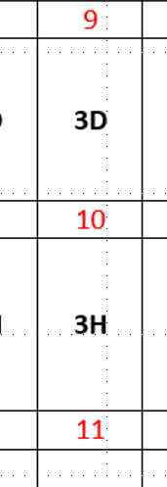
Question: Does the Function Work for Only Seven Cards
1C | 2C | 3C | 4C | 5C | 6C | 7C | 8C | 9C | 10C | 11C | 12C | 13C
1D | 2D | 3D | 4D | 5D | 6D | 7D | 8D | 9D | 10D | 11D | 12D | 13D
1H | 2H | 3H | 4H | 5H | 6H | 7H | 8H | 9H | 10H | 11H | 12H | 13H
1S | 2S | 3S | 4S | 5S | 6S | 7S | 8S | 9S | 10S | 11S | 12S | 13S

Slide 10
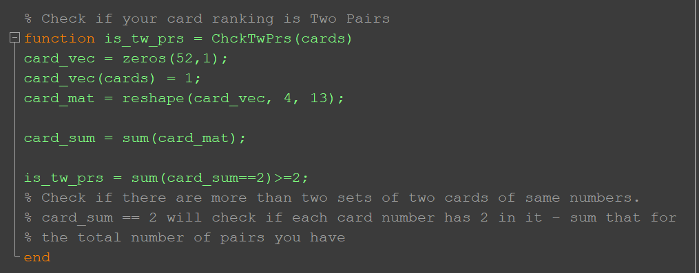
function is_tw_prs = ChckTwPrs(cards)
There is no three pairs

Slide 11
Example: Two Pairs
1C | 2C | 3C | 4C | 5C | 6C | 7C | 8C | 9C | 10C | 11C | 12C | 13C
1D | 2D | 3D | 4D | 5D | 6D | 7D | 8D | 9D | 10D | 11D | 12D | 13D
1H | 2H | 3H | 4H | 5H | 6H | 7H | 8H | 9H | 10H | 11H | 12H | 13H
1S | 2S | 3S | 4S | 5S | 6S | 7S | 8S | 9S | 10S | 11S | 12S | 13S

Slide 12
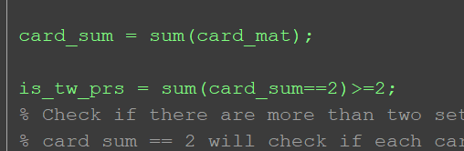
Example: Two Pairs
 |  |  |  |  | 1 |  | 1 |  |  |  | 1
 |  | 1
 |  | 1
 |  |  |  |  | 1 |  |  |  | 1
2
2
1
1
1

Slide 13
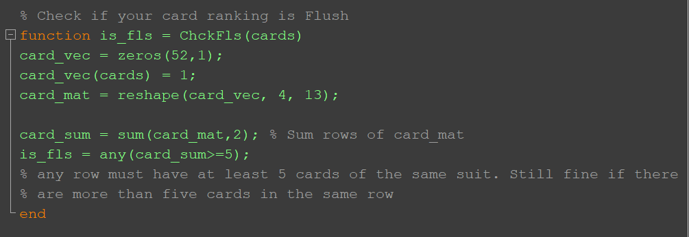
function is_fls = ChckFls(cards)

Slide 14
Example: Flush
1C | 2C | 3C | 4C | 5C | 6C | 7C | 8C | 9C | 10C | 11C | 12C | 13C
1D | 2D | 3D | 4D | 5D | 6D | 7D | 8D | 9D | 10D | 11D | 12D | 13D
1H | 2H | 3H | 4H | 5H | 6H | 7H | 8H | 9H | 10H | 11H | 12H | 13H
1S | 2S | 3S | 4S | 5S | 6S | 7S | 8S | 9S | 10S | 11S | 12S | 13S

Slide 15
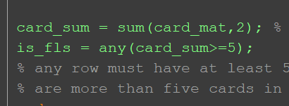
Example: Flush
1
 |  | 1 |  | 1 |  |  | 1 |  | 1 | 1
 |  |  |  |  |  |  |  |  |  |  | 1
1
5
1

Slide 16
function is_str_fls = ChckStrFls(cards)
1C | 2C | 3C | 4C | 5C | 6C | 7C | 8C | 9C | 10C | 11C | 12C | 13C
1D | 2D | 3D | 4D | 5D | 6D | 7D | 8D | 9D | 10D | 11D | 12D | 13D
1H | 2H | 3H | 4H | 5H | 6H | 7H | 8H | 9H | 10H | 11H | 12H | 13H
1S | 2S | 3S | 4S | 5S | 6S | 7S | 8S | 9S | 10S | 11S | 12S | 13S
Are there more than one Flush pair?

Slide 17
function is_str_fls = ChckStrFls(cards)
1C | 2C | 3C | 4C | 5C | 6C | 7C | 8C | 9C | 10C | 11C | 12C | 13C
1D | 2D | 3D | 4D | 5D | 6D | 7D | 8D | 9D | 10D | 11D | 12D | 13D
1H | 2H | 3H | 4H | 5H | 6H | 7H | 8H | 9H | 10H | 11H | 12H | 13H
1S | 2S | 3S | 4S | 5S | 6S | 7S | 8S | 9S | 10S | 11S | 12S | 13S
Check Straight !!!!

Slide 18
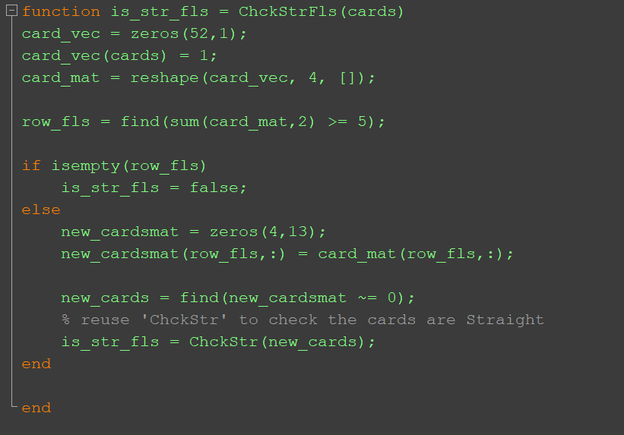
function is_str_fls = ChckStrFls(cards)

Slide 19
How Many Royal Straight Flush ?
1C | 2C | 3C | 4C | 5C | 6C | 7C | 8C | 9C | 10C | 11C | 12C | 13C
1D | 2D | 3D | 4D | 5D | 6D | 7D | 8D | 9D | 10D | 11D | 12D | 13D
1H | 2H | 3H | 4H | 5H | 6H | 7H | 8H | 9H | 10H | 11H | 12H | 13H
1S | 2S | 3S | 4S | 5S | 6S | 7S | 8S | 9S | 10S | 11S | 12S | 13S

Slide 20
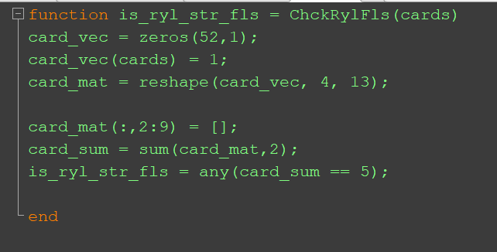
function is_ryl_str_fls = ChckRylFls(cards)

