Slide 1
Selection Statement
Chul Min Yeum
Assistant Professor
Civil and Environmental Engineering
University of Waterloo, Canada
AE121: Computational Method
Last updated: 2019-06-04

Slide 2
Recall Relational Expressions
The relational operators in MATLAB are:
> greater than
< less than
>= greater than or equals
<= less than or equals
== equality
~= inequality
The resulting type is logical 1 for true or 0 for false
The logical operators are:
|| or for scalars (and)
&& and for scalars (or)
~ not
Also, xor function which returns logical true if only one of the arguments is true

Slide 3
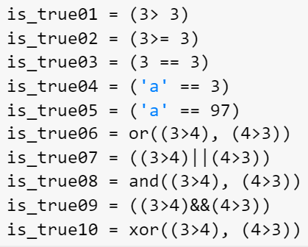
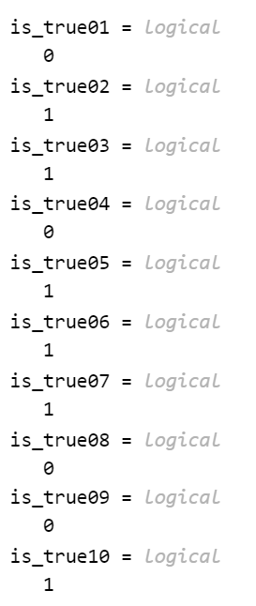
Example: Relational Expressions

Slide 4
The “is” Functions
There are many “is” functions in MATLAB that essentially ask a true/false question, and return logical 1 for true or 0 for false
isscalar returns logical 1 (true) if size(A) returns [1 1], and logical 0 (false) otherwise.
isvector returns logical 1 (true) if size(A) returns [1 n] or [n 1] with a nonnegative integer value n, and logical 0 (false) otherwise.
ismatrix returns logical 1 (true) if size(V) returns [m n] with nonnegative integer values m and n, and logical 0 (false) otherwise.
isrow returns logical 1 (true) if size(V) returns [1 n] with a nonnegative integer value n, and logical 0 (false) otherwise.
iscolumn returns logical 1 (true) if size(V) returns [n 1] with a nonnegative integer value n, and logical 0 (false) otherwise.

Slide 5
The “is” Functions (Continue)
isempty returns 1 if the variable argument is empty, or 0 if not.
ischar returns logical 1 (true) if A is a character array and logical 0 (false) otherwise.
isspace returns a logical array TF. If A is a character array or string scalar, then the elements of TF are logical 1 (true) where corresponding characters in A are space characters, and logical 0 (false) elsewhere. isspace recognizes all Unicode® whitespace characters.
isletter returns 1 or 0 for every character in a string – whether it is a letter of the alphabet or not.

Slide 6
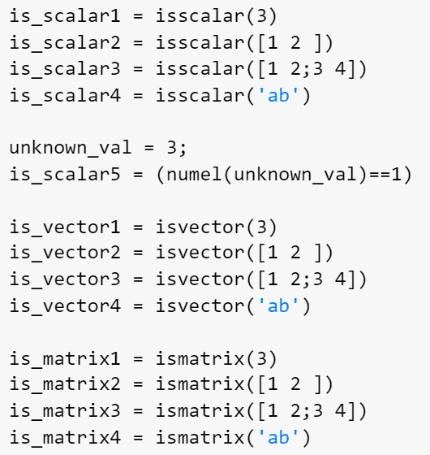
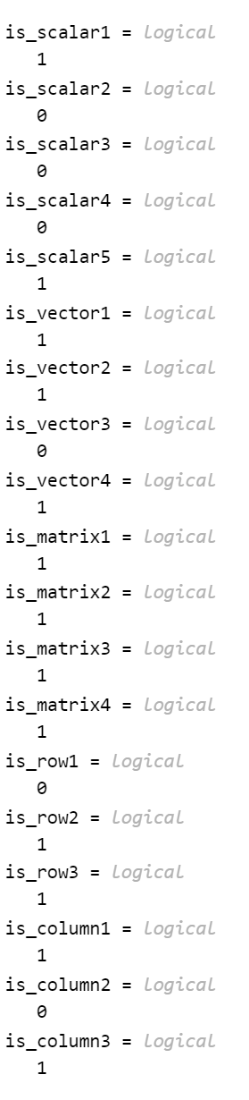
Example: isscalar, isvector, and ismatrix
A scalar is considered to be a 1 x 1 vector or 1 x 1 matrix.
A n x 1 vector is considered to be a n x 1 matrix.

Slide 7
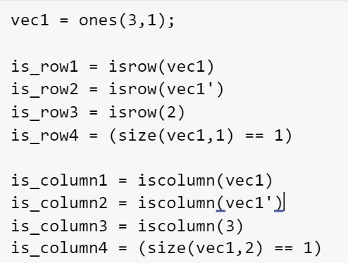
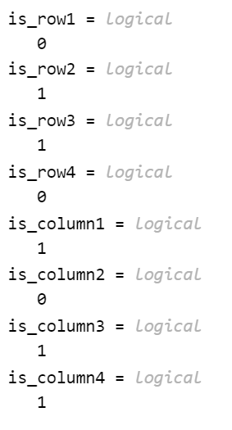
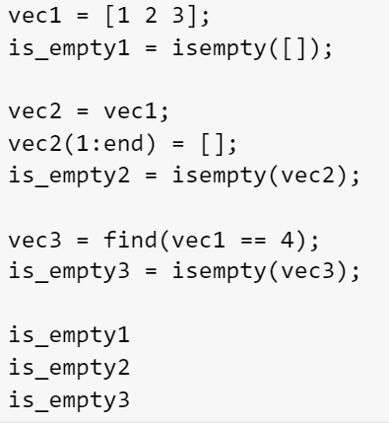
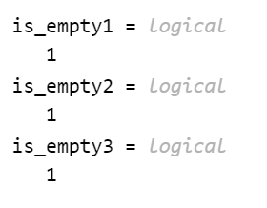
Example: isrow, iscolumn, isempty

Slide 8
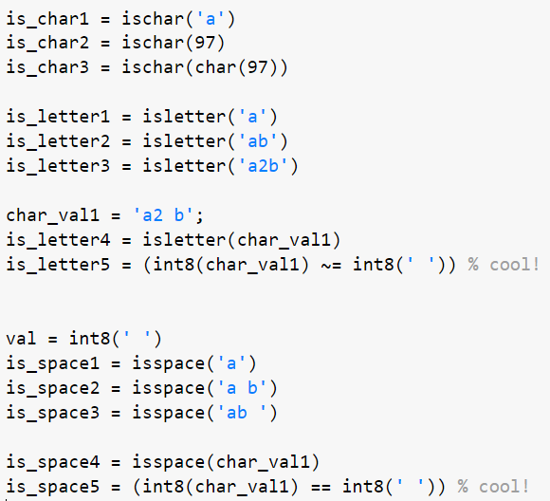
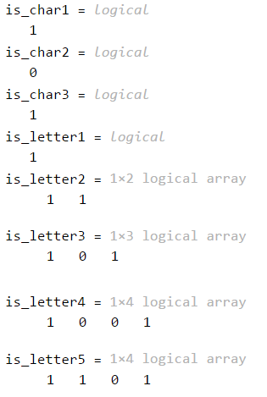
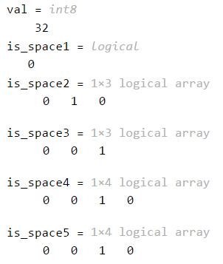
Example: ischar, isletter, and isspace

Slide 9
If Statement
The if statement is used to determine whether or not a statement or group of statements is to be executed
General form:
if condition
action
end
the condition is any relational expression
the action is any number of valid statements (including, possibly, just one)
if the condition is true, the action is executed – otherwise, it is skipped entirely

Slide 10
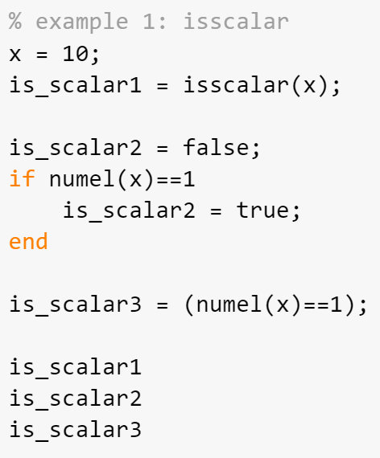
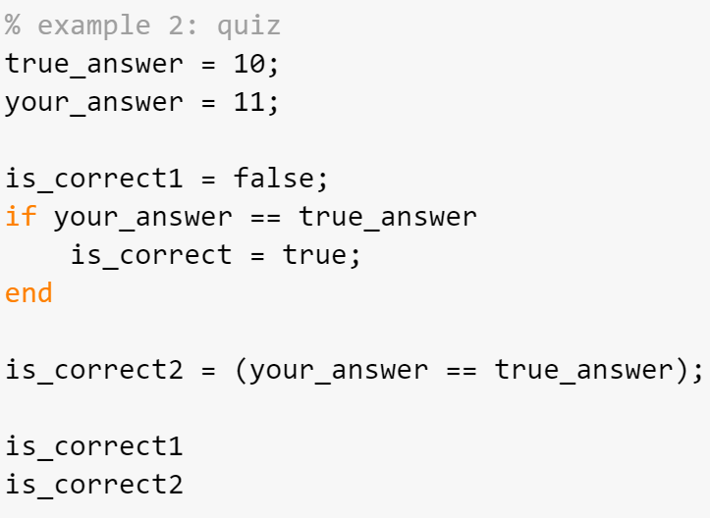
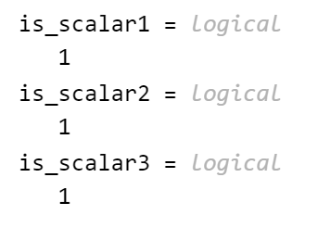
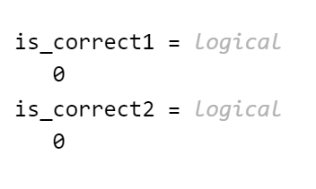
Example: Simple Example 1

Slide 11
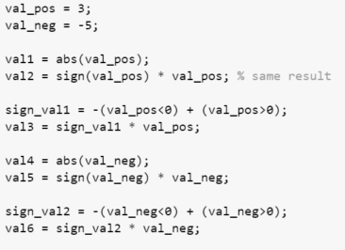
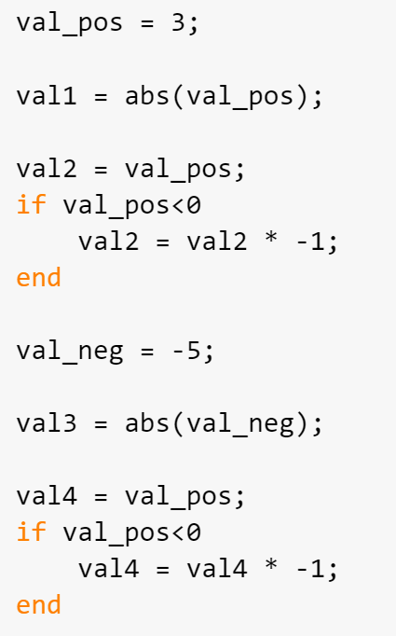
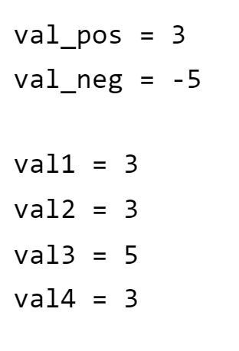

Example: Simple Example 2

Slide 12
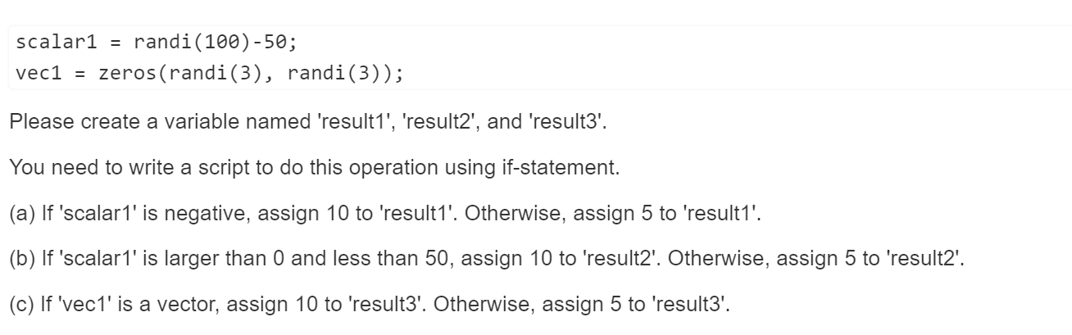
Quiz: Design Operation using if-Statement or Logical Operation

Slide 13
If-else Statements
The if-else statement chooses between two actions
General form:
if condition
action1
else
action2
end
One and only one action is executed; which one depends on the value of the condition (action1 if it is logical true or action2 if it is false)

Slide 14
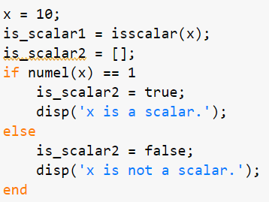
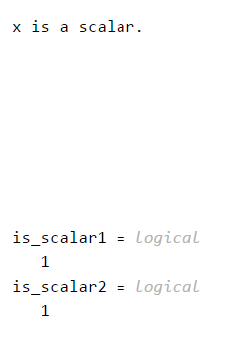
Revisit: Simple Example

Slide 15
If-else Statements are not Always Necessary!
Simplify this statement:
if num < 0
num = 0;
else
num = num;
end
Answer:
if num < 0
num = 0;
end
Simplify this statement:
if num < 0
num = 0;
else
num = 3;
end
Answer:
num = 3;
if num < 0
num = 0;
end

Slide 16
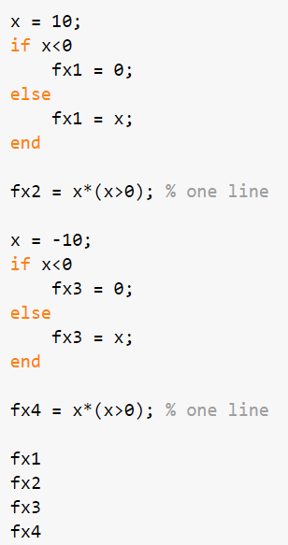
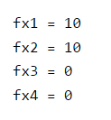
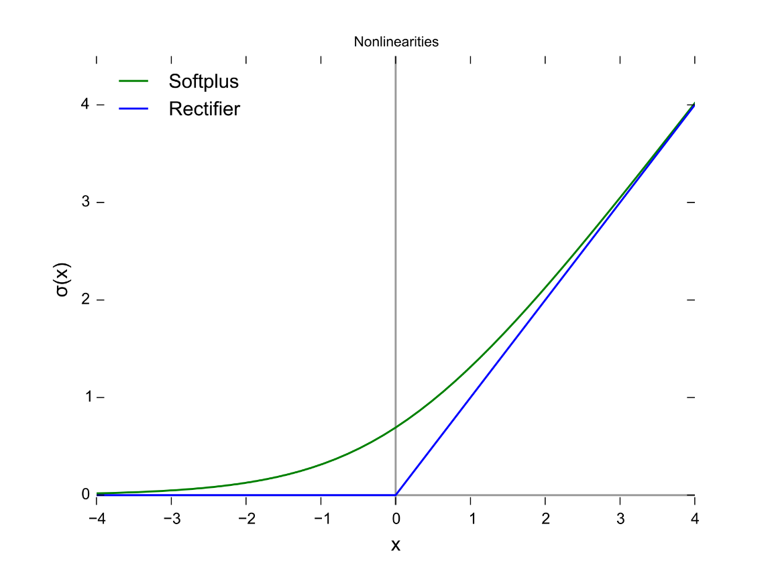

Example: Rectifier
$$f\left(x\right)=max⁡(0, x)$$
https://en.wikipedia.org/wiki/Rectifier_(neural_networks)

Slide 17
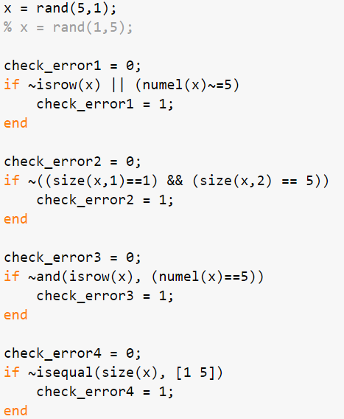
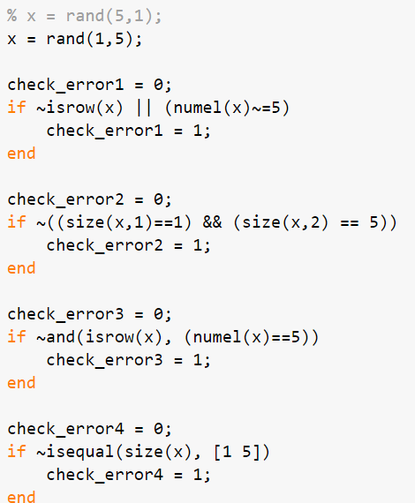
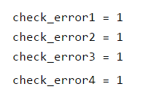
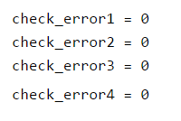
Example: Check a Dimension of Your Input Vector

Slide 18
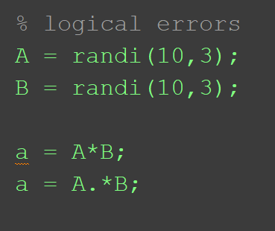
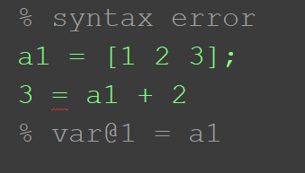
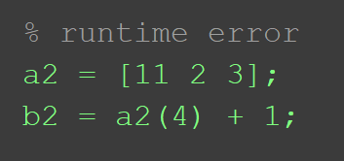
Types of Errors
Syntax error
Runtime error
Logical error

Slide 19
Throwing an Error
MATLAB has an error function that can be used to display an error message in red, similar to the error messages generated by MATLAB
if radius <= 0
error('Sorry; %.2f is not a valid radius\n', radius)
else
% carry on
end
When an error is thrown in a script, the script stops executing

Slide 20
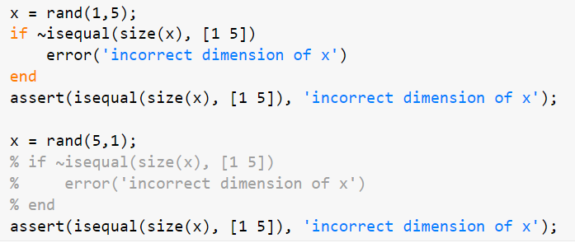
Example: Throwing an Error

Slide 21
Nested if-else Statements
To choose from more than two actions, nested if-else statements can be used (an if or if-else statement as the action of another)
General form:
if condition1
action1
else
if condition2
action2
else
if condition3
action3
% etc: there can be many of these
else
actionn % the nth action
end
end
end

Slide 22
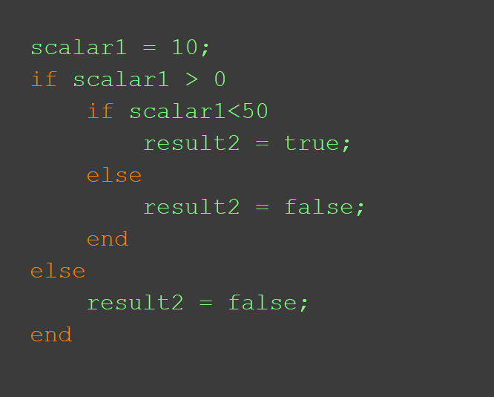
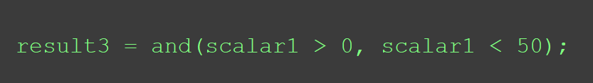
Example
If 'scalar1' is larger than 0 and less than 50, assign 10 to 'result2'. Otherwise, assign 5 to 'result2'.
Logical operation
Nested if-statement

Slide 23
The elseif Clause
MATLAB also has an elseif clause which shortens the code (and cuts down on the number of ends)
General form:
if condition1
action1
elseif condition2
action2
elseif condition3
action3
% etc: there can be many of these
else
actionn % the nth action
end

Slide 24
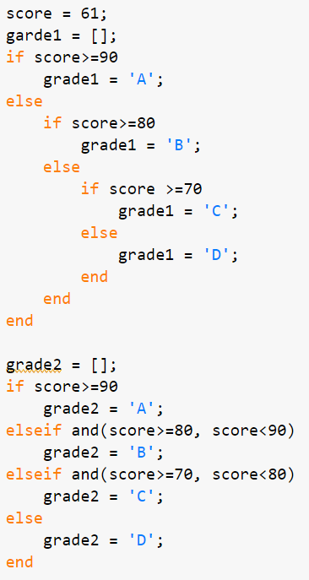

Example: Grading
Write a program that gives a grade based on a score. A: >=90, B: 80~90, C:70~80, D: <70

Slide 25
if , if-else, if-elseif, if-elseif-else
if condition1
action1
end
if condition1
action1
else
action2
end
if condition1
action1
elseif condition2
action2
end
if condition1
action1
elseif condition2
action2
else
action3
end

Slide 26
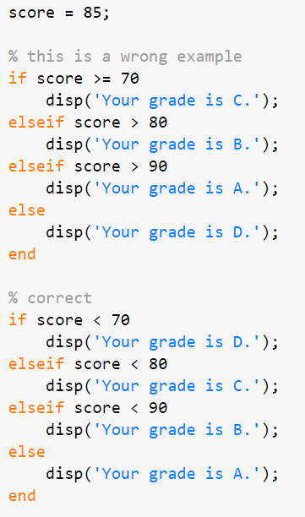


Example: Correct Use of elseif Statement
Write a program that gives a grade based on a score. A: >=90, B: 80~90, C:70~80, D: <70

Slide 27
The Switch Statement
The switch statement can frequently be used in place of a nested if-else statement
General form:
switch switch_expression
case caseexp1
action1
case caseexp2
action2
case caseexp3
action3
% etc: there can be many of these
otherwise
actionn
end
this can be used when comparing the switch_expression to see if it is equal to the values on the case labels (the otherwise clause handles all other possible values)

Slide 28
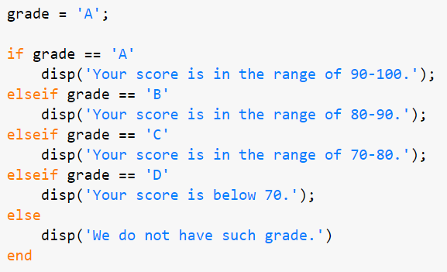
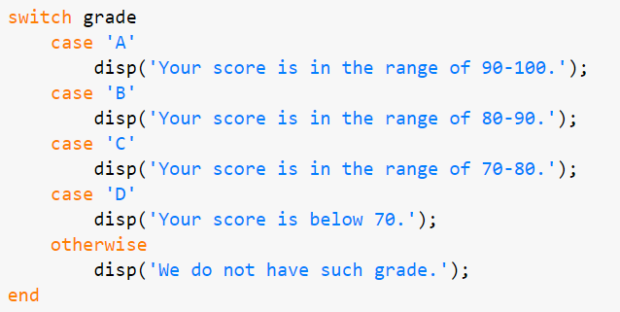
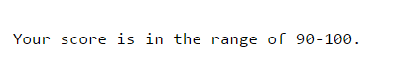
Example: Switch Statement
Let's write a code for conducting an opposite action. A program tells you the score range when you type your grade.

Slide 29
Common Pitfalls
Some common pitfalls have been pointed out already; others include:
Using = instead of == for equality in conditions
Putting a space in the keyword elseif
Not using quotes when comparing a string variable to a string, such as
letter == y
instead of
letter == 'y'
Writing conditions that are more complicated than necessary, such as
if (x < 5) == 1 instead of just if (x < 5)

Slide 30
Programming Style Guidelines
Use indentation to show the structure of a script or function. In particular, the actions in an if statement should be indented.
When the else clause isn’t needed, use an if statement rather than an if-else statement
CTRL + I : Smart Indent

Slide 31
Slide Credits and References
Stormy Attaway, 2018, Matlab: A Practical Introduction to Programming and Problem Solving, 5th edition
Lecture slides for “Matlab: A Practical Introduction to Programming and Problem Solving”
Holly Moore, 2018, MATLAB for Engineers, 5th edition

