Slide 1
Loop Statement
Chul Min Yeum
Assistant Professor
Civil and Environmental Engineering
University of Waterloo, Canada
AE121: Computational Method
Last updated: 2019-06-04

Slide 2
For-Loop
used as a counted loop
repeats an action a specified number of times
an iterator or loop variable specifies how many times to repeat the action
general form:
for loopvar = range
action
end
the range is specified by a vector
the action is repeated for every value of the loop variable in the specified vector

Slide 3
Input in a For-Loop
If it is desired to repeat the process of prompting the user and reading input a specified number of times (N), a for loop is used:
for ii = 1:N
% prompt and read in a value
% do something with it!
end
If it is desired to store the values entered in a vector, the most efficient method is to preallocate the vector first to have N elements

Slide 4
Example: How For-Loop Works
ii is 1.
sum = 0 + 1; (‘sum’ becomes 1)
end
ii is 2.
sum = 1 + 2; (‘sum’ becomes 3)
end
ii is 3.
sum = 3 + 3; (‘sum’ becomes 6)
End
No more ii -> exit the loop.
‘sum’ becomes 6.
‘ii’ becomes 3.
sum = 0
for ii = 1:3
sum = sum + ii;
end

Slide 5
Pre-allocating a Vector
Preallocating sets aside enough memory for a vector to be stored
The alternative, extending a vector, is very inefficient because it requires finding new memory and copying values every time
Many functions can be used to preallocate, although it is common to use zeros
For example, to preallocate a vector vec to have N elements:
vec = zeros(1,N);
-
(Highly recommended) if you knew the array size that you allocate values computed from a loop !!!

Slide 6
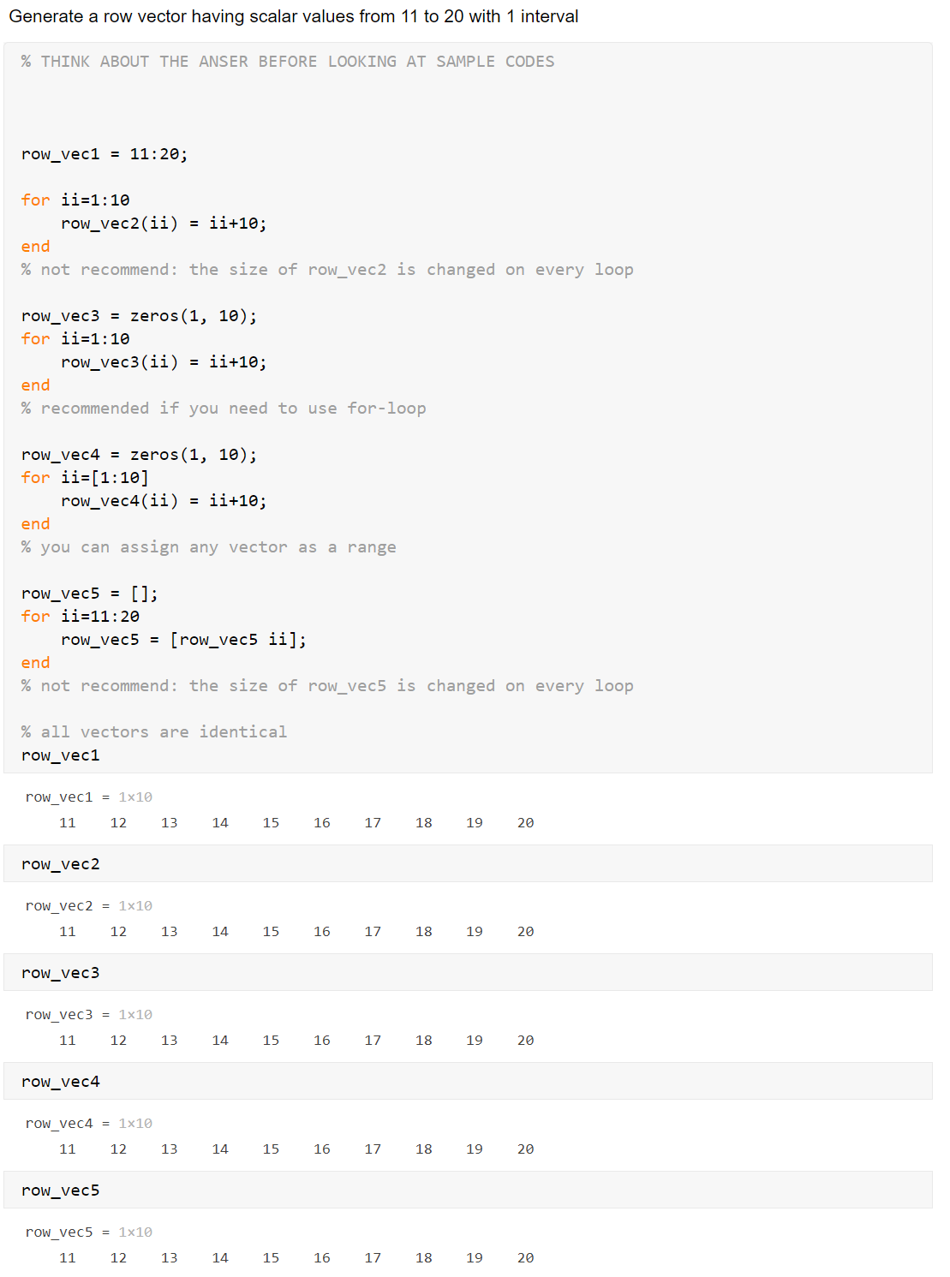
Example: Simple Example I
Generate a row vector having scalar values from 11 to 20 with 1 interval
Refereeing: Error
Assigning : Okay
matlab

Slide 7
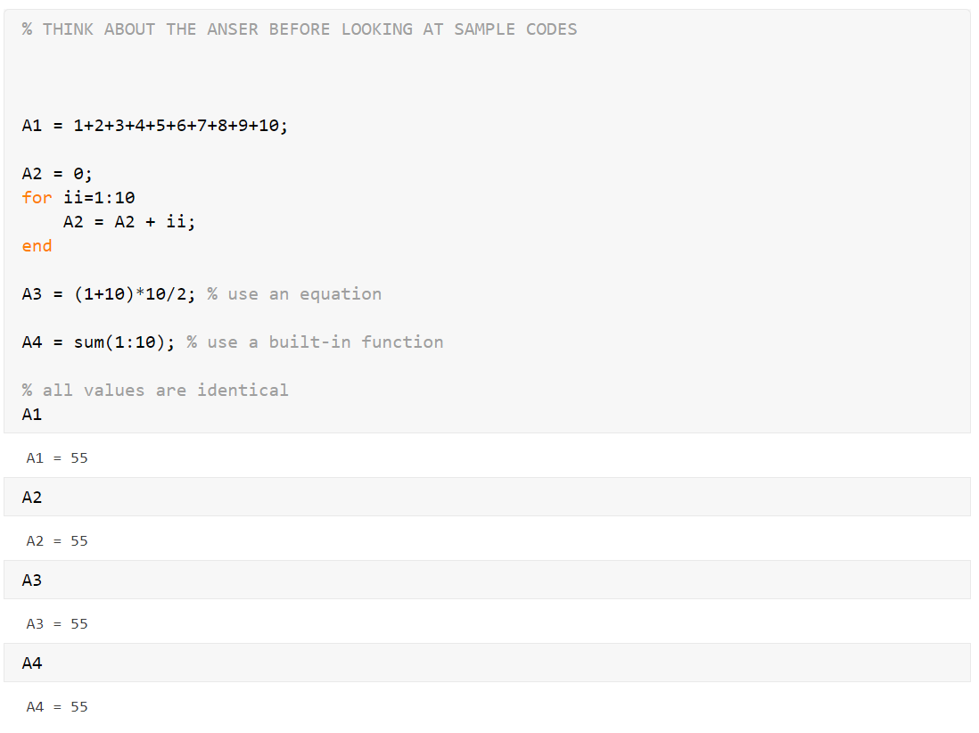
Example: Simple Example II
Sum 1 to 10 and assign its value to a variable

Slide 8
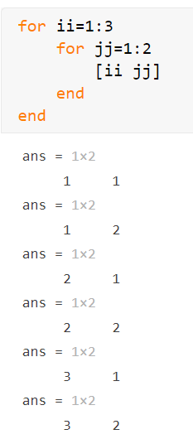
Nested For-Loops
A nested for loop is one inside of ( as the action of) another for loop
General form of a nested for loop:
for loopvarone = rangeone
actionone:
for loopvartwo = rangetwo
actiontwo
end
end
The inner loop action is executed in its entirety for every value of the outer loop variable

Slide 9
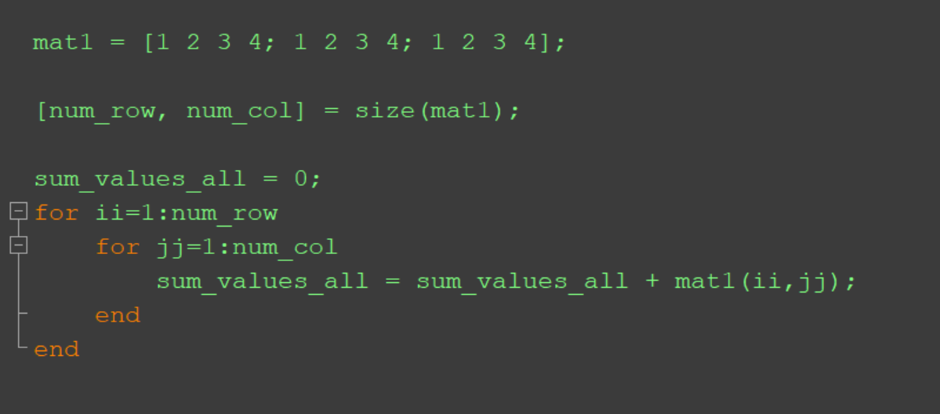
Use of Nested For-Loops
1 | 2 | 3 | 4
1 | 2 | 3 | 4
1 | 2 | 3 | 4
mat1

Slide 10
Combining For-Loop(s) and If
for loops and if statements can be combined
the action of a loop can include an if statement
the action of an if statement can include a for loop
This is also true for nested for loops; if statements can be part of the action(s) of the outer and/or inner loops
This is done if an action is required on an element (of a vector or matrix) only if a condition is met

Slide 11
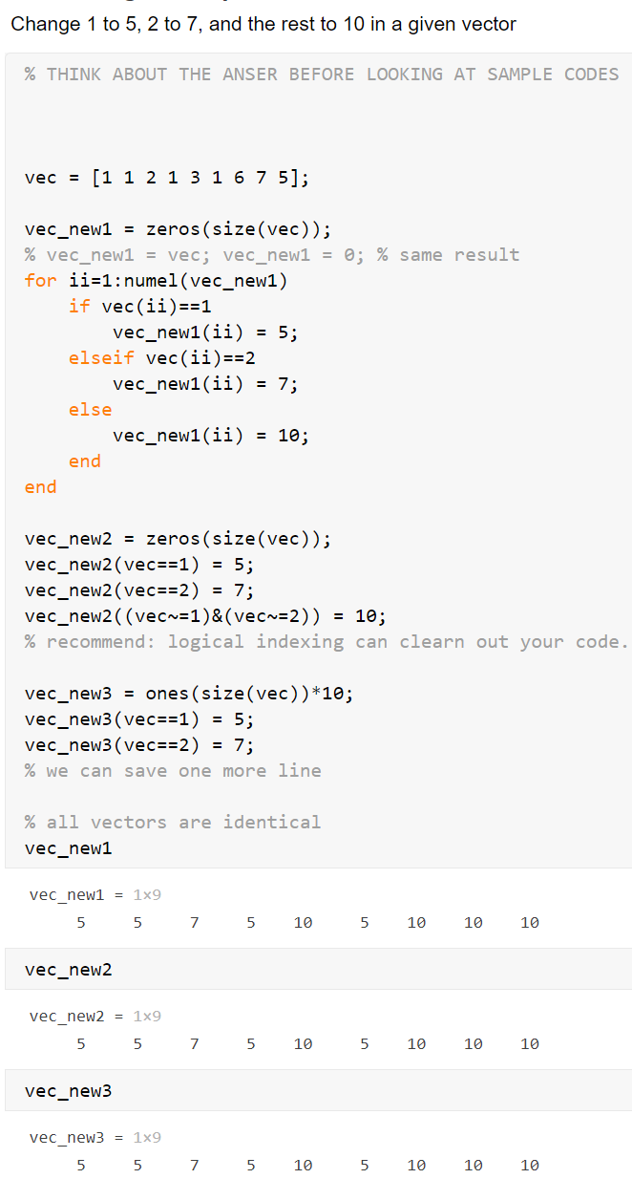
Example: Logical Operation
Change 1 to 5, 2 to 7, and the rest to 10 in a given vector

Slide 12
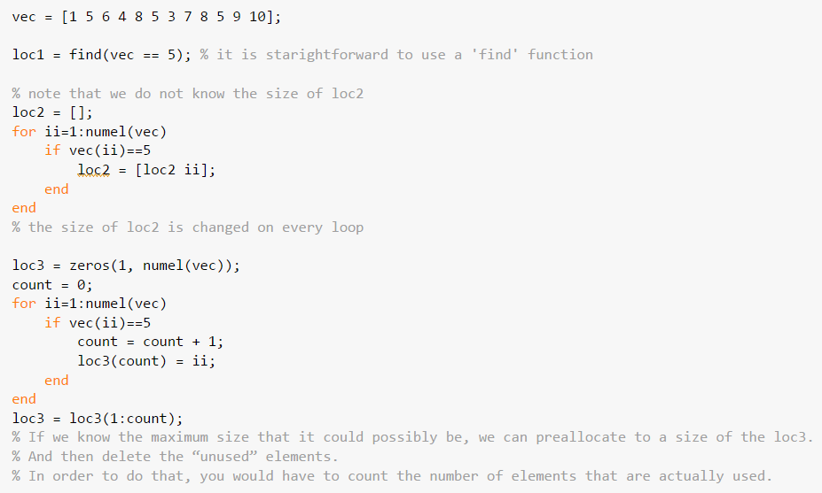
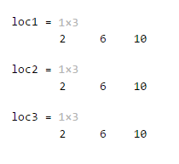
Example: Find
Find indexes of a vector where 5 is located

Slide 13
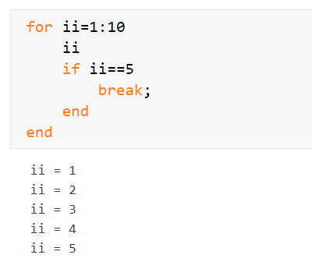
Break
Break command can be used to terminate a loop prematurely (while the comparison in the first line is still true.
A break statement will cause termination of the smallest enclosing while or for loop.

Slide 14
Quiz: Value Replacement
If values in ‘vec1' are larger than 0 and less than 50, replace the values to 10. Otherwise, replace them to 5.
vec1 = [ 1 10 70 80 2]
vec1 = [10 10 5 5 10]

Slide 15
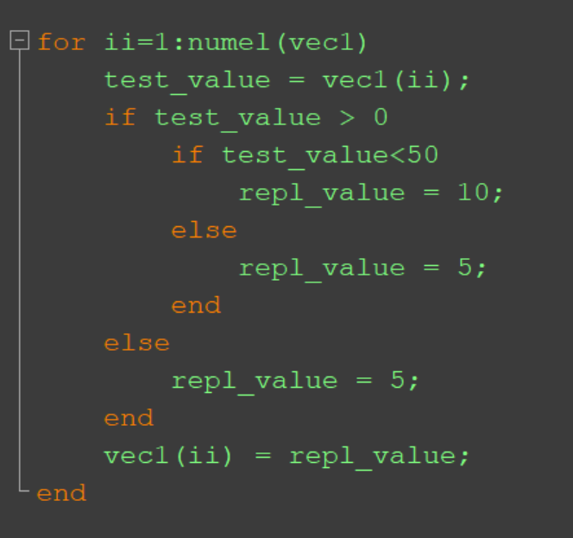
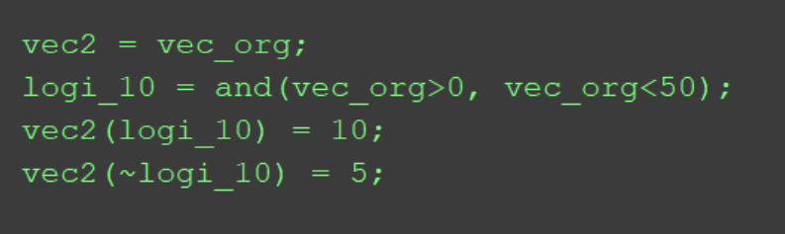
Quiz: Value Replacement (Answer)
If values in ‘vec1' are larger than 0 and less than 50, replace the values to 10. Otherwise, replace them to 5.

Slide 16
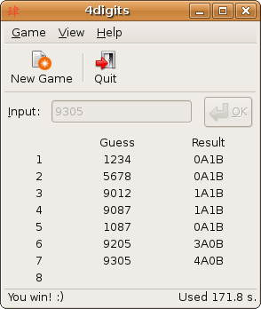
Quiz: Bulls and Cows
Bulls and Cows is a mind game played by two players. In the game, a random, 4-digit number is chosen and it's values are compared to those of another trial number. All four digits of the number are different. If any digit in the chosen number is the exact same value and in the exact same position as any digit in the trial number, this is called a bull. If the digit is present in both the trial number and chosen number, but is not in the same location, this is called a cow.
Use selection and loop statements to solve this problem

Slide 17
While-Loop
used as a conditional loop
used to repeat an action when ahead of time it is not known how many times the action will be repeated
general form:
while condition
action
end
the action is repeated as long as the condition is true
an infinite loop can occur if the condition never becomes false (Use Ctrl-C to break out of an infinite loop)
Note: since the condition comes before the action, it is possible that the condition will be false the first time it is evaluated and therefore the action will not be executed at all

Slide 18
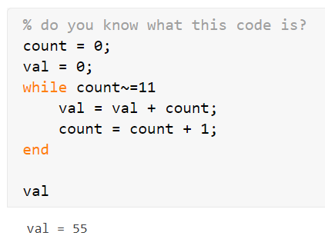
Counting in a While-Loop
it is frequently useful to count how many times the action of the loop has been repeated
general form of a while loop that counts:
counter = 0;
while condition
% action
counter = counter + 1;
end
% use counter – do something with it!

Slide 19
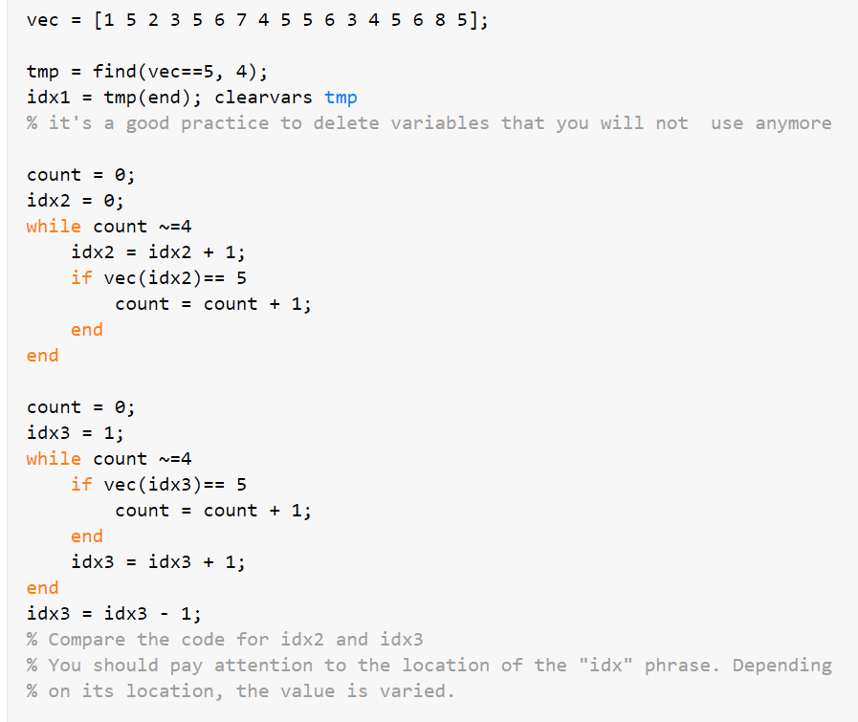
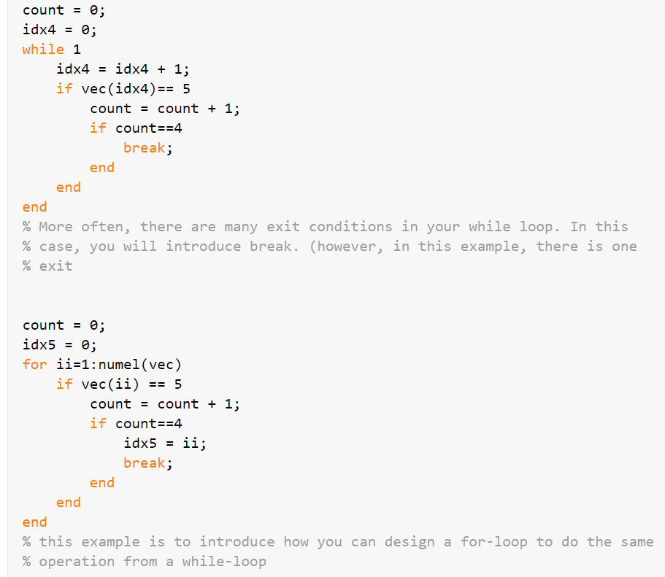
Example: Find (Advanced)
Find an first 4th index of 5 in a given vector
All ‘idx’ are 10.

Slide 20
Use MATLAB Wisely!!
Using for loops with vectors and matrices is a very important programming concept, and is necessary when working with many languages
However… Although for loops are very useful in MATLAB, they are almost not necessary when performing an operation on every element in a vector or matrix!
This is because MATLAB is written to work with matrices (and therefore also vectors), so functions on matrices and operations on matrices automatically iterate through all elements – no loops needed!

Slide 21
Vectorizing
The term vectorizing is used in MATLAB for re-writing code using loops in a traditional programming language to matrix operations in MATLAB
For example, instead of looping through all elements in a vector vec to add 3 to each element, just use scalar addition:
vec = vec + 3;

Slide 22
Efficient Code
In most cases, code that is faster for the programmer to write in MATLAB is also faster for MATLAB to execute.
Faster to write = less making mistakes = less time for debugging
Keep in mind these important features:
Scalar and array operations
Logical vectors
Built-in functions
Preallocation of vectors

Slide 23
Operations on Vectors & Matrices
Can perform numerical operations on vectors and matrices, e.g. vec + 3
Scalar operations e.g. mat * 3
Array operators operate term-by-term or element-by-element, so must be same size
Addition + and subtraction -
Array operators for any operation based on multiplication require dot in front .* ./ .\ .^

Slide 24
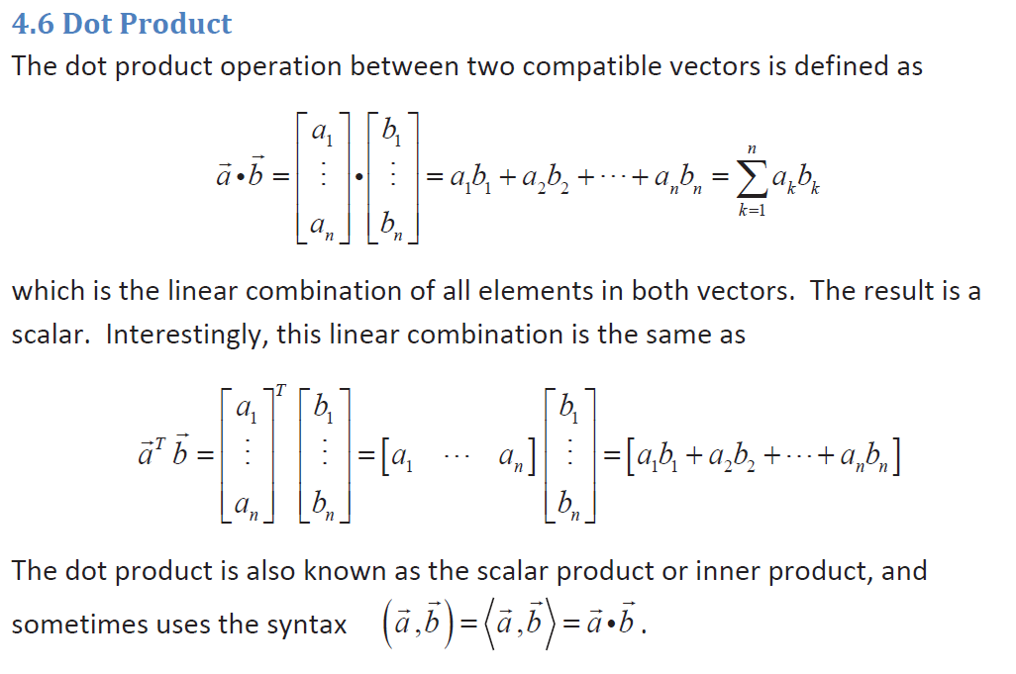
Example: Dot Product (Theory)
AE115 lecture note (Dr. Brush)

Slide 25
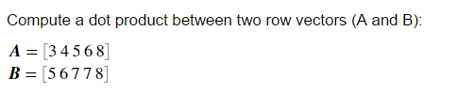
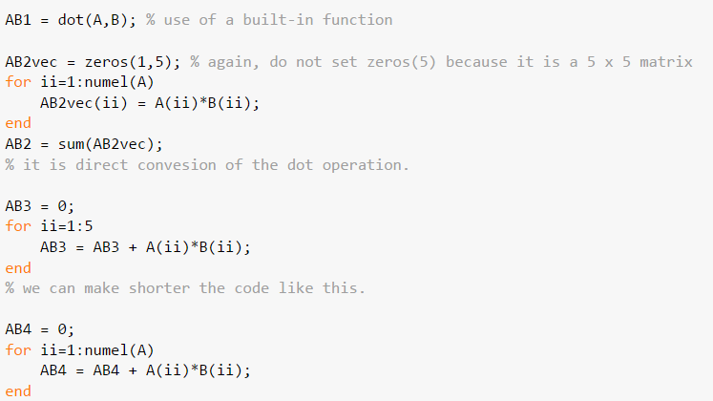
Example: Dot Product (Code)

Slide 26
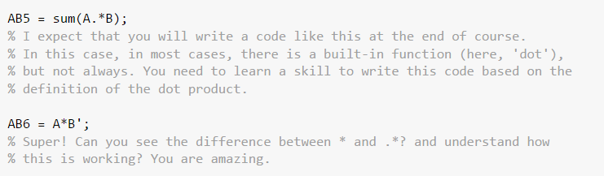
Example: Dot Product (Continue)

Slide 27
Common Pitfalls
Forgetting to initialize a running sum or count variable to 0 or a running product to 1
Not realizing that it is possible that the action of a while loop will never be executed
Not error-checking input into a program (debugging using a MATLAB workspace helps)
Not taking advantage of MATLAB; not vectorizing! (Do matrix operations!!!)

Slide 28
Programming Style Guidelines
Use loops for repetition only when necessary
for statements as counted loops
while statements as conditional loops (because we need to have an exist condition)
Do not use i or j for iterator variable names if the use of the built-in constants i and j is desired (recommendation: use ii or jj)
Indent the action of loops (use a smart indent – Ctrl + I)
Preallocate vectors and matrices whenever possible (when the size is known ahead of time).
If the loop variable is just being used to specify how many times the action of the loop is to be executed, use the colon operator 1:n

Slide 29
Slide Credits and References
Stormy Attaway, 2018, Matlab: A Practical Introduction to Programming and Problem Solving, 5th edition
Lecture slides for “Matlab: A Practical Introduction to Programming and Problem Solving”
Holly Moore, 2018, MATLAB for Engineers, 5th edition

