Slide 1
Numerical Technique
Chul Min Yeum
Assistant Professor
Civil and Environmental Engineering
University of Waterloo, Canada
AE121: Computational Method
Last updated: 2019-07-20

Slide 2




Numeric Technique
Algorithms that are used to obtain numerical solutions of a mathematical problem
It is useful when no analytical solution exists or analytical solution is difficult to obtain.
$$f(x) = 2x + 3$$
$$f\left(x\right)=\log\left(x\right)∗2x+{e^{3x}∗x}^{2/3}$$
$$f′\left(3\right)$$
$$f′\left(3\right)$$

Slide 3
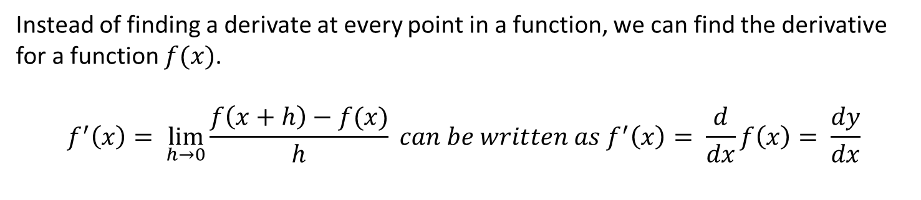
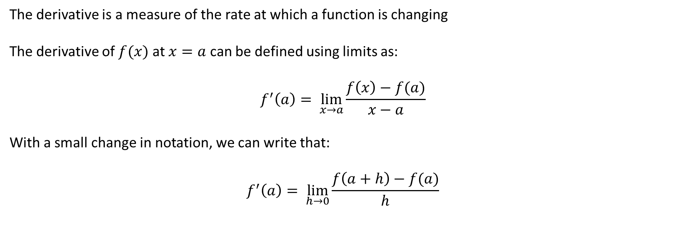
Theory: Differentiation
The derivative is a measure of the rate at which a function is changing
The derivative of $f(x)$ at $x=a$ can be defined using limits as:
$$f^{′}\left(a\right)= \lim_{x→a}{\frac{f\left(x\right)−f(a)}{x−a}}$$
With a small change in notation, we can write that:
$$f^{′}\left(a\right)= \lim_{h→0}{\frac{f\left(a+h\right)−f(a)}{h}}$$
For one point
Instead of finding a derivate at every point in a function, we can find the derivative for a function $f(x)$.
$$f^{′}\left(x\right)= \lim_{h→0}{\frac{f\left(x+h\right)−f(x)}{h}} can be written as f^{′}\left(x\right)= \frac{d}{dx}f\left(x\right)= \frac{dy}{dx}$$
For a function

Slide 4
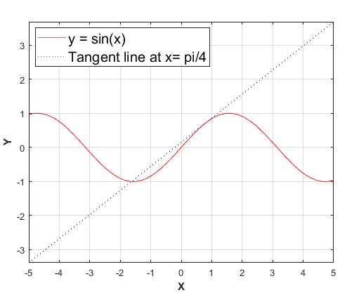
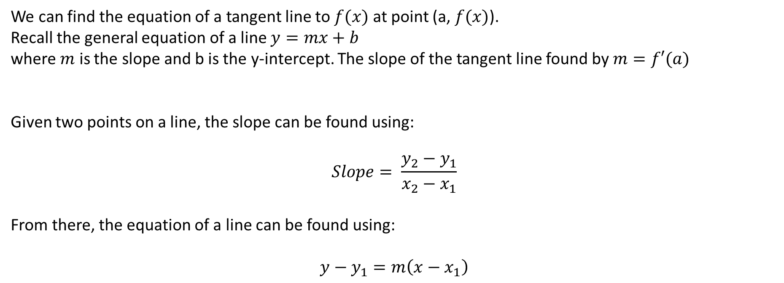
Theory: Tangent Lines
We can find the equation of a tangent line to $f(x)$ at point (a, $f(x)$).
Recall the general equation of a line $y=mx+b$
where $m$ is the slope and b is the y-intercept. The slope of the tangent line found by $m=f′(a)$
Given two points on a line, the slope can be found using:
$$Slope= \frac{y_{2}−y_{1}}{x_{2}−x_{1}}$$
From there, the equation of a line can be found using:
$$y−y_{1}=m\left(x−x_{1}\right)$$

Slide 5
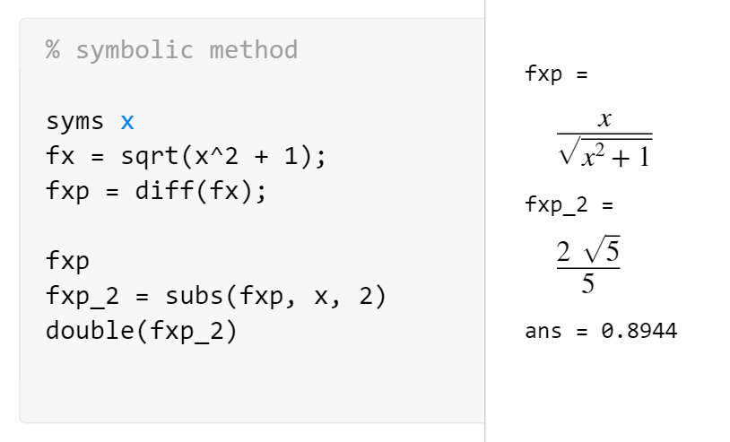
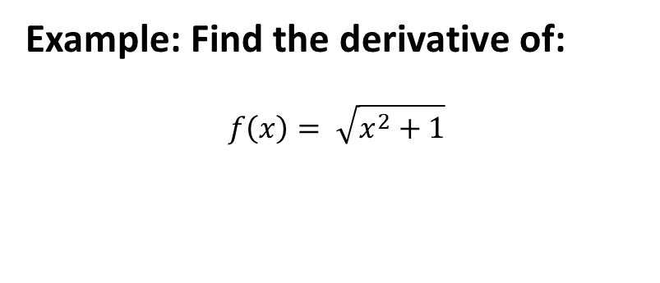
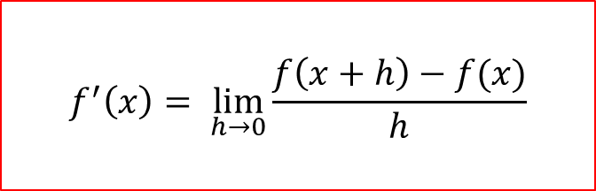
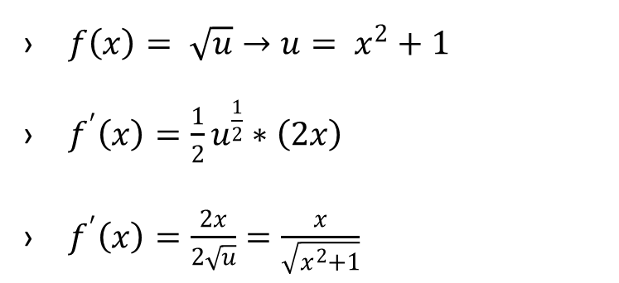
Example: Differentiation 1 – Symbolic Way
Example: Find the derivative of:
$$f\left(x\right)= \sqrt{x^{2}+1}$$
$f\left(x\right)= \sqrt{u}→u= x^{2}+1$
$f^{′}\left(x\right)=\frac{1}{2}u^{\frac{1}{2}}∗\left(2x\right)$
$f^{′}\left(x\right)=\frac{2x}{2\sqrt{u}}=\frac{x}{\sqrt{x^{2}+1}}$
$$f^{′}\left(x\right)= \lim_{h→0}{\frac{f\left(x+h\right)−f(x)}{h}}$$

Slide 6
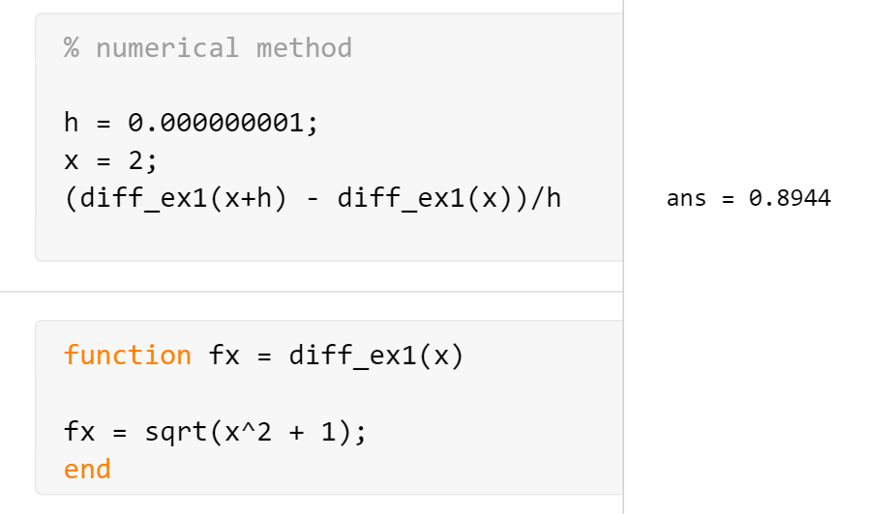

Example: Differentiation 1 – Numerical Way
Example: Find the derivative of:
$$f\left(x\right)= \sqrt{x^{2}+1}$$
$f\left(x\right)= \sqrt{u}→u= x^{2}+1$
$f^{′}\left(x\right)=\frac{1}{2}u^{\frac{1}{2}}∗\left(2x\right)$
$f^{′}\left(x\right)=\frac{2x}{2\sqrt{u}}=\frac{x}{\sqrt{x^{2}+1}}$
$$f^{′}\left(x\right)= \lim_{h→0}{\frac{f\left(x+h\right)−f(x)}{h}}$$

Slide 7
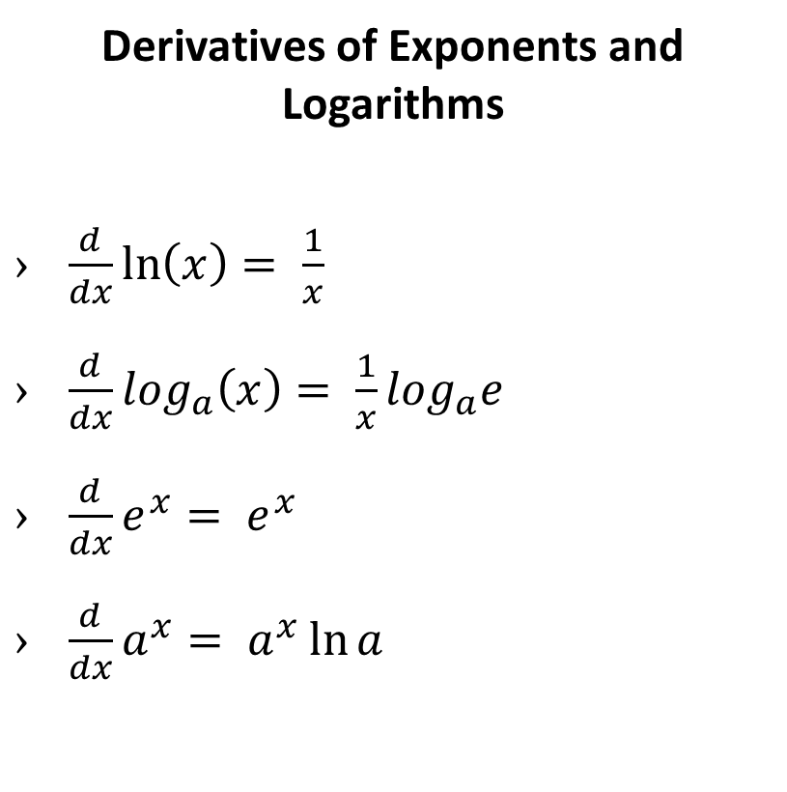
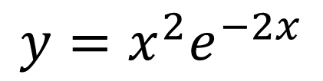


Example: Differentiation 2
$$= {2xe}^{−2x}+x^{2}{(−2)e}^{−2x}=2xe^{−2x}−2x^{2}e^{−2x}=2xe^{−2x}(1−x)$$
Derivatives of Exponents and Logarithms
$\frac{d}{dx}\ln\left(x\right)= \frac{1}{x}$
$\frac{d}{dx}\log_{a}\left(x\right)= \frac{1}{x}\log_{a}e$
$\frac{d}{dx}e^{x}= e^{x}$
$\frac{d}{dx}a^{x}= a^{x}\ln{a}$
$$y=x^{2}e^{−2x}$$
$$\frac{dy}{dx}$$

Slide 8
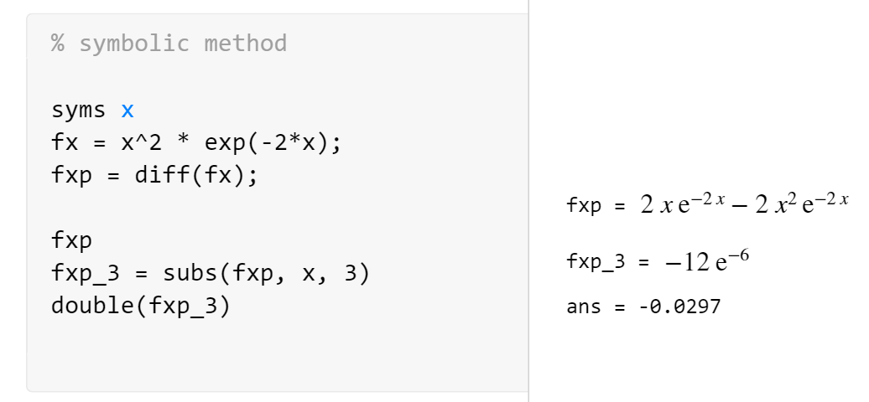
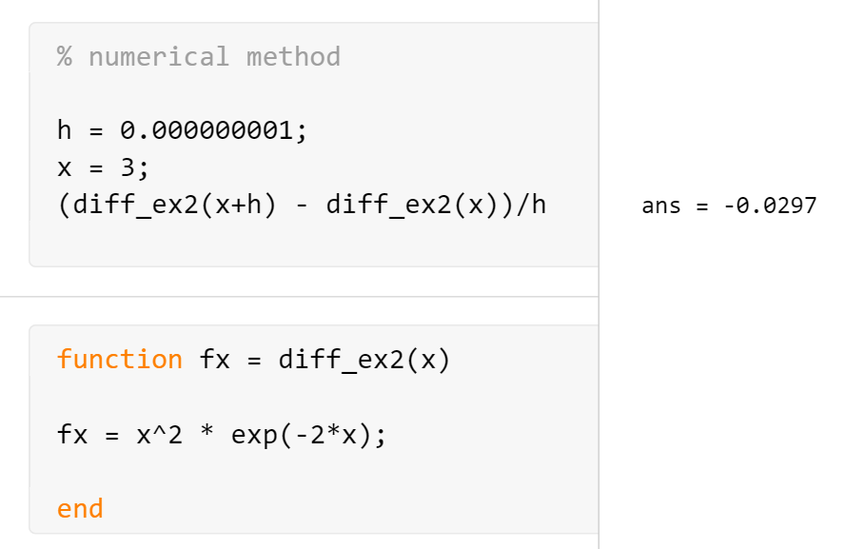

Example: Differentiation 2
$$f^{′}\left(x\right)= \lim_{h→0}{\frac{f\left(x+h\right)−f(x)}{h}}$$

Slide 9
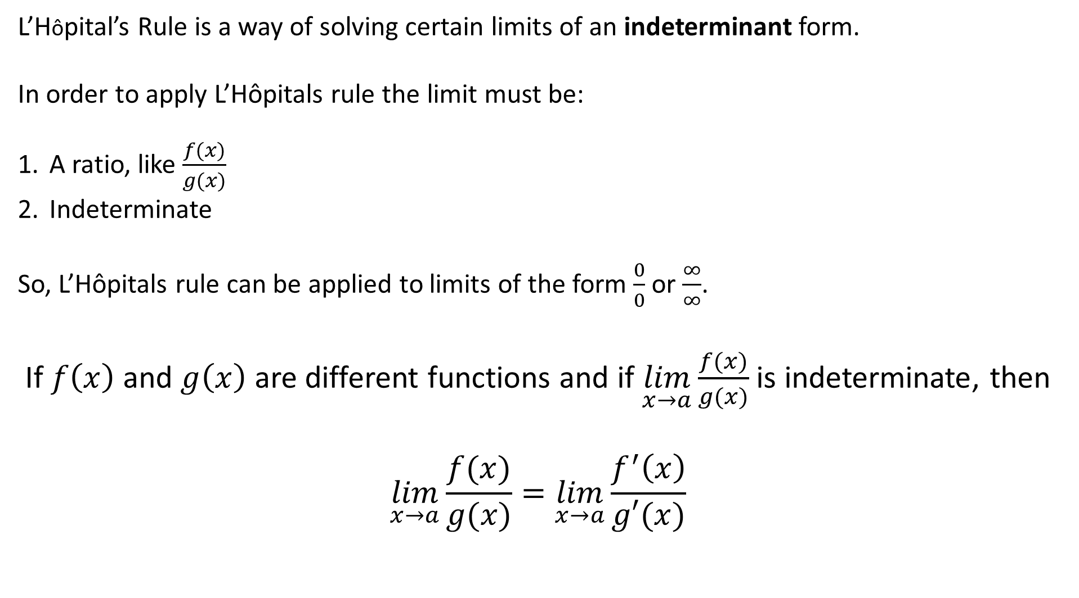
Theory: L’Hôpital’s Rule
L’Hôpital’s Rule is a way of solving certain limits of an indeterminant form.
In order to apply L’Hôpitals rule the limit must be:
A ratio, like $\frac{f(x)}{g(x)}$
Indeterminate
So, L’Hôpitals rule can be applied to limits of the form $\frac{0}{0}$ or $\frac{∞}{∞}$.
If $f\left(x\right)$ and $g\left(x\right)$ are different functions and if $\lim_{x→a}{\frac{f(x)}{g(x)}}$is indeterminate, then
$$\lim_{x→a}{\frac{f(x)}{g(x)}}=\lim_{x→a}{\frac{f^{′}\left(x\right)}{g′(x)}}$$

Slide 10

Example: L’Hôpital’s Rule
Example: Find the following using L’Hôpital’s rule
1. $\lim_{x→1}{\frac{ln(x)}{x−1}⇒\frac{0}{0}}$
Using L’Hôpital’s rule $=\lim_{x→1}{\frac{\frac{1}{x}}{1}}=1$
2. $\lim_{x→∞}{\frac{e^{x}}{x^{2}}⇒\frac{0}{0}}$
Using L’Hôpitlals rule $=\lim_{x→∞}{\frac{e^{x}}{2x}=\lim_{x→∞}\frac{e^{x}}{2}}= ∞$

Slide 11
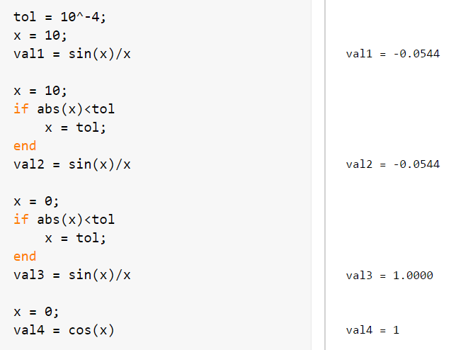
Example: L’Hopitals Rule (Script)
Notes:
ADD MATLAB

Slide 12

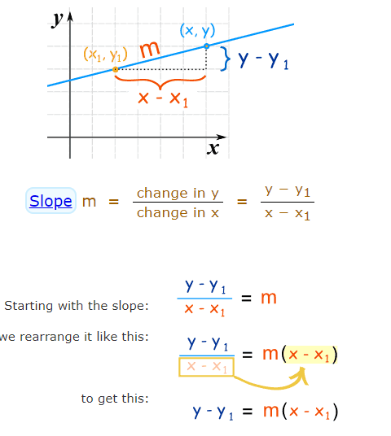
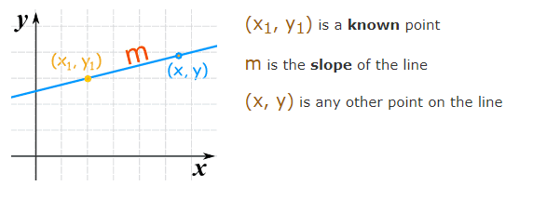
Theory: Point-Slope Equation of a Line
https://www.mathsisfun.com/algebra/line-equation-point-slope.html

Slide 13
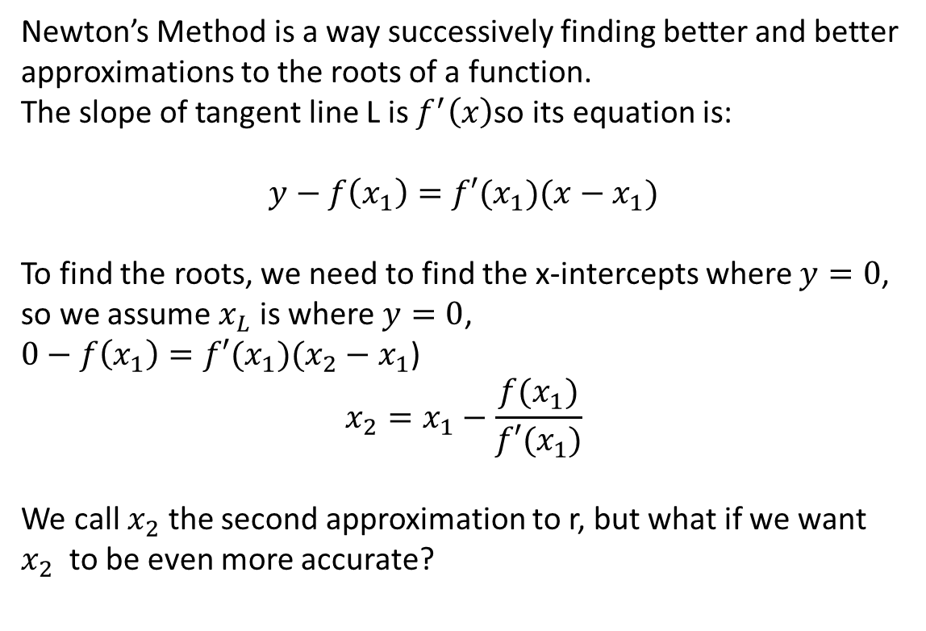

Theory: Newton’s Method
Newton’s Method is a way successively finding better and better approximations to the roots of a function.
The slope of tangent line L is $f^{′}\left(x\right)$so its equation is:
$$y−f\left(x_{1}\right)=f′(x_{1})(x−x_{1})$$
To find the roots, we need to find the x-intercepts where $y=0$,
so we assume $x_{L}$ is where $y=0$,
$0−f\left(x_{1}\right)=f′(x_{1})(x_{2}−x_{1}$)
$$x_{2}=x_{1}−\frac{f(x_{1})}{f′(x_{1})}$$
We call $x_{2}$ the second approximation to r, but what if we want $x_{2}$ to be even more accurate?
Initial Estimation: x = 5
This process can be repeated for $x_{1},x_{2}$, $x_{3}$…
In general, if the $n^{th}$ approximation is $x_{n}$ and $f^{′}\left(x_{n}\right)≠0$, then the next approximation $x_{n+1}$is:
$x_{n+1}=x_{n}−\frac{f(x_{n})}{f′(x_{n})}$
Why important?

Slide 14
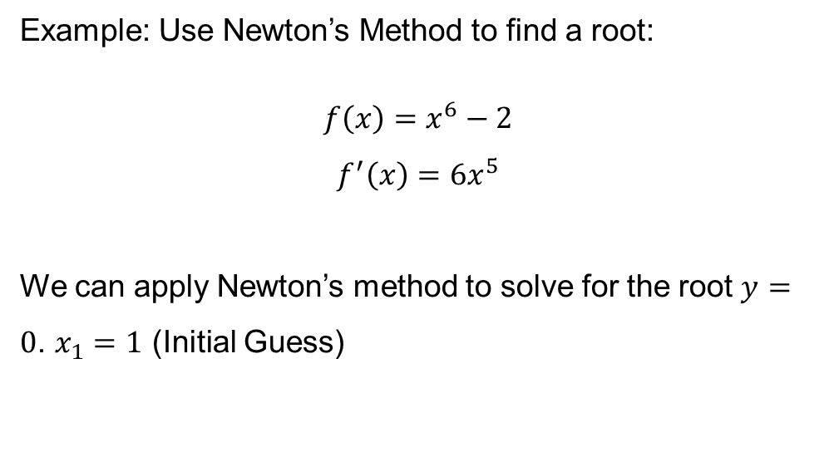
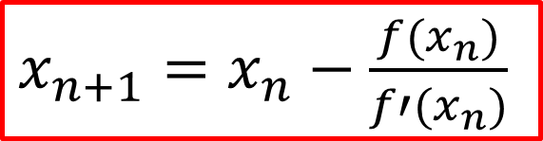
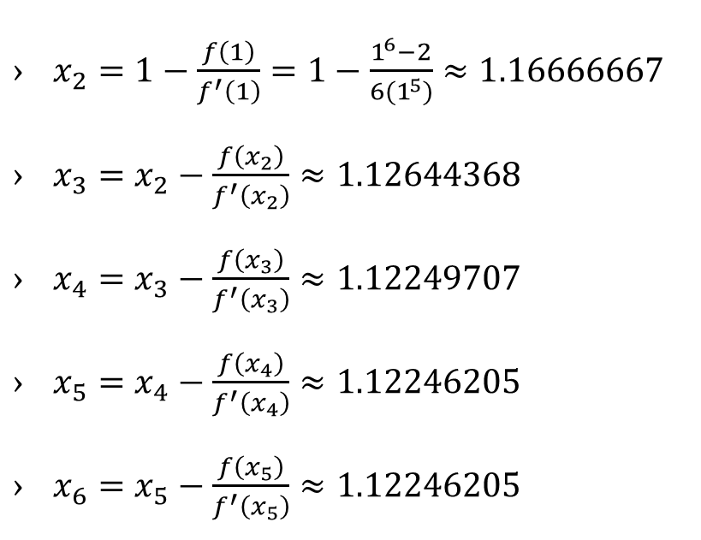
Example: Newton’s Method 1
$x_{2}=1−\frac{f\left(1\right)}{f^{′}\left(1\right)}=1−\frac{1^{6}−2}{6(1^{5})}≈1.16666667$
$x_{3}=x_{2}−\frac{f\left(x_{2}\right)}{f^{′}\left(x_{2}\right)}≈1.12644368$
$x_{4}=x_{3}−\frac{f\left(x_{3}\right)}{f^{′}\left(x_{3}\right)}≈1.12249707$
$x_{5}=x_{4}−\frac{f\left(x_{4}\right)}{f^{′}\left(x_{4}\right)}≈1.12246205$
$x_{6}=x_{5}−\frac{f\left(x_{5}\right)}{f^{′}\left(x_{5}\right)}≈1.12246205$
Example: Use Newton’s Method to find a root:
$$f\left(x\right)=x^{6}−2$$
$$f^{′}\left(x\right)=6x^{5}$$
We can apply Newton’s method to solve for the root $y=0$. $x_{1}=1$ (Initial Guess)
$x_{n+1}=x_{n}−\frac{f(x_{n})}{f′(x_{n})}$
Notes:
ADD MATLAB??

Slide 15
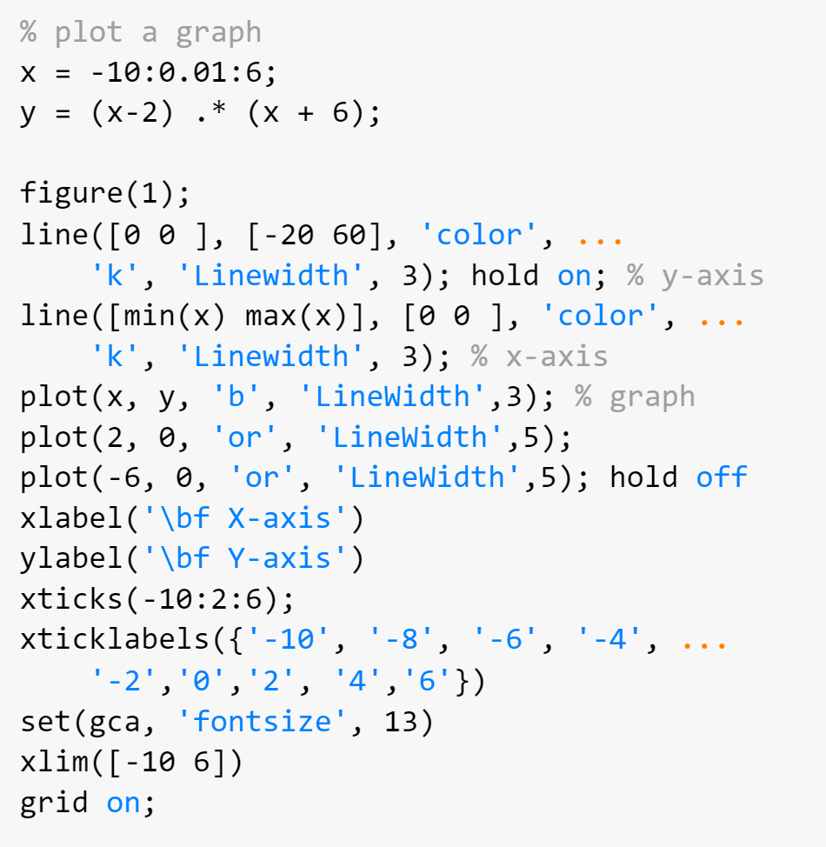
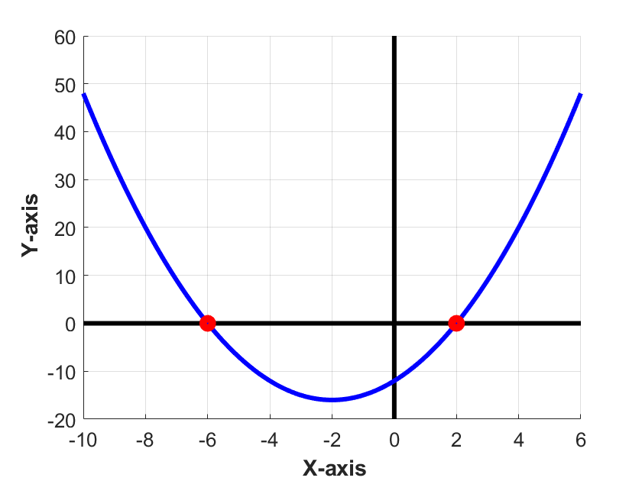

Example: Root Finding 1
$$f\left(x\right)=\left(x−2\right)\left(x−6\right)$$
$$=x^{2}−4x−12$$

Slide 16
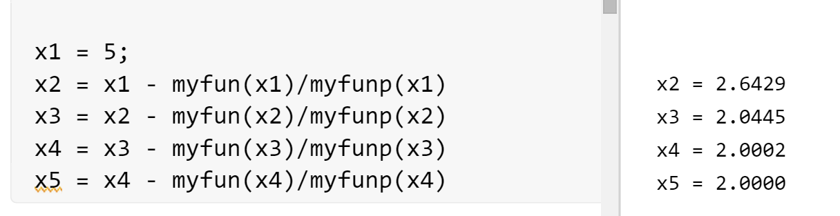
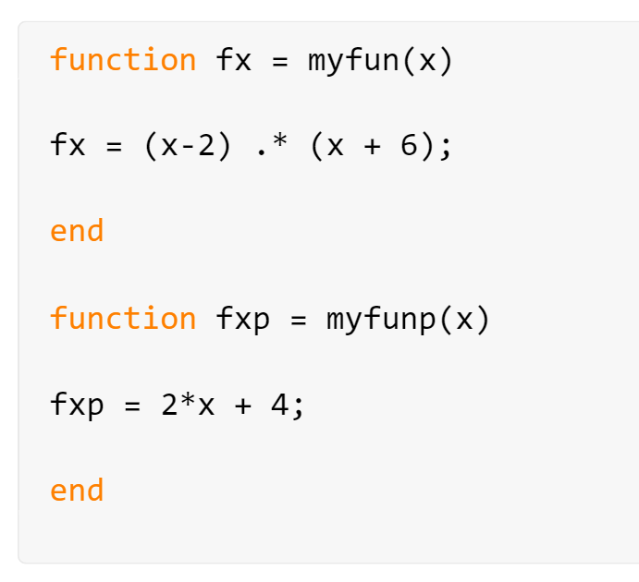
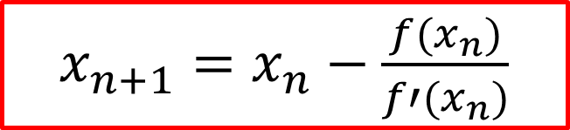
Example: Root Finding 1 (Simulation)
$x_{n+1}=x_{n}−\frac{f(x_{n})}{f′(x_{n})}$
$$f\left(x\right)=x^{2}−4x−12$$
$$f′\left(x\right)=2x−4$$

Slide 17
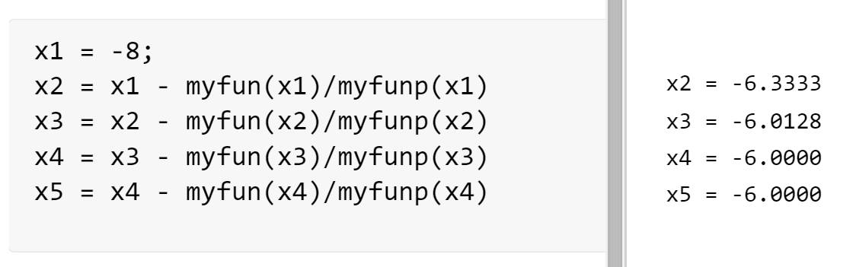
Example: Root Finding 1 (Simulation)
$x_{n+1}=x_{n}−\frac{f(x_{n})}{f′(x_{n})}$
$$f\left(x\right)=x^{2}−4x−12$$
$$f′\left(x\right)=2x−4$$

Slide 18
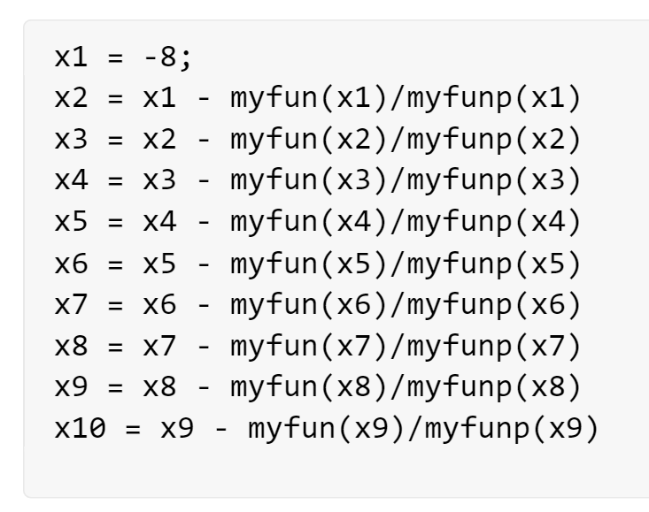
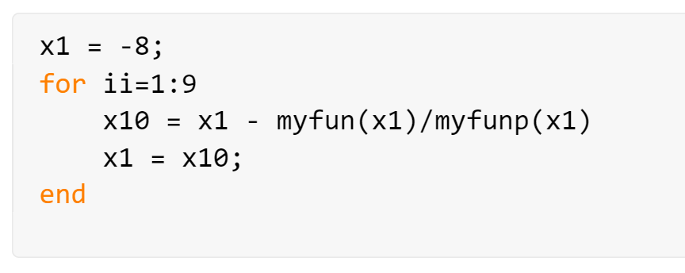
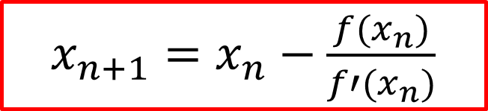
Quiz: How to Write the Script using a Loop Structure
$x_{n+1}=x_{n}−\frac{f(x_{n})}{f′(x_{n})}$

Slide 19
Quiz: How to Write the Script using a Loop Structure (Continue)
ii == 1 | x1 == x1 | x10 == x2
ii == 2 | x1 == x2 | x10 == x3
ii == 3 | x1 == x3 | x10 == x4
ii == 4 | x1 == x4 | x10 == x5
ii == 9 | x1 == x9 | x10 == x10
The variables generated from the above code are marked in red.
Notes:
X1 = -8;
diff_var = 100000;
while diff_var < 0.001
x10 = x1 – myfun(x1)/myfunp(x1);
x1 = x10;
diff_var = abs(myfun(x1));
end

Slide 20
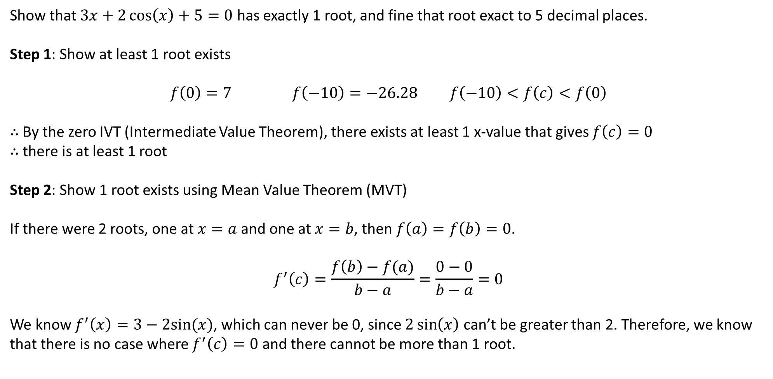
Example: Root Finding 2
Show that $3x+2\cos\left(x\right)+5=0$ has exactly 1 root, and fine that root exact to 5 decimal places.
Step 1: Show at least 1 root exists
$$f\left(0\right)=7 f\left(−10\right)=−26.28 f\left(−10\right)<f\left(c\right)<f\left(0\right)$$
$∴$ By the zero IVT (Intermediate Value Theorem), there exists at least 1 x-value that gives $f\left(c\right)=0$
$∴$ there is at least 1 root
Step 2: Show 1 root exists using Mean Value Theorem (MVT)
If there were 2 roots, one at $x=a$ and one at $x=b$, then $f\left(a\right)=f\left(b\right)=0$.
$$f^{′}\left(c\right)=\frac{f\left(b\right)−f(a)}{b−a}=\frac{0−0}{b−a}=0$$
We know $f^{′}\left(x\right)=3−2sin(x)$, which can never be 0, since $2\sin\left(x\right)$ can’t be greater than 2. Therefore, we know that there is no case where $f^{′}\left(c\right)=0$ and there cannot be more than 1 root.

Slide 21
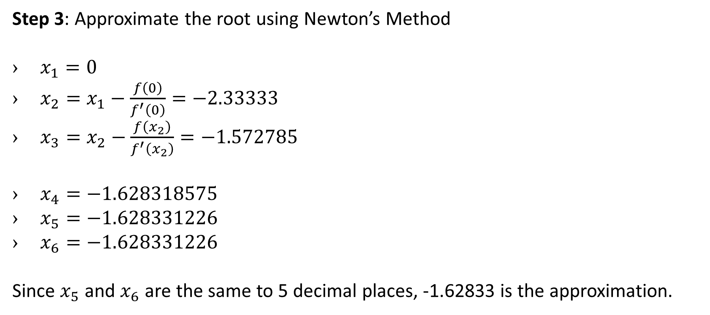
Example: Root Finding 2 (Continue)
Step 3: Approximate the root using Newton’s Method
$x_{1}=0$
$x_{2}=x_{1}−\frac{f\left(0\right)}{f^{′}\left(0\right)}=−2.33333$
$x_{3}=x_{2}−\frac{f\left(x_{2}\right)}{f^{′}\left(x_{2}\right)}=−1.572785$
$x_{4}=−1.628318575$
$x_{5}=−1.628331226$
$x_{6}=−1.628331226$
Since $x_{5}$ and $x_{6}$ are the same to 5 decimal places, -1.62833 is the approximation.

Slide 22
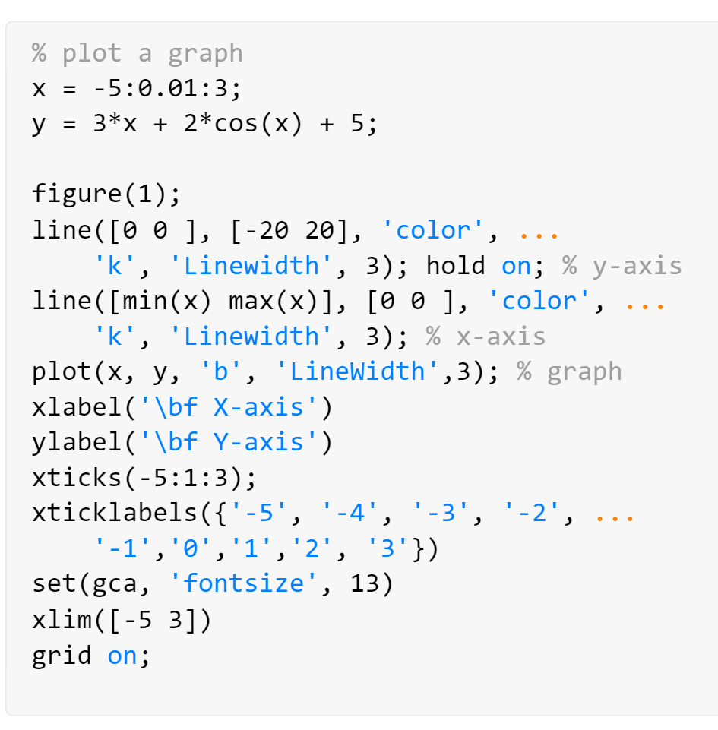
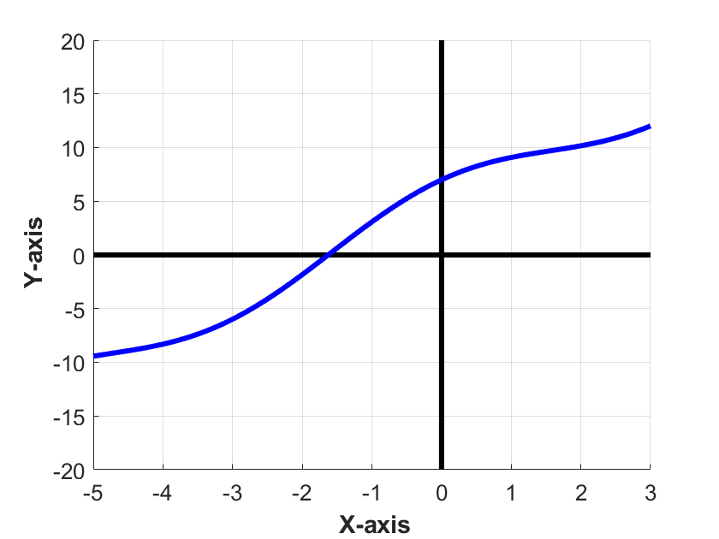
Example: Root Finding 2 (Continue)
$$f\left(x\right)=3x+2\cos{x}+5$$

Slide 23
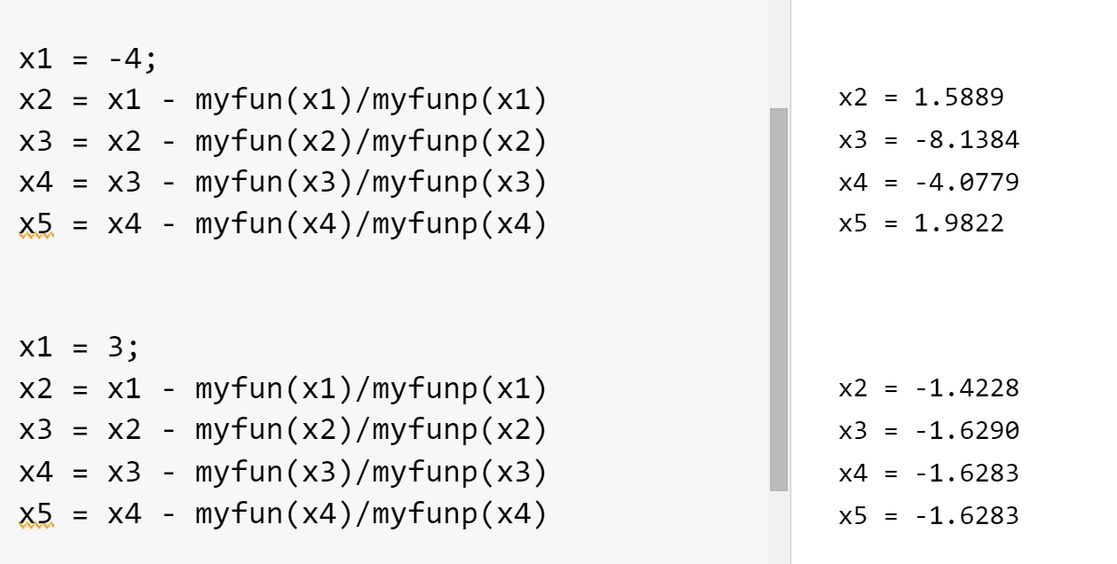
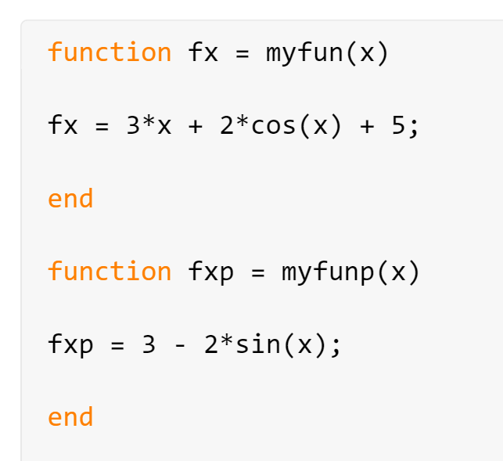
Example: Root Finding 2 (Continue)

Slide 24
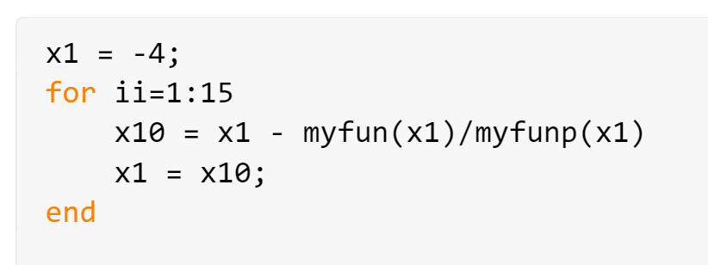
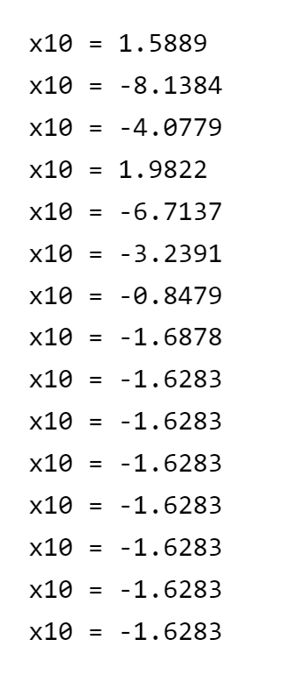
Example: Root Finding 2 (Continue)

Slide 25
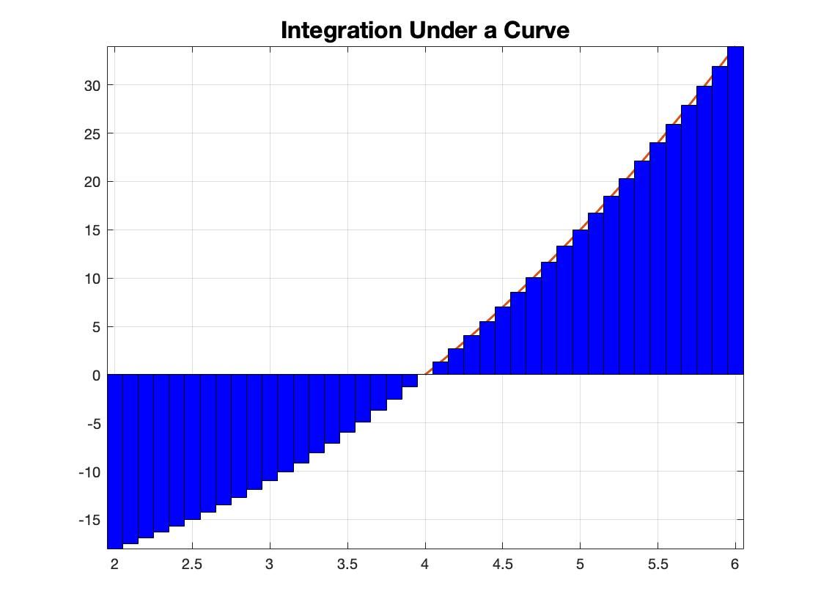
Theory: Integral
Integration is the technique of determining the area under a curve. This process is opposite the process of differentiation.
To find the area under a curve, we divide the curve into many equal segments of equal width. Each rectangle is multiplied by it’s corresponding y-value to get the area of that rectangle. The rectangle’s areas are summed for the total area under that curve segment:
Left endpoints can be used so that the rectangular segments give an underestimation
Right endpoints can be used so that the rectangular segments give an overestimation
Center endpoints can be used to try and balance the error from overestimations and underestimations
How can you make your estimation even more accurate?
Take smaller segments!

Slide 26
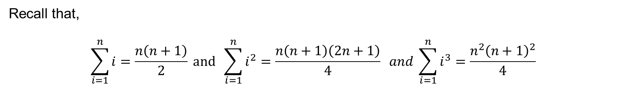
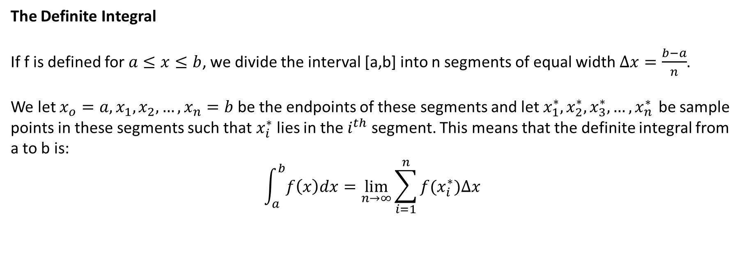
Theory: Integral
The Definite Integral
If f is defined for $a≤x≤b$, we divide the interval [a,b] into n segments of equal width $∆x=\frac{b−a}{n}$.
We let $x_{o}=a,x_{1},x_{2},…,x_{n}=b$ be the endpoints of these segments and let $x_{1}^{∗},x_{2}^{∗},x_{3}^{∗},…,x_{n}^{∗ }$ be sample points in these segments such that $x_{i}^{∗}$lies in the $i^{th}$ segment. This means that the definite integral from a to b is:
$$\int_{a}^{b}{f\left(x\right)dx}=\lim_{n→∞}{\sum_{i=1}^{n}{f(x_{i}^{∗})∆x}}$$
Recall that,
$$\sum_{i=1}^{n}{i}=\frac{n\left(n+1\right)}{2} and \sum_{i=1}^{n}{i^{2}}=\frac{n\left(n+1\right)\left(2n+1\right)}{4} and \sum_{i=1}^{n}{i^{3}}=\frac{n^{2}{\left(n+1\right)}^{2}}{4}$$

Slide 27
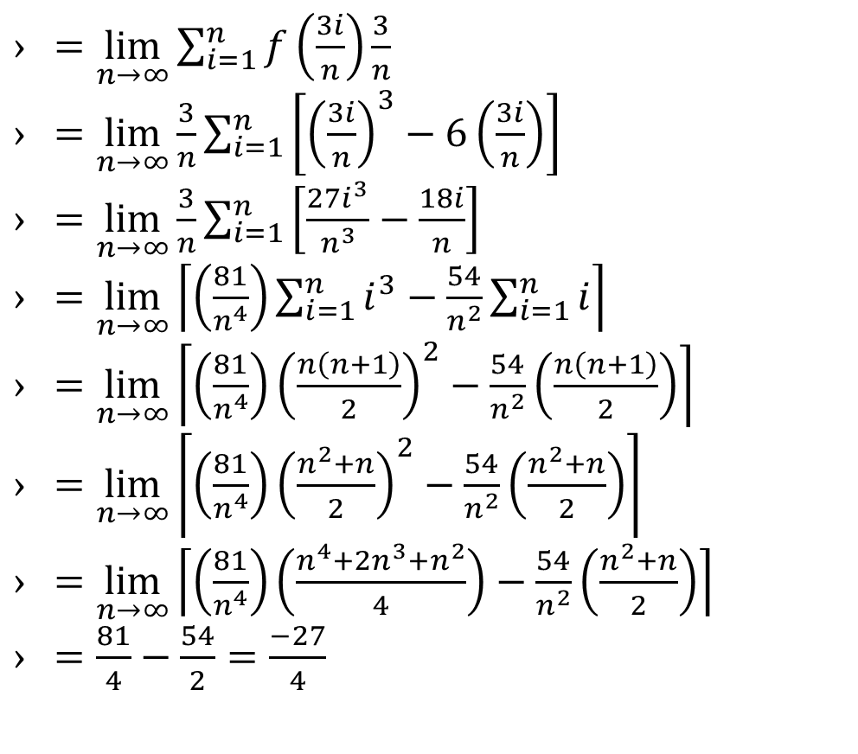
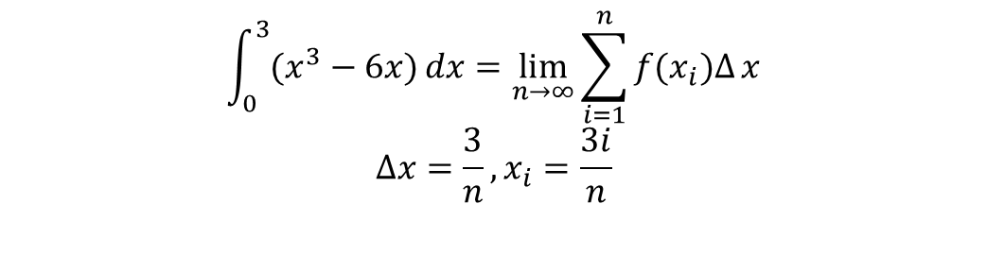
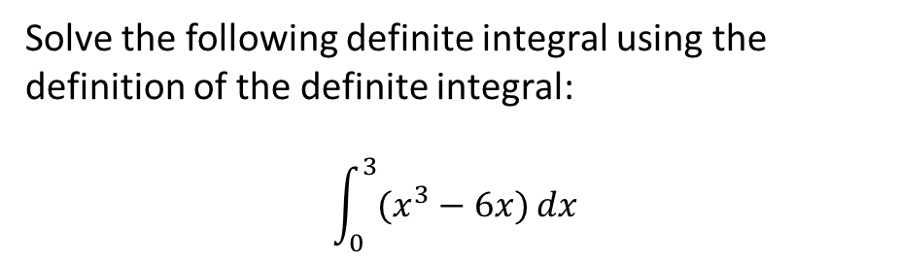
Example: Definite Integral
Solve the following definite integral using the definition of the definite integral:
$$\int_{0}^{3}{(x^{3}−6x)}dx$$
$=\lim_{n→∞}{\sum_{i=1}^{n}{f\left(\frac{3i}{n}\right)\frac{3}{n}}}$
$=\lim_{n→∞}{\frac{3}{n}\sum_{i=1}^{n}{\left[{\left(\frac{3i}{n}\right)}^{3}−6\left(\frac{3i}{n}\right)\right]}}$
$=\lim_{n→∞}{\frac{3}{n}\sum_{i=1}^{n}{\left[\frac{27i^{3}}{n^{3}}−\frac{18i}{n}\right]}}$
$=\lim_{n→∞}\left\lceil \left(\frac{81}{n^{4}}\right)\sum_{i=1}^{n}{i^{3}−\frac{54}{n^{2}}}\sum_{i=1}^{n}{i}\right\rceil$
$=\lim_{n→∞}\left\lceil \left(\frac{81}{n^{4}}\right){\left(\frac{n\left(n+1\right)}{2}\right)}^{2}−\frac{54}{n^{2}}\left(\frac{n\left(n+1\right)}{2}\right)\right\rceil$
$=\lim_{n→∞}\left\lceil \left(\frac{81}{n^{4}}\right){\left(\frac{n^{2}+n}{2}\right)}^{2}−\frac{54}{n^{2}}\left(\frac{n^{2}+n}{2}\right)\right\rceil$
$=\lim_{n→∞}\left\lceil \left(\frac{81}{n^{4}}\right)\left(\frac{n^{4}+2n^{3}+n^{2}}{4}\right)−\frac{54}{n^{2}}\left(\frac{n^{2}+n}{2}\right)\right\rceil$
$=\frac{81}{4}−\frac{54}{2}=\frac{−27}{4}$
$$\int_{0}^{3}{(x^{3}−6x)}dx=\lim_{n→∞}\sum_{i=1}^{n}{f(x_{i})∆}{x}$$
$$∆x=\frac{3}{n}, x_{i}=\frac{3i}{n}$$

Slide 28
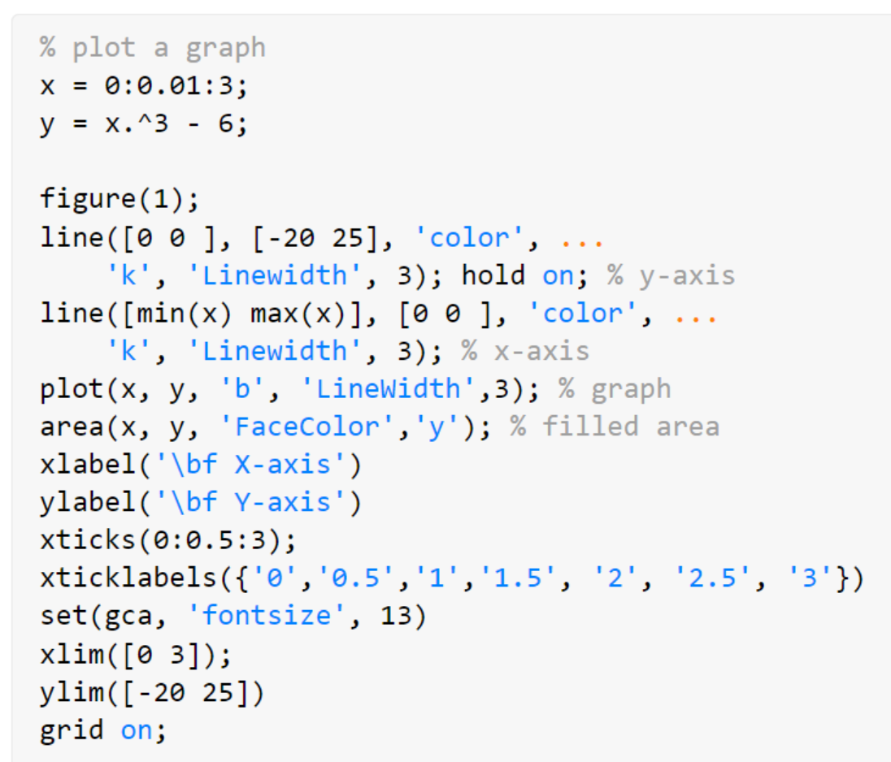
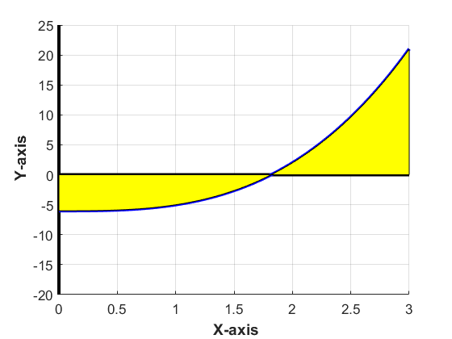
Example: Integral (graph)
$$f\left(x\right)=x^{3}−6x$$

Slide 29
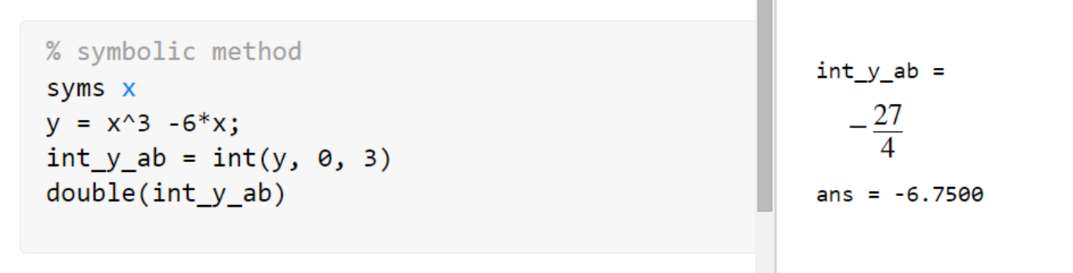
Example: Integral (Symbolic)

Slide 30




Example: Integral (Numeric 1)
$$\int_{a}^{b}{f\left(x\right)dx}=\lim_{n→∞}{\sum_{i=1}^{n}{f(x_{i}^{∗})∆x}}$$
$$f\left(x\right)=x^{3}−6x$$

Slide 31


Example: Integral (Numeric 2)

Slide 32

Example: Integral (Numeric 1 vs Numeric 2)

Slide 33
Slide Credits and References
Stormy Attaway, 2018, Matlab: A Practical Introduction to Programming and Problem Solving, 5th edition
Lecture slides for “Matlab: A Practical Introduction to Programming and Problem Solving”
Holly Moore, 2018, MATLAB for Engineers, 5th edition

