Slide 1
Symbolic Function
Chul Min Yeum
Assistant Professor
Civil and Environmental Engineering
University of Waterloo, Canada
AE121: Computational Method
Last updated: 2019-07-05

Slide 2
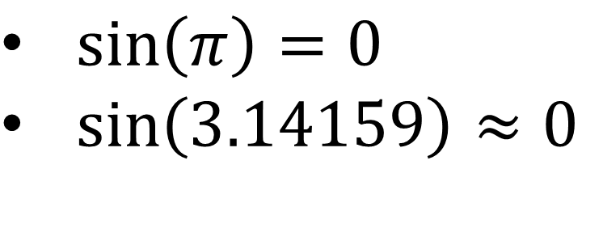
Symbolic Math Toolbox
Perform symbolic math computations
Symbolic Math Toolbox™ provides functions for solving, plotting, and manipulating symbolic math equations. The toolbox provides functions in common mathematical areas such as calculus, linear algebra, algebraic and ordinary differential equations, equation simplification, and equation manipulation.
Symbolic Math Toolbox lets you analytically perform differentiation, integration, simplification, transforms, and equation solving.
$\sin\left(π\right)=0$
$\sin\left(3.14159\right)≈0$

Slide 3
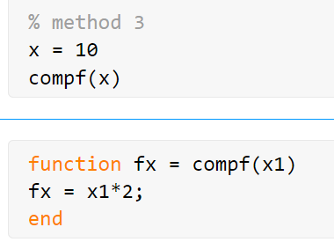
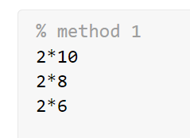
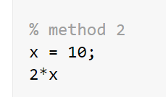

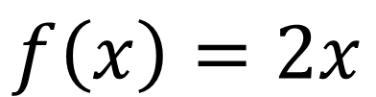
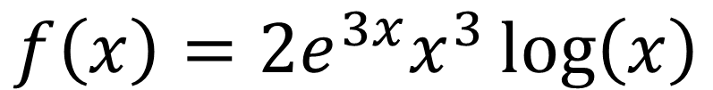

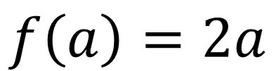

How to Solve a Mathematical Equation
$$f\left(x\right)=2x$$
$$f\left(10\right)= ?$$
What if ?
$$f\left(8\right)= ?$$
$$f\left(x\right)=2{e^{3x}x}^{3}\log\left(x\right)$$
$$f\left(a\right)=2a$$
$$f\left(6\right)= ?$$

Slide 4
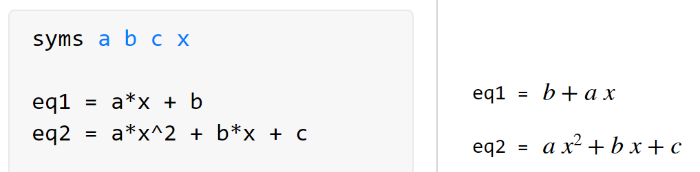
Create Symbolic Variables and Expression
syms – Create symbolic variables in MATLAB
You can write a equation using a symbolic variable.

Slide 5
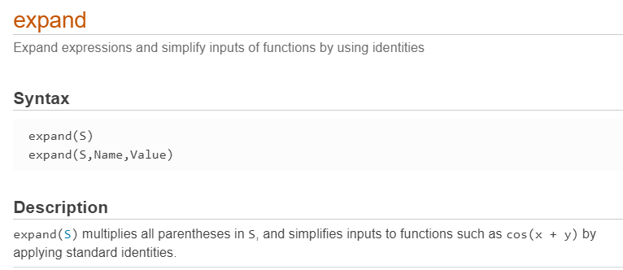
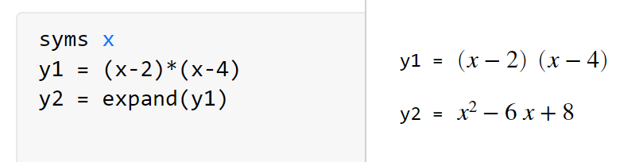
Built-in Function: expand

Slide 6
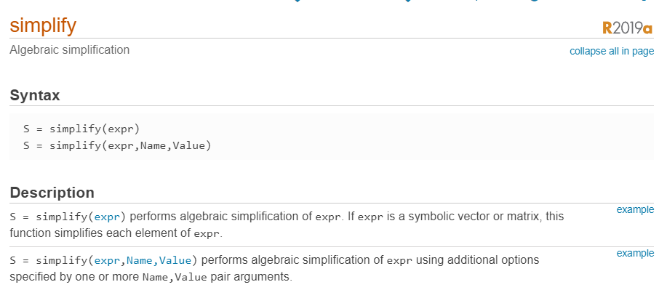
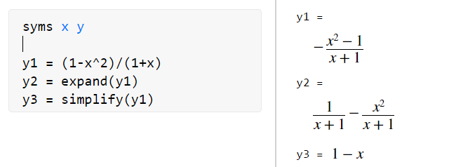
Built-in Function: simplify

Slide 7
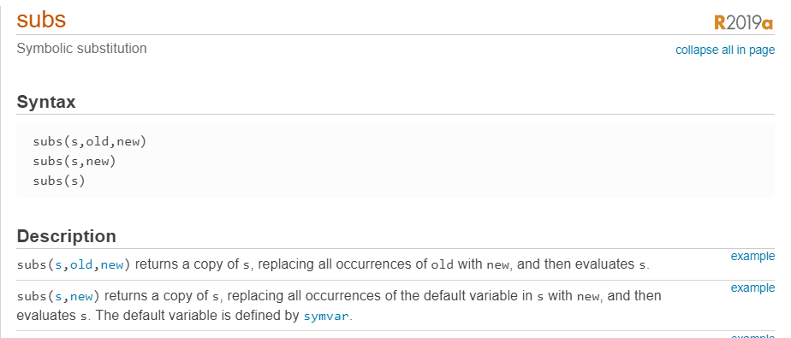
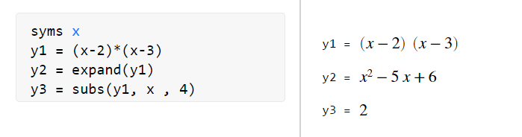
Built-in Function: subs

Slide 8
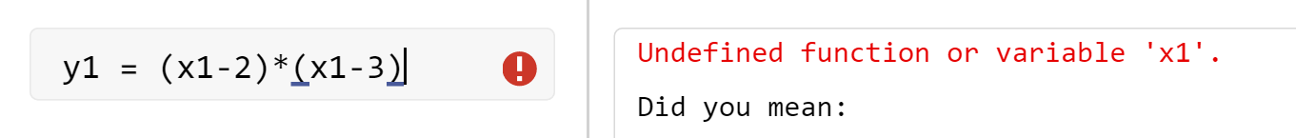
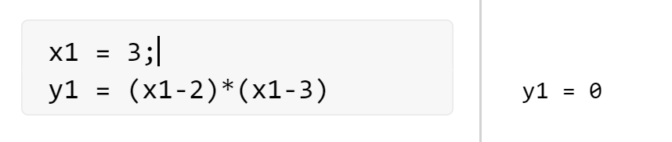
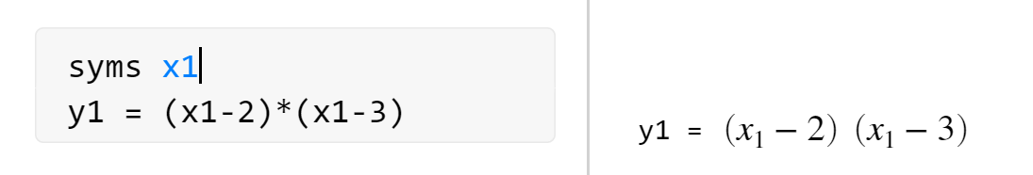
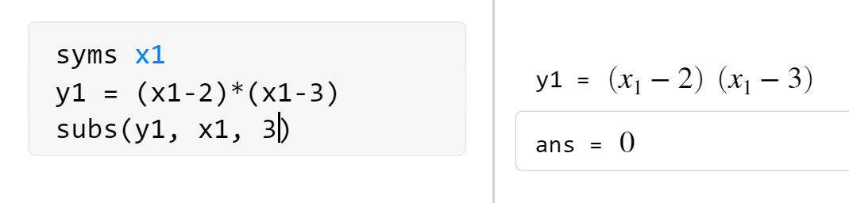
Use of Numeric and Symbolic Variables
Numeric variables
Symbolic variables

Slide 9
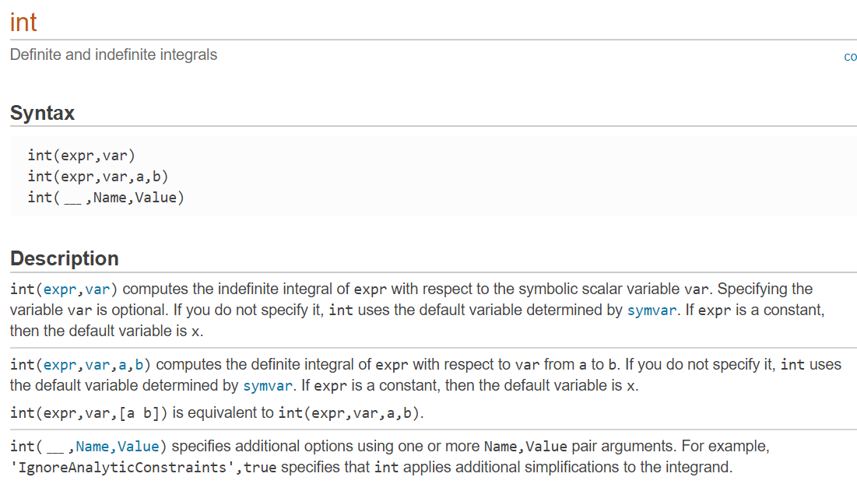
Built-in Function: int

Slide 10
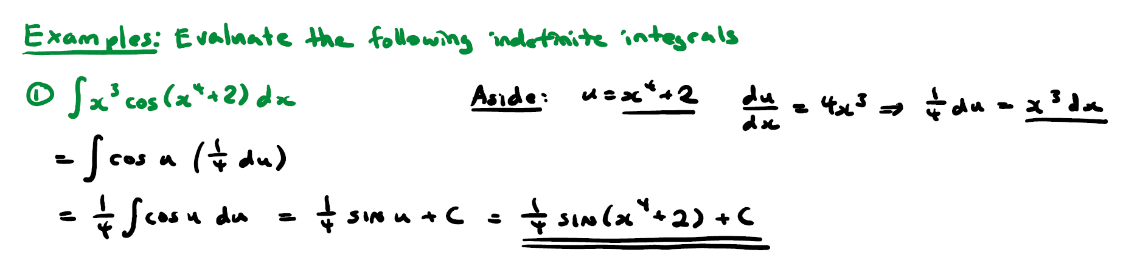
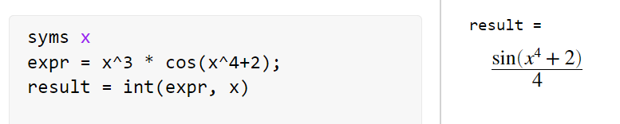
Example: Simple Integration 1
Lecture note: Integration by Substitution (Courtesy of Brenda Lee)

Slide 11
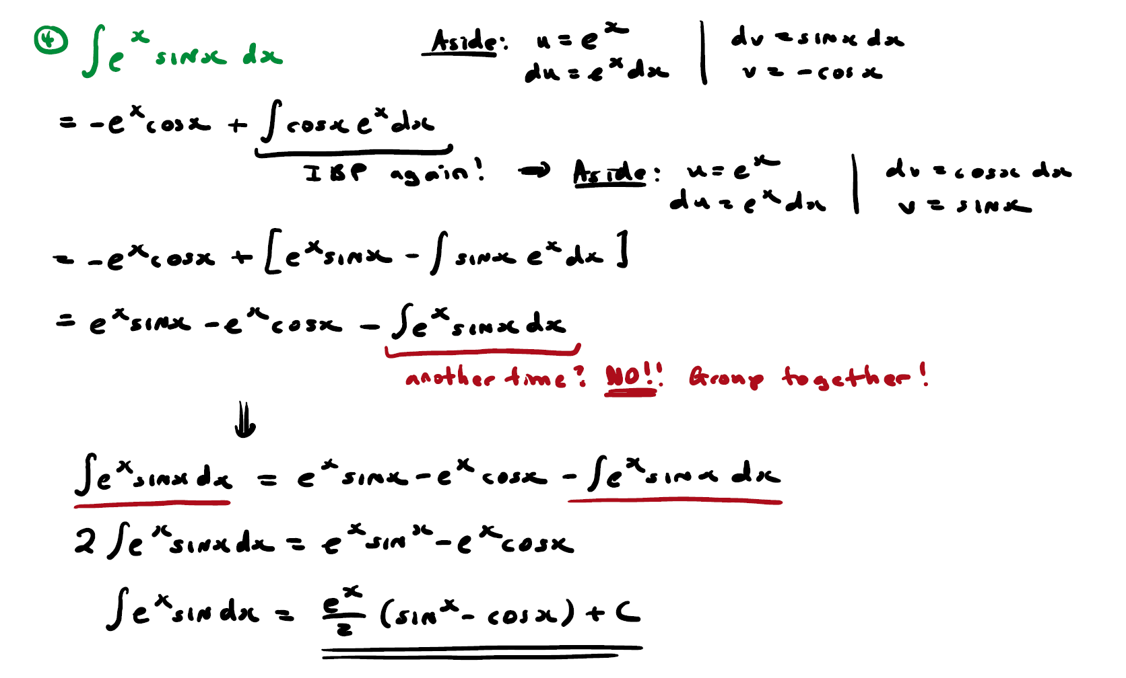
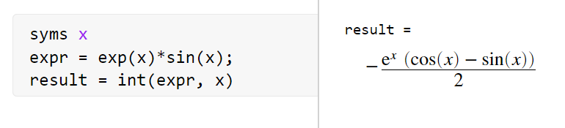
Example: Simple Integration 2
Lecture note: Integration by Parts (Courtesy of Brenda Lee)

Slide 12
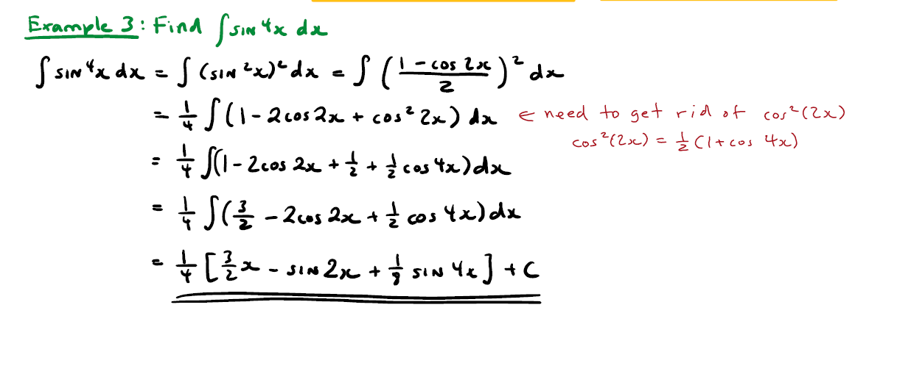
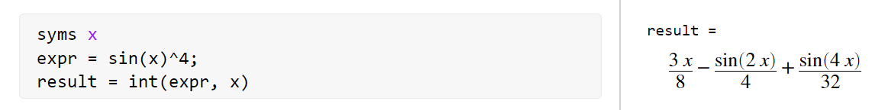
Example: Simple Integration 3
Lecture note: Trigonometric Integrals (Courtesy of Brenda Lee)

Slide 13
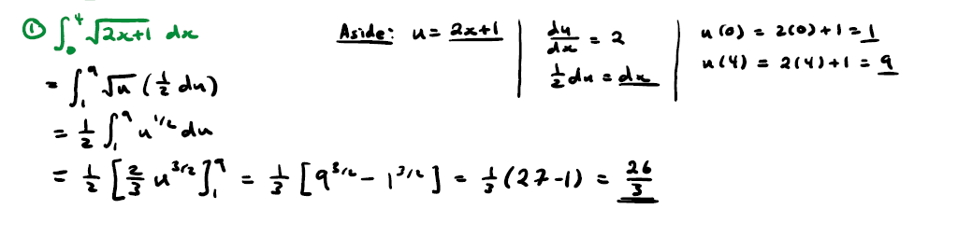
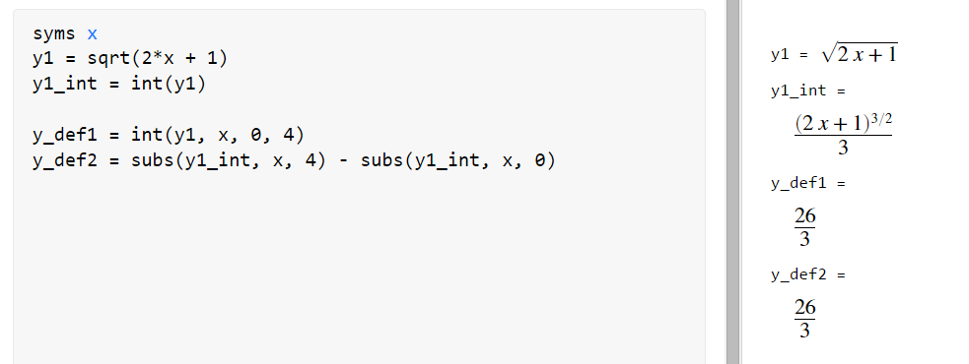
Example: Simple Integration 4
Lecture note: Substitution Method (Courtesy of Brenda Lee)

Slide 14
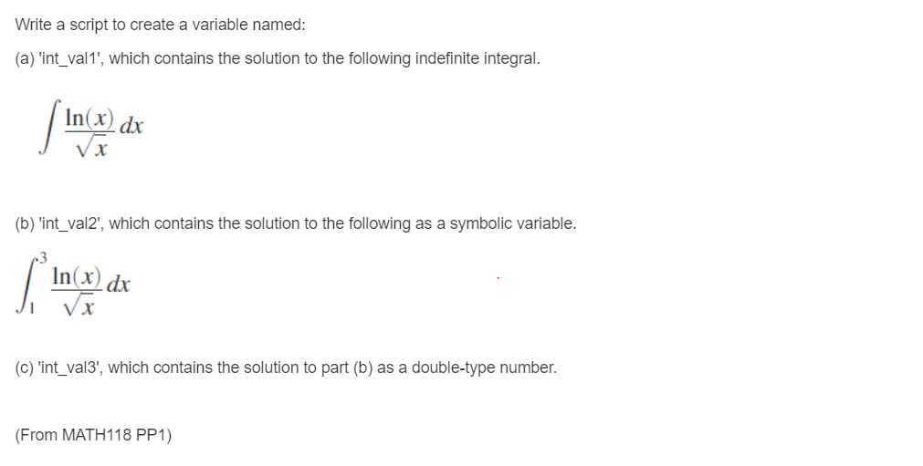
Example in MATLAB Grader

Slide 15
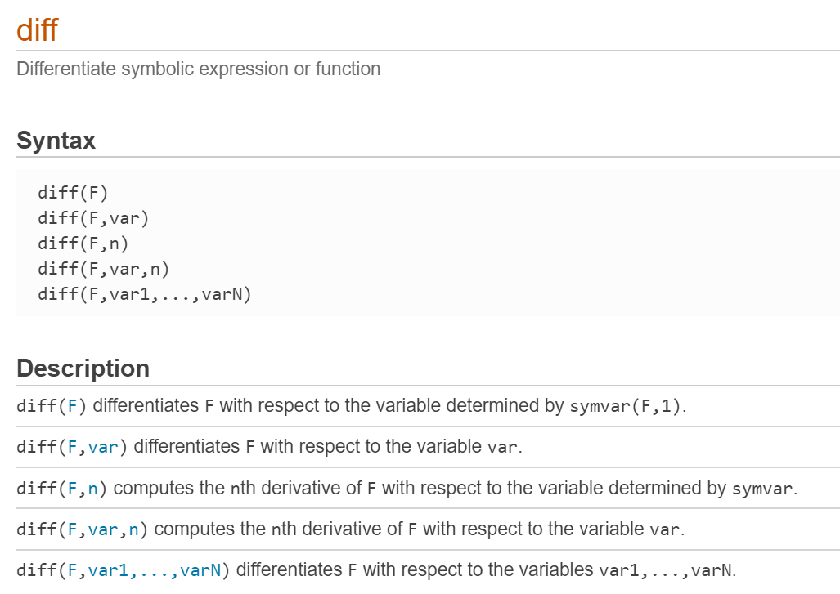
Built-in Function: diff

Slide 16
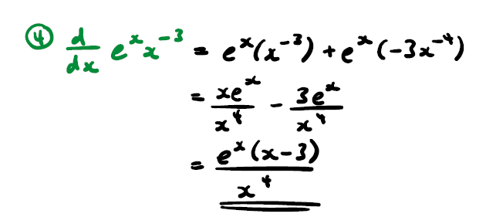
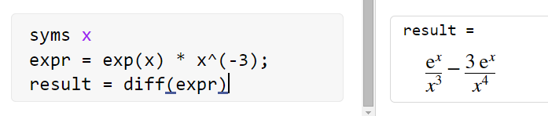
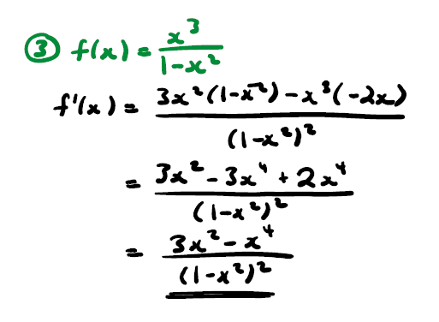
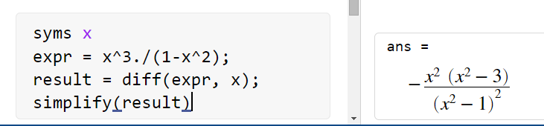
Example: Simple Differentiation 1
Lecture note: Introduction to Differentiation (Courtesy of Brenda Lee)

Slide 17
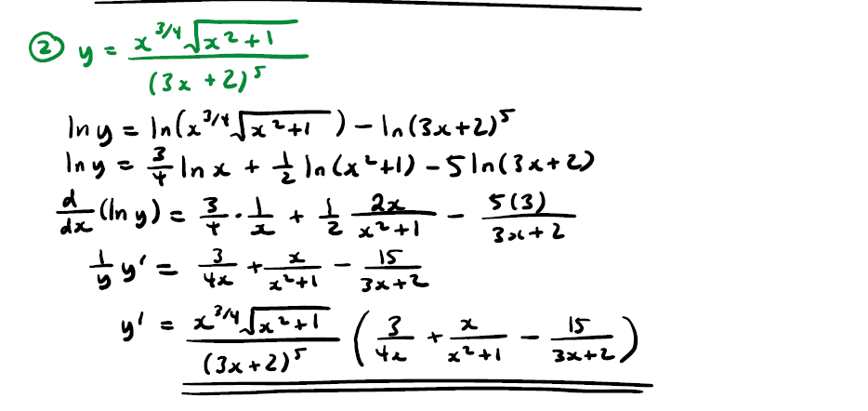
Example: Simple Differentiation 2
Lecture note: Implicit and Logarithmic Differentiation (Courtesy of Brenda Lee)

Slide 18
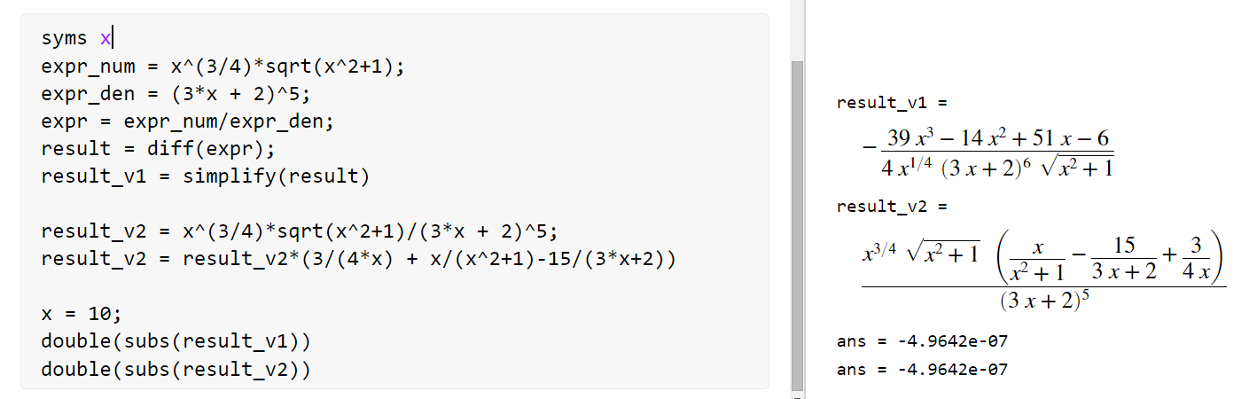
Example: Simple Differentiation 2 (Continue)

Slide 19
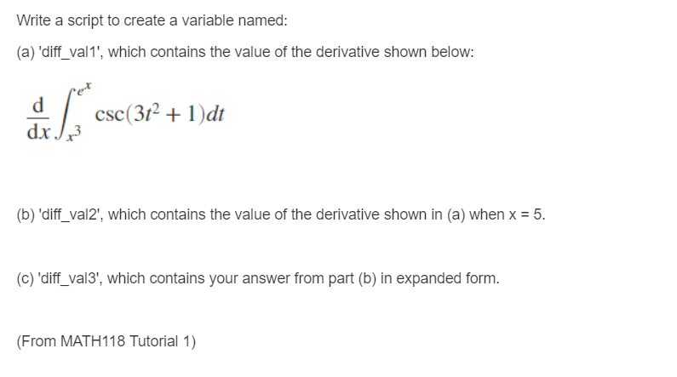
Example in MATLAB Grader

Slide 20
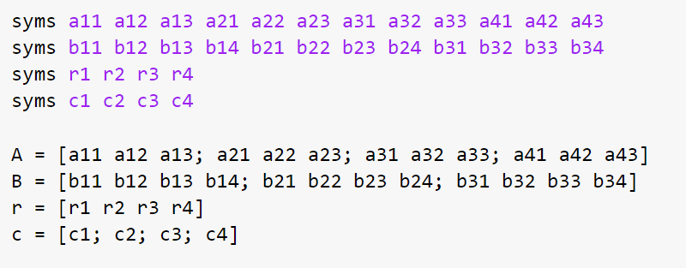
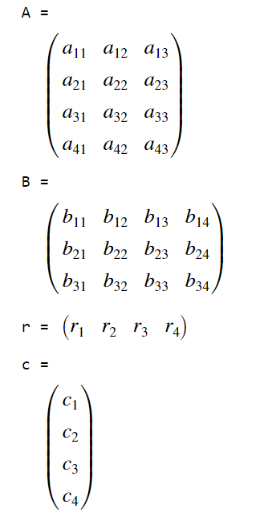
Example: Matrix Operation

Slide 21
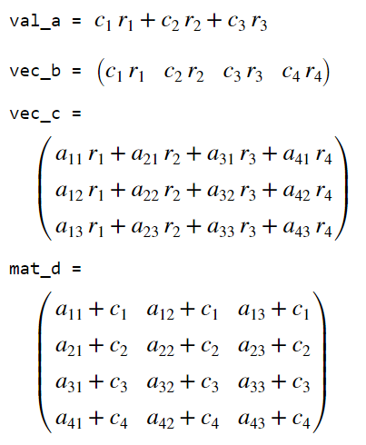
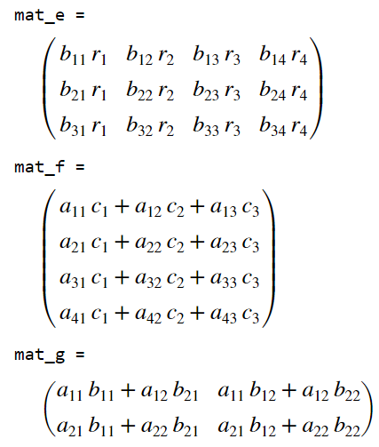
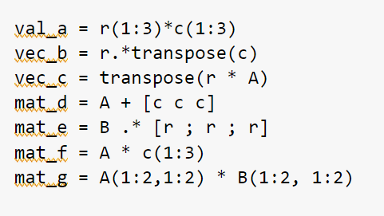
Example: Matrix Operation (Continue)

Slide 22
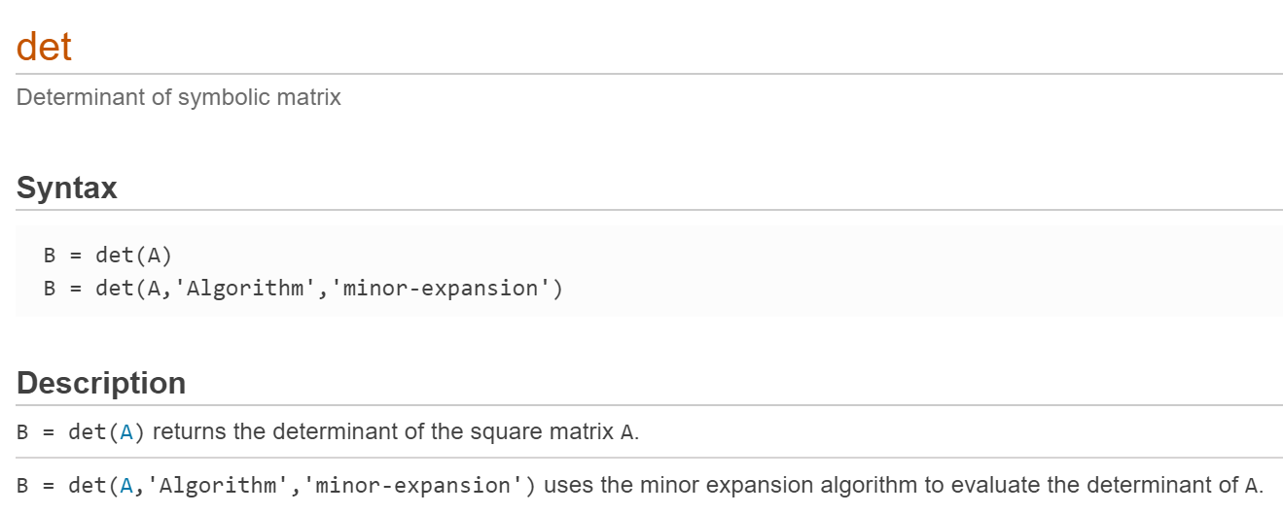
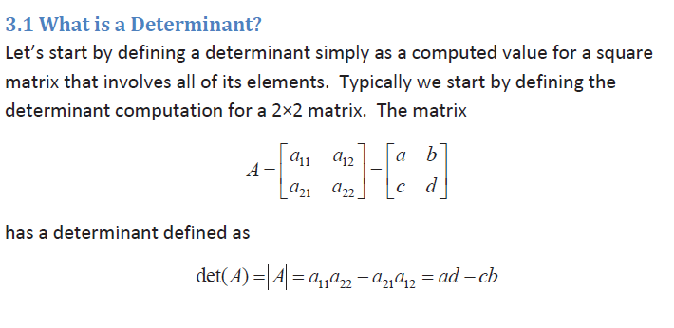
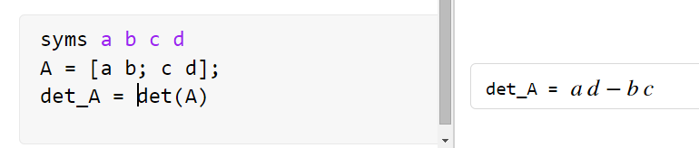
Example: det (Matrix Operation: Determinant)

Slide 23
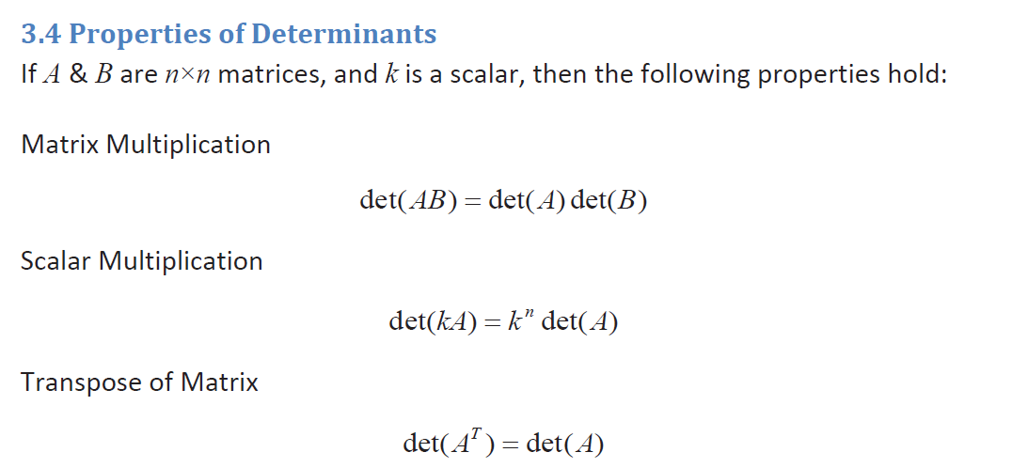
Example: How to Validate the Properties of Determinants
Lecture note: Linear Algebra (Courtesy of David Bruch)

Slide 24
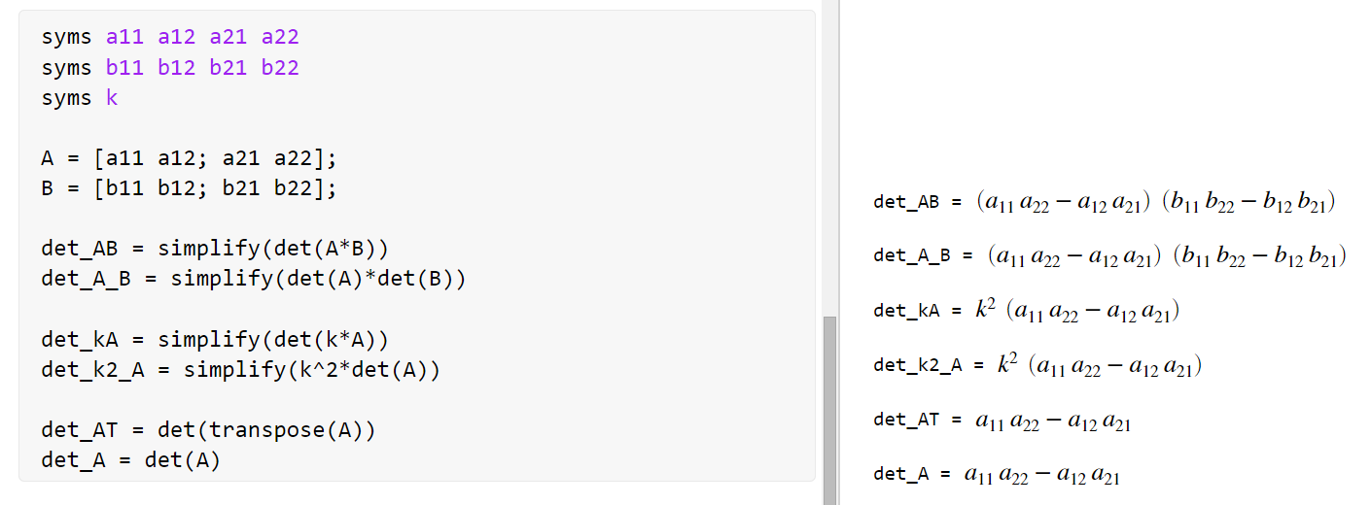
Example: Properties of Determinants (Continue)

Slide 25
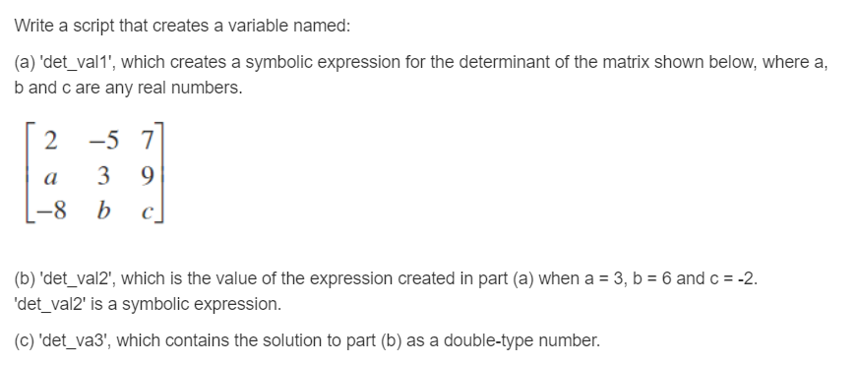
Example in MATLAB Grader

Slide 26
Slide Credits and References
Stormy Attaway, 2018, Matlab: A Practical Introduction to Programming and Problem Solving, 5th edition
Lecture slides for “Matlab: A Practical Introduction to Programming and Problem Solving”
Holly Moore, 2018, MATLAB for Engineers, 5th edition

