Slide 1
Data Structure
Chul Min Yeum
Assistant Professor
Civil and Environmental Engineering
University of Waterloo, Canada
AE121: Computational Method
Last updated: 2019-06-19

Slide 2
Cell Array
A cell array is a type of data structure that can store different types of values in its elements
A cell array could be a vector (row or column) or a matrix
It is an array, so indices are used to refer to the elements
For example, in “Pressure Calculation” assignment, what if # of measurements or # of days are different at each stations?

Slide 3
Creating Cell Arrays
The syntax used to create a cell array is curly braces { } instead of [ ]
The direct method is to put values in the row(s) separated by commas or spaces, and to separate the rows with semicolons (so, same as other arrays) – the difference is using { } instead of [ ]
The cell function can also be used to preallocate by passing the dimensions of the cell array, e.g.
cell(4,2)

Slide 4
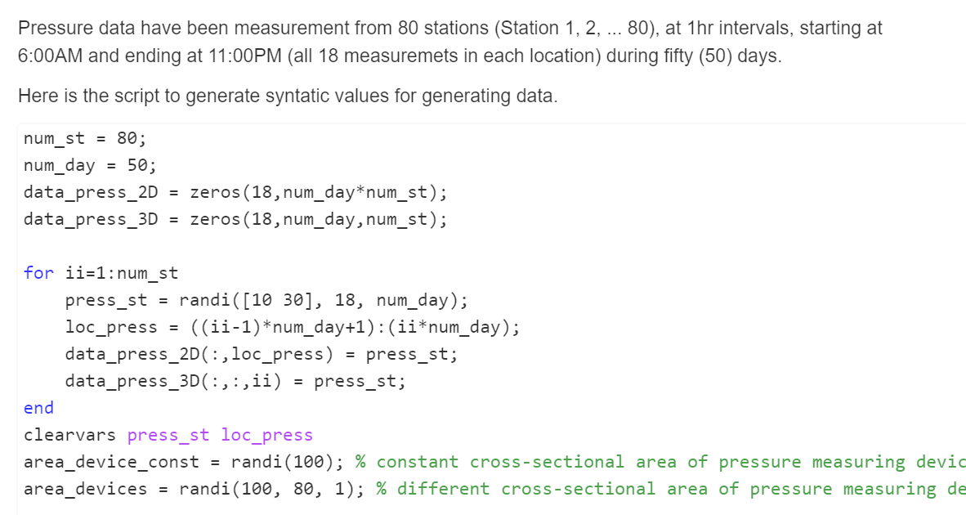
Revisit: Pressure Calculation
Size: 18, 50*80
Size: 18, 50, 80

Slide 5
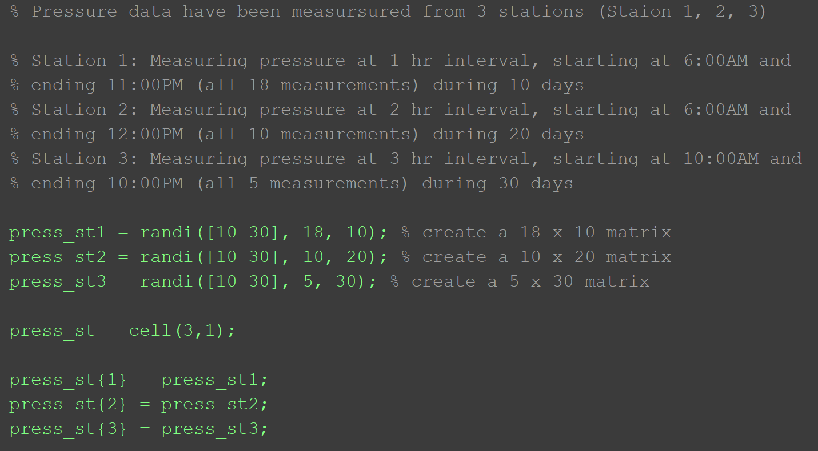
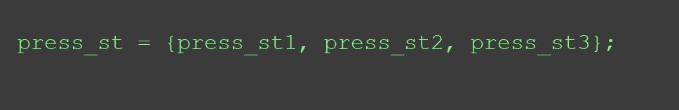
Example: Use of a Cell Array

Slide 6
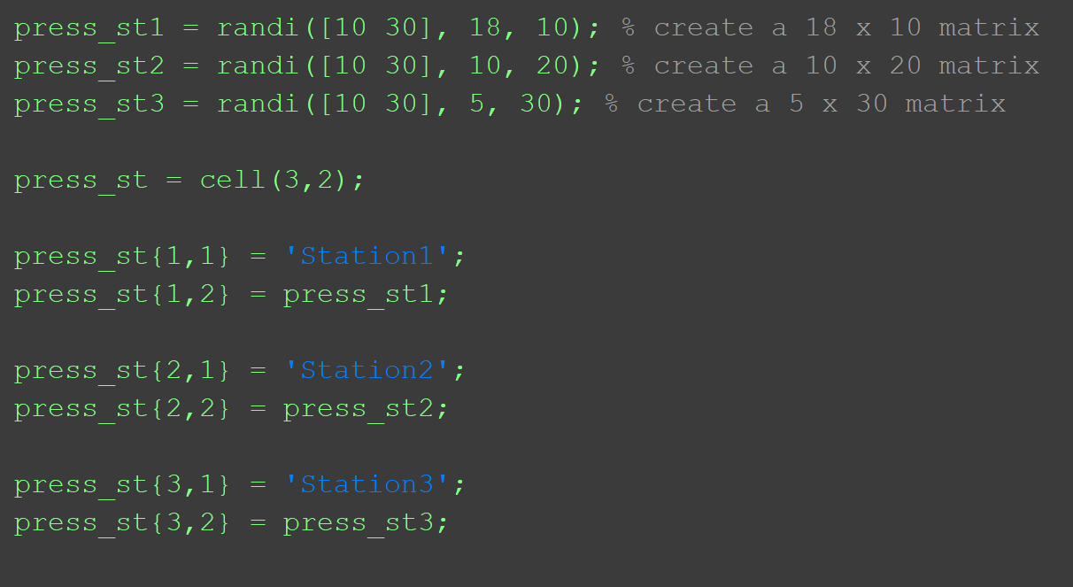
Example: Containing Multiple Data Types

Slide 7
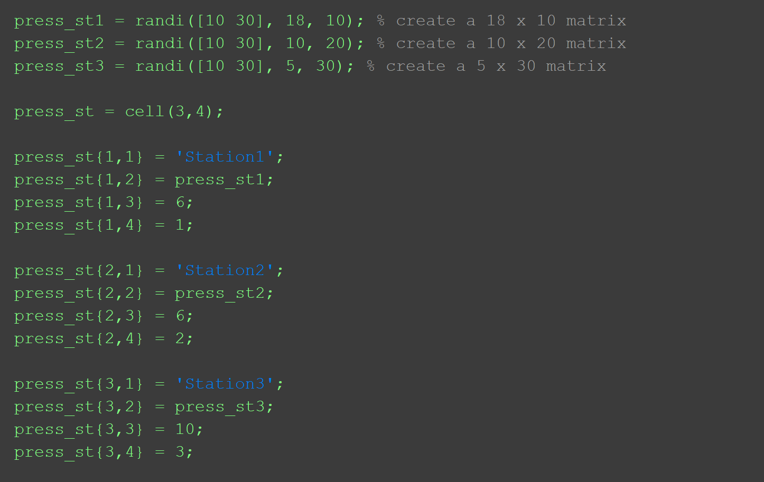
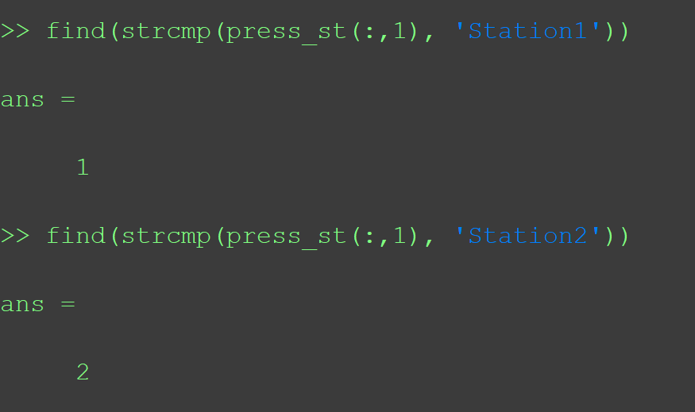
Example: Containing Multiple Data Types (Continue)

Slide 8
Referring to Cell Array Elements
The elements in cell arrays are cells
There are two methods of referring to parts of cell arrays:
you can refer to the cells; this is called cell indexing and parentheses are used
you can refer to the contents of the cells; this is called content indexing and curly braces are used
For example:
>> ca = {2:4, 'hello'};
>> ca(1)
ans =
[1x3 double]
>> ca{1}
ans =
2 3 4

Slide 9
Example: Two Methods to Refer the Cell Array

Slide 10
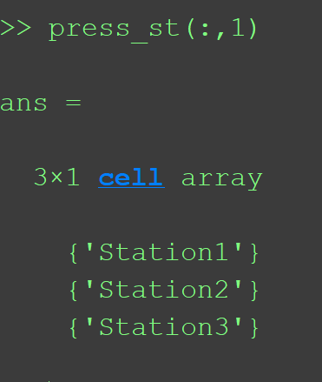
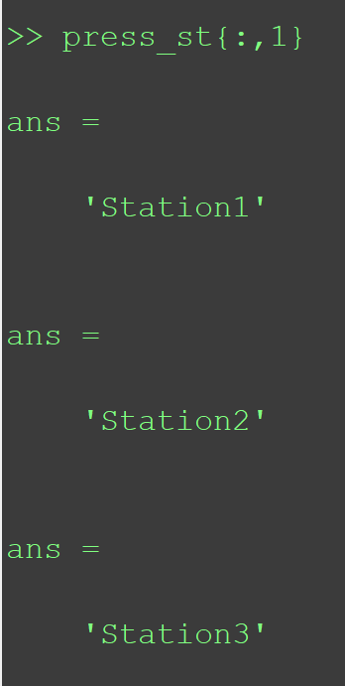
Example: Two Methods to Refer the Cell Array (Continue)

Slide 11
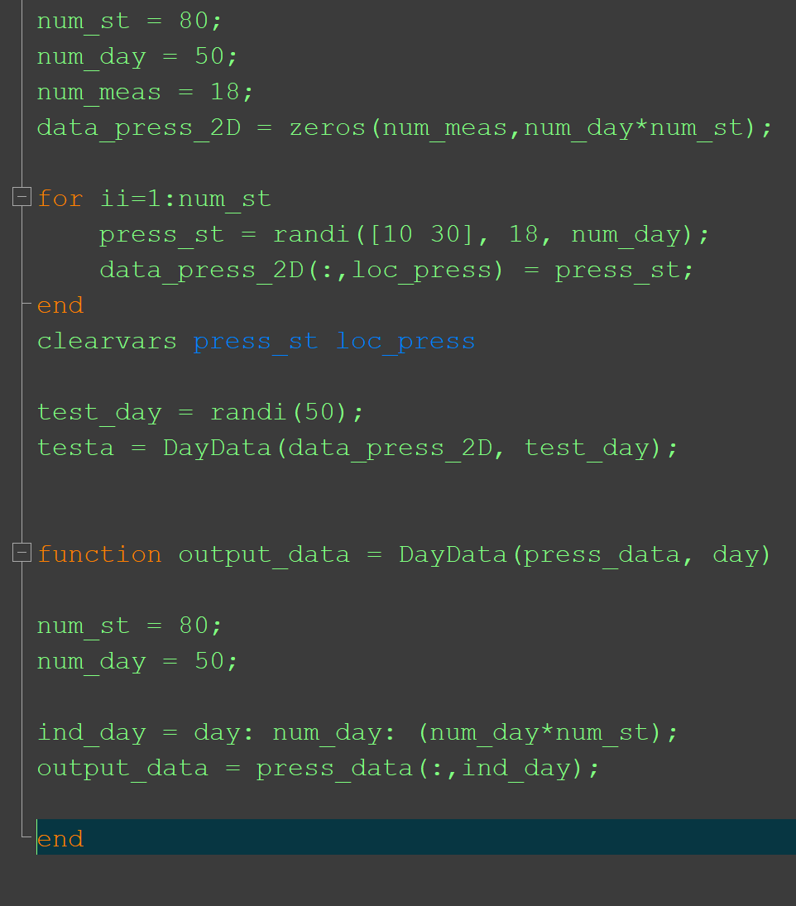
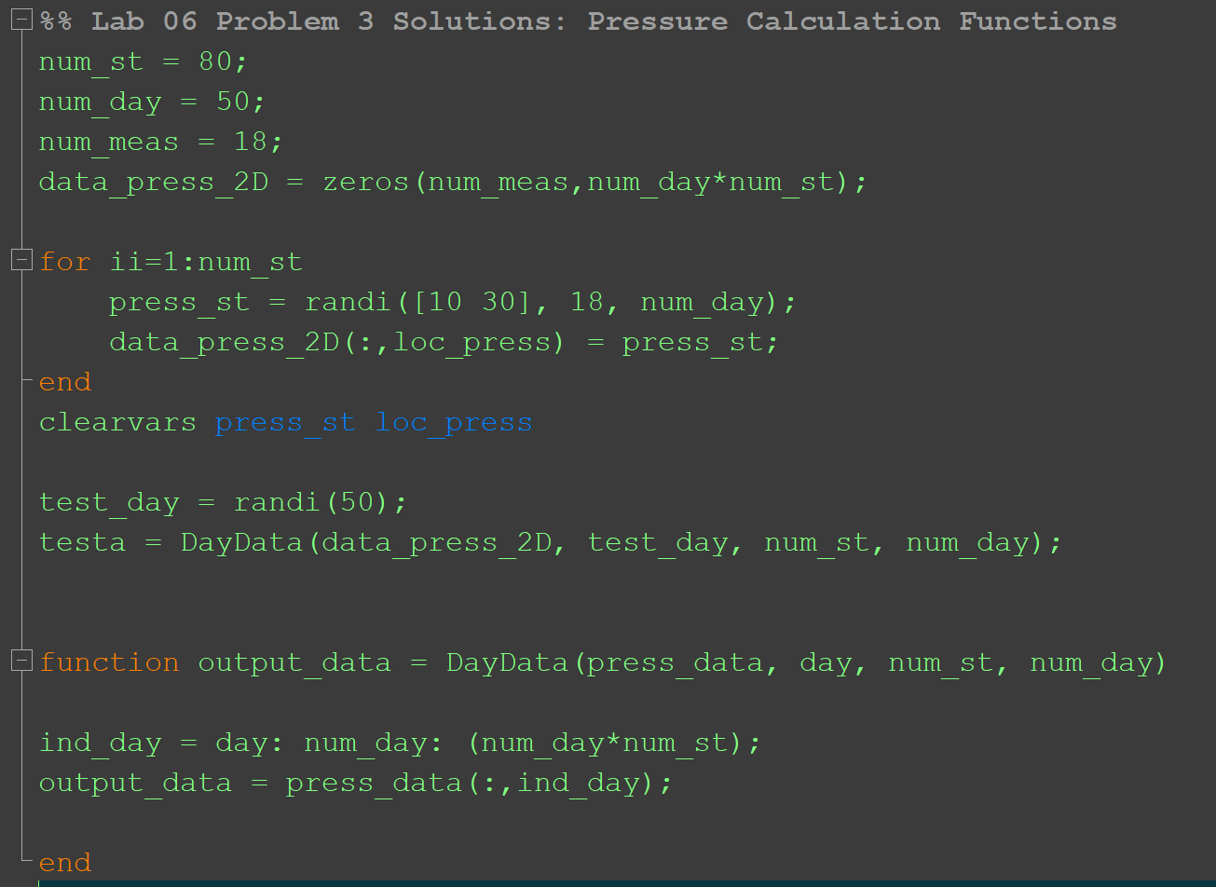
Example: Multiple Input Data in Functions

Slide 12
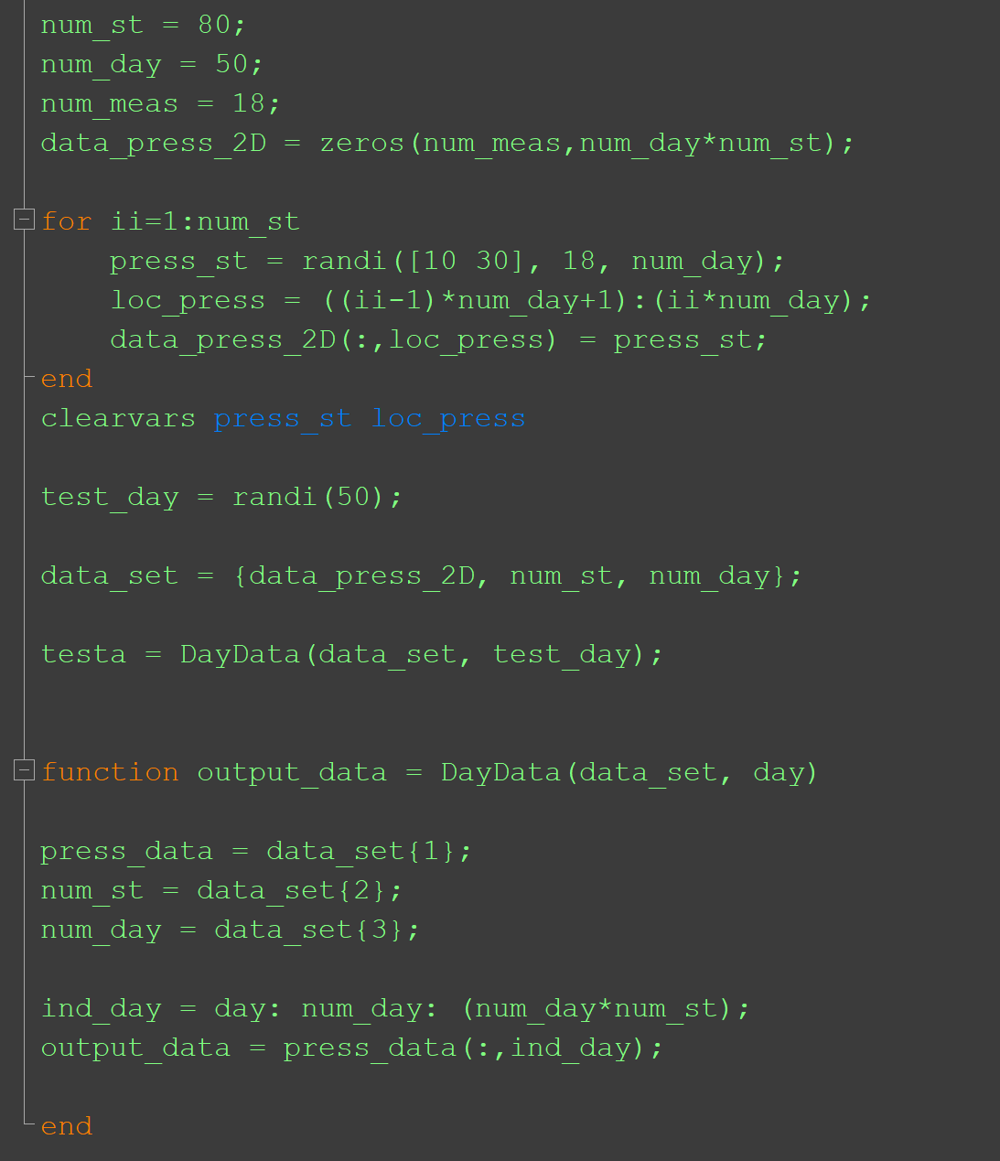
Example: Multiple Input Data in Functions (Continue)

Slide 13
Structure Variables
Structures store values of different types, in fields
Fields are given names; they are referred to as
structurename.fieldname using the dot operator
Structure variables can be initialized using the struct function, which takes pairs of arguments (field name as a string followed by the value for that field)
To print, disp will display all fields; fprintf can only print individual fields

Slide 14
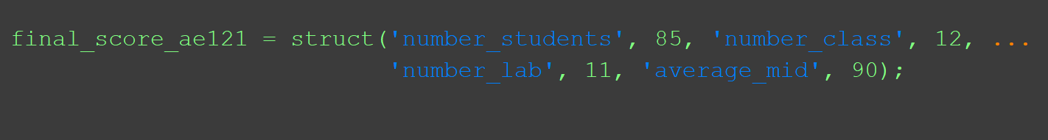
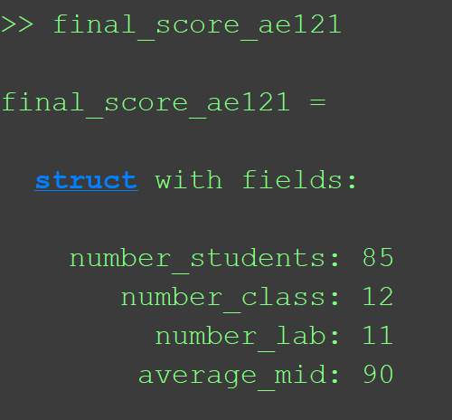
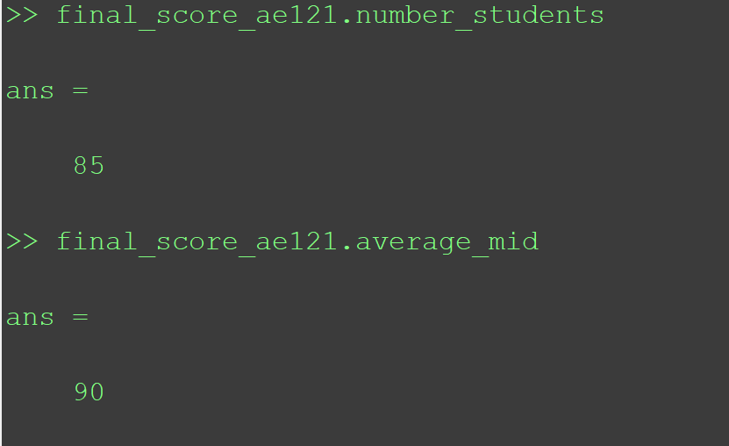
Example: Simple Example

Slide 15
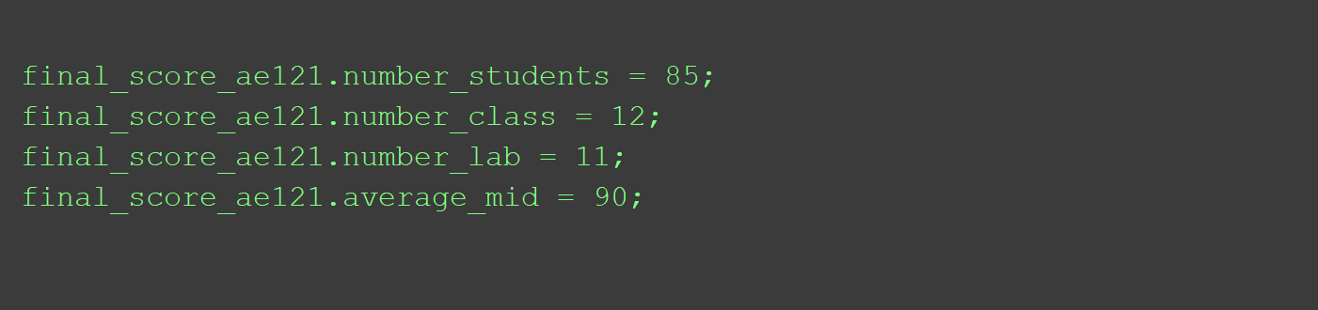
Example: Simple Example (Continue)

Slide 16
Cell Arrays vs. Structs
Cell arrays are arrays, so they are indexed
That means that you can loop though the elements in a cell array – or have MATLAB do that for you by using vectorized code
Structs are not indexed, so you cannot loop
However, the field names are mnemonic so it is more clear what is being stored in a struct
For example:
variable{1} vs. variable.weight: which is more mnemonic?

Slide 17
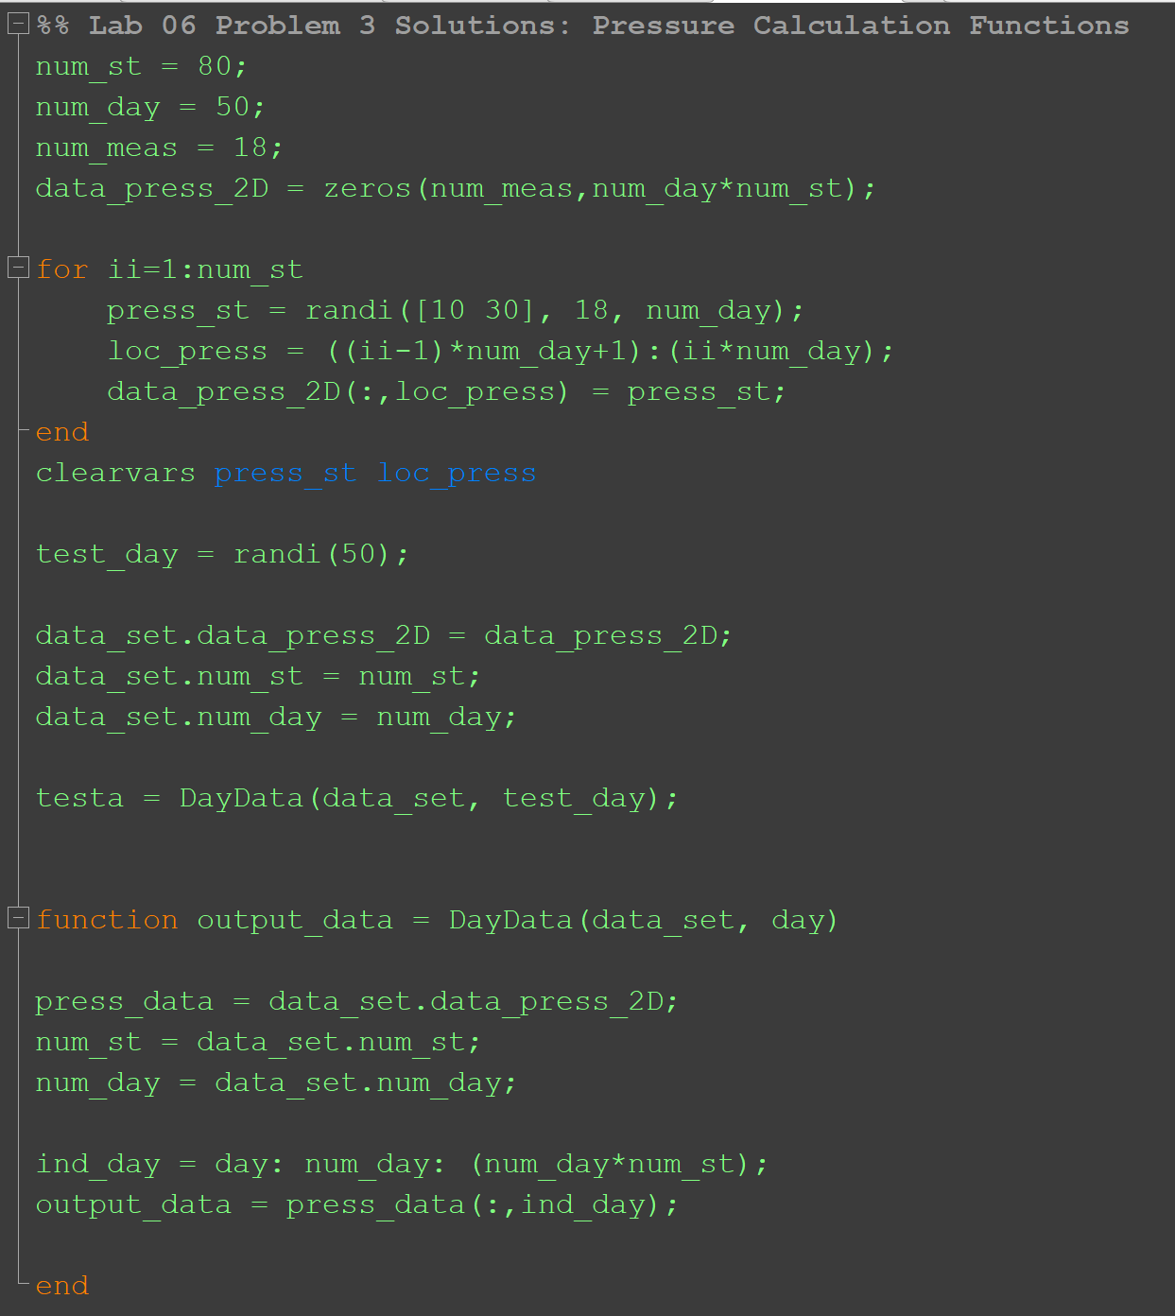
Example: Multiple Input Data in Functions

Slide 18
Slide Credits and References
Stormy Attaway, 2018, Matlab: A Practical Introduction to Programming and Problem Solving, 5th edition
Lecture slides for “Matlab: A Practical Introduction to Programming and Problem Solving”
Holly Moore, 2018, MATLAB for Engineers, 5th edition

