Slide 1
Function
Chul Min Yeum
Assistant Professor
Civil and Environmental Engineering
University of Waterloo, Canada
AE121: Computational Method
Last updated: 2019-06-17

Slide 2
Types of Functions
Categories of functions:
functions that calculate and return one value
functions that calculate and return more than one value
functions that just accomplish a task, such as printing, without returning any values
They are different in:
the way they are called
what the function header looks like
All are stored in code files with the extension .m

Slide 3
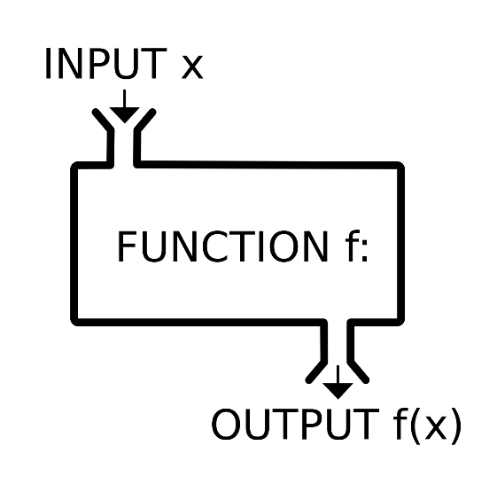
Function
A function is a group of statements that together perform a task. In MATLAB, functions are defined in separate files. The name of the file and of the function should be the same.
Built-in Functions: Functions that are frequently used or that can take more time to execute are often implemented as executable files. These functions are called built-ins.
Single input
Multiple inputs
Single/Multiple inputs
Single/Multiple inputs
Single input
Single output
Multiple output
No return value
x = -1
y = abs(-1)
vec1 = randi(10,3,3)
mat1 = [1 1; 1 1];
[cz, rz] = size(mat1)
disp(‘hello’)

Slide 4
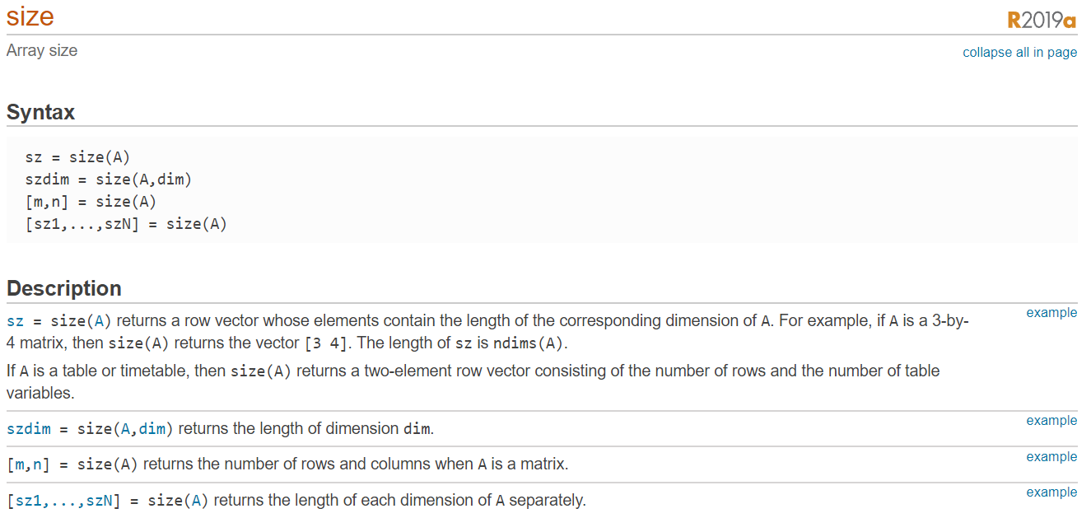
Example: Size Function

Slide 5
Generic Function Definition
functionname.m
function [output arguments] = functionname (input arguments)
% Comment describing the function
Your script
end

Slide 6
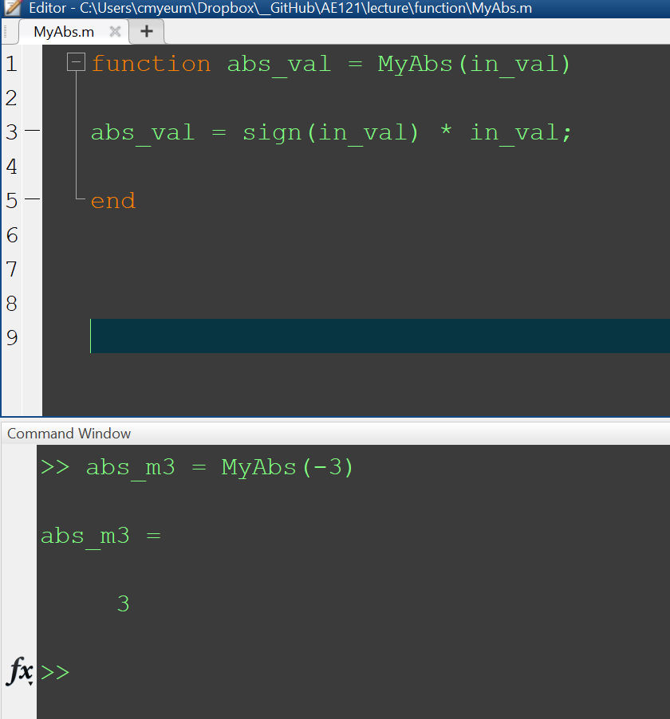
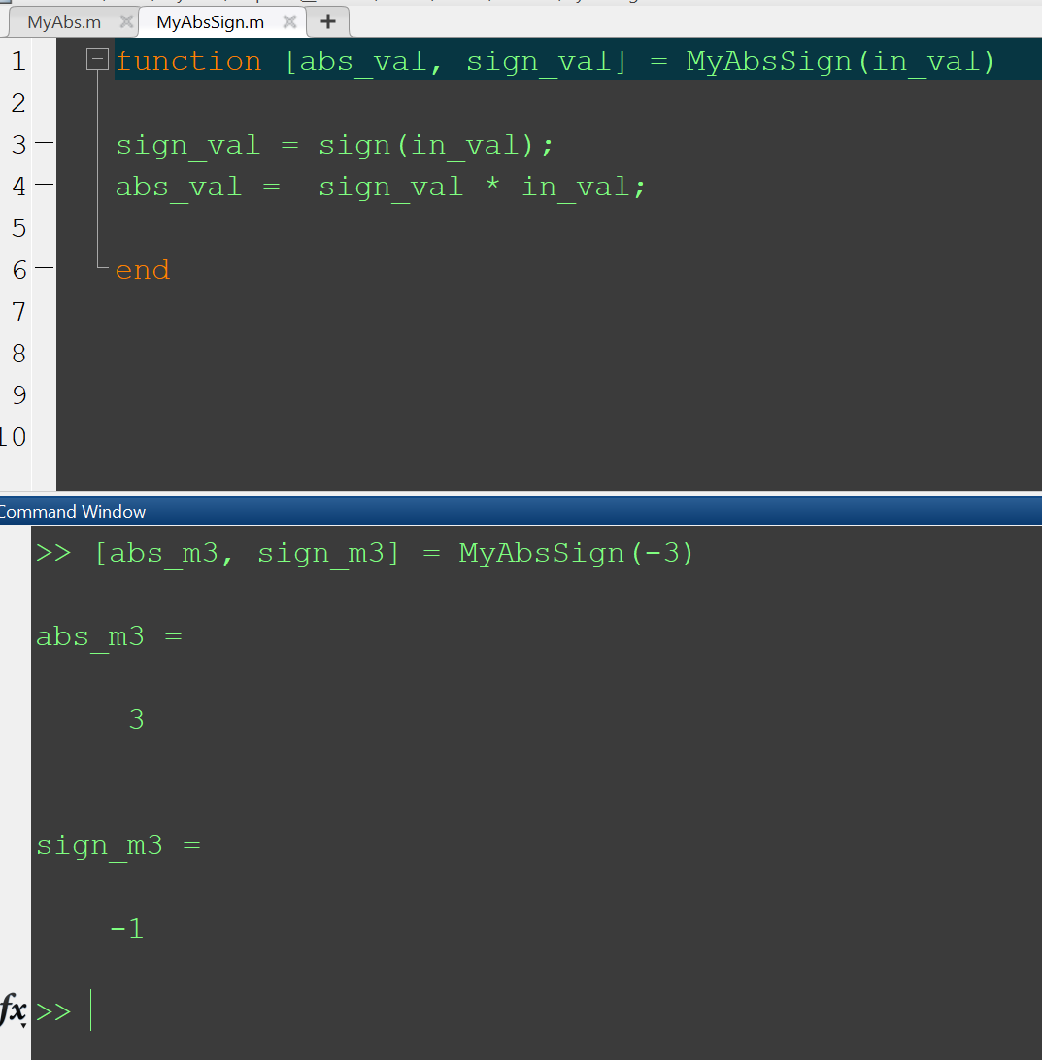
Example: Sample Functions

Slide 7
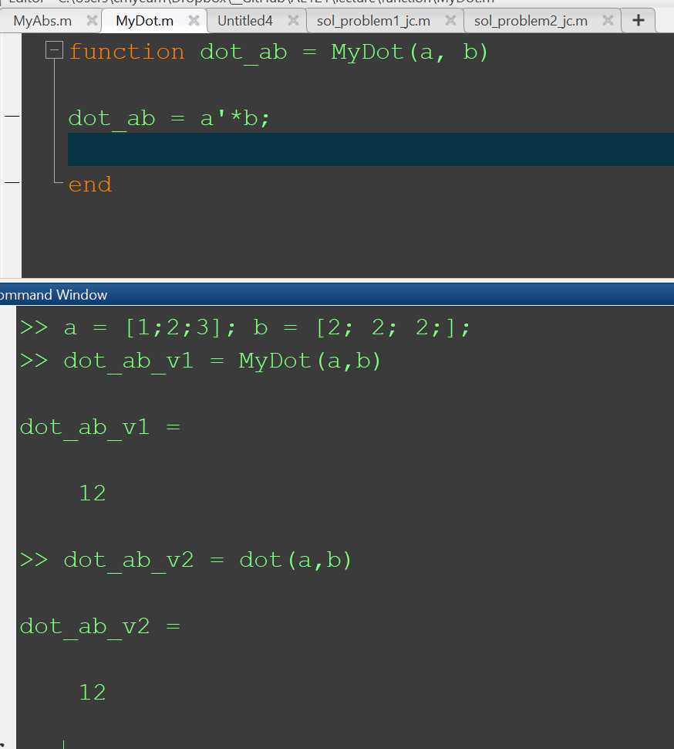
Example: Sample Functions 2

Slide 8
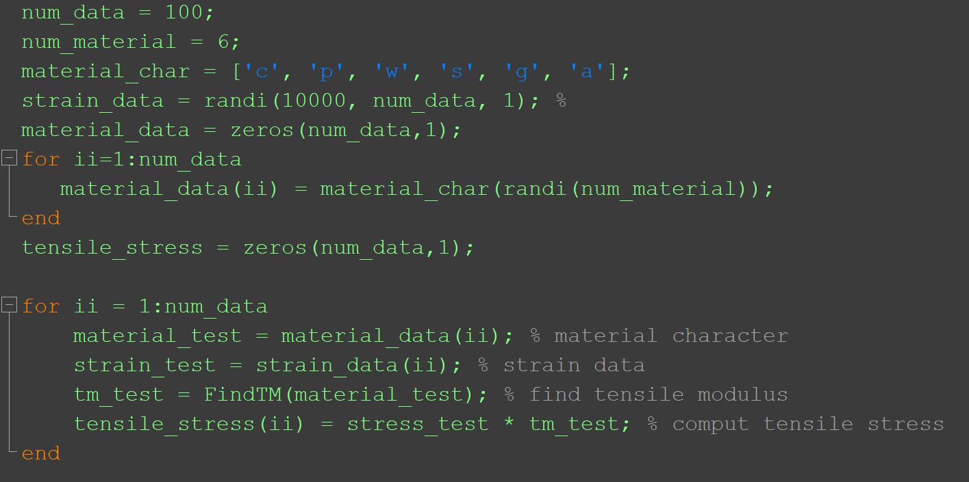
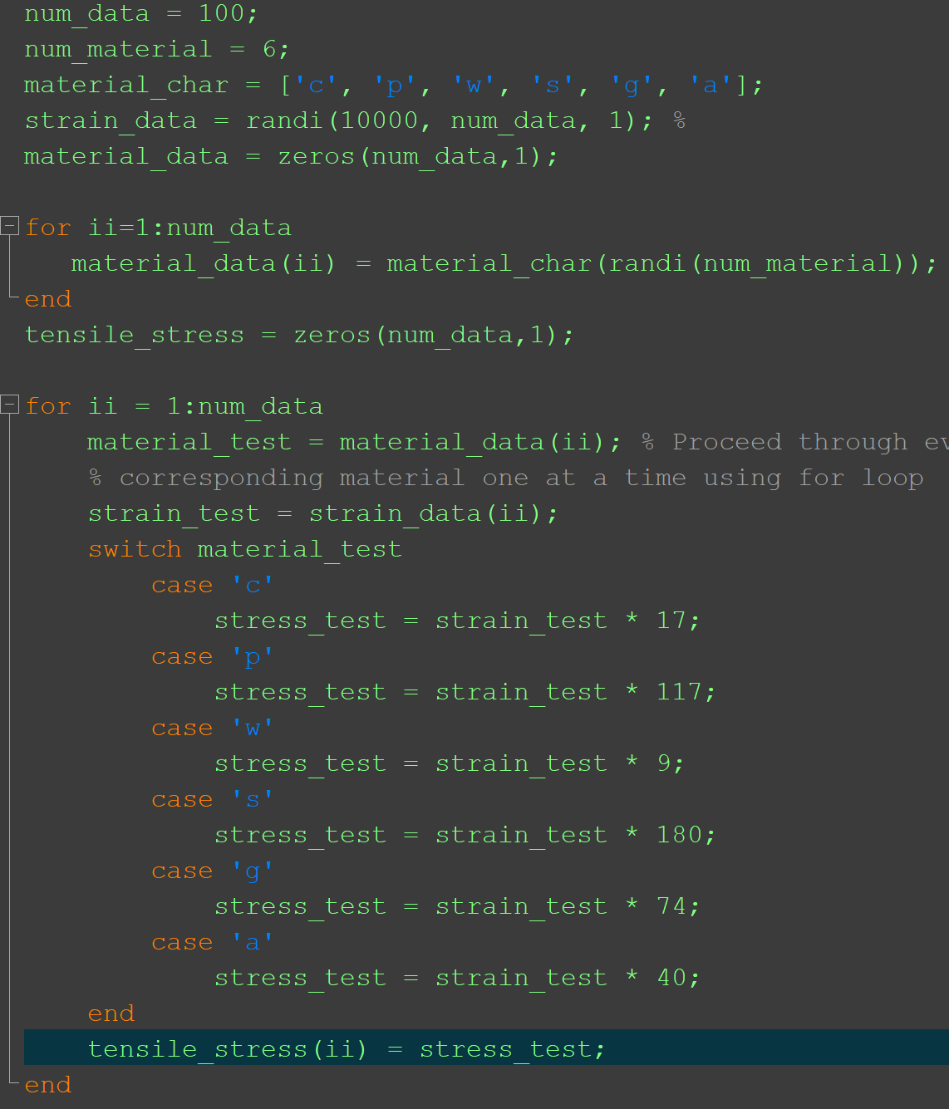
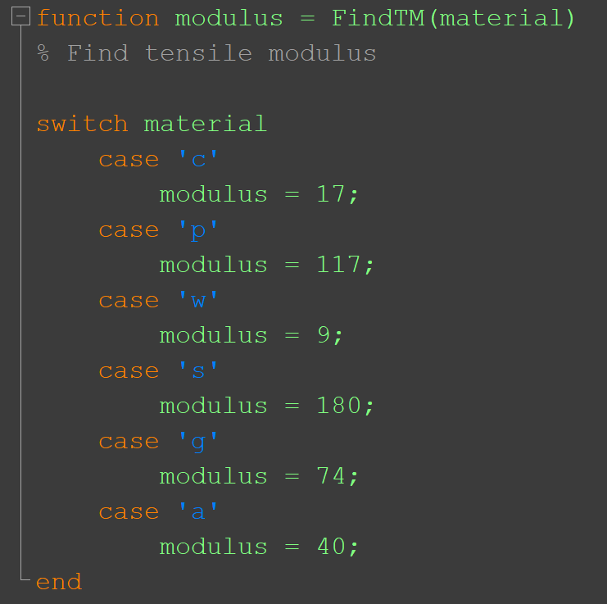
Example: Tensile Stress
demo_tensile_function.m
FindTM.m

Slide 9
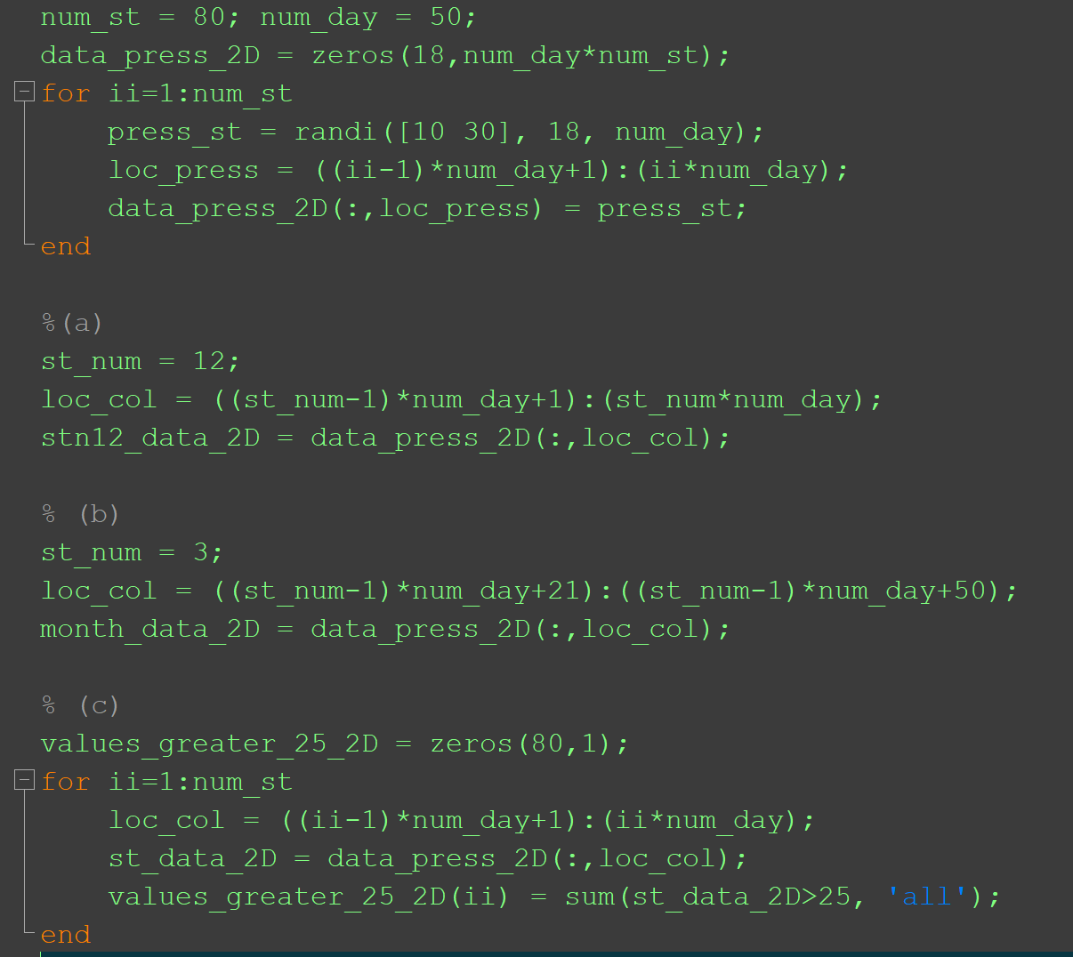
Example: Pressure Calculation
'stn12_data_2D' which contain all the data measured at Station 12.
'month_data_2D' which contains all the data collected from days 21 to 50 at Station 3.
'values_greater_25_2D' which contains the number of pressure values greater than 25 during whole fifty days at each station.

Slide 10
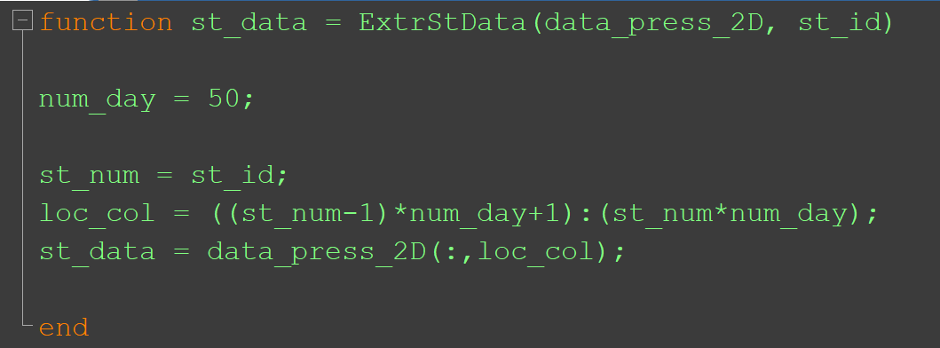
Example: Pressure Calculation (Continue)
'stn12_data_2D' which contain all the data measured at Station 12.
'month_data_2D' which contains all the data collected from days 21 to 50 at Station 3.
'values_greater_25_2D' which contains the number of pressure values greater than 25 during whole fifty days at each station.
Function ExtrStData
input: ‘data_press_2D’, ‘st_id’
output: ‘st_data’
Read ‘data_press_2D’
Extract data for station ‘st_id’
Assign the data to ‘st_data’

Slide 11
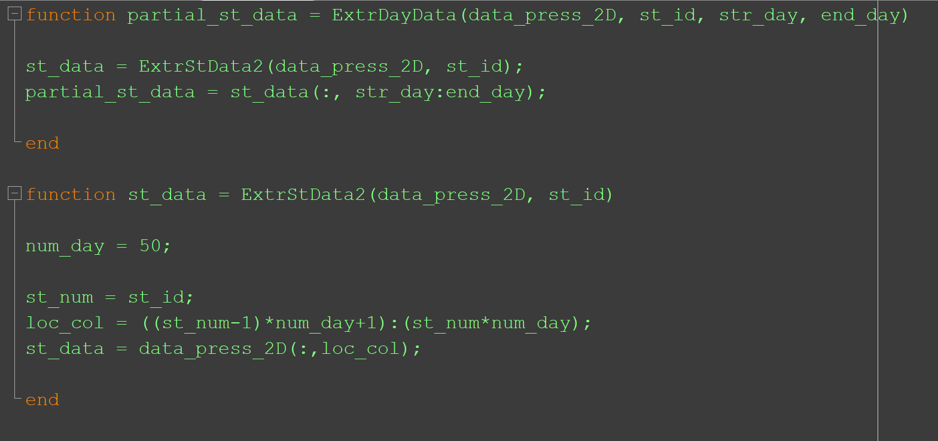
Example: Pressure Calculation (Continue)
'stn12_data_2D' which contain all the data measured at Station 12.
'month_data_2D' which contains all the data collected from days 21 to 50 at Station 3.
'values_greater_25_2D' which contains the number of pressure values greater than 25 during whole fifty days at each station.
Function ExtrDayData
input: : ‘data_press_2D’, ‘st_id’, ‘str_day’, ‘end_day’
output: ‘partial_st_data’
Read ‘data_press_2D’
Extract station data for ‘st_id’
Extract data collected from ‘str_day’ to ‘end_day’
Assign the data to ‘partial_st_data’

Slide 12
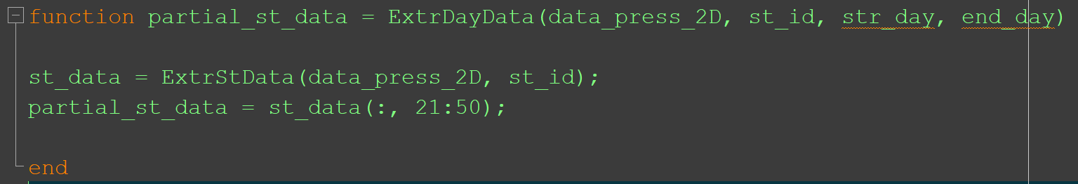
Example: Pressure Calculation (Continue)
'stn12_data_2D' which contain all the data measured at Station 12.
'month_data_2D' which contains all the data collected from days 21 to 50 at Station 3.
'values_greater_25_2D' which contains the number of pressure values greater than 25 during whole fifty days at each station.
Function ExtrDayData
input: : ‘data_press_2D’, ‘st_id’, ‘str_day’, ‘end_day’
output: ‘partial_st_data’
Read ‘data_press_2D’
Extract station data for ‘st_id’
Extract data collected from ‘str_day’ to ‘end_day’
Assign the data to ‘partial_st_data’

Slide 13
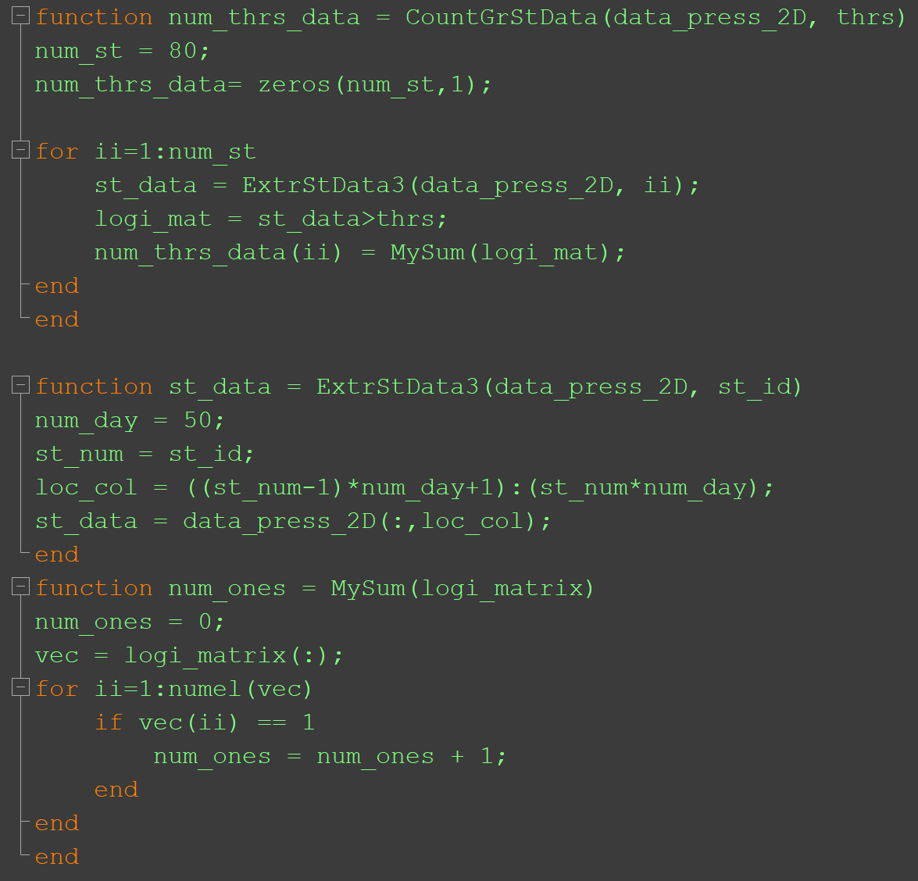
Example: Pressure Calculation (Continue)
'values_greater_25_2D' which contains the number of pressure values greater than 25 during whole fifty days at each station.
Function CountGrStData
input: : ‘data_press_2D’, ‘thrs’
output: ‘num_thrs_data
Read ‘data_press_2D’
Extract station data for station ii
Count # of values that are more than 25
Assign the value to num_thres_data(ii)

Slide 14
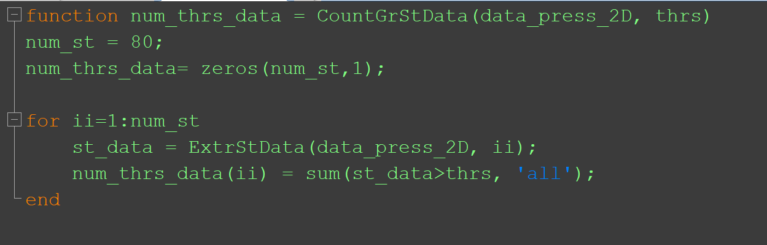
Example: Pressure Calculation (Continue)
'values_greater_25_2D' which contains the number of pressure values greater than 25 during whole fifty days at each station.
Function CountGrStData
input: : ‘data_press_2D’, ‘thrs’
output: ‘num_thrs_data
Read ‘data_press_2D’
Extract station data for station ii
Count # of values that are more than 25
Assign the value to num_thres_data(ii)

Slide 15
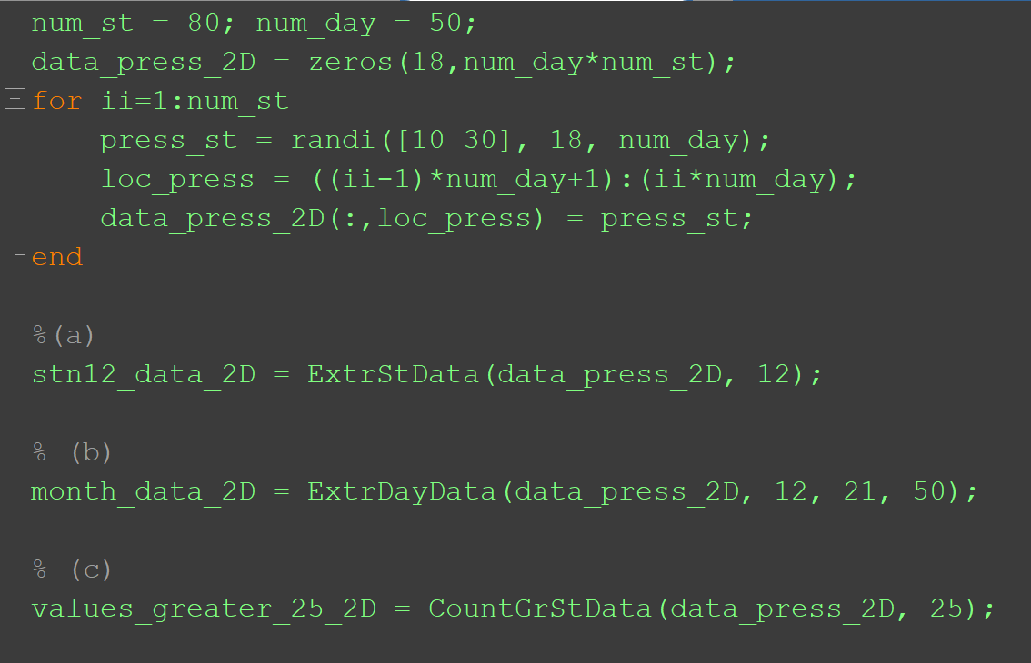
Example: Pressure Calculation (Comparisons)

Slide 16
Local Functions
This topic explains the term local function, and shows how to create and use local functions.
MATLAB® program files can contain code for more than one function. In a function file, the first function in the file is called the main function. This function is visible to functions in other files, or you can call it from the command line. Additional functions within the file are called local functions, and they can occur in any order after the main function. Local functions are only visible to other functions in the same file. They are equivalent to subroutines in other programming languages, and are sometimes called subfunctions.
https://www.mathworks.com/help/matlab/matlab_prog/local-functions.html

Slide 17

Example: Local Functions
my1fun
my2fun
my1fun
my2fun
my1subfun1
my2subfun1
my1subfun2
my2subfun1
subfun1
⁞
⁞
⁞
⁞
my1subfunn
my2subfunn
my1subfunn
my2subfunn
my1fun1.m
my2fun.m
my1fun1.m
subfun1.m
my2fun.m

Slide 18
Add Functions to Scripts
MATLAB® scripts, including live scripts, can contain code to define functions. These functions are called local functions. Local functions are useful if you want to reuse code within a script. By adding local functions, you can avoid creating and managing separate function files. They are also useful for experimenting with functions, which can be added, modified, and deleted easily as needed. Functions in scripts are supported in R2016b or later.
Local functions are only visible within the file where they are defined, both to the script code and other local functions within the file. They are not visible to functions in other files, and cannot be called from the command line. They are equivalent to subroutines in other programming languages, and are sometimes called subfunctions.
To add local functions to a script, first, create the script. Go to the Home tab and select New > Script. For more information about creating scripts, see Create Scripts. You also can Create Live Scripts in the Live Editor.

Slide 19
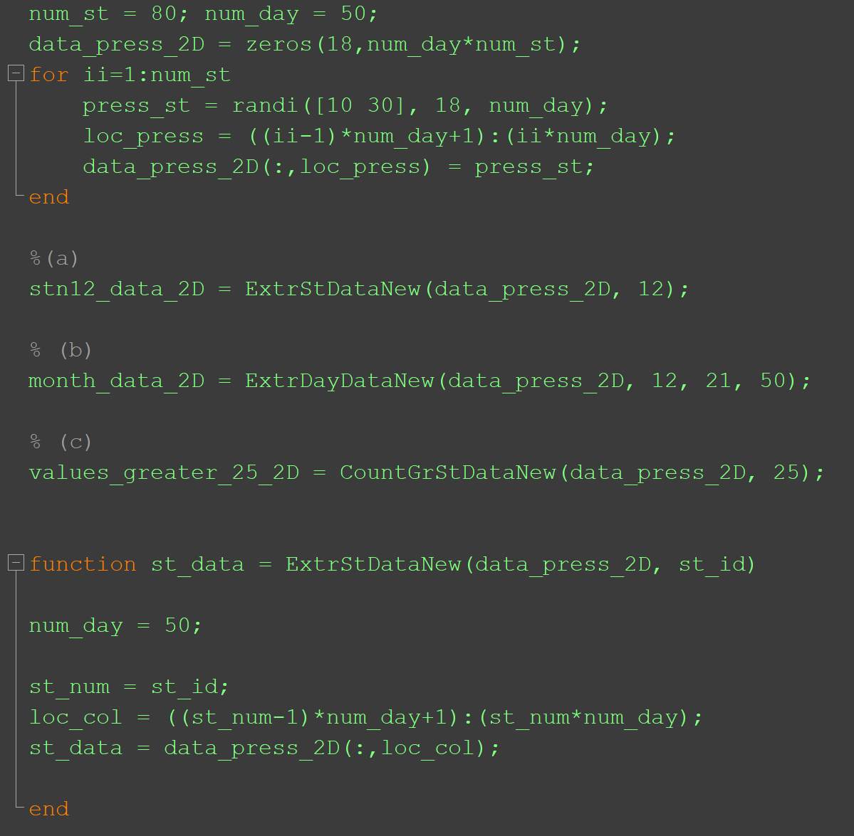
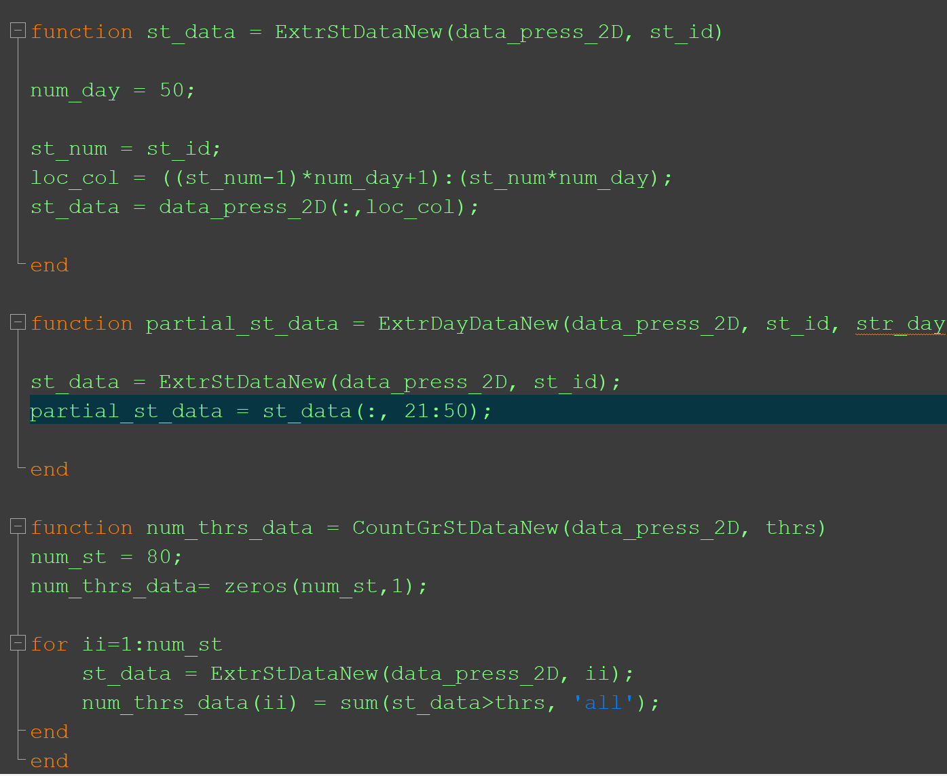
Example: Add Functions to the Scripts (Pressure Calculations)
Continue

Slide 20
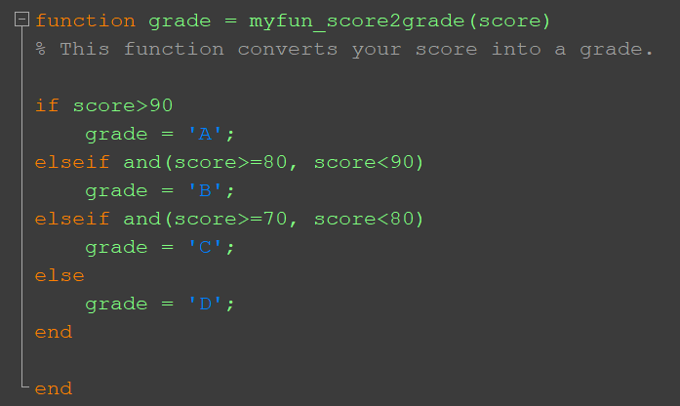
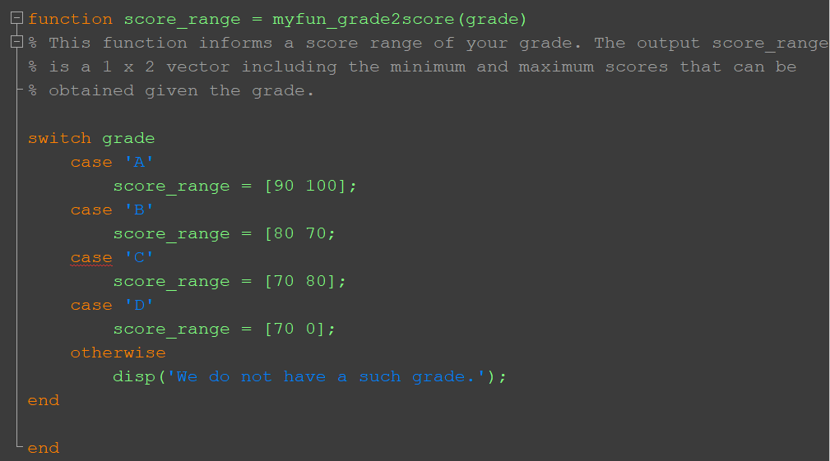
Example: Main and Local Functions
myfun_score2grade.m
myfun_grade2score.m

Slide 21
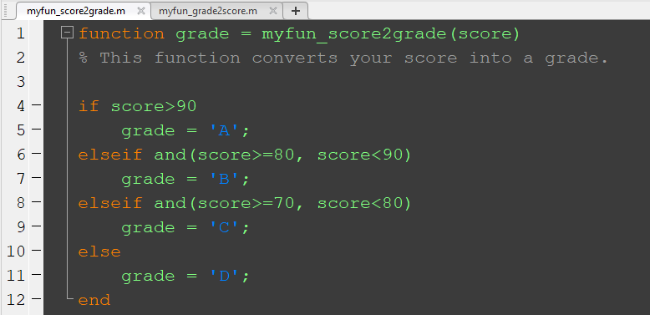
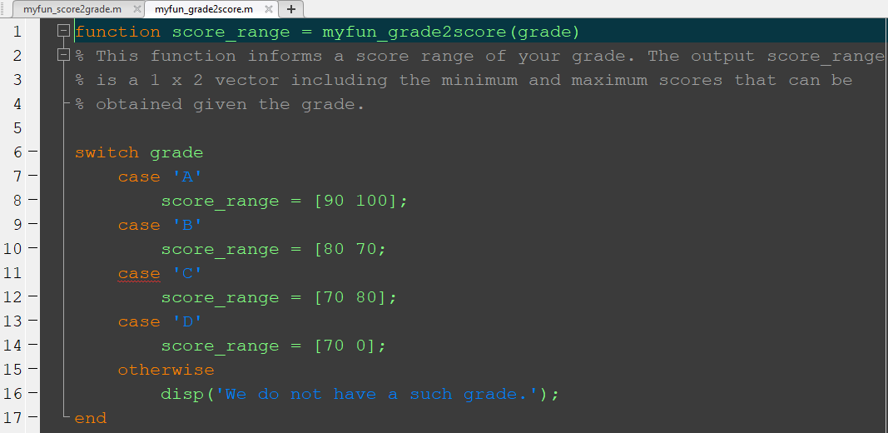
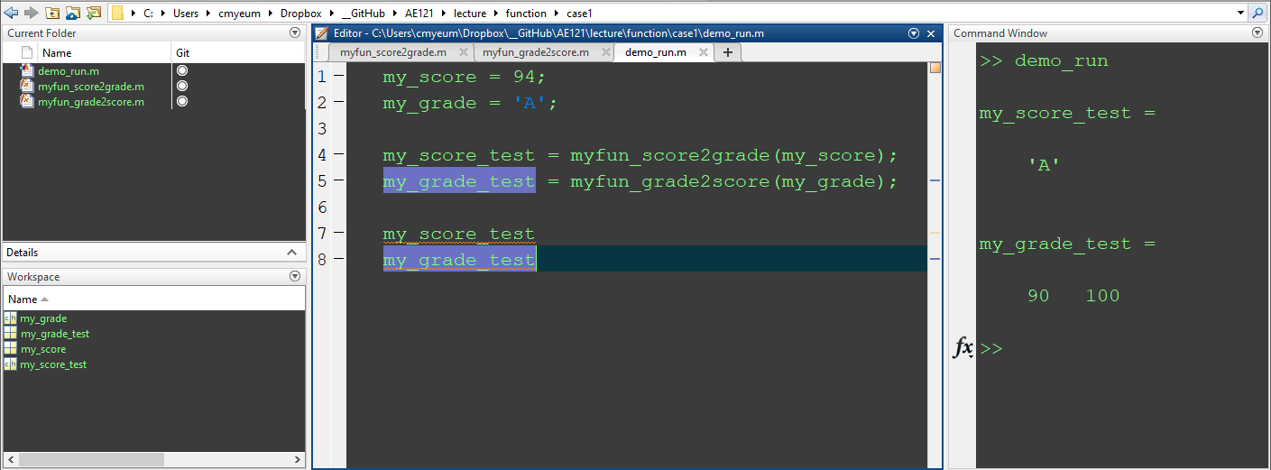
Example: Main and Local Functions
Case1: Each function is stored in a m file (define them as main functions).
demo_run.m
Any file name is possible !!!

Slide 22
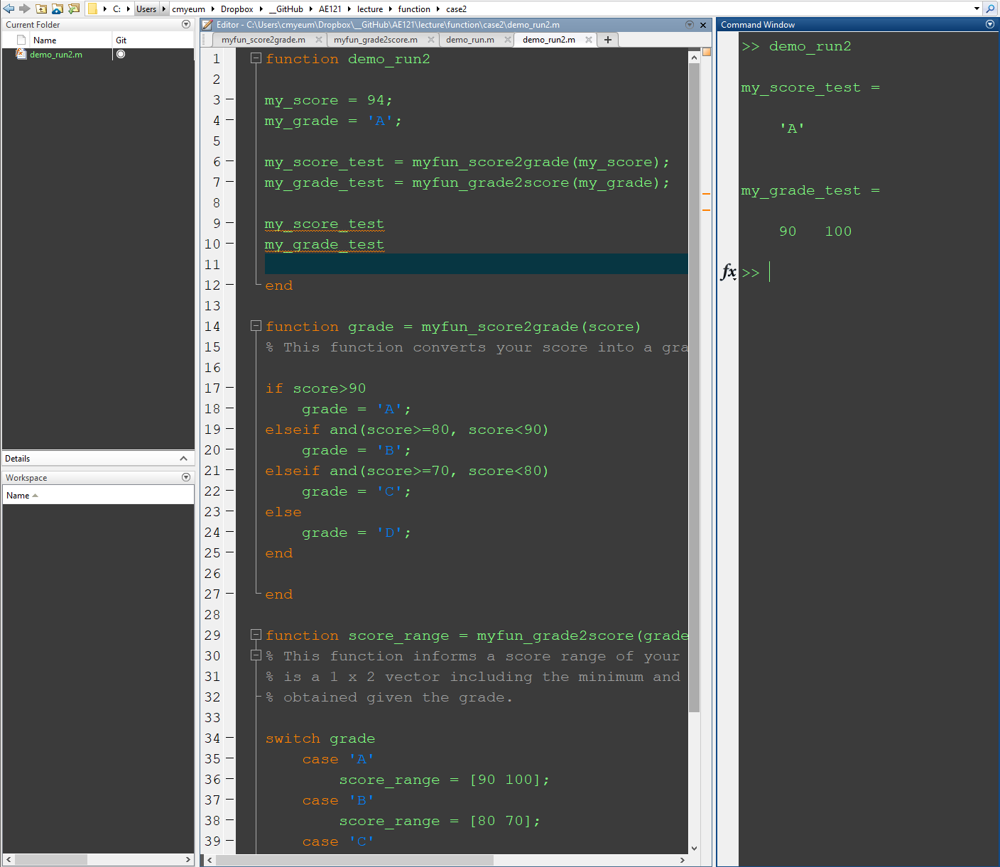
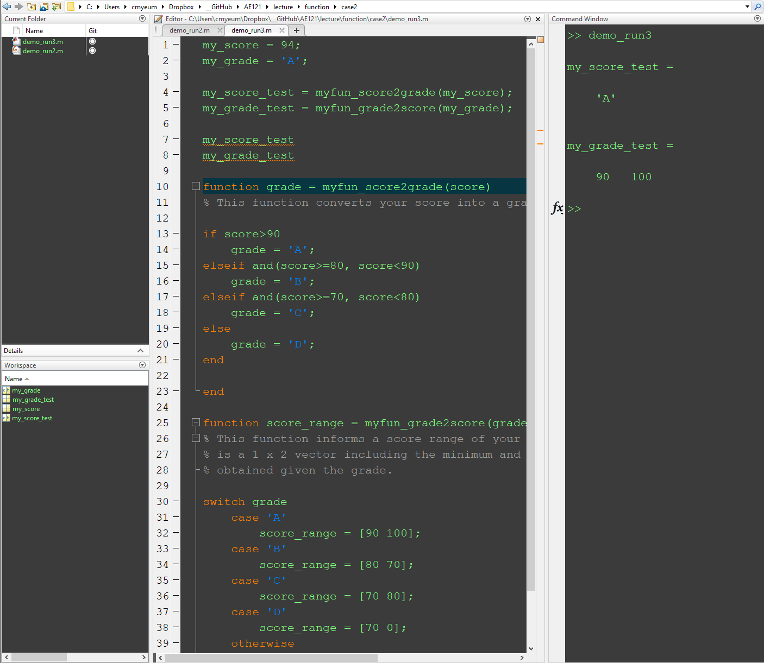
Example: Main and Local Functions
Case2: Functions are stored as local functions.
It is possible now!!!!

Slide 23
Variable Scope
The scope of any variable is the workspace in which it is valid.
The workspace created in the Command Window is called the base workspace.
Scripts also create variables in the base workspace
That means that variables created in the Command Window can be used in scripts and vice versa
However, that is very poor programming style
Functions do not use the base workspace. Every function has its own function workspace. Each function workspace is separate from the base workspace and all other workspaces to protect the integrity of the data. Even local functions in a common file have their own workspaces. Variables specific to a function workspace are called local variables. Typically, local variables do not remain in memory from one function call to the next.
https://www.mathworks.com/help/matlab/matlab_prog/base-and-function-workspaces.html

Slide 24
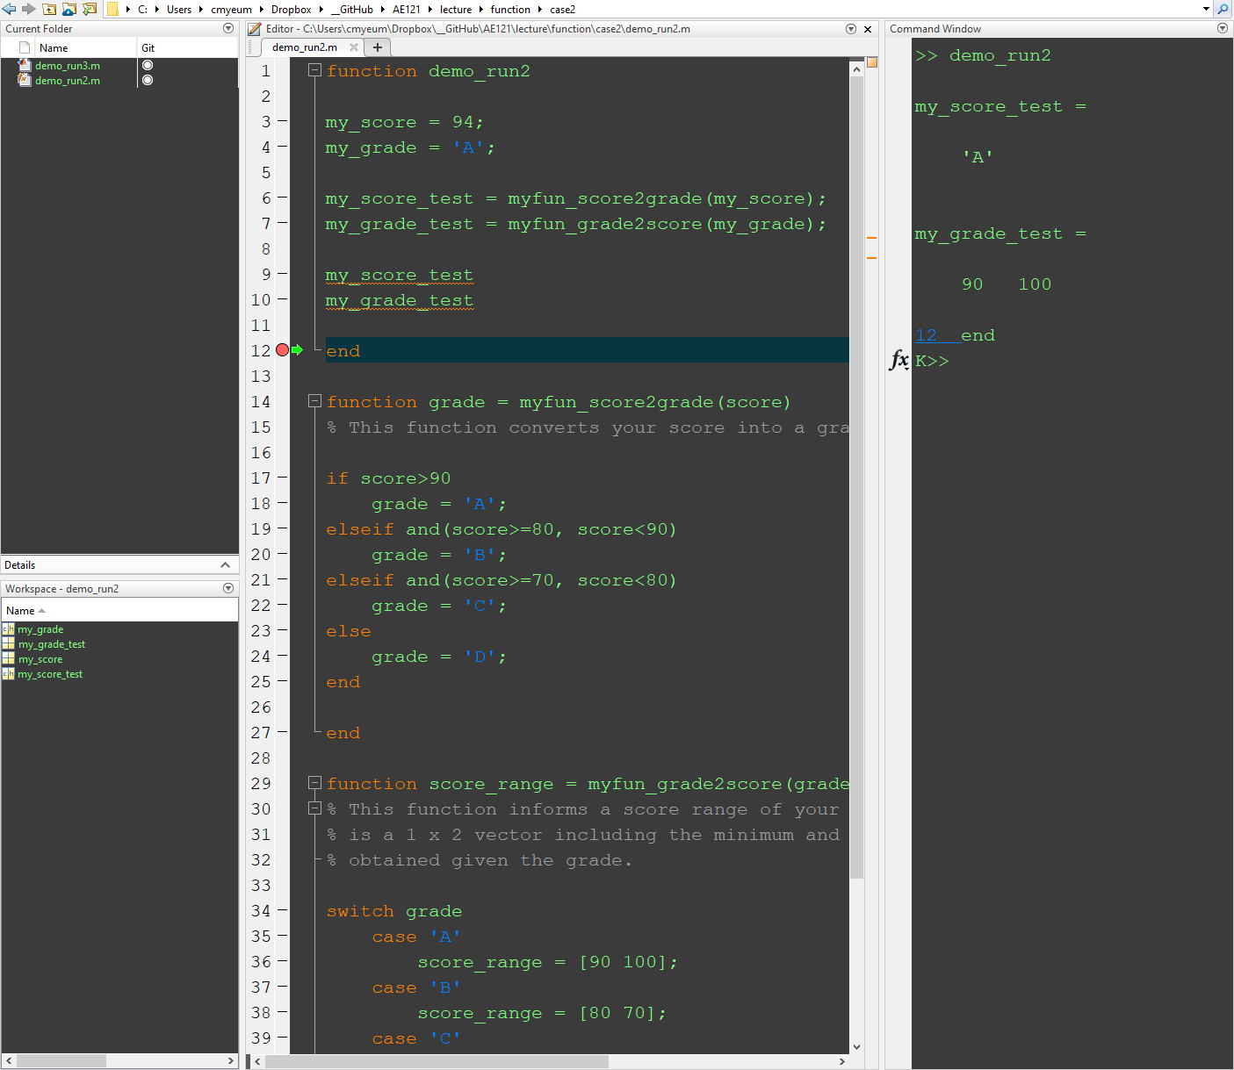
How to See Variables in Function Workspace

Slide 25
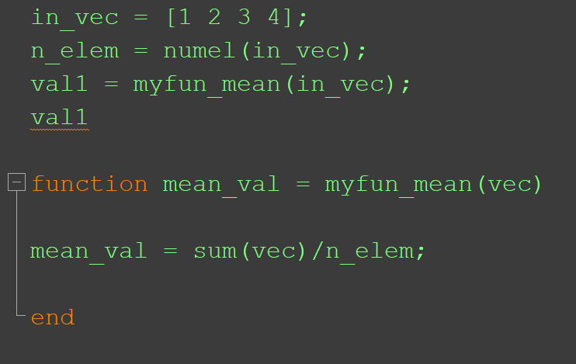
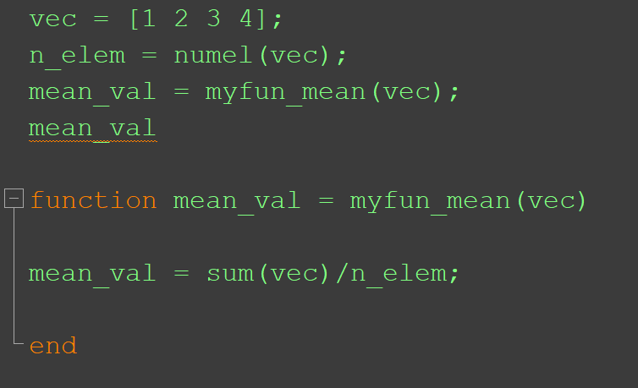
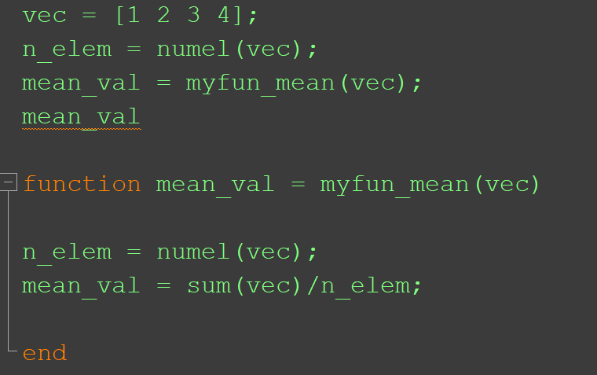
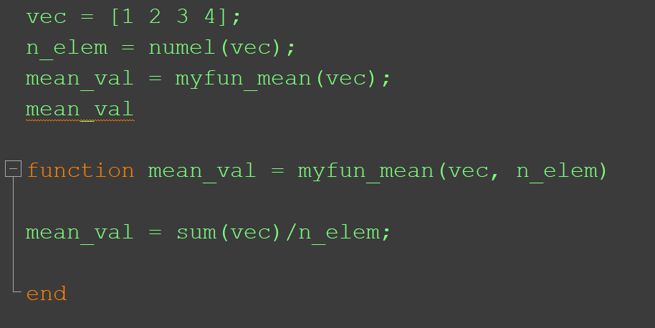
Example: Variable Scope (Which is a valid code?)
2
1
3
4

Slide 26
Notes on Functions
The function header and function call have to match up:
the name has to be the same
the number of input arguments must be the same
the number of variables in the left-hand side of the assignment should be the same as the number of output arguments
if there are no output arguments, the function call is a statement
Functions that return values do not normally print them, also – that is left to the calling function/script

Slide 27
Calling the function
Since the function is returning multiple values through the output arguments, the function call should be in an assignment statement with multiple variables in a vector on the left-hand side (the same as the number of output arguments in the function header) in order to capture all of them
Otherwise, some will be lost.
For example, if the function header is:
function [x,y,z] = fnname(a,b)
This indicates that the function is returning 3 things, so a call to the function might be (assuming a and b are numbers):
[g,h,t] = fnname(11, 4.3);
Or using the same names as the output arguments (it doesn’t matter since the workspace is not shared):
[x,y,z] = fnname(11, 4.3);
This function call would only get the first value returned:
result = fnname(11, 4.3);

Slide 28
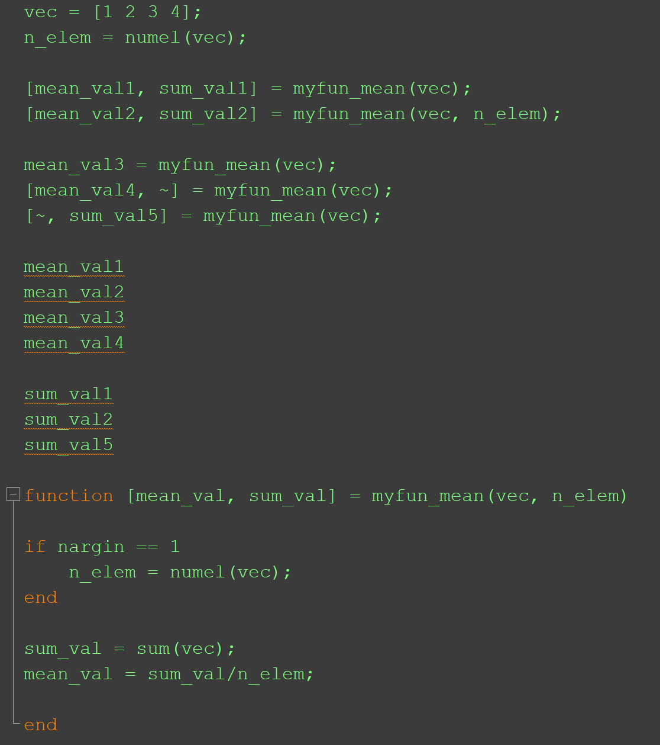
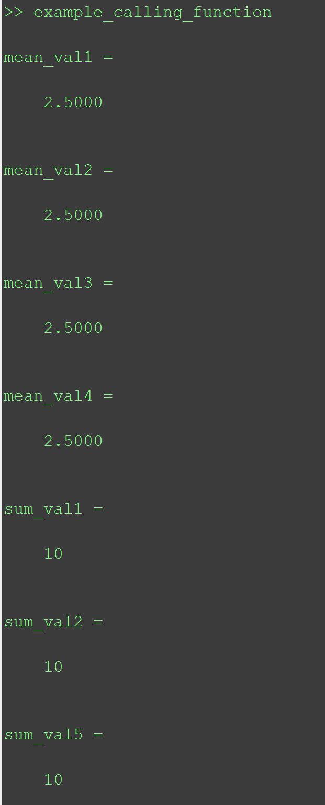
Example: Function Call

Slide 29
Functions that Do Not Return Anything
A function that does not return anything has no output arguments in the function header, nor does it have the assignment operator
The statements in the body would typically display or plot information from the input arguments
functionname.m
function functionname(input arguments)
% Comment describing the function
statements here
end

Slide 30
Calling a Function with No Output
Since no value is returned, the call to such a function is a statement
For example, if this is the function header:
function fnname(x,y)
A call to the function might look like this:
fnname(x,y)
The following would NOT be a valid call; since the function is not returning anything, there is no value to assign:
result = fnname(x,y); % Invalid!
You do not always have to pass input arguments to a function. If you do not, you can have (both in the function header and in the function call) empty (), or you can just leave them out

Slide 31
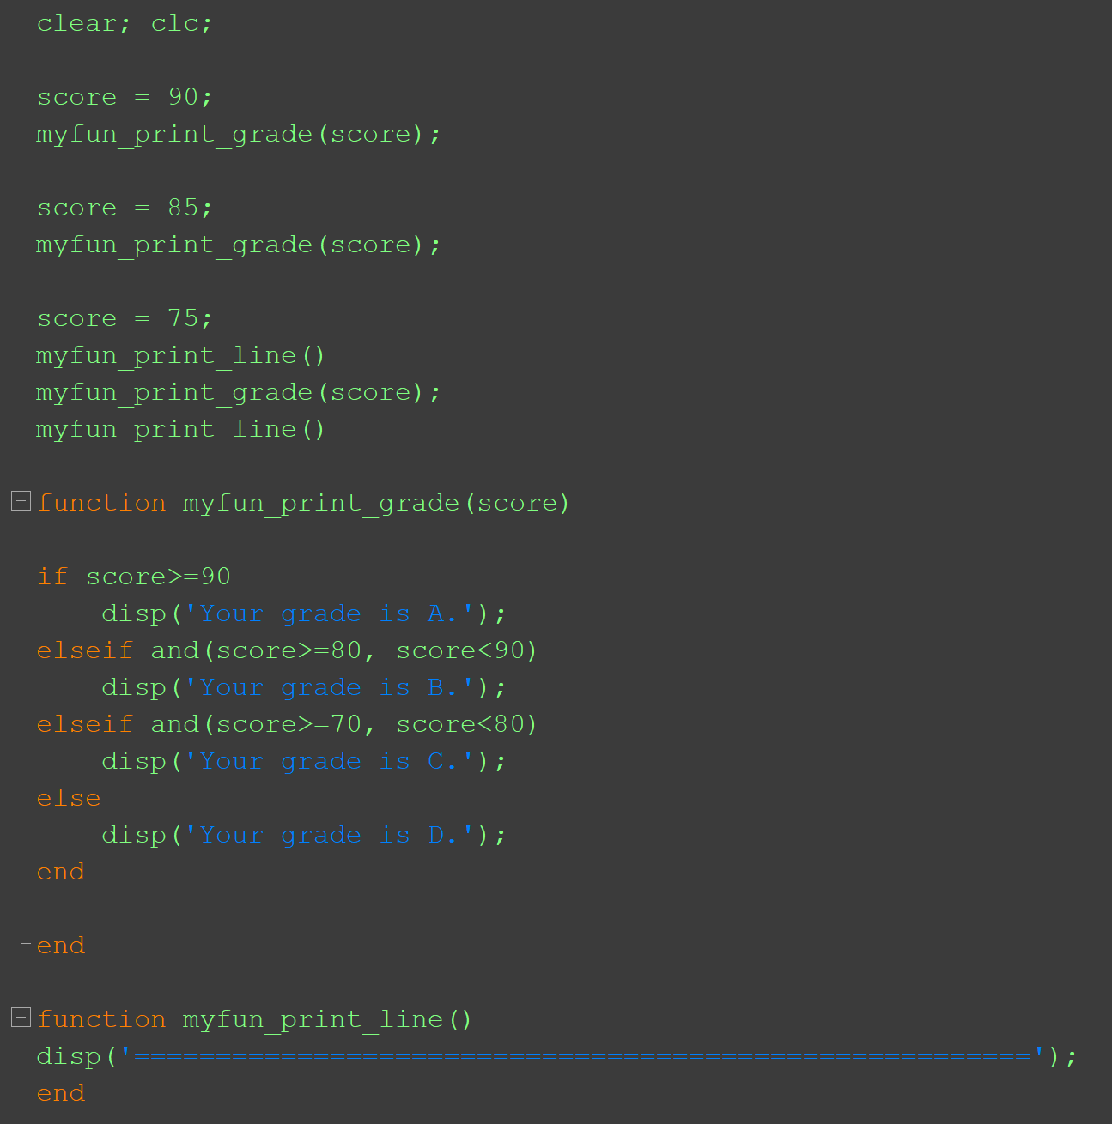
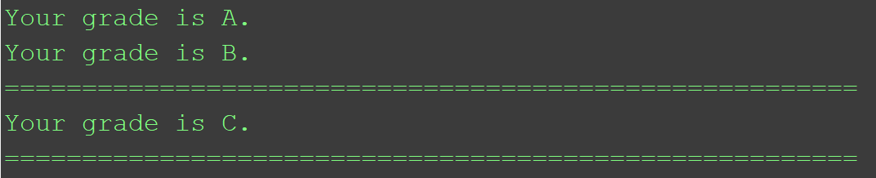
Example: Functions with No Ouptut

Slide 32
Common Pitfalls
Not matching up arguments in a function call with the input arguments in a function header.
Not having enough variables in an assignment statement to store all of the values returned by a function through the output arguments.
Attempting to call a function that does not return a value from an assignment statement, or from an output statement.
Clear and valid input-output relationship!

Slide 33
Slide Credits and References
Stormy Attaway, 2018, Matlab: A Practical Introduction to Programming and Problem Solving, 5th edition
Lecture slides for “Matlab: A Practical Introduction to Programming and Problem Solving”
Holly Moore, 2018, MATLAB for Engineers, 5th edition

