Slide 1
Text Manipulation
Chul Min Yeum
Assistant Professor
Civil and Environmental Engineering
University of Waterloo, Canada
AE121: Computational Method
Last updated: 2019-07-08

Slide 2
Text Terminology
Text in MATLAB can be represented using:
character vectors (in single quotes)
string arrays, introduced in R2016b (in double quotes)
Many functions that manipulate text can be called using either a character vector or a string
Additionally, new functions have been created for the string type
Prior to R2016b, the word “string” was used for what are now called character vectors

Slide 3
Characters
Both character vectors and string scalars are composed of groups of characters
Characters include letters of the alphabet, digits, punctuation marks, white space, and control characters
Individual characters in single quotation marks are the type char (so, the class is char)

Slide 4
Character Vectors
Character vectors:
consist of any number of characters
are contained in single quotation marks
are displayed using single quotation marks
are of the type, or class, char
Examples: ‘x’, ‘ ’, ‘abc’, ‘hi there’
Since these are vectors of characters, many built-in functions and operators that we’ve seen already work with character vectors as well as numbers – e.g., length to get the length of a character vector, or the transpose operator
You can also index into a character vector to get individual characters or to get subsets

Slide 5
Dimensions of Character Vectors
A single character is a 1 x 1 scalar
>> letter = 'x';
>> size(letter)
ans =
1 1
A character vector is 1 x n where n is the length
>> myword = 'Hello';
>> size(myword)
ans =
1 5

Slide 6
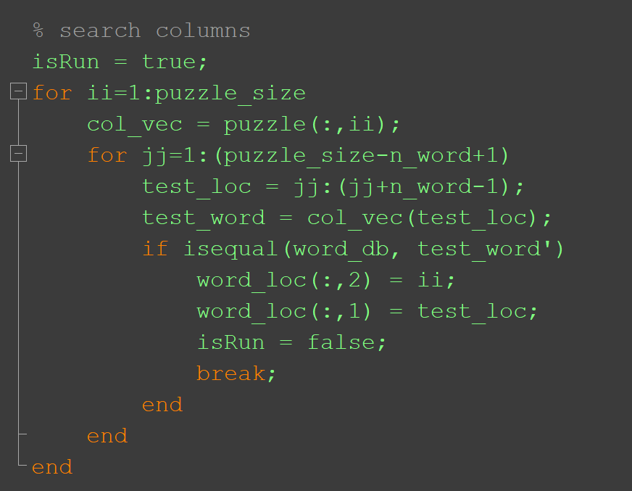
Revisit: Lab05-Problem 4
all(word_db == test_word’)

Slide 7
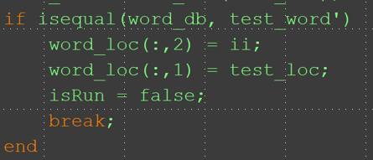
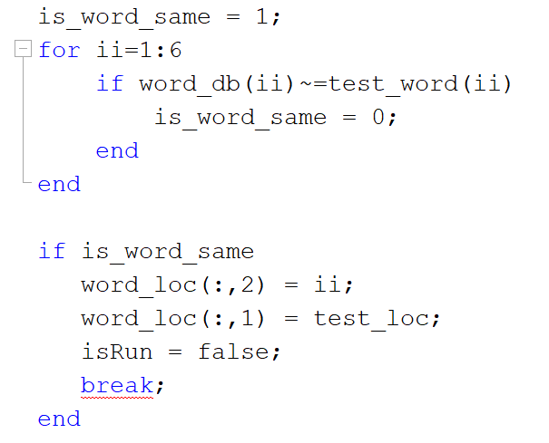
Revisit: Lab05-Problem 4 (Continue)
l
u
v
v
j
b
word_db => ‘luvvjb‘
b | a | n | a | n | a
test_word => ‘banana‘

Slide 8
String Scalars
A string scalar is a single string, and is used to store a group of characters such as a word
Strings can be created
using double quotes, e.g. “Awesome”
using the string function, e.g. string(‘Awesome’)
Strings are displayed using double quotes
The class of a string scalar is ‘string’
A string is a 1 x 1 scalar
>> mystr = "Awesome";
>> size(mystr)
ans =
1 1

Slide 9
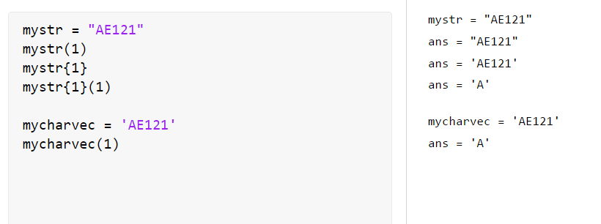
String Indexing
A character vector is contained in a string; curly braces can be used to index:

Slide 10
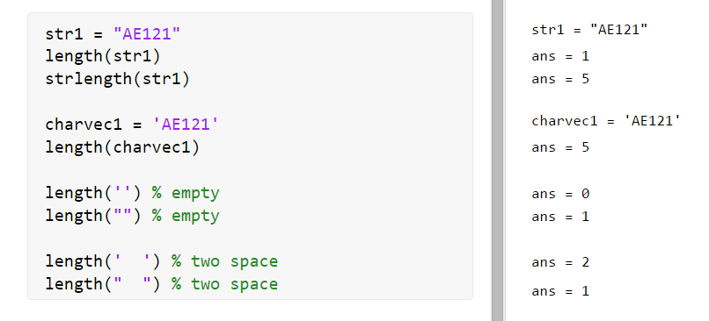
String Length
We have seen that the length function can be used to find the number of characters in a character vector
However, since a string is a 1 x 1 scalar, the length of a string is 1
Use the strlength function for strings:
Even an empty string is a 1 x 1 scalar, so the length is 1 (not 0)

Slide 11
Groups of strings
Groups of strings can be stored in
string arrays
character matrices
cell arrays (in Chapter 8)
String arrays are very easy to use:
>> greets = ["hi", "ciao"]
greets =
1×2 string array
"hi" "ciao"
>> greets(1)
ans =
"hi"

Slide 12
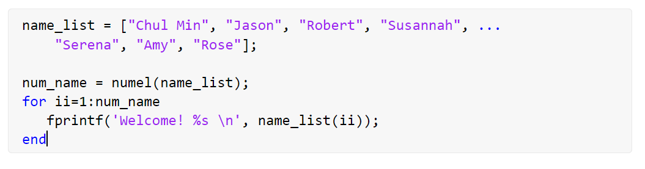
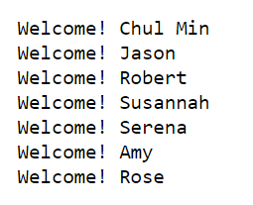
Example: Simple Example 1

Slide 13
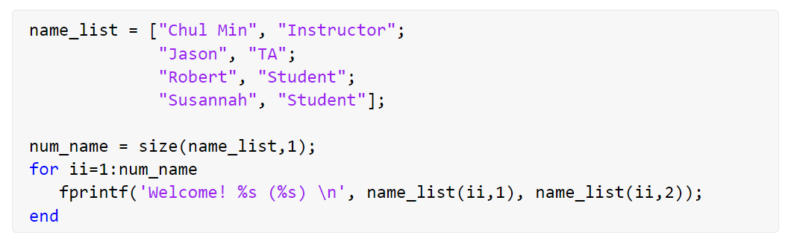
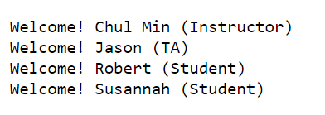
Example: Simple Example 2

Slide 14
Operations on Strings
Strings are created using double quotes or by passing a character vector to the string function
Without any arguments, the string function creates an empty string (which, don’t forget, is still a 1 x 1 scalar so the length is 1)
The plus function or operator can join, or concatenate, two strings together
>> "abc" + "xyz"
ans =
"abcxyz"

Slide 15
Text Functions
Many functions can have either character vectors or strings as input arguments
Generally, if a character vector is passed to the function, a character vector will be returned, and if a string is passed, a string will be returned
For example, changing case using upper or lower:
>> upper('abc')
ans =
'ABC'
>> lower("HELP")
ans =
"help"

Slide 16
String Concatenation
There are several ways to concatenate, or join, strings (using +) and character vectors (using [ ])
>> "abc"+"d"
ans =
"abcd"
>> ['abc' 'd']
ans =
'abcd'
The strcat function can be used; it will remove trailing blanks for character vectors but not for strings
>> strcat('Hi ', 'everyone')
ans =
'Hieveryone'
>> strcat("Hi ", "everyone")
ans =
"Hi everyone”

Slide 17
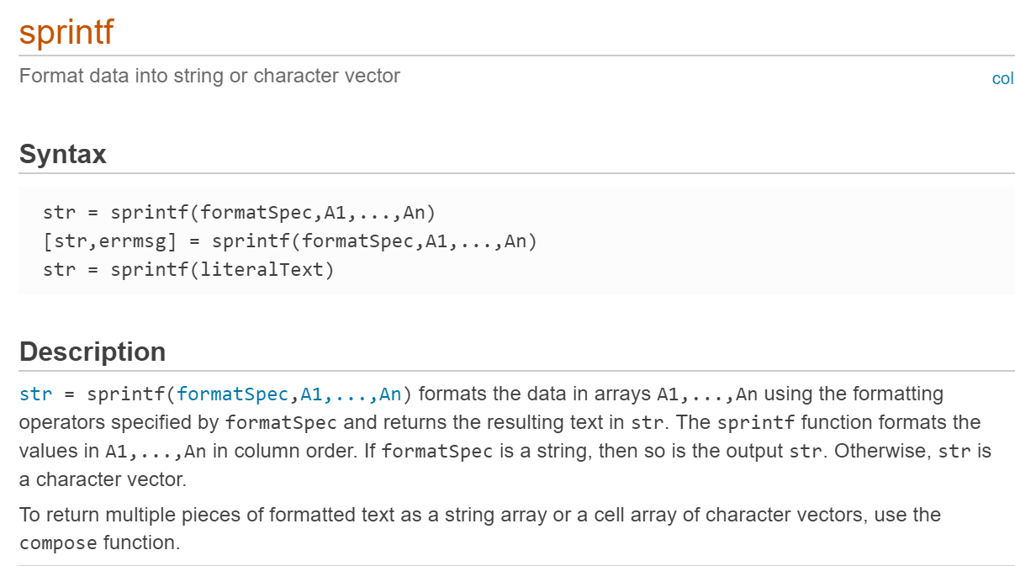
The sprintf function
sprintf works just like fprintf, but instead of printing, it creates text– so it can be used to customize the format of text.
Any time text is required as an input, sprintf can create customized text.

Slide 18
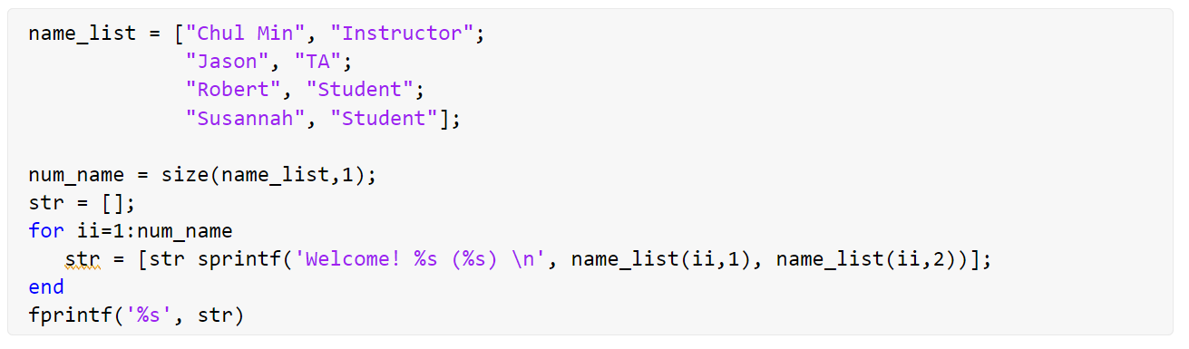
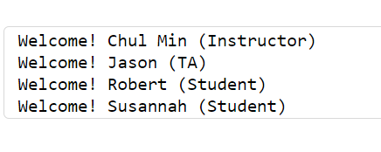
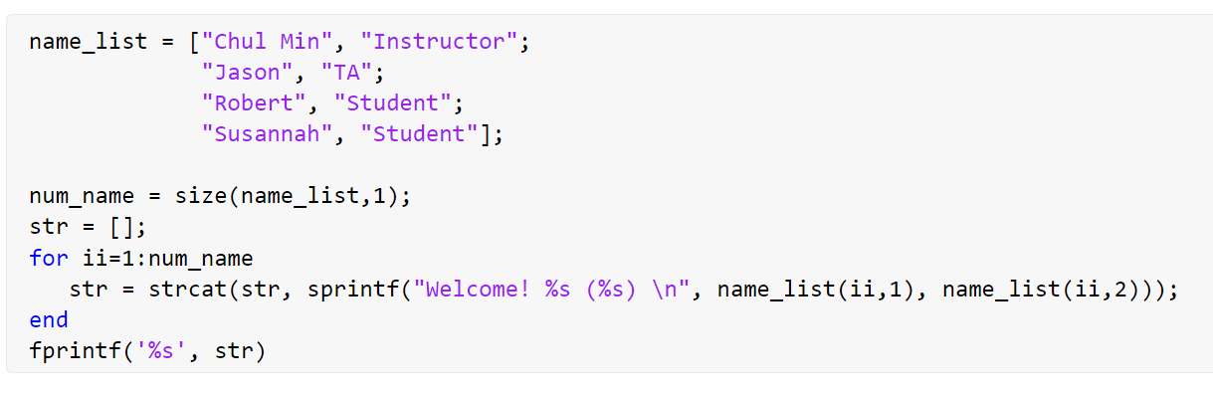
Example: Simple Example

Slide 19
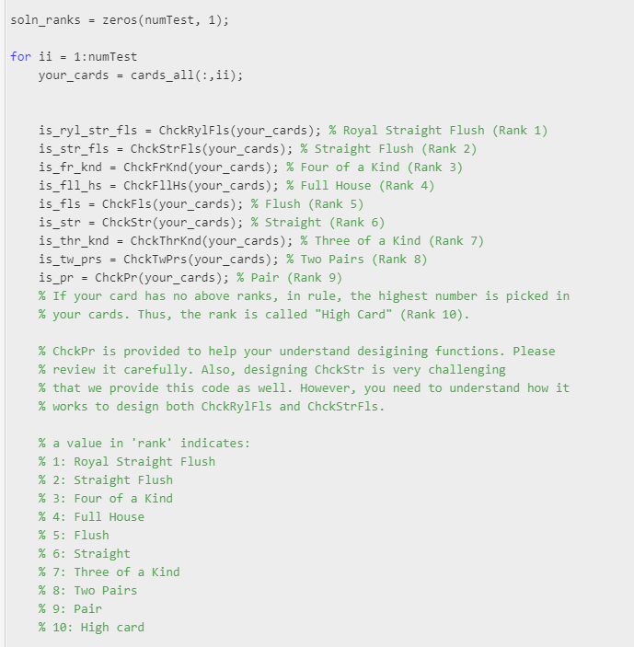
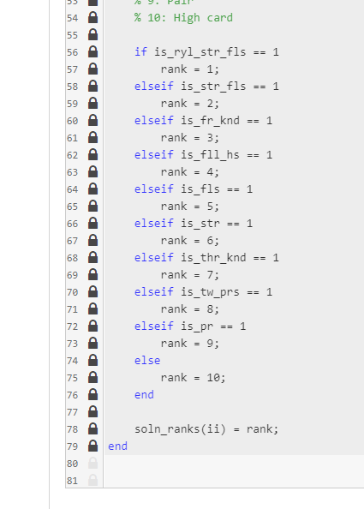
Example: Poker Game

Slide 20
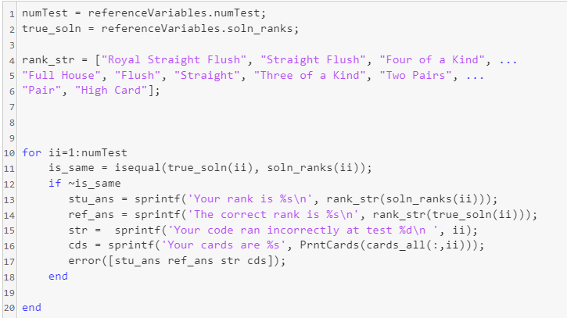
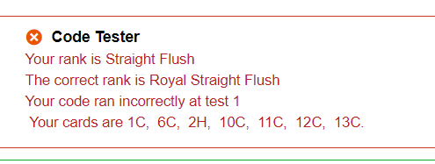
Example: Poker Game (Continue)

Slide 21
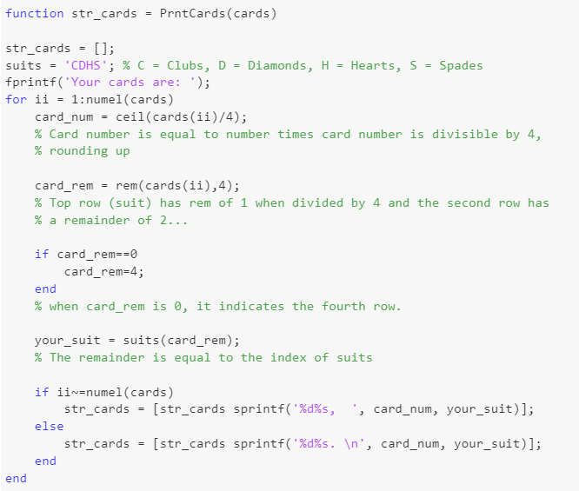
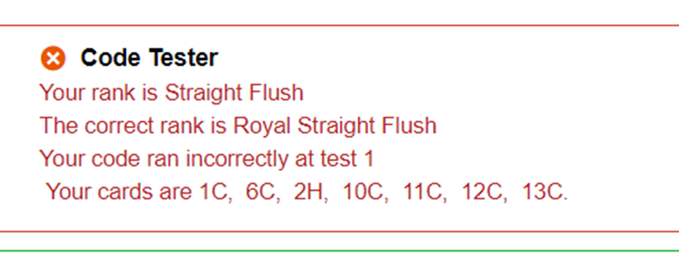
Example: Poker Game (Continue)

Slide 22
Comparing Strings
strcmp compares two strings or character vectors and returns logical 1 if they are identical or 0 if not (or not the same length)
Variations:
strncmp compares only the first n characters
strcmpi ignores case (upper or lower)
strncmpi compares n characters, ignoring case

Slide 23
Comparing Strings: Equality Operator (String)
To use the equality operator with character vectors, they must be the same length, and each element will be compared. For strings, however, it will simply return 1 or 0:
>> 'cat' == 'car'
ans =
1 1 0
>> 'cat' == 'mouse'
Matrix dimensions must agree.
>> "cat" == "car"
ans =
0
>> "cat" == "mouse"
ans =
0

Slide 24
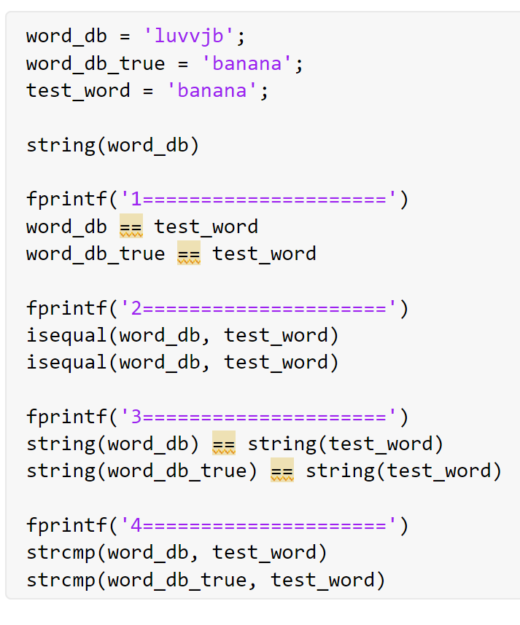
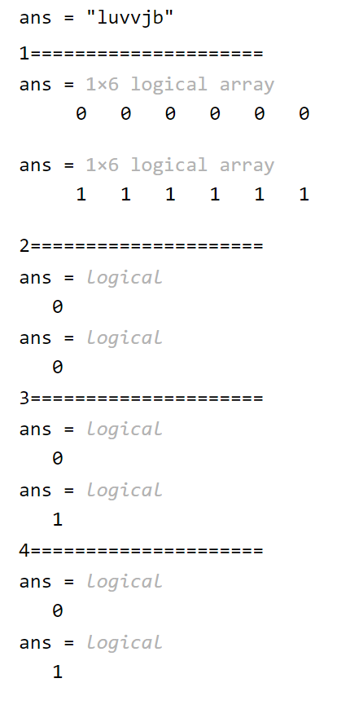
Revisit: Lab05-Problem 4
l
u
v
v
j
b
word_db => ‘luvvjb‘
b | a | n | a | n | a
test_word => ‘banana‘

Slide 25
Find and replace functions
Note that the word “string” here can mean string or character vector
strfind(string, substring): finds all occurrences of the substring within the string; returns a vector of the indices of the beginning of the strings, or an empty vector if the substring is not found
strrep(string, oldsubstring, newsubstring): finds all occurrences of the old substring within the string, and replaces with the new substring
the old and new substrings can be different lengths
count(string, substring): counts the number of occurrences of a substring within a string

Slide 26
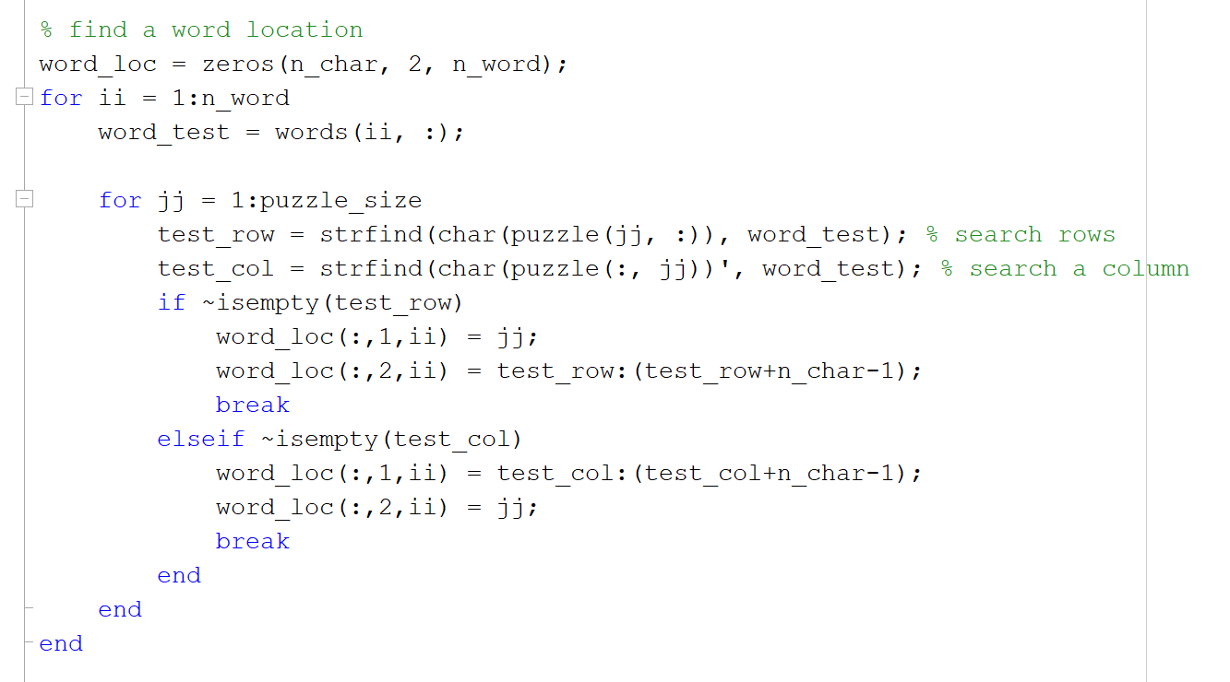
Revisit: HW03-Problem 3

Slide 27
String/Number Functions
Converting from strings to numbers and vice versa:
int2str converts from an integer to a character vector storing the integer
num2str converts a real number to a character vector containing the number
string converts number(s) to strings
str2num (and str2double) converts from a string or character vector containing number(s) to a number array

Slide 28
Common Pitfalls
Trying to use == to compare character vectors for equality, instead of the strcmp function (and its variations)
Confusing sprintf and fprintf. The syntax is the same, but sprintf creates a string whereas fprintf prints

Slide 29
Slide Credits and References
Stormy Attaway, 2018, Matlab: A Practical Introduction to Programming and Problem Solving, 5th edition
Lecture slides for “Matlab: A Practical Introduction to Programming and Problem Solving”
Holly Moore, 2018, MATLAB for Engineers, 5th edition

