Slide 1
Vectors and Matrices
Chul Min Yeum
Assistant Professor
Civil and Environmental Engineering
University of Waterloo, Canada
AE121: Computational Method
Last updated: 2019-05-20

Slide 2
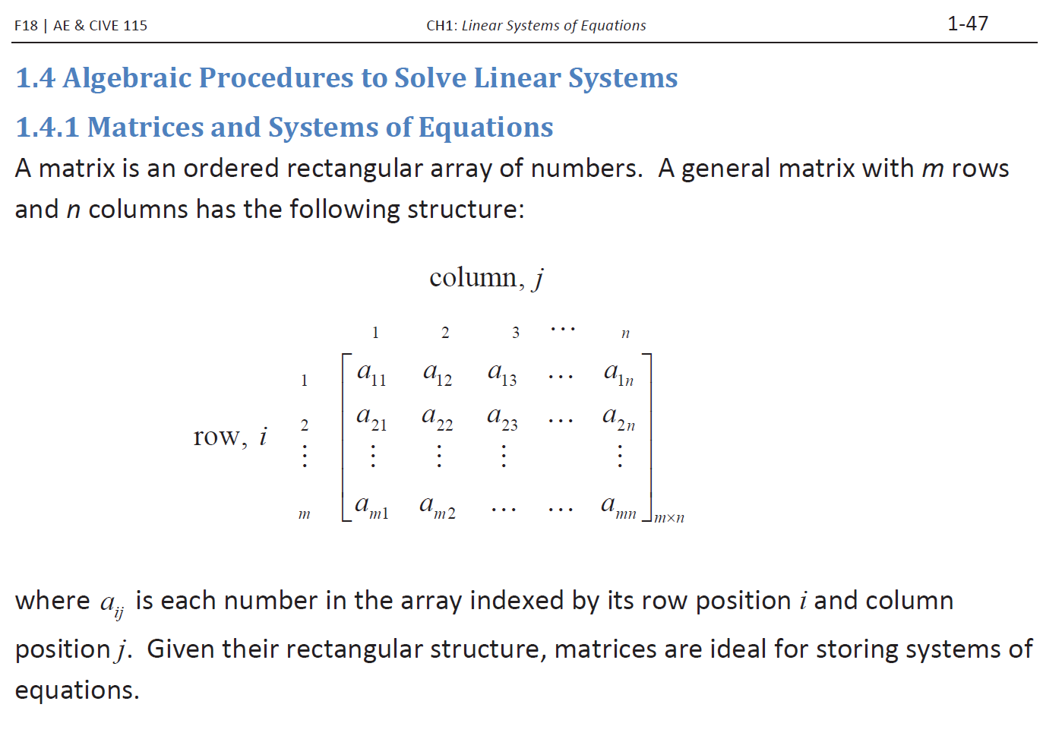
Remind: Matrix, Row Vector, and Column Vector
AE115 lecture note (Dr. Brush)

Slide 3
Matrix, Row Vector, and Column Vector
A matrix is used to store a set of values of the same type; every value is stored in an element.
MATLAB stands for “matrix laboratory”
A matrix looks like a table; it has both rows and columns
A matrix with m rows and n columns is called m x n; these are called its dimensions;
A vector is a special case of a matrix in which one of the dimensions is 1
The term array is frequently used in MATLAB to refer generically to a matrix or a vector
a row vector with n elements is 1 x n, e.g. 1 x 4:
a column vector with m elements is m x 1, e.g. 3 x 1:
A scalar is an even more special case; it is 1 x 1, or in other words, just a single value

Slide 4
Creating Row Vectors
Direct method: put the values you want in square brackets, separated by either commas or spaces
>> v = [1 2 3 4]
v =
1 2 3 4
>> v = [1,2,3,4]
v =
1 2 3 4
Colon operator: iterates through values in the form first:step:last e.g. 5:3:14 returns vector [5 8 11 14]
If no step is specified, the default is 1 so for example 2:4 creates the vector [2 3 4]
Can go in reverse e.g. 4:-1:1 creates[4 3 2 1]
Will not go beyond last e.g., 1:2:6 creates [1 3 5]

Slide 5
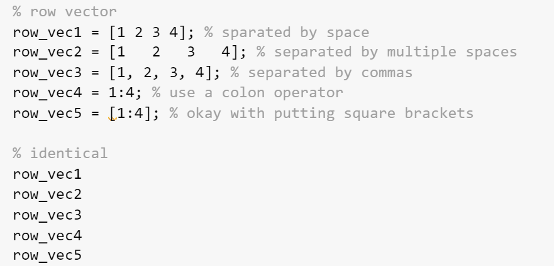
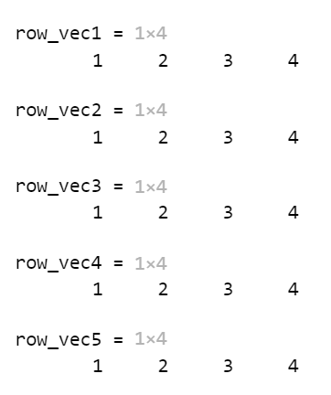
Example: Creating Row Vectors

Slide 6
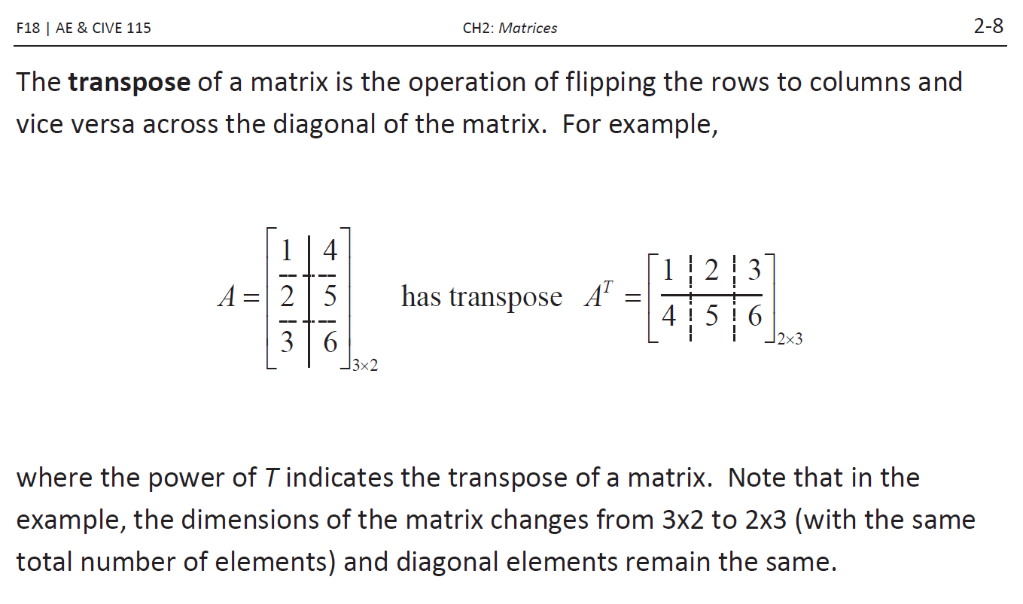
Remind: Transpose
By AE115 lecture note (Dr. Brush)

Slide 7
Creating Column Vectors
A column vector is an m x 1 vector
Direct method: can create by separating values in square brackets with semicolons e.g. [4; 7; 2]
You cannot directly create a column vector using methods such as the colon operator, but you can create a row vector and then transpose it to get a column vector using the transpose operator ’e.g., [4 7 2]’

Slide 8
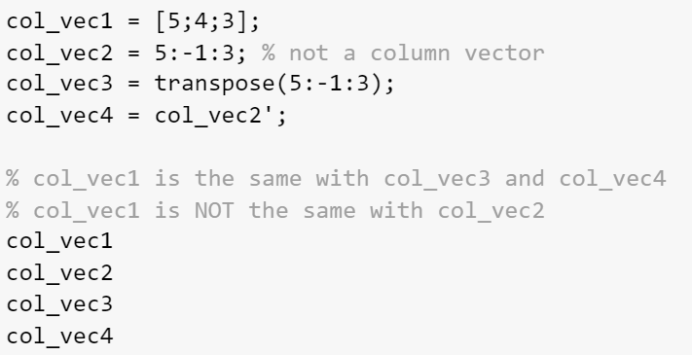
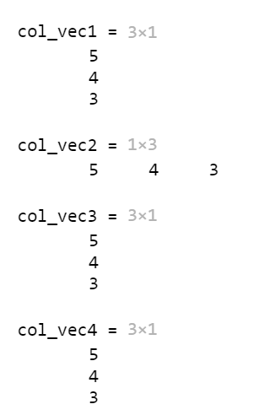
Example: Creating Column Vectors

Slide 9
Referring to Elements
The elements in a vector are numbered sequentially; each element number is called the index, or subscript and are shown above the elements here:
Refer to an element using its index or subscript in parentheses, e.g. vec(4) is the 4th element of a vector vec (assuming it has at least 4 elements)
Can also refer to a subset of a vector by using an index vector which is a vector of indices e.g. vec([2 5]) refers to the 2nd and 5th elements of vec; vec([1:4]) refers to the first 4 elements
1 | 2 | 3 | 4 | 5
5 | 33 | 11 | -4 | 2
The index in MATLAB starts from 1

Slide 10
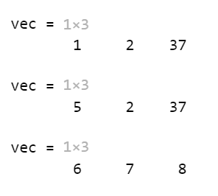
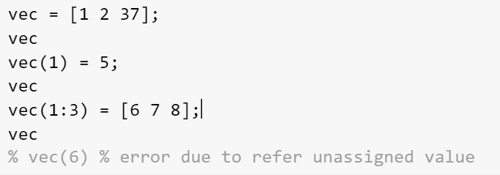
Modifying Vectors
Elements in a vector can be changed e.g.
vec(3) = 11
A vector can be extended by referring to elements that do not yet exist; if there is a gap between the end of the vector and the new specified element(s), zeros are filled in, e.g.
>> vec = [3 9];
>> vec(4:6) = [33 2 7]
vec =
3 9 0 33 2 7
Extending vectors is not recommended
Refereeing: Error
Assigning : Okay

Slide 11
Concatenation
Vectors can be created by joining together existing vectors, or adding elements to existing vectors
This is called concatenation
For example:
>> v = 2:5;
>> x = [33 11 2];
>> w = [v x]
w =
2 3 4 5 33 11 2
>> newv = [v 44]
newv =
2 3 4 5 44

Slide 12
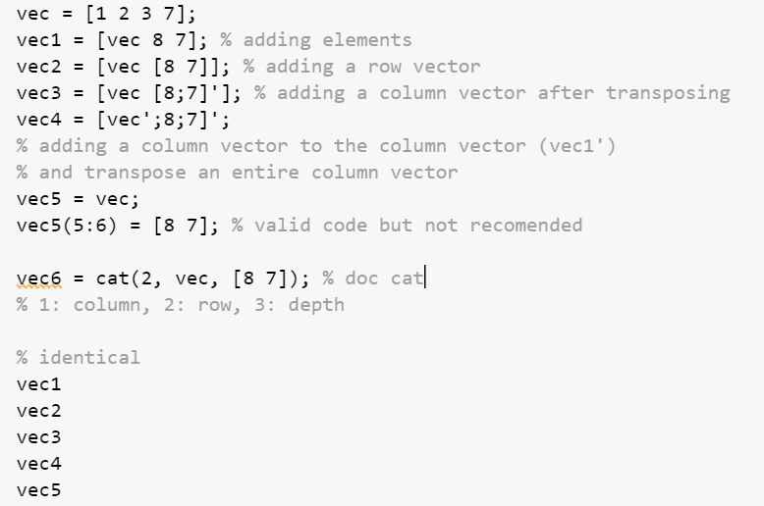
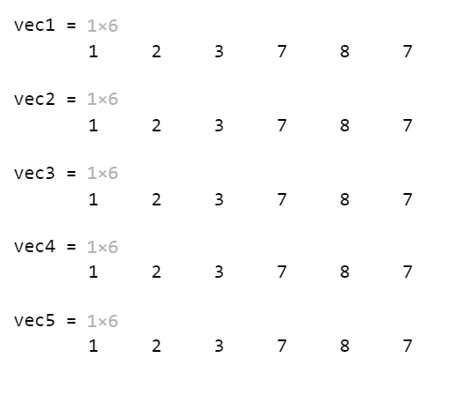
Example: Concatenation

Slide 13
Creating a Matrix
Separate values within rows with blanks or commas, and separate the rows with semicolons
Can use any method to get values in each row (any method to create a row vector, including colon operator)
>> mat = [1:3; 6 11 -2]
mat =
1 2 3
6 11 -2
There must ALWAYS be the same number of values in every row!!

Slide 14
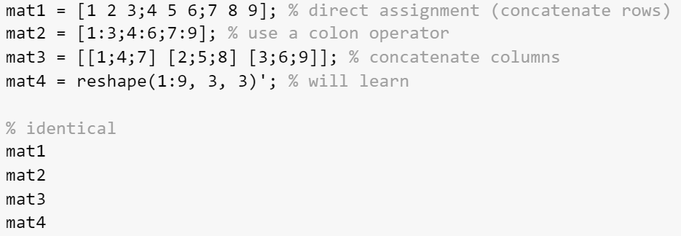
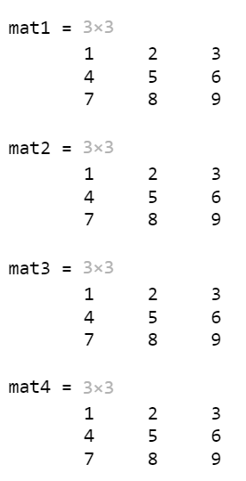
Example: Creating Matrices

Slide 15
Functions that create matrices
There are many built-in functions to create matrices
rand(n) creates an nxn matrix of random reals
rand(n,m) create an nxm matrix of random reals
randi([range],n,m) creates an nxm matrix of random integers in the specified range
zeros(n) creates an nxn matrix of all zeros
zeros(n,m) creates an nxm matrix of all zeros
ones(n) creates an nxn matrix of all ones
ones(n,m) creates an nxm matrix of all ones
Note: there is no twos function – or thirteens – just zeros and ones!

Slide 16
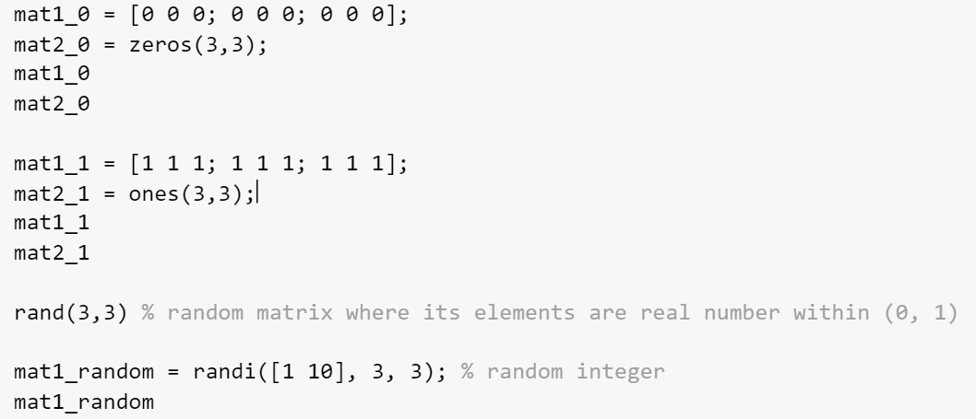
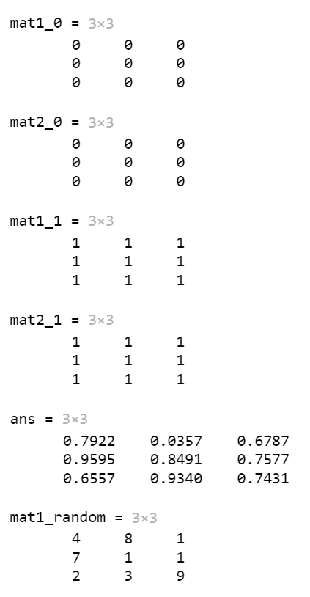
Example: Functions to Create Matrices

Slide 17
Matrix Elements
To refer to an element in a matrix, you use the matrix variable name followed by the index of the row, and then the index of the column, in parentheses
ALWAYS refer to the row first, column second
This is called subscripted indexing
Can also refer to any subset of a matrix
To refer to the entire mth row: mat(m,:)
To refer to the entire nth column: mat(:,n)
To refer to the last row or column use end, e.g. mat(end,m) is the mth value in the last row
Can modify an element or subset of a matrix in an assignment statement

Slide 18
Modifying Matrices
An individual element in a matrix can be modified by assigning a new value to it
Entire rows and columns can also be modified
Any subset of a matrix can be modified, as long as what is being assigned has the same dimensions as the subset being modified
Exception to this: a scalar can be assigned to any size subset; the same scalar is assigned to every element in the subset

Slide 19
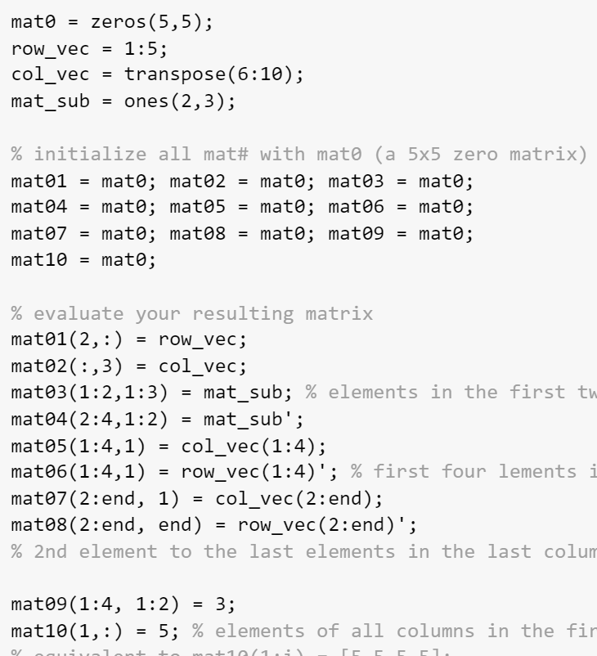
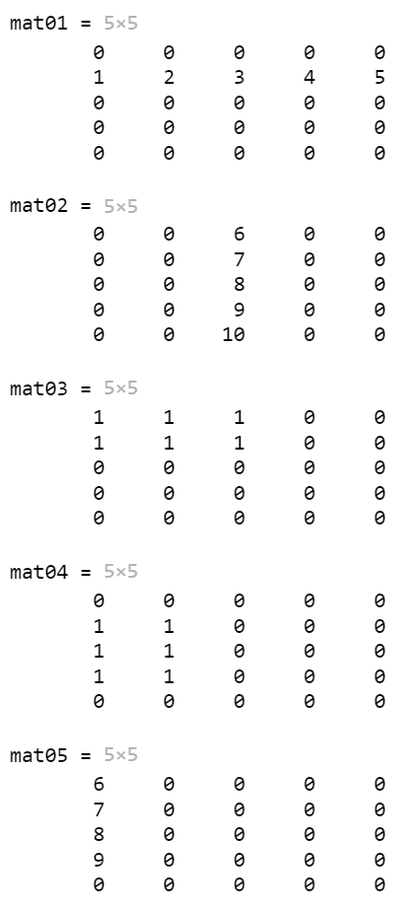
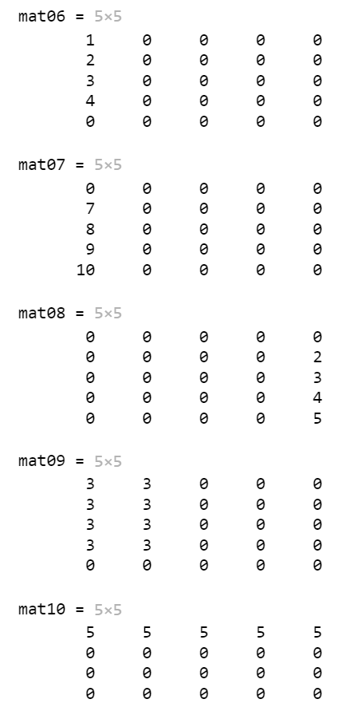
Example: Modifying Matrix

Slide 20
Matrix Dimension
There are several functions to determine the dimensions of a vector or matrix:
size returns the # of rows and columns for a vector or matrix
Important: capture both of these values in an assignment statement
[r c] = size(mat)
numel returns the total # of elements in a vector or matrix
length(vec) returns the # of elements in a vector
length(mat) returns the larger dimension (row or column) for a matrix
Very important to be general in programming: do not assume that you know the dimensions of a vector or matrix – use length or size to find out!

Slide 21
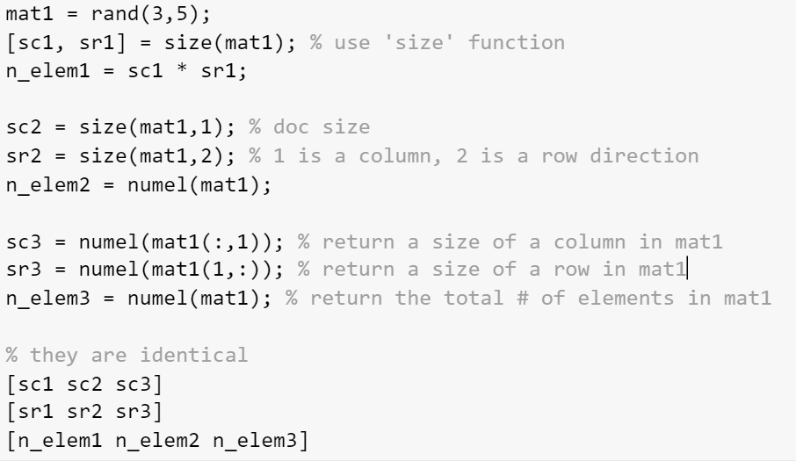
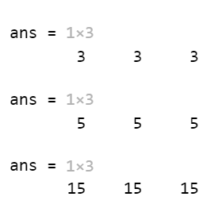
Example: Matrix Dimension

Slide 22
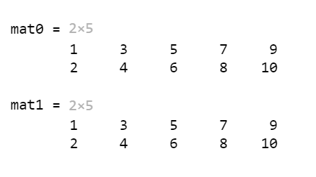
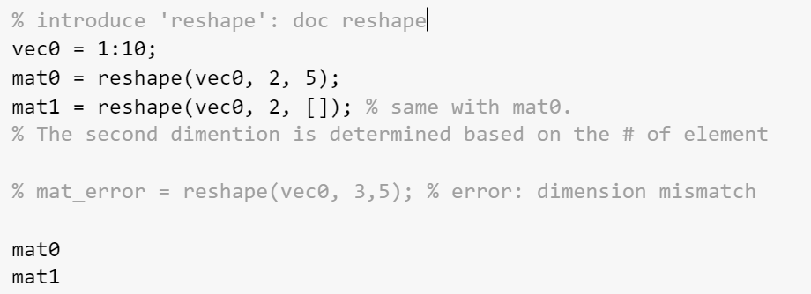
Linear Indexing
Linear indexing: only using one index into a matrix (MATLAB will unwind it column-by column)
Very important
reshape

Slide 23
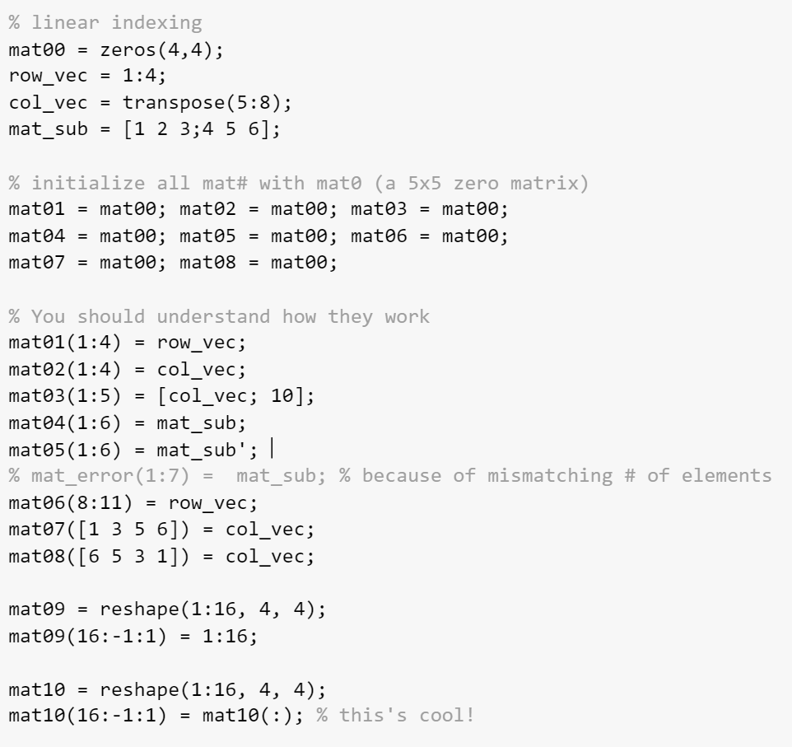
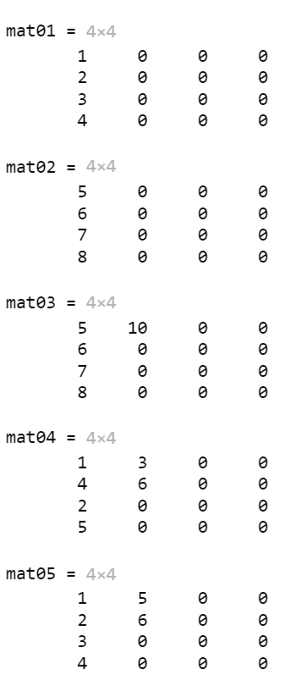
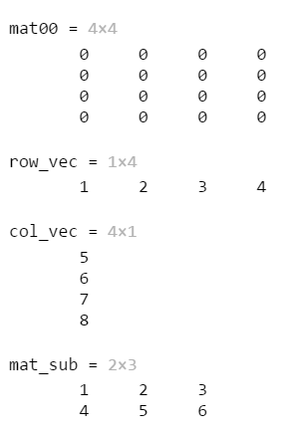
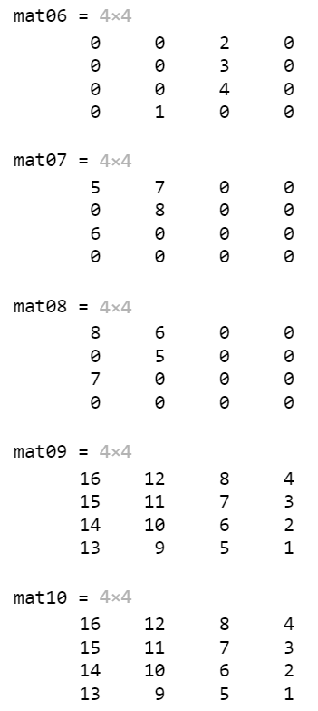
Example: Linear Indexing

Slide 24
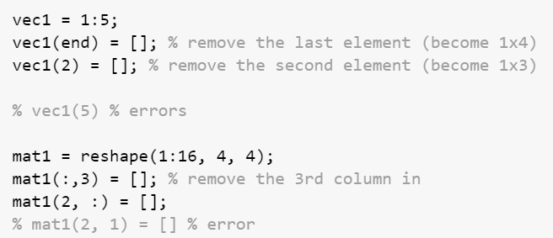
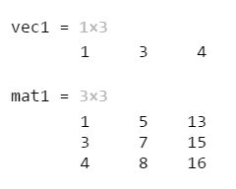
Empty Vectors
An empty vector is a vector with no elements; an empty vector can be created using square brackets with nothing inside [ ]
to delete an element from a vector, assign an empty vector to that element
delete an entire row or column from a matrix by assigning [ ]
Note: cannot delete an individual element from a matrix

Slide 25
3D Matrices
A three dimensional matrix has dimensions m x n x p
Can create using built-in functions, e.g. the following creates a 3 x 5 x 2 matrix of random integers; there are 2 layers, each of which is a 3 x 5 matrix
>> randi([0 50], 3,5,2)
ans(:,:,1) =
36 34 6 17 38
38 33 25 29 13
14 8 48 11 25
ans(:,:,2) =
35 27 13 41 17
45 7 42 12 10
48 7 12 47 12
Challenging ! But very useful !!

Slide 26
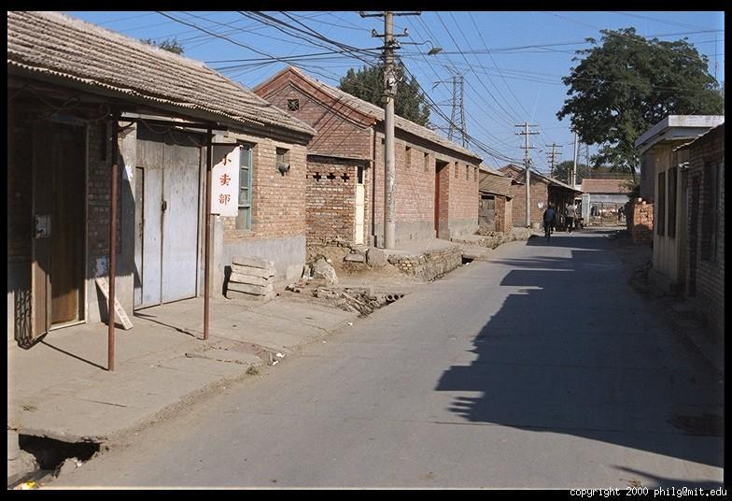
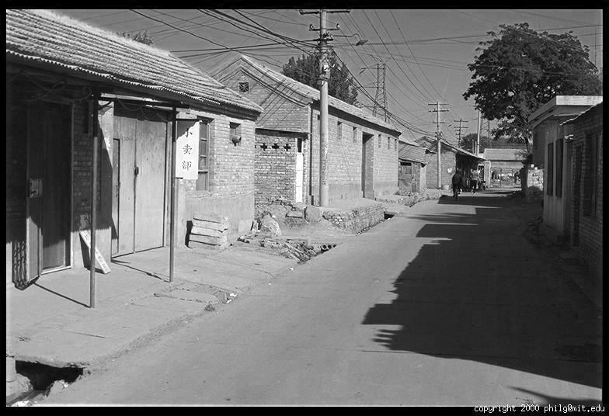
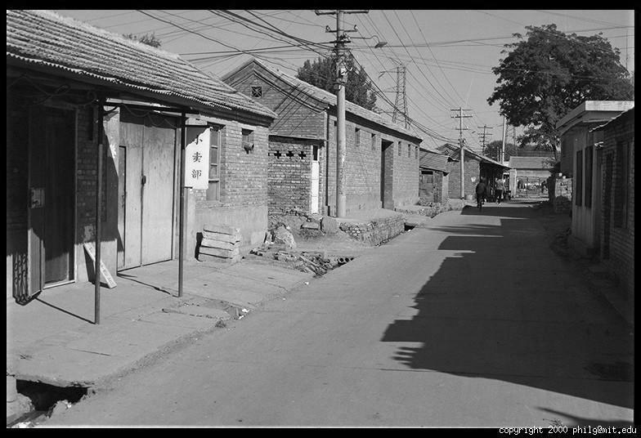
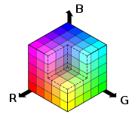
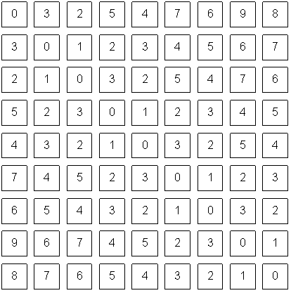
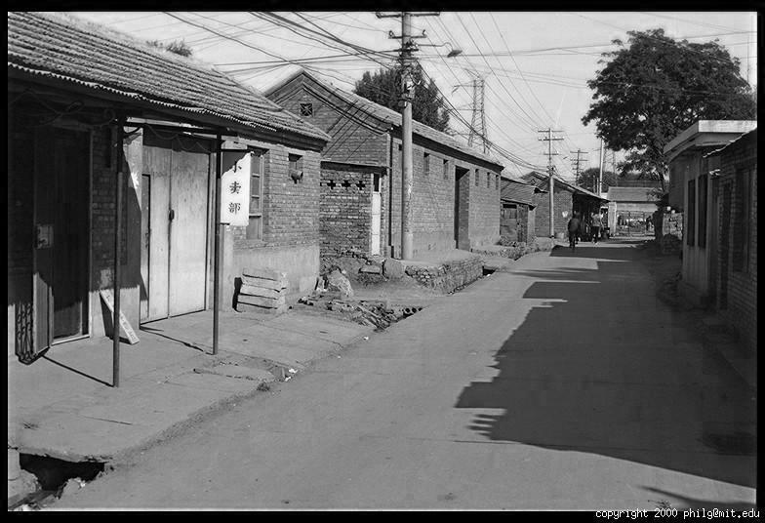
(Off-Topic) Color Image
R
G
B

Slide 27
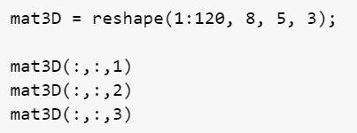
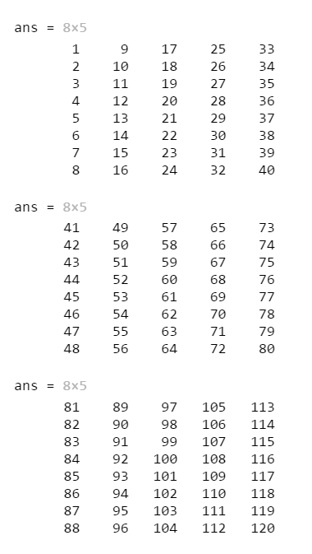
Example: 3D Matrix
mat3D(:,:,1)
mat3D(:,:,2)
mat3D(:,:,3)

Slide 28
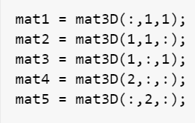
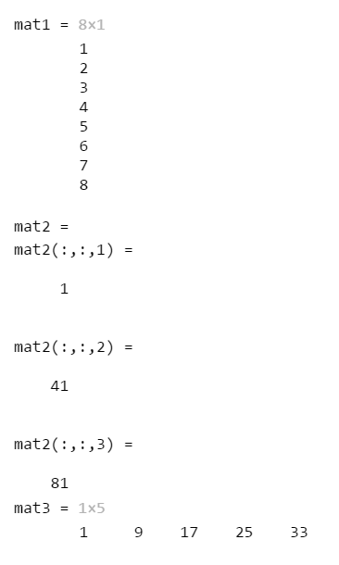
Example: 3D Matrix (Continue)
Column vector
mat3D(:,:,3)
8 x 1
3D vector
mat3D(:,:,2)
1 x 1 x 3
mat3D(:,:,1)
1 x 5
Row vector

Slide 29
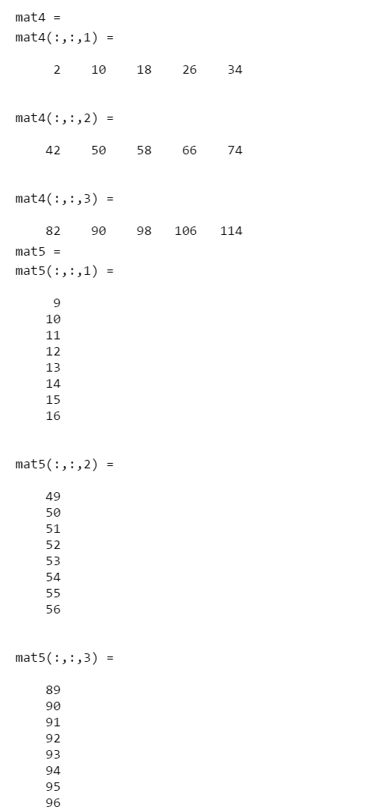
Example: 3D Matrix (Continue)
8 x 1 x 3
mat3D(:,:,3)
1 x 5 x 3
mat3D(:,:,2)
mat3D(:,:,1)

Slide 30
Arrays as function arguments
Entire arrays (vectors or matrices) can be passed as arguments to functions; this is very powerful!
The result will have the same dimensions as the input
For example:
>> vec = randi([-5 5], 1, 4)
vec =
-3 0 5 1
>> av = abs(vec)
av =
3 0 5 1

Slide 31
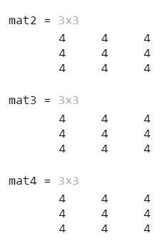
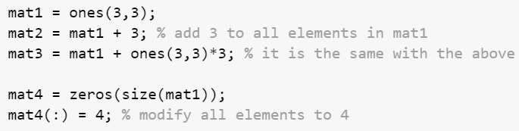
Scalar Operations
Numerical operations can be performed on every element in a vector or matrix
For example, Scalar multiplication: multiply every element by a scalar
>> [4 0 11] * 3
ans =
12 0 33
Another example: scalar addition; add a scalar to every element
>> zeros(1,3) + 5
ans =
5 5 5

Slide 32
Array Operations
Array operations on two matrices A and B:
these are applied term-by-term, or element-by-element
this means the matrices must have the same dimensions (NO! after R2016)
In MATLAB:
matrix addition: A + B
matrix subtraction: A – B or B – A
For operations that are based on multiplication (multiplication, division, and exponentiation), a dot must be placed in front of the operator
array multiplication: A .* B
array division: A ./ B, A .\ B
array exponentiation A .^ 2
matrix multiplication: NOT an array operation
They are totally different!

Slide 33
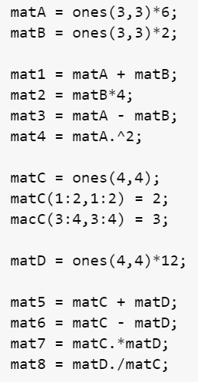
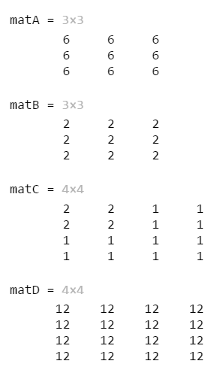
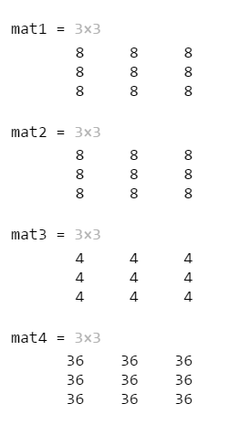
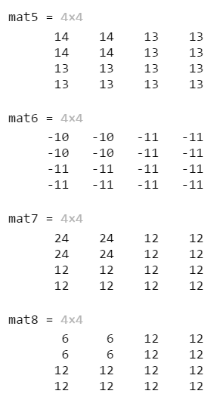
Example: Array Operations

Slide 34
True/False
false equivalent to logical(0)
true equivalent to logical(1)
false and true are also functions that create matrices of all false or true values
As of R2016a, this can also be done with ones and zeros, e.g.
logzer = ones(1,5, 'logical')

Slide 35
Logical Vectors
Using relational operators on a vector or matrix results in a logical vector or matrix
>> vec = [44 3 2 9 11 6];
>> logv = vec > 6
logv =
1 0 0 1 1 0
Can use this to index into a vector or matrix (only if the index vector is the type logical)
>> vec(logv)
ans =
44 9 11
Logical Indexing!!!

Slide 36
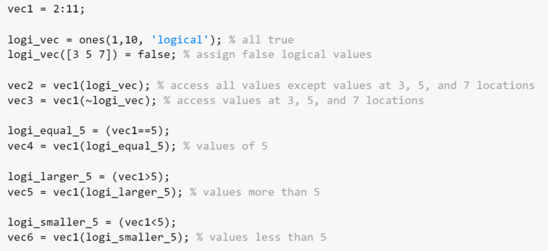
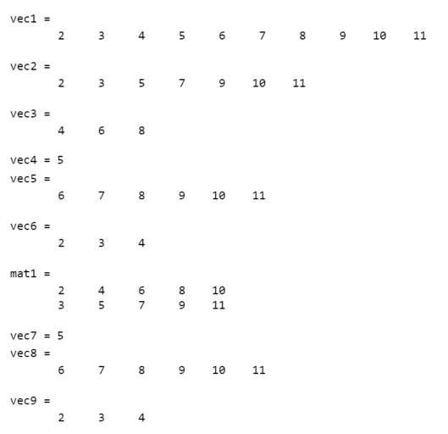
Example: Logical Vectors
vec1
2 | 3 | 4 | 5 | 6 | 7 | 8 | 9 | 10 | 11
logi_vec
1 | 1 | 0 | 1 | 0 | 1 | 0 | 1 | 1 | 1
Q1: Find numbers less than or equal to 10 in ‘vec1’
Q2: Find numbers not equal to 5 in ‘vec1’
Q3: Find numbers larger than 3 and less than 7.

Slide 37
Example: Logical Vectors (Continue)
vec1
2 | 3 | 4 | 5 | 6 | 7 | 8 | 9 | 10 | 11
vec1>3
0 | 0 | 1 | 1 | 1 | 1 | 1 | 1 | 1 | 1
vec1<7
1 | 1 | 1 | 1 | 1 | 0 | 0 | 0 | 0 | 0
logi_3_7 =
(vec1>3) & (vec1<7)
0 | 0 | 1 | 1 | 1 | 0 | 0 | 0 | 0 | 0
vec1 (logi_3_7)
4 | 5 | 6

Slide 38
Logical Built-in Functions
any returns true if anything in the input argument is true
all returns true only if everything in the input argument is true
find finds locations and returns indices
>> vec
vec =
44 3 2 9 11 6
>> find(vec>6)
ans =
1 4 5

Slide 39
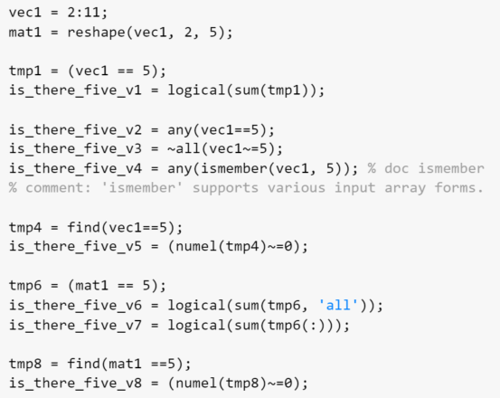
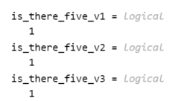
Example: Logical Vectors
How to check if there is a certain number in a vector? Let's say 5 in ‘vec1’.
vec1
2 | 3 | 4 | 5 | 6 | 7 | 8 | 9 | 10 | 11
any(tmp1) => true
any(tmp1) => false
find(tmp1) => 4
tmp1 = (vec1== 5)
0 | 0 | 0 | 1 | 0 | 0 | 0 | 0 | 0 | 0
Test ‘is_there_five_v2’ and ‘is_there_five_v3’.

Slide 40
Element-wise operators
| and & are used for matrices; go through element-by-element and return logical 1 or 0
|| and && are used for scalars
Logical: 0 is false otherwise true

Slide 41
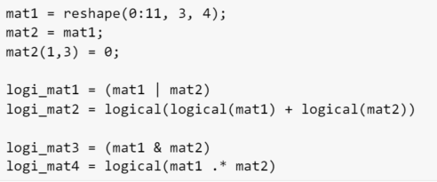
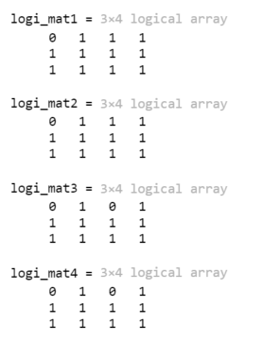
Example: Logical AND and OR
0 | 3 | 6 | 9
1 | 4 | 7 | 10
2 | 5 | 8 | 11
0 | 3 | 0 | 9
1 | 4 | 7 | 10
2 | 5 | 8 | 11
mat1
mat2

Slide 42
Matrix Multiplication: Dimensions
Matrix multiplication is NOT an array operation
it does NOT mean multiplying term by term
In MATLAB, the multiplication operator * performs matrix multiplication
In order to be able to multiply a matrix A by a matrix B, the number of columns of A must be the same as the number of rows of B
If the matrix A has dimensions m x n, that means that matrix B must have dimensions n x something; we’ll call it p
In mathematical notation, [A]m x n [B]n x p
We say that the inner dimensions must be the same
The resulting matrix C has the same number of rows as A and the same number of columns as B
in other words, the outer dimensions m x p
In mathematical notation, [A]m x n [B]n x p = [C]m x p.
This only defines the size of C; it does not explain how to calculate the values

Slide 43

Matrix Times a Vector
AE115 lecture note (Dr. Brush)

Slide 44


Example: Matrix Times a Vector

Slide 45


Example: Matrix Times a Vector (Symbolic Expression)

Slide 46

Matrix Times a Matrix
AE115 lecture note (Dr. Brush)

Slide 47


Example: Matrix Times a Matrix

Slide 48
Common Pitfalls
Attempting to create a matrix that does not have the same number of values in each row
Confusing matrix multiplication and array multiplication. Array operations, including multiplication, division, and exponentiation, are performed term by term (so the arrays must have the same size); the operators are .*, ./, .\, and .^.
Attempting to use || or && with arrays. Always use | and & when working with arrays; || and && are only used with scalars.

Slide 49
Programming Style Guidelines
If possible, try not to extend vectors or matrices, as it is not very efficient.
To be general, never assume that the dimensions of any array (vector or matrix) are known. Instead, use the function numel to determine the number of elements in a vector, and the function size for a matrix:
len = numel(vec);
[r, c] = size(mat);
Use true instead of logical(1) and false instead of logical(0), especially when creating vectors or matrices.

Slide 50
Slide Credits and References
Stormy Attaway, 2018, Matlab: A Practical Introduction to Programming and Problem Solving, 5th edition
Lecture slides for “Matlab: A Practical Introduction to Programming and Problem Solving”
Holly Moore, 2018, MATLAB for Engineers, 5th edition

