Slide 1
DS 4004 / GROUP A / 2026
FloodLens
Sri Lanka
Flood and extreme weather analytics
Historical evidence and API forecasts.
Notes:
Release dataset: 2016-01-01 through 2026-09-09; release date 2026-09-10. Explain point sampling, source transitions and the distinction between provider forecasts and confirmed flood events. Open-Meteo does not expose 2/5/20-year return-period thresholds. Historical percentile screening is an explicit alternative. Cloud provisioning and Databricks execution require the team accounts; do not claim those runs as completed. The project fits no forecasting model. The baseline is 2016–2020; source changes can affect comparisons.
[Sources]
Course brief: DS 4004 Group Project 2026, supplied PDF, pages 1–2.
https://open-meteo.com/en/docs/historical-weather-api
https://open-meteo.com/en/docs/flood-api
https://open-meteo.com/en/docs
https://www.geoboundaries.org/api/current/gbOpen/LKA/ADM2/
Computed release evidence: dist/data/summary.json; dist/data/current.json; docs/presentation-facts.json.
[/Sources]

Slide 2
A national view built from monitored points
2.34 million
Historical data + API forecasts
ERA5 / recent IFS weather
GloFAS modelled discharge
January 2016–September 2026
Future forecasts stay separate.
actual hourly weather records
25 district reference points
89,815 daily discharge values
All nine provinces represented
FLOODLENS / DS 4004
02
Notes:
Release dataset: 2016-01-01 through 2026-09-09; release date 2026-09-10. Explain point sampling, source transitions and the distinction between provider forecasts and confirmed flood events. Open-Meteo does not expose 2/5/20-year return-period thresholds. Historical percentile screening is an explicit alternative. Cloud provisioning and Databricks execution require the team accounts; do not claim those runs as completed. The project fits no forecasting model. The baseline is 2016–2020; source changes can affect comparisons.
[Sources]
Course brief: DS 4004 Group Project 2026, supplied PDF, pages 1–2.
https://open-meteo.com/en/docs/historical-weather-api
https://open-meteo.com/en/docs/flood-api
https://open-meteo.com/en/docs
https://www.geoboundaries.org/api/current/gbOpen/LKA/ADM2/
Computed release evidence: dist/data/summary.json; dist/data/current.json; docs/presentation-facts.json.
[/Sources]

Slide 3
Prepare once; explore without heavy queries
COLLECT
PROCESS
EXPLORE
Source evidence
Analytical records
Lightweight website
API responses, timestamps,
units and returned grids.
Resumable cache and retries.
Parquet and Spark processing.
S3 storage; PostgreSQL queries.
Cloud execution: team accounts.
React and FastAPI.
Maps, EDA, replay and forecasts.
Static or connected hosting.
FLOODLENS / DS 4004
03
Notes:
Release dataset: 2016-01-01 through 2026-09-09; release date 2026-09-10. Explain point sampling, source transitions and the distinction between provider forecasts and confirmed flood events. Open-Meteo does not expose 2/5/20-year return-period thresholds. Historical percentile screening is an explicit alternative. Cloud provisioning and Databricks execution require the team accounts; do not claim those runs as completed. The project fits no forecasting model. The baseline is 2016–2020; source changes can affect comparisons.
[Sources]
Course brief: DS 4004 Group Project 2026, supplied PDF, pages 1–2.
https://open-meteo.com/en/docs/historical-weather-api
https://open-meteo.com/en/docs/flood-api
https://open-meteo.com/en/docs
https://www.geoboundaries.org/api/current/gbOpen/LKA/ADM2/
Computed release evidence: dist/data/summary.json; dist/data/current.json; docs/presentation-facts.json.
[/Sources]

Slide 4
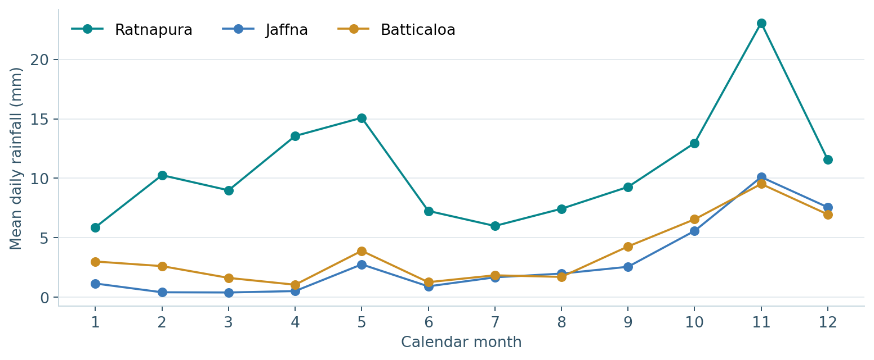
Seasonal context changes the comparison
Compare each point
with its own history.
Rainfall patterns differ across
locations and months.
One absolute threshold can
hide these differences.
FLOODLENS / DS 4004
04
Notes:
Release dataset: 2016-01-01 through 2026-09-09; release date 2026-09-10. Explain point sampling, source transitions and the distinction between provider forecasts and confirmed flood events. Open-Meteo does not expose 2/5/20-year return-period thresholds. Historical percentile screening is an explicit alternative. Cloud provisioning and Databricks execution require the team accounts; do not claim those runs as completed. The project fits no forecasting model. The baseline is 2016–2020; source changes can affect comparisons.
[Sources]
Course brief: DS 4004 Group Project 2026, supplied PDF, pages 1–2.
https://open-meteo.com/en/docs/historical-weather-api
https://open-meteo.com/en/docs/flood-api
https://open-meteo.com/en/docs
https://www.geoboundaries.org/api/current/gbOpen/LKA/ADM2/
Computed release evidence: dist/data/summary.json; dist/data/current.json; docs/presentation-facts.json.
[/Sources]

Slide 5
Every flag has an explainable definition
Seasonal percentiles
Episodes, not isolated dots
Reference: 2016–2020, same month.
≥95th percentile: elevated
≥99th percentile: unusual
Discharge, 3-day rain, heat and wind.
Consecutive exceedances form
an episode. Inspect its duration,
peak and surrounding days.
This identifies unusual conditions;
it does not confirm flood damage.
FLOODLENS / DS 4004
05
Notes:
Release dataset: 2016-01-01 through 2026-09-09; release date 2026-09-10. Explain point sampling, source transitions and the distinction between provider forecasts and confirmed flood events. Open-Meteo does not expose 2/5/20-year return-period thresholds. Historical percentile screening is an explicit alternative. Cloud provisioning and Databricks execution require the team accounts; do not claim those runs as completed. The project fits no forecasting model. The baseline is 2016–2020; source changes can affect comparisons.
[Sources]
Course brief: DS 4004 Group Project 2026, supplied PDF, pages 1–2.
https://open-meteo.com/en/docs/historical-weather-api
https://open-meteo.com/en/docs/flood-api
https://open-meteo.com/en/docs
https://www.geoboundaries.org/api/current/gbOpen/LKA/ADM2/
Computed release evidence: dist/data/summary.json; dist/data/current.json; docs/presentation-facts.json.
[/Sources]

Slide 6
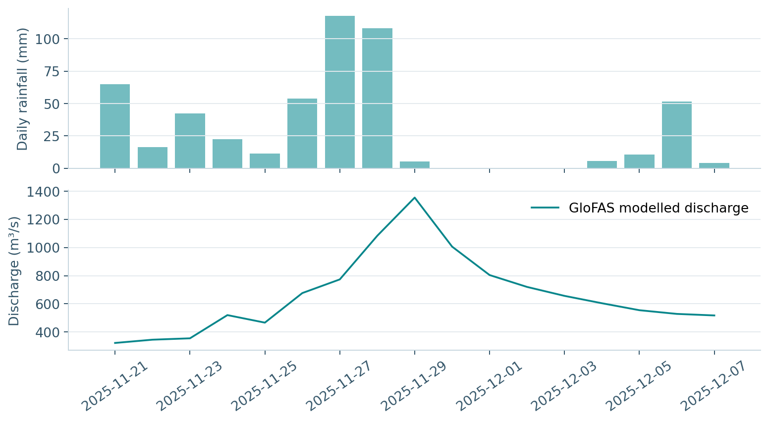
Replay connects rainfall with river response
Kalutara
2025-11-29
1354.2 m³/s
Selected peak modelled flow.
Explore before, during and
after the episode.
FLOODLENS / DS 4004
06
Notes:
Release dataset: 2016-01-01 through 2026-09-09; release date 2026-09-10. Explain point sampling, source transitions and the distinction between provider forecasts and confirmed flood events. Open-Meteo does not expose 2/5/20-year return-period thresholds. Historical percentile screening is an explicit alternative. Cloud provisioning and Databricks execution require the team accounts; do not claim those runs as completed. The project fits no forecasting model. The baseline is 2016–2020; source changes can affect comparisons.
[Sources]
Course brief: DS 4004 Group Project 2026, supplied PDF, pages 1–2.
https://open-meteo.com/en/docs/historical-weather-api
https://open-meteo.com/en/docs/flood-api
https://open-meteo.com/en/docs
https://www.geoboundaries.org/api/current/gbOpen/LKA/ADM2/
Computed release evidence: dist/data/summary.json; dist/data/current.json; docs/presentation-facts.json.
[/Sources]

Slide 7
Interpret the provider forecasts
WEATHER API
FLOOD API
HISTORICAL CONTEXT
Rain and weather
River-flow outlook
Explain each signal
Daily weather predictions.
Current conditions and rain chance.
Median flow and ensemble spread.
Keep the retrieval timestamp.
Compare with monthly thresholds.
No project-trained model.
FLOODLENS / DS 4004
07
Notes:
Release dataset: 2016-01-01 through 2026-09-09; release date 2026-09-10. Explain point sampling, source transitions and the distinction between provider forecasts and confirmed flood events. Open-Meteo does not expose 2/5/20-year return-period thresholds. Historical percentile screening is an explicit alternative. Cloud provisioning and Databricks execution require the team accounts; do not claim those runs as completed. The project fits no forecasting model. The baseline is 2016–2020; source changes can affect comparisons.
[Sources]
Course brief: DS 4004 Group Project 2026, supplied PDF, pages 1–2.
https://open-meteo.com/en/docs/historical-weather-api
https://open-meteo.com/en/docs/flood-api
https://open-meteo.com/en/docs
https://www.geoboundaries.org/api/current/gbOpen/LKA/ADM2/
Computed release evidence: dist/data/summary.json; dist/data/current.json; docs/presentation-facts.json.
[/Sources]

Slide 8
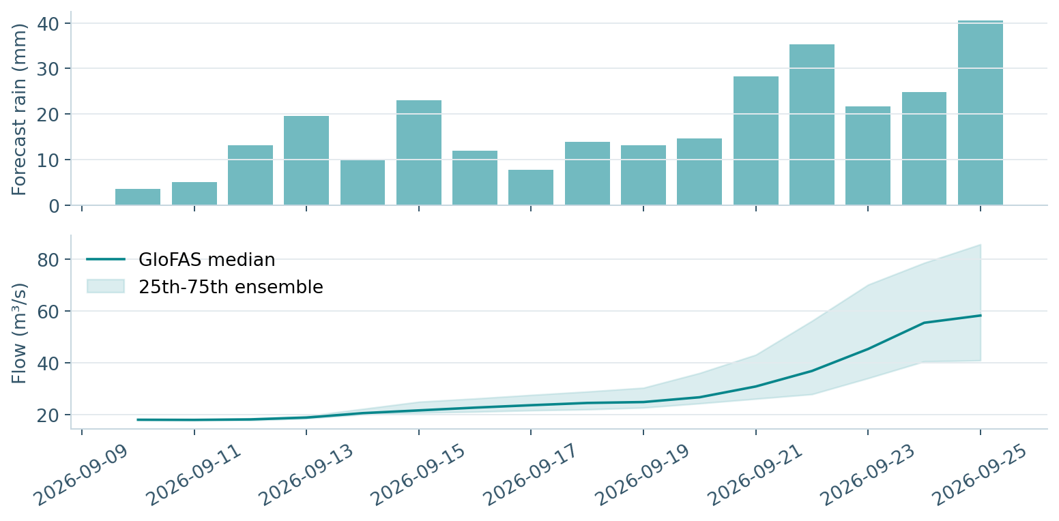
Read the rainfall and river outlook
16 days
API forecast
outlook
Ratnapura
Forecast rain: 286.6 mm
Source: Open-Meteo / GloFAS
FLOODLENS / DS 4004
08
Notes:
Release dataset: 2016-01-01 through 2026-09-09; release date 2026-09-10. Explain point sampling, source transitions and the distinction between provider forecasts and confirmed flood events. Open-Meteo does not expose 2/5/20-year return-period thresholds. Historical percentile screening is an explicit alternative. Cloud provisioning and Databricks execution require the team accounts; do not claim those runs as completed. The project fits no forecasting model. The baseline is 2016–2020; source changes can affect comparisons.
[Sources]
Course brief: DS 4004 Group Project 2026, supplied PDF, pages 1–2.
https://open-meteo.com/en/docs/historical-weather-api
https://open-meteo.com/en/docs/flood-api
https://open-meteo.com/en/docs
https://www.geoboundaries.org/api/current/gbOpen/LKA/ADM2/
Computed release evidence: dist/data/summary.json; dist/data/current.json; docs/presentation-facts.json.
[/Sources]

Slide 9
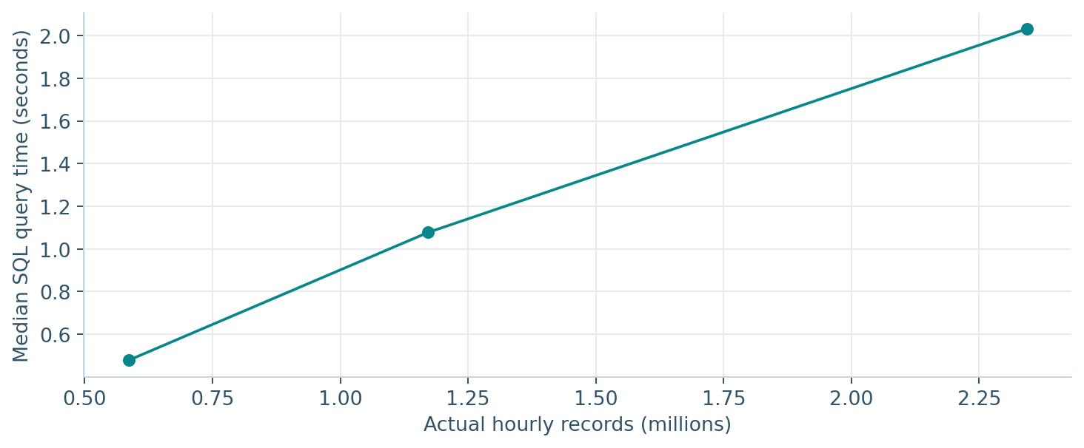
Measure processing on actual records
SQL + Spark
20.0 MiB hourly CSV
Spark: 97,625 daily rows
2 local workers; 58.0 seconds
Cloud run needs team accounts.
No synthetic row inflation.
FLOODLENS / DS 4004
09
Notes:
Release dataset: 2016-01-01 through 2026-09-09; release date 2026-09-10. Explain point sampling, source transitions and the distinction between provider forecasts and confirmed flood events. Open-Meteo does not expose 2/5/20-year return-period thresholds. Historical percentile screening is an explicit alternative. Cloud provisioning and Databricks execution require the team accounts; do not claim those runs as completed. The project fits no forecasting model. The baseline is 2016–2020; source changes can affect comparisons.
[Sources]
Course brief: DS 4004 Group Project 2026, supplied PDF, pages 1–2.
https://open-meteo.com/en/docs/historical-weather-api
https://open-meteo.com/en/docs/flood-api
https://open-meteo.com/en/docs
https://www.geoboundaries.org/api/current/gbOpen/LKA/ADM2/
Computed release evidence: dist/data/summary.json; dist/data/current.json; docs/presentation-facts.json.
[/Sources]

Slide 10
The product is ready for a team handover
A complete analytical workflow
Three clear ownership areas
25 districts and global map
16-day API forecasts; GPS and elevation
EDA, monsoons and screening scores
Historical exploration and event replay
React / FastAPI; Spark / cloud files
Kasun Vishvajith: data pipeline
Akindu Liyanage: analysis
Yasuri Fernando: application
Proposed roles; record actual work.
Group A · review and rehearse.
FLOODLENS / DS 4004
10
Notes:
Release dataset: 2016-01-01 through 2026-09-09; release date 2026-09-10. Explain point sampling, source transitions and the distinction between provider forecasts and confirmed flood events. Open-Meteo does not expose 2/5/20-year return-period thresholds. Historical percentile screening is an explicit alternative. Cloud provisioning and Databricks execution require the team accounts; do not claim those runs as completed. The project fits no forecasting model. The baseline is 2016–2020; source changes can affect comparisons.
[Sources]
Course brief: DS 4004 Group Project 2026, supplied PDF, pages 1–2.
https://open-meteo.com/en/docs/historical-weather-api
https://open-meteo.com/en/docs/flood-api
https://open-meteo.com/en/docs
https://www.geoboundaries.org/api/current/gbOpen/LKA/ADM2/
Computed release evidence: dist/data/summary.json; dist/data/current.json; docs/presentation-facts.json.
[/Sources]

Slide 11
Useful indicators need honest boundaries
What the project establishes
What comes next
A reproducible multi-source dataset.
Seasonally contextualised extremes.
Interactive episode exploration.
An explainable API forecast outlook.
Verify channel-to-grid mapping.
Validate with gauges and events.
Use catchment-average rainfall.
Test operational data availability.
Research analytics, not official alerts.
FLOODLENS / DS 4004
11
Notes:
Release dataset: 2016-01-01 through 2026-09-09; release date 2026-09-10. Explain point sampling, source transitions and the distinction between provider forecasts and confirmed flood events. Open-Meteo does not expose 2/5/20-year return-period thresholds. Historical percentile screening is an explicit alternative. Cloud provisioning and Databricks execution require the team accounts; do not claim those runs as completed. The project fits no forecasting model. The baseline is 2016–2020; source changes can affect comparisons.
[Sources]
Course brief: DS 4004 Group Project 2026, supplied PDF, pages 1–2.
https://open-meteo.com/en/docs/historical-weather-api
https://open-meteo.com/en/docs/flood-api
https://open-meteo.com/en/docs
https://www.geoboundaries.org/api/current/gbOpen/LKA/ADM2/
Computed release evidence: dist/data/summary.json; dist/data/current.json; docs/presentation-facts.json.
[/Sources]

