Slide 1
Reproducing: Joint Geographical and Temporal Modeling Based on Matrix Factorization for Point-of-Interest Recommendation by Hossein A. Rahmani, Mohammad Aliannejadi, Mitra Baratchi, Fabio Crestani
Mariusz Karpowicz, Katrin Schreiberhuber, Jakub Cimiega

Slide 2
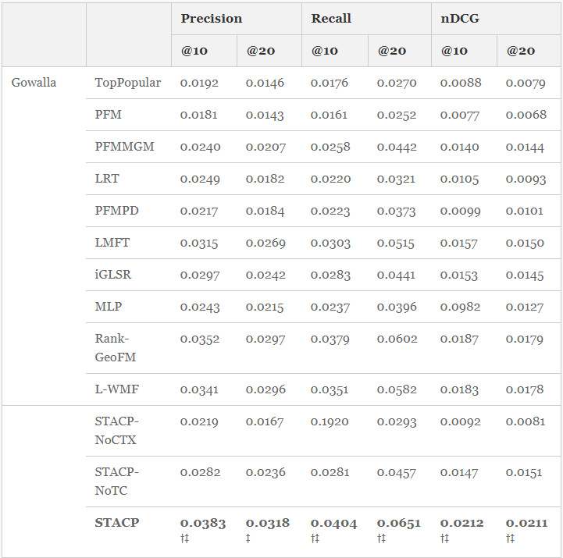
Experiment 1

