Slide 1
Reproducing: Joint Geographical and Temporal Modeling Based on Matrix Factorization for Point-of-Interest Recommendation by Hossein A. Rahmani, Mohammad Aliannejadi, Mitra Baratchi, Fabio Crestani
Mariusz Karpowicz, Katrin Schreiberhuber, Jakub Cimiega

Slide 2
Original Paper
Introducing a new algorithm for POI – Recommendation based on spatial and temporal data
Tested on 2 datasets (Gowalla and Foursquare)
High execution time – well reproducible, but very time consuming

Slide 3
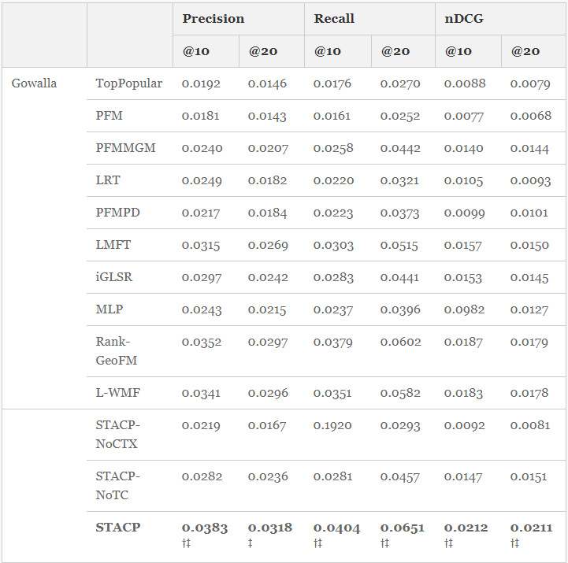
Experiment 1

Slide 4
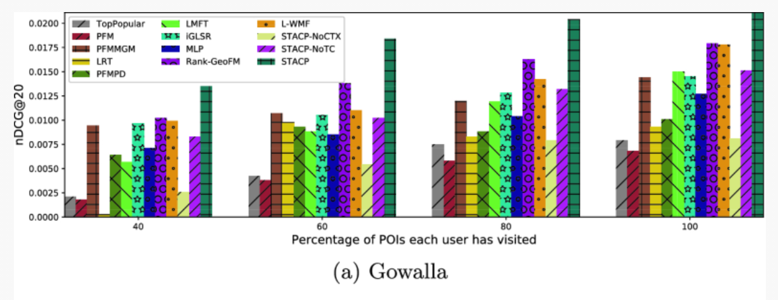
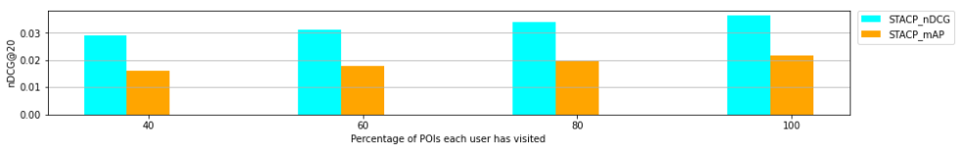
Experiment 2

Slide 5
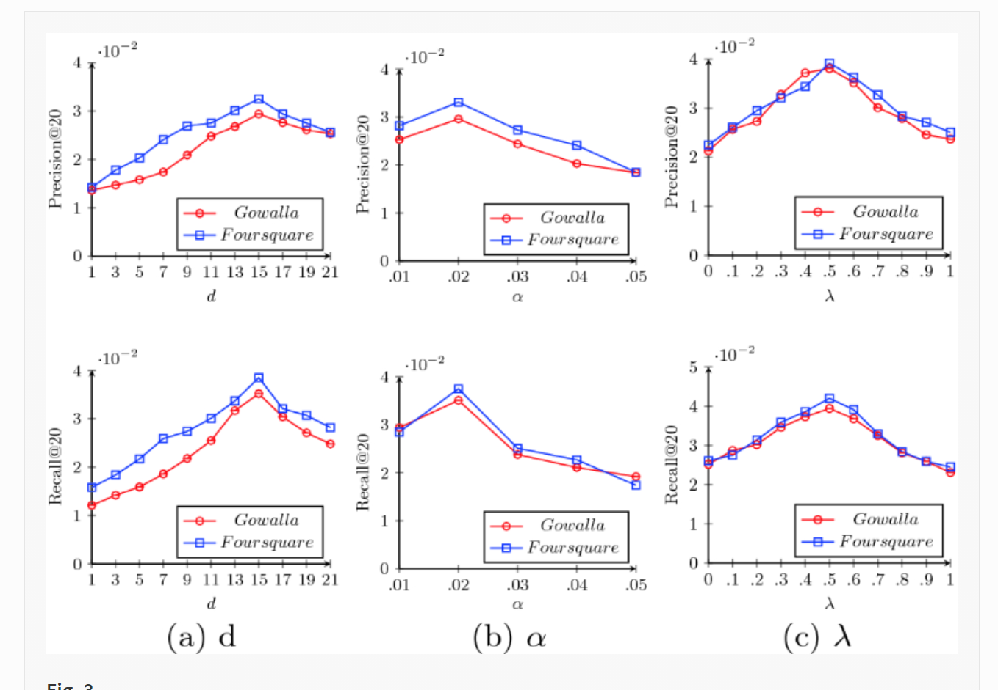
Experiment 3

